Slide 1
Instructional Role of the Librarian
Class #2 – Teaching Workshop
May 13, 2026
Fiona Hunt

Slide 2

Before we begin…

Slide 3
Housekeeping
Thank you for the information you shared on the Exit Ticket last week
Vote on breaks – Clear majority wanted one break, so that’s what we’ll do for three hour classes
  Please feel free to get up and walk around or take a break if you need to, anytime

Slide 4
Housekeeping
Sent an email yesterday:
Please download the Course Schedule again – new date at end of document is May 12, 2026
Readings sent for Class 4
Will send the rest soon

Slide 5
Housekeeping
Answer to the question about FNCC requirements for this course:
“For FNCC assignments, the students should bring the individual assignment instructions to Amy Perreault (amy.perreault@ubc.ca) who is the FNCC manager for the iSchool.
Amy is a wealth of information and support for students and faculty alike.
In consultation with the student and instructor as needed, Amy will help the student formulate an approach that fulfills the assignment parameters and satisfies the FNCC requirements.”

Slide 6
Housekeeping
Information Literacy Pre-Assessment
I’ve had six responses so far. So far, it’s looking like Proximity searching, The Information Cycle, and AI Search Tools are the topics that are least familiar.
The most familiar topics include Article database searching and Citation styles.
It’s too early to see patterns across the class just yet. When everyone has completed the survey, I’ll be able to report back more fully.
Survey link: https://ubc.ca1.qualtrics.com/jfe/form/SV_3LeUPAVH99Ug2cm.
Due date: Please aim for May 17

Slide 7
Housekeeping
Sign ups for Class #3 Discussion
Our official class size is now 23 students, which means we need:
4 discussion leaders
4 reporters
5 of the other roles
We currently have 5 reporters – would someone feel comfortable switching to a different role?
For those who haven’t yet signed up, please do so as soon as you can.
https://wiki.ubc.ca/LIBR535SignupWk3

Slide 8
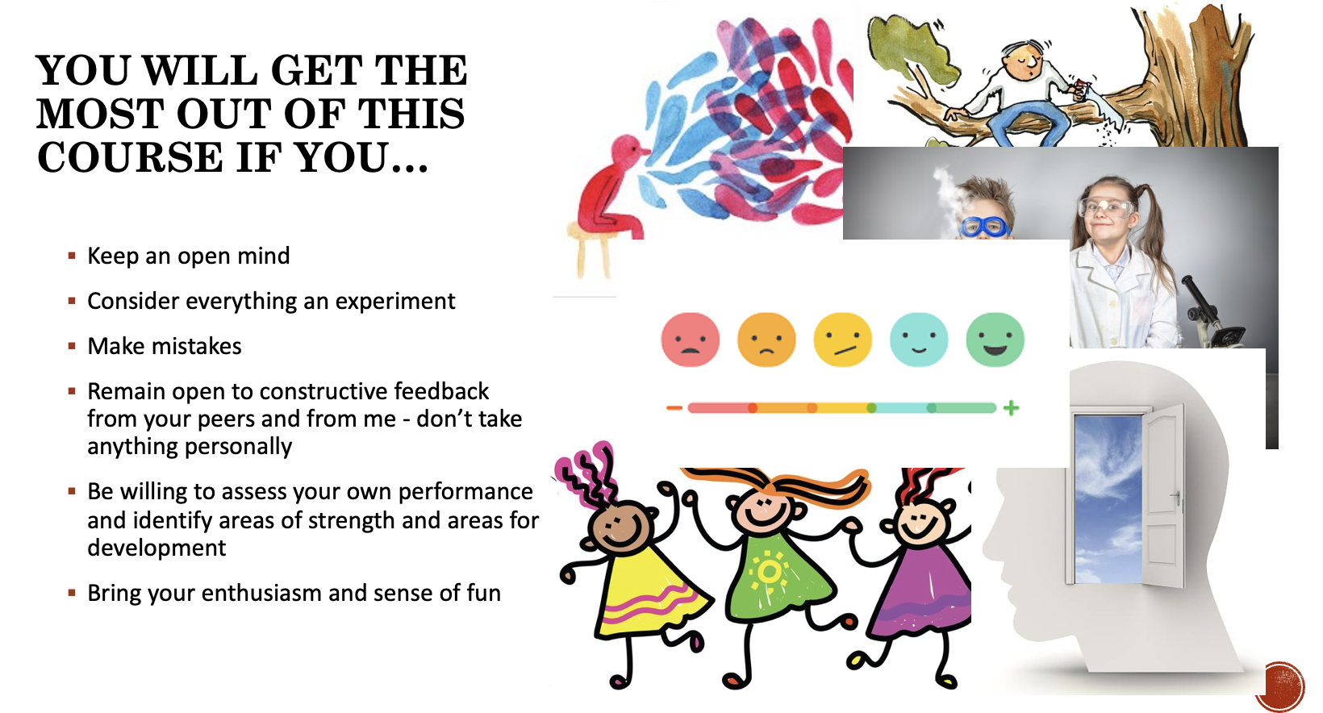
Housekeeping
Expectations
  Your expectations of me are clear from the effective teaching list!
  My expectations of you:
    List from Class #1’s PowerPoint (You will get the most out of this course if you...)

Slide 9
Housekeeping
Expectations
  My expectations of you, cont…
    Read the rubrics for all assignments – ask if anything is unclear
    Read all assignment instructions carefully
    Ask questions
    Participate in activities
    Challenge yourself and be gentle with yourself
    Be respectful and kind towards yourselves and each other
    Make mistakes!

Slide 10

Housekeeping
Questions/Comments from pre-Class #2’s ppt?

Slide 11
Housekeeping
Questions/Comments from pre-Class #2’s ppt?
Did you think about how you learn best?
Do you prefer active learning or passive?
  Maybe you like both
Have you had experiences in your learning history so far that helped you come to a conclusion on this point?
We’ll discuss in Class #3, if you have any insights you’d like to share

Slide 12
Teaching Demonstration
Lesson: Journals vs. Magazines (15 min)
Purpose: You will be able to…
    explain the difference between a journal and a magazine
Context: First year undergrads at college or university
  Probably part of a larger lesson, exploring this topic further, or focusing on other topics as well

Slide 13
Teaching Demonstration
Journals vs. Magazines
Please be sure that you and your partner have one of each type of resource (you should have two resources in front of you)
NB: Be a student in my ”undergrad” class and also try to observe what I’m doing and think about why I’m doing it, if you can

Slide 14
Deconstruction of Lesson
Deconstruction:
What did I do during this lesson?
What did the students do?
When did I give information?
Was this lesson structured or unstructured?
Did the instructor control what the students did, or let the students explore on their own?
Was this lesson student-centred?
Was this lesson experiential?
What is the benefit of doing a lesson like this, focusing on questions?

Slide 15
Deconstruction of Lesson
Deconstruction….cont.
How does one construct a lesson like this?
  First: Decide what you want the students to learn/explore
  Second: Decide what props, if any, you will need (in this case, magazines and journals – might be something different depending on the topic) – this may become obvious as you come up with questions to ask Ss
  Third: Decide what questions you want to ask
    Build a step by step journey – start simple, build complexity based on earlier questions
    Each question should address only one concept at a time
    Add information as needed
How are the questions delivered? Orally or on a handout?
  (Depending on what you’re teaching, both approaches are effective)

Slide 16
Let’s Try It!
Practice: (30 min)
Work in groups to create a lesson using primarily questions (all questions if you can swing it)
Lesson topic:
  Option A: Searching in a periodical database (eg. PsycInfo, or similar)
  Option B: Evaluating Information
  There are two PowerPoints on Canvas – turn those into questions-based lessons
Decide your aims for the lesson
  What do you want students to learn/investigate/think about?
Any props?
  Eg. For option A, you will need a database. You might also want to have a worksheet or handout, but not necessarily – it will depend on how you see the lesson happening
    Eg. if a demonstration to a class, you might simply ask the questions orally
    Eg. if a self paced lesson where students work with the database directly, individually or in pairs, you might want to give them a handout to work through
    For today, no need to create a handout, but you could indicate if you think you’d use one
Build your lesson with Questions
  Make each question simple, with a single answer
We’ll aim for groups of 3 or 4, but if you want to work in a pair, that’s fine. We need an even # of groups.

Slide 17

Let’s Try It!
TIP: Every time you want to tell students something, see if you could ask them a question instead
Example

Slide 18
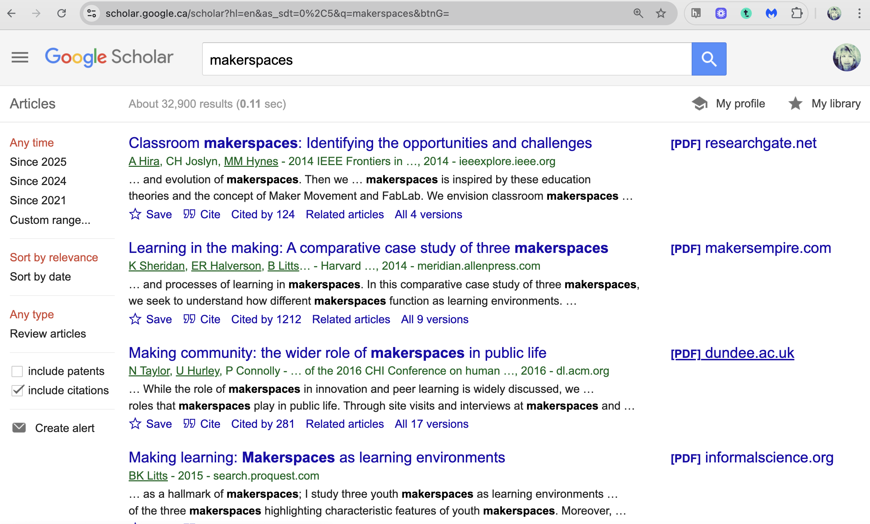
Let’s Try It!
Example

Slide 19
Let’s Try It!
Practice: (30 min)
I’ll start you off…..
Option A – Searching an article database (based on ppt)
  What might be a good first question?
Option B – Evaluating information (based on ppt)
  What might be a good first question?
TIP: Every time you want to tell students something, see if you could ask them a question instead

Slide 20
Share your Lesson
Share: (30 min)
Share what you’ve done with another group
Ask them the questions and see if it works
Share what the aim of the lesson is

Slide 21

Debrief
https://padlet.com/langara/week-2-teaching-workshop-debrief-pac18l8hodkyil3l
Debrief: (15 min)
How did that go? How did you feel through the process? Any surprises? Any challenges?
Why is it helpful to ask questions rather than telling?
TIP: Every time you want to tell students something, see if you could ask them a question instead

Slide 22
Debrief
Incidentally, when a student asks you a question, it’s often a good response to turn that question back to the class:
  “That’s a great question, what do YOU think?”
  And see if anyone in the class can answer it
Why is this a helpful strategy?

Slide 23

Next week
Will not be flipped. Three hour class. 9am-12pm
Classroom: LIFE 2404
We will start with a reading discussion, using the roles you’ve signed up for on the wiki
Two articles

