Slide 1
Case study 1
Ashley Wang

Slide 2
What are the signs and symptoms?
Signs
No fever
No swollen lymph nodes
No rash else where besides the mouth and nose area
Symptoms
Rash around patient’s mouth and nose area

Slide 3
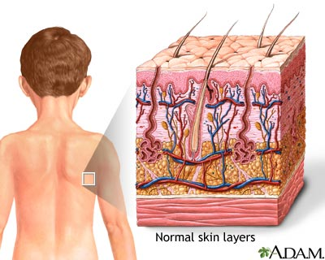
Which body system is affected?
Integumentary System
The rash specifically developed in the skin around Stephanie’s mouth & nose area
Notes:
Image Source
http://healthsciencesatdailylife.weebly.com/integumentary-system.html

Slide 4
Structure of the Facial Skin
Epidermis
Contain melanin-producing, antigen-presenting, and sensory cells
Facial skin is thin, therefore only consists of 4 layers
Dermis
Consists of 2 layers: papillary & reticular layers
Supports and connects epidermis to hypodermis, which provides insulation and stores energy
Notes:
Image Source:
https://en.wikipedia.org/wiki/Epidermis

Slide 5
Functions of the Facial Skin
A Safe Environment
Enable safe DNA reproduction for an organism
Prevent loss of nutrition such as fluid and protein
A Physical Barrier
Prevent pathogenic invasion
Change in skin flora may result in diseases
A Chemical Barrier
Protect organisms against toxic chemicals and UV
Made possible by antimicrobial peptides
Notes:
Image Sources:
1. https://www.youtube.com/watch?v=uXdzuz5Q-hs
2. http://phys.org/news/2015-03-antimicrobial-crispr-cas-weapons-bacteria-antibiotics.html
3. http://bathcare.mercola.com/hair-care.aspx

Slide 6
How is the skin been disturbed?
Rash found around patient’s mouth and nose indicates skin lesions
This break down in the physical barrier may lead to
Further invasion of pathogenic microorganisms
Loss of moisture and nutrition in the area
Ultraviolet radiation damage

Slide 7
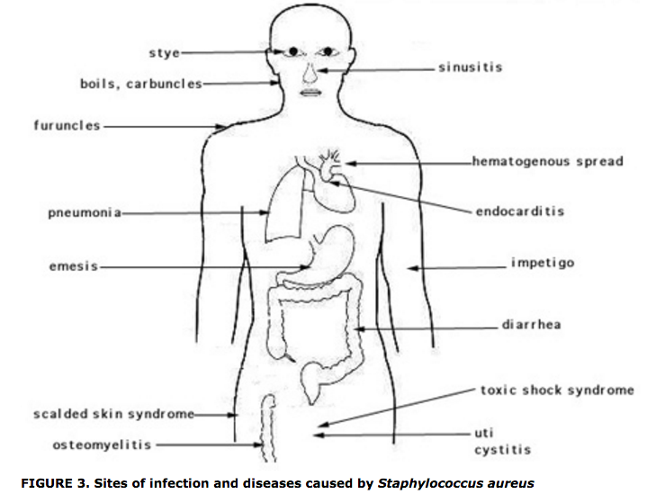
Secondary Sites of Infection
There doesn’t seem to be secondary sites of infection in this case, however they could develop
Todar, K. 2012

Slide 8
Secondary Sites of Infection
What enables bacteria to travel these areas?
Spread by entering the blood stream
Internal abscess and additional skin lesions
What enables bacteria to affect these areas?
Virulence factors such as surface proteins, invasins, membrane-damaging toxins, and so on
Human staphylococcal infections often stay localized.

Slide 9
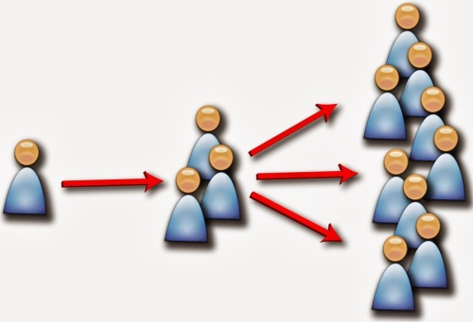
Why should Stephanie stay at home?
Doctor diagnosed Stephanie’s condition to be Impetigo
→ a highly contagious bacterial infection
Morris, J. 2014
Notes:
Image Source:
http://www.shinglesexpert.org/is-shingles-contagious

Slide 10
References
Arda, O., Goksugur, N., & Tuzun, Y. (2014). Basic histological structure and functions of facial skin. Clinics in Dermatology, 32(1), 3-13.
Baron, S. (Ed.). (1996). Medical microbiology. 4th edition. [Chapter 12 Staphylococcus] (4th ed.). Galveston (TX): University of Texas Medical Branch at Galveston.
Martel, J. (2012). Impetigo. Retrieved 01/16, 2015, from http://www.healthline.com/health/impetigo#Overview1
Nordqvist, C. (2015). Impetigo (infantigo): Causes, symptoms and treatments. Retrieved 01/15, 2015, from http://www.medicalnewstoday.com/articles/162945.php?page=2#complications_of_impetigo
Todar, K. (2012). Todar's online textbook of bacteriology. Retrieved 01/12, 2015, from http://textbookofbacteriology.net/staph_2.html

