Slide 1
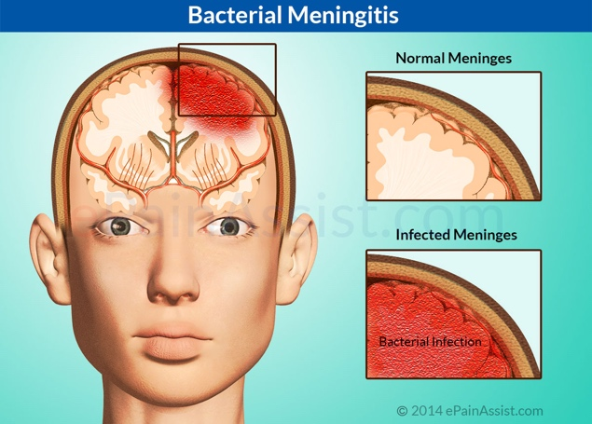
Bacterial Pathogenesis
To Discuss Clinical Manifestations of a Stiff Neck
Aman Sidhu

Slide 2
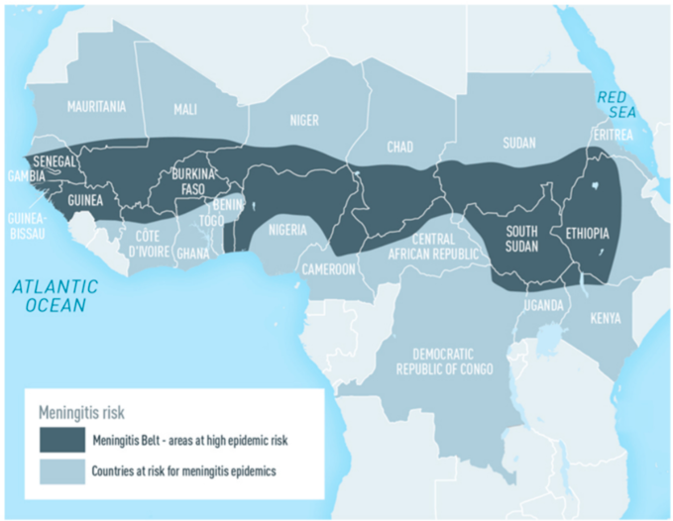
Origin of Bacterial Meningitis
Meningitis belt of Africa
Extends from the eastern side (ETHIOPIA) to the western end (Senegal)
Highest outbreak seen in regions that fall under the belt
Epidemic seen due to the dry climate and season associated with this region.

Slide 3
Epidemiology
During the dry seasons from December – June, meningococcal disease is constantly present at a high prevalence rate.
Periodic epidemics reach up to 1,000 cases per 100,000 population in comparison to 0.15 to 3 cases per 100, 000 population in United States, Europe, South America and Australia.

Slide 4
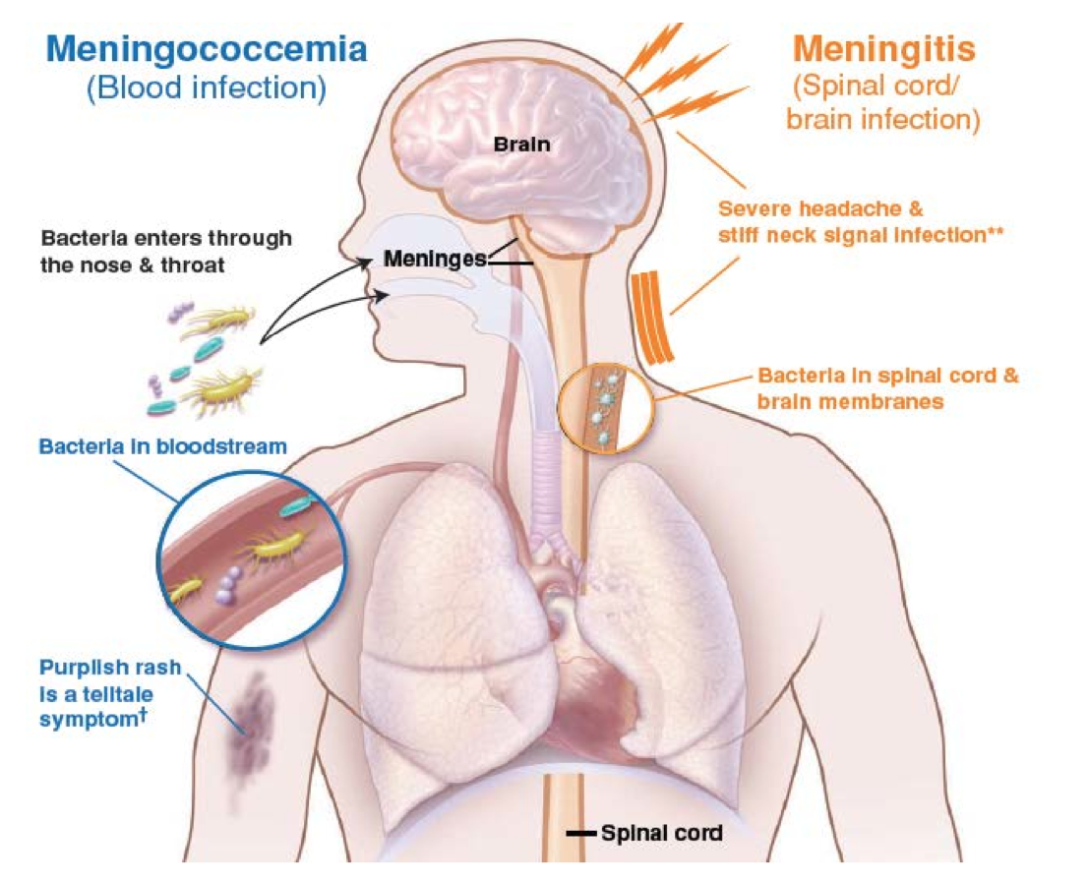
Bacteria Host
Thrives inside of humans
Resides within the posterior nasopharynx and adhere to the epithelium via pili
Spread of bacteria is through human-human interaction and direct contact through respiratory secretions.
i.e kissing, hugging, shaking hands and sharing drinks

Slide 5
Contraction of Meningococcus
Small spaces such as dorms create high risk of contraction
Become more exposed to asymptomatic carriers within large populations and at a higher risk in engaging in different activities.
Thus, exposing a person to increase their chance of contracting meningococci during close contact.

Slide 6
Structure of N. Meningitidis
Diplococcus gram negative bacteria
Possesses an:
Outer membrane
IgA protease
Porin protiens for selective permeabilty
Protective polysaccharide glycocalyx capsule layer around its cell wall

Slide 7
Entry of N. Meningitidis
The process of breathing, facilitates respiratory droplets containing N. meningitidis to enter the nasopharyngeal region
N. meningitidis relies on its adhesin proteins to bind to host cell components
To penetrate the epithelia first encountered in the nasopharyngeal region

Slide 8
Entry of N. Meningitidis
The capsular layer is made up of negatively charged sialic acid polymers
The capsules slimy characteristic, allows N. meningitidis to enter a person’s respiratory tract via aspiration without drying.
The capsule keeps the pathogen protected from degradation while being transmitted between hosts

Slide 9
Entry of N. Meningitidis
N. meningitidis posses IgA protease
IgA protease degrades active IgA at the mucosal surface
Decreasing IgA levels at the mucosa facilitates the bacteria’s ability to efficiently utilize its adherence factors.

Slide 10
Entry of Meningitidis
Type IV pilus
1
Primary major adhesion protein utilized by N. meningitidis for the initial attachment of bacteria to host
Upon inhalation and interface with the epithelia, N. meningitidis utilizes its type IV pili to adhere to non-ciliated mucosal cells, ultimately invading/penetrating them.
2

Slide 11
Pili Components that Enhance Type IV Pili Interaction
Type IV pili
Locates a point of entry along the epithelial lining due to its twitching motility.
Twitching motility is the product of a pilus component known as PilT.
PilT
A motor molecule, which stimulates pilus retraction and generates a strong molecular force.
This twitching motility allows N. meningitidis to search for the perfect point of entry.
The strong force has the added potential to punch a hole in the host membrane following initial adhesion.

Slide 12
Adherence: Major Adhesion Proteins
Primary attachment is enhanced by opacity proteins (Opa and Opc):
initial binding between pilus and receptor/host membrane protein is amplified
Opa proteins are transmembrane proteins made of 8 beta strands.
Opa is thought to bind cell-cell adhesion facilitating proteins on the host such as CD66

Slide 13
Adherence: Major Adhesion Proteins
Opa
Bind to CEACAM (carcinoembryonic antigen-related cell-adhesion molecule) receptors or HSPGs (Heparin sulfate proteoglycans), which are receptors that are upregulated by inflammatory cytokines
The presence of inflammation leads the epithelial lining to increased vulnerability to attachment and invasion by N. meningitidis.

Slide 14
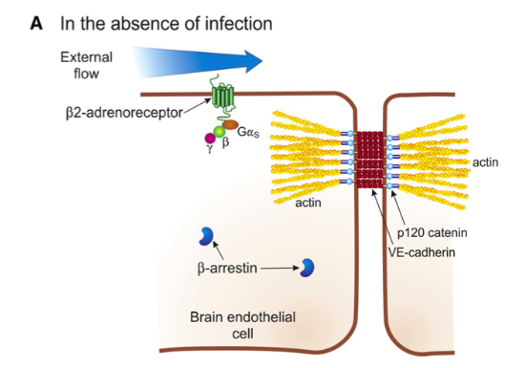
Adherence: Major Adhesion Proteins
Upon pili stimulation the B2-AR receptor is activated, recruiting B- arrestin.
B- arrestin construct a raft by accumulating proteins and assembling integrins such as CD44 and ICAM-1 to generate cortical plaque colony formation
Protein grouped protrusion and puncturing of the host cell, promotes bacterial uptake by the host.

Slide 15
Adherence: Major Adhesion Proteins

Slide 16
Different Pili components that enhance the Type IV pili interaction
PilX is a protein essential for adhesion and aggregation
The Pil C proteins are minor adhesion factors
PilC1 and PilC2 proteins are utilized to form the pili assemblage
PilQ demonstrates adhesion activity with the ability to bind laminin host cell receptors.

Slide 17
Other Adhesion factors/processes that are important
Nonspecific factors such as:
surface charge
hydrophobicity may aid in adherence.
The anti-phagocytic capsule protects against damage from macrophages and neutrophils.
Lipooligosaccharide (LOS) is toxic and promotes an inflammatory response, which can upregulate receptors for bacterial adhesion and entry
NhhA (trimeric; binds extracellular host proteins) and NadA are minor adhesin proteins on the N. meningitidis that support attachment.

Slide 18
Factors Facilitating Adhesion and Invasion of the Meninges
Four different methods:
Transcellular transport by passive or adhesion induced transcytosis (carried in a vesicle across the cell)
May enter by paracellular passage through opened tight junctions
Meningococci may disrupt endothelial barrier by direct cytotoxic effects
Bacteria may use leukocyte facilitated transport by infected phagocytes

Slide 19
N. Meningitidis Survives Intracellularly
IgA protease takes down the mucosal surface antibody defense
These exists a type 2 Iga1 protease which intracellularly decreases levels of host lysosomal activity, which are a part of the endocytic pathway.
By altering lysosomal membrane proteins (LAMP1 and LAMP2), Neisseria can utilize the endocytic pathway and facilitate a parasite mediated endocytosis.
The type 2 IgA1 cleaves LAMP1 and reduces steady state of the epithelial surface.
Yielding a flux of Ca2+ ions which stimulates the lysosome to release the N. meningitidis into the interior of the cell.

Slide 20
Multiplication and Spread:
After entry through the host nasopharynx and passed through the epithelial cells via endocytosis, they enter their primary infection site in the blood.
The antiphagocytic polysaccharide capsule is key in survival and evasion of the hosts immune system.
Allows the bacteria to remain resistant and mediate antibody killing

Slide 21
Multiplication and Spread:
Within the blood stream, meningococci produce a strong inflammatory response and activate complement and coagulation cascades using LPS (a PAMP)
These processes eventually lead to host damage.
N. Meningitidis can recruit negative regulators of complement, using factor H-binding protein (GNA1870)
Which recruits Factor H, an inhibitor of the alternative complement pathway

Slide 22
Multiplication and Spread:
Meningococci virulence factors that help the bacteria survive in the blood, replicate and disseminate:
Porin PorA binds a complement regulator called C4-binding protein, influencing serum resistance.
Victronectin – the binding site for Opc
inhibits the formation and insertion of the membrane attack complex, a key complement component, into bacterial membranes

Slide 23
Multiplication and Spread:
Attachment of the bacteria to the endothelial cells is facilitated by pili, when there are low shear rates caused by blood flow.
Pili maintains adherence to endothelial cells under high flow conditions.
Pili interactions may cause:
intracellular signaling and disruption of tight junctions,
PilE and PilV are involved in adhesion to host cells by activating beta2-adrenergic receptor
promoting endothelial signaling events and enabling translocation of meningococci across the brain epithelium

Slide 24
Multiplication and Spread:
In the cerebrospinal fluid (CSF) of the subarachnoid space, bacteria are able to replicate as there is no infection control, making this an easy site to infect
1
As the number of bacteria in the CSF increase, a local inflammatory response is induced causing:
2
swelling and accessibility into the blood-brain-barrier to increase.
Increased permeability of the blood- brain- barrier allows:
3
white blood cells, and neutrophils to enter the CSF and cause damage to endothelial surfaces

Slide 25
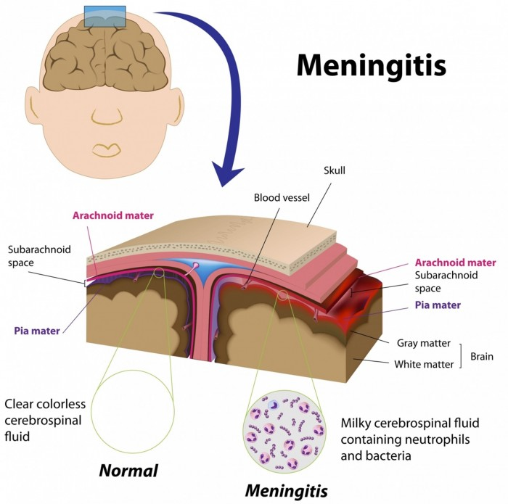
Bacterial Damage
The meninges consists of three layers of the tissue:
dura mater
arachnoid mater,
pia mater
They protect the brain and the spinal cord, and the subarachnoid space contains CSF that helps cushion the brain and spinal cord
immune system reacts by gathering immune cells to the site and causing inflammation with the presence of bacteria.

Slide 26
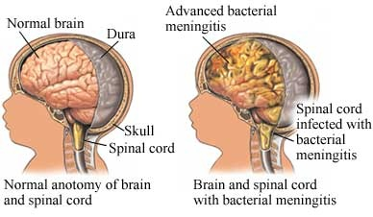
Bacterial Damage
Complications arising because of this inflammation include:
Blood clots: can spread to the vessels in the brain and may cause stroke
Swelling in the brain (cerebral edema): damage brain tissue
Increased pressure within the skull: may cause parts of the brain to shift, brain herniation, and causing compression of the brain.
Inflammation of the cranial nerves: these nerves are involved in sight, hearing, taste, and control of facial muscles and glands. Subdural empyema: accumulation of pus in the dura mater
Septic shock: from low blood pressure
Intravascular coagulation: small blood clots throughout the bloodstream (Purpura fulminans )

Slide 27
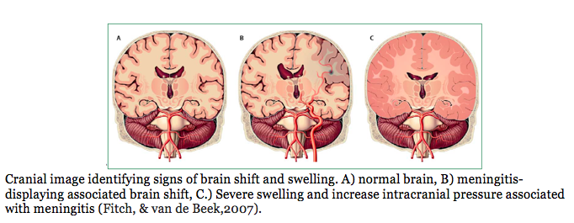
Bacterial Damage
Most of the damage, however, is due to the induction of the inflammatory response
Inflammatory response leading to cytokine release (IL- 6 and TNF-a), chemokine release, and cellular damage from reactive oxygen species (ROS).
This increases barrier penetration and leakage

Slide 28
Images retrieved from:
https://classconnection.s3.amazonaws.com/445/flashcards/4085445/png/screen_shot_2014-03-27_at_11958_am-145029FE49E7C49F152.png
https://static1.squarespace.com/static/54e28a88e4b014cdbc431590/t/54f26316e4b0f6df27b72993/1425171227061/?format=500w
http://path.upmc.edu/cases/case53/images/micro5.jpg
http://ase.tufts.edu/chemistry/kritzer/pix/iga%20proteases.gif
https://www2.le.ac.uk/projects/vgec/highereducation/topics/microbial-genetics-1/our-research/pv-of-opa-ali/Opa.PNG
https://image.slidesharecdn.com/1-3-guillaumedumenil-110610091214-phpapp02/95/13-guillaume-dumenil-5-728.jpg?cb=1307697291

