Slide 1
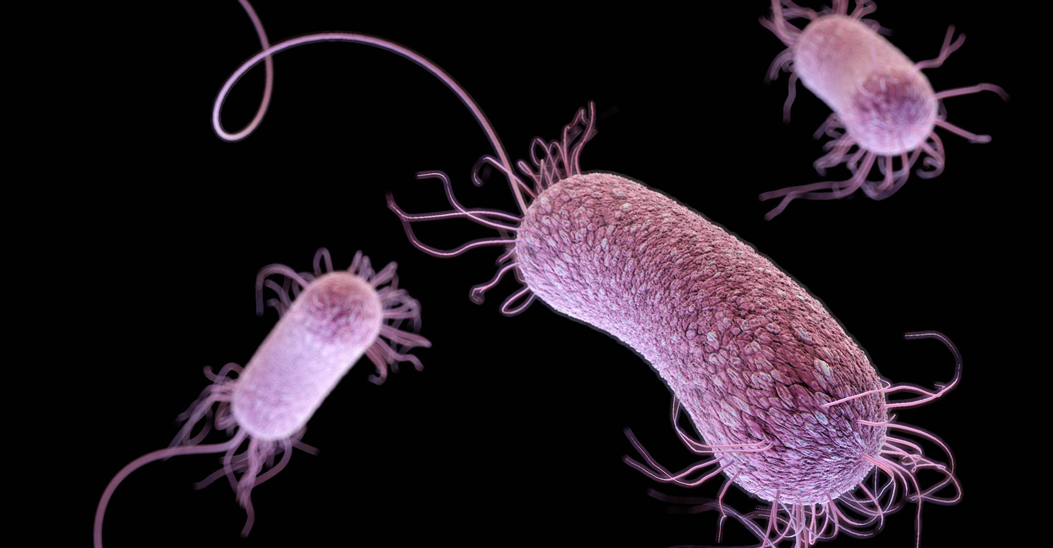
P. aeruginosa: The Immune Response PATH 417 UBC – Isabelle Goy

Slide 2
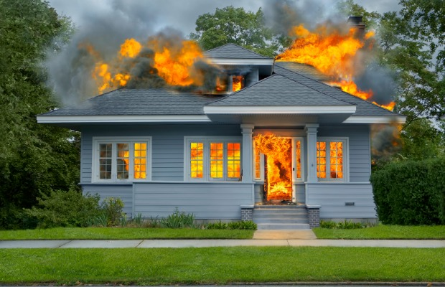
The case: A House Fire
Rescued from a house fire Marian is hospitalized with second degree burns extending deep into the dermis layers in her upper limbs. After three days in hospital during which time she has regular changes of her wound dressings, she is released home to the care of her sister who expresses confidence in her ability to maintain the needed dressing changes. With a keen interest in natural remedies Marian and her sister treat her burn wounds with honey. A few days later Marian begins to experience pain associated with her burns and notices that they seem to be producing more fluid than before. After a bad nights sleep her sister takes her back to the hospital where the doctor notes that one of the wounds is expressing pus. A swab of the pus is sent to the laboratory and Marian is again hospitalized. The laboratory grows Pseudomonas aeruginosa from the wound and Marian is started on antibiotics.

Slide 3
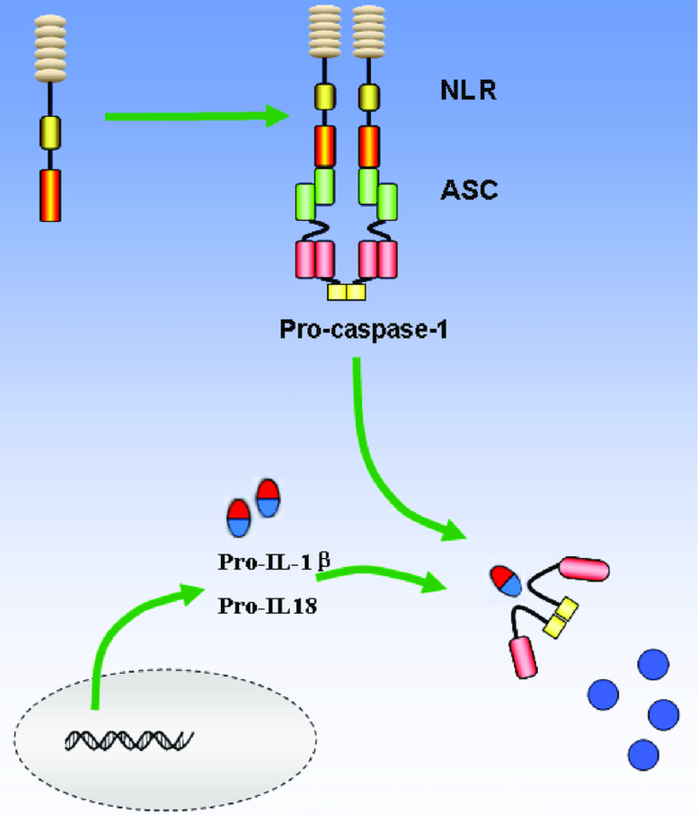
Host response: Innate immune system
Microbe-associated molecular patterns (MAMPs) recognized by PPRs: Toll-like Receptors (TLRs) and NOD-like receptors (NLRs)
TLR4: Bacteria’s LPS recognition
TLR5: Flagellin recognition
NLRs: endo and exogenous ligands recognition → formation of the inflammasome multi-protein complex→ caspace-1 induction→ IL-1B and IL-18 cleavage

Slide 4
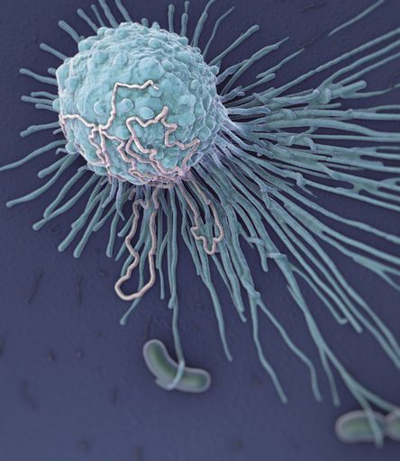
Host response: Innate immune system
Phagocytic cells:
Lung damage induced by bacteria: chemokines production (e.g. IL-5, IL-8) → PMN recruitment and activation
Presense of the nicotinamide adenine dinucleotide phosphate-reduced oxidase system in macrophages and PMNs:
Nitric oxide production (bactericide for P. aeruginosa)
Macrophages :
Bacteria sensing
Pathogen killing
Polymorphonuclear neutrophil leukocytes (PMNs):
Phagocytosis
Neutrophil serine proteases: bacteria clearance in the infection site

Slide 5
Host response: Innate immune system
NK cells:
Limit bacteria spreading
Produce IL-22 → increase AMPs production by epithelial cells NKG2D receptor:
Also expressed by NKT cells and CD8+ T cells
Recognize RAE-1 familly expressed by P. aeruginosa

Slide 6
Host response: Innate immune system
Formation of pus: host and bacterial material that the body needs to get rid of
Mucus membranes: release the pathogen from the host body through fluids

Slide 7
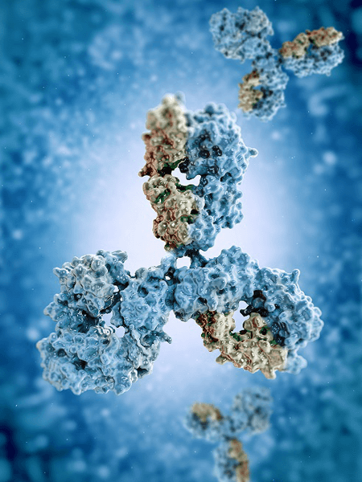
Host response: Adaptive immune system
Humoral immunity:
P. aeruginosa clearing if innate system is not enough
Antibodies production:
Bacteria opsonization
LPS targeting
IgG production: high level = chronic infection
Complement activation
APC activation → interaction with CD4+ T cells

Slide 8
Host damage from the immune response
Thermal injuries:
Neutrophils dysfunctionment
Hyperactivited immune system:
IL-10, IL-18 and IL-1 overexpression → impair bacterial clearance
Biofilm resistance to leukocytes and antibodies

Slide 9
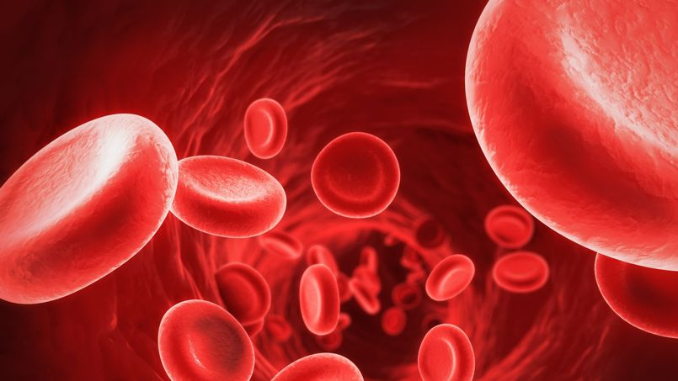
Host response: Adaptive immune system
Sepsis:
Why ?
Molecules released into bloodstream to fight infection
Signs:
Weak immune system or immunosupression
Mechanism:
C5a from complement induces macrophage migration-inhibitory factor (MIF) and high-mobility group box 1 (HMGB1) → systemic coagulation → host homeostasis affected
If not treated: Death

Slide 10
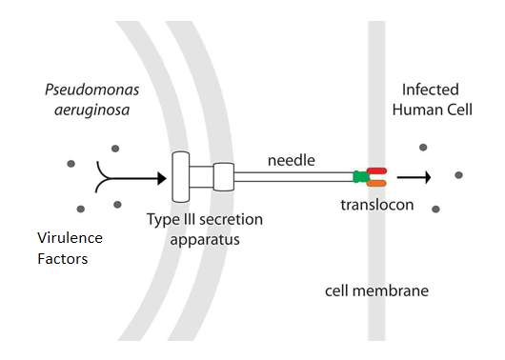
Bacterial evasion from immune system
Physical barrier lost due to burning: entrance for opportunistic
P. aeruginosa:
Lives in soil/water: resistant to naturally occuring antibiotics, resistance transmitted to other bacteria through horizontal gene transfer
Flagellum: motility, biofilm formation
Type III secretion system (TTSS):
virulence factor delivery into host cytoplasm :
Protease IV: endoprotease
IL-22 degradation→ disruption of the production of AMPs
IgG and Complement proteins degradation
Toxinogenicity:
Exoenzyme S: ADP-ribosylation → MyD88 dependant pathway → production of TNFalpha
Exotoxin A : inhibits protein synthesis → cell death
Exotoxin U
Type IV pili:
bacterial adherance to epitelial cells through carbohydrates receptors → fibronectin degradation with elastase helps binding.

Slide 11
Bacterial evasion from immune system
Elastase and alkaline protease production:
Destroy structures with fibrin and elastin
Inactive INFgamma and TNF
Cytotoxin, phospholipase and lecithin:
Cytotoxic effects on neutrophils and lymphocytes
Pyochelin:
Siderophore: collect iron

Slide 12
Bacterial evasion from immune system
P. aeruginosa Quorum sensing
Allows it to adapt to the environment through the control of its gene expression
Quorum sensing molecules:
Acyl homoserine lactones (AHL) accumulation
LasR/Rh1R transcriptional factor binding → PAI-1 and PAI-2 (autoinducers) expressed → biofilm formation
Host’s immune system modifications:
COX-2 expression → production of Prostaglandin E2 → vasodilation increased
Induce apoptosis in neutrophils and macrophages

Slide 13
Finally,
Is the bacteria completely removed?
P. aeruginosa can persists due to its biofilm production
Does the patient recover fully and is there immunity to future infections from this particular bacteria ?
Normally: innate immune response suffisant when still in the acute phase
Otherwise: Elimination of bacteria possible with specific antibiotics:
Collistin: changes P. aeruginosa’s membrane permeability to Mg2+ and Ca2+

