Slide 1
Week 1 – Case 1 “School Sores” Kirk Chen (1) Pawan Dhaliwal (2) Kyle Gillard (3) Jaspreet Padam (4) Ashley Wang (A) Kevin Chu (B)
The Body Systems
Questions
PATH 417A
January 2016

Slide 2
The Case
6-year-old Stephanie O. has developed red sores around her mouth and nose. At the start of class her teacher noticed the rash and called her parents to take her home. Her parents take her to the family doctor who examines Steph. She is afebrile and does not have any swollen lymph nodes. There is no rash on her hands or feet or inside her mouth. He prescribes an antibiotic and tells her parents that she needs to stay at home for a couple of days. He swabs the rash and sends the swab to the Microbiology Laboratory.

Slide 3
Body Systems Question 1 presented by: Pawan Dhaliwal
What are the signs and symptoms?

Slide 4
Defining the terms
Let’s first look more closely at what is meant by a sign versus a symptom…

Slide 5
Sign vs. symptom
Table 1: Differences between a sign and a symptom¹
 | Sign | Symptom
Taken note of by… | Healthcare professional | Patient
Characteristics are… | Objective | Subjective
Examples | High blood pressure Abnormal densities in lungs detected on x-ray | Feelings of tiredness or pain Observation of skin rash

Slide 6
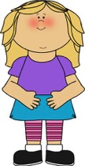
Sign vs. symptom
An illness characteristic can be a sign, symptom (or both) depending on the observer(s):²
Doctor
Patient
Doctor and Patient
Illness characteristic is (a):
Sign
Symptom
Both sign and symptom
Notes:
http://www.clipartpanda.com/categories/doctor-clip-art-pictures
https://www.pinterest.com/scentsy_bex/preschool-3-year-old/

Slide 7
Stephanie’s Signs
Red sores around mouth and nose
Afebrile
No swollen lymph nodes
No rash on hands/feet or inside of mouth
Can you define
this medical
sign?
Click for the
answer!
Afebrile:
absence of
fever³
Notes:
https://commons.wikimedia.org/wiki/File:Clipboard_01.svg
http://www.clker.com/clipart-cartoon-thought-bubble.html

Slide 8
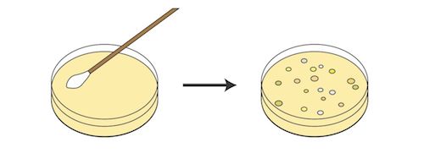
Stephanie’s signs
The microbiology lab test results, when they are completed, will also be another one of Stephanie’s signs

Slide 9
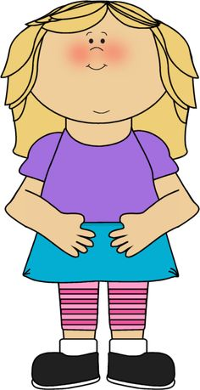
Stephanie’s Symptoms
As noted before, a symptom is a subjective characteristic experienced (e.g. felt or observed) by the patient.
In this case, the symptom is the rash around Stephanie’s nose and mouth.
Although not explicitly stated in the case, in real life Stephanie would have had a chance to describe the rash in her own words (on in her parents’ words).

Slide 10
sources
[1]
Niamh, K., & Lowe, C. (n.d.). Signs and Symptoms. Retrieved January 12, 2016, from https://connect.ubc.ca/webapps/blackboard/execute/content/blankPage?cmd=view
[2]
Niamh, K., & Lowe, C. (n.d.). Signs and Symptoms. Retrieved January 12, 2016, from https://connect.ubc.ca/webapps/blackboard/execute/content/blankPage?cmd=view
[3]
Merriam-Webster Medical Dictionary. (n.d.). Definition of afebrile Retrieved January 12, 2016, from http://www.merriam-webster.com/medical/afebrile

Slide 11
Images
All images used in this presentation are Public Domain Images:
Doctor:
http://www.clipartpanda.com/categories/doctor-clip-art-pictures
Little girl:
https://www.pinterest.com/scentsy_bex/preschool-3-year-old/
Clipboard:
https://commons.wikimedia.org/wiki/File:Clipboard_01.svg
Thought bubble:
http://www.clker.com/clipart-cartoon-thought-bubble.html
Petri dish:
http://www.clipartsheep.com/petri-dish-with-bacteria-it-on-a-and-let-clipart-1710729.html
Lab results:
http://www.illustrationsource.com/stock/image/752/the-signing-of-a-document/?page=1&square=CHECKED&vcd=CHECKED&vertical=CHECKED&color=CHECKED&photography=CHECKED&grey=CHECKED&illustration=CHECKED&detail=TRUE&filter=CHECKED&panoramic=CHECKED&RF=CHECKED&results_per_page=1&query=Write&RM=CHECKED&horizontal=CHECKED&order=relevance

