Slide 1
Teaching and Learning Activities
Course Design Institute – December 2014
Stefania Burk, Senior Instructor, Asian Studies
Luisa Canuto, Manager, Faculty Programs, CTLT

Slide 2
integrated course design — elements
Learning Goals
Feedback and Assessment
Teaching and Learning Activities
Situational Factors

Slide 3
session learning outcomes
Discuss how active learning helps students engage with course materials
Share techniques you use in your teaching
Consider active learning teaching and learning techniques most appropriate for your course
Apply your knowledge to develop at least one (new?) learning activity for your course

Slide 4
learning activities — why
What is Truly Important for my Students to Learn? Revisit: “What would distinguish students who have taken this course from students who have not?”

Slide 5
Active learning - why
“Learning is not a spectator sport”

Slide 6
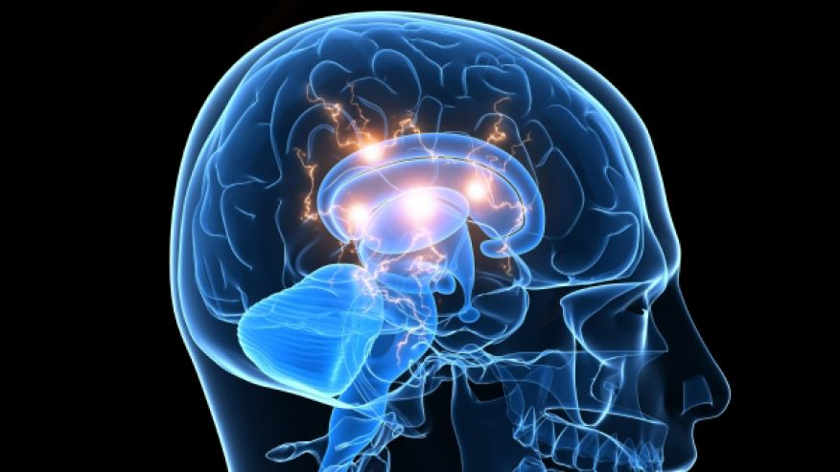
active learning — why

Slide 7
active learning — how
Gather information and ideas
Experience
Reflect
produce

Slide 8
learning activities — where
comprehension
application
analysis
synthesis
evaluation
knowledge

Slide 9
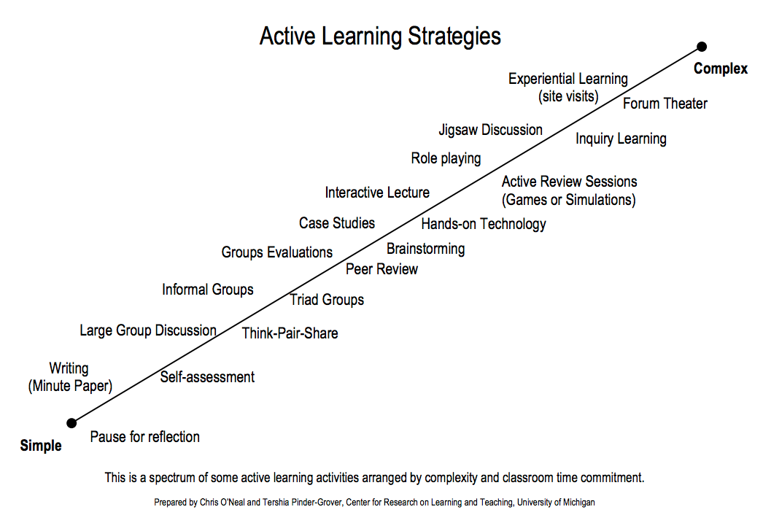

Slide 10
learning activities — with technologies
Numerous technologies with UBC’s elearning ecosystem to support active learning.
Active course materials – iClickers, games and simulations
Self-reflective activities
Discussion-based, collaborative activities
Students as Producer activities
Within Connect:
Discussions, Wikis, Blogs, Kaltura, Group tools, iClickers
UBC Open Tools:
Blogs, Wikis
Notes:
Suggested Activity
What is a learning technology? - 2 mins
The learning technology ecosystem at UBC (toolkit intro) - 3 mins
Cooperative Activity (Active Learning)
In your small groups / or in pairs….?

Slide 11
learning activities — with technologies
1. http://elearning.ubc.ca/toolkit/
2. Explore the learning technology tool on the card on your table…
- What is it?
- Uses and Benefits
- Examples at UBC-
- Getting Started. Best Practices
3. How you would integrate this tool into your OWN teaching and learning practice
4. Report back to the class on 'your' tool.

Slide 12
Learning activities —
Share 3 learning activities you use
Consider and discuss 3 learning activities you would like to use

Slide 13
Learning activities for your course
Using MATRIX, develop 1-2 learning activities that are linked to your course objectives that you could use in class or outside of class
Ensure that your learning activities include
Description
Rationale
Links to course materials and objectives
Instructions,
Grading information
Potential issues and your plan for dealing with them

