Slide 1
FNH 200 Introduction to Library Research
Katherine Miller, MLIS
Woodward Library
katherine.miller@ubc.ca
January 21, 2016
Katherine Miller, Biology Librarian

Slide 2
Lesson Plan
Finding & accessing collections
Web of Science

Slide 3
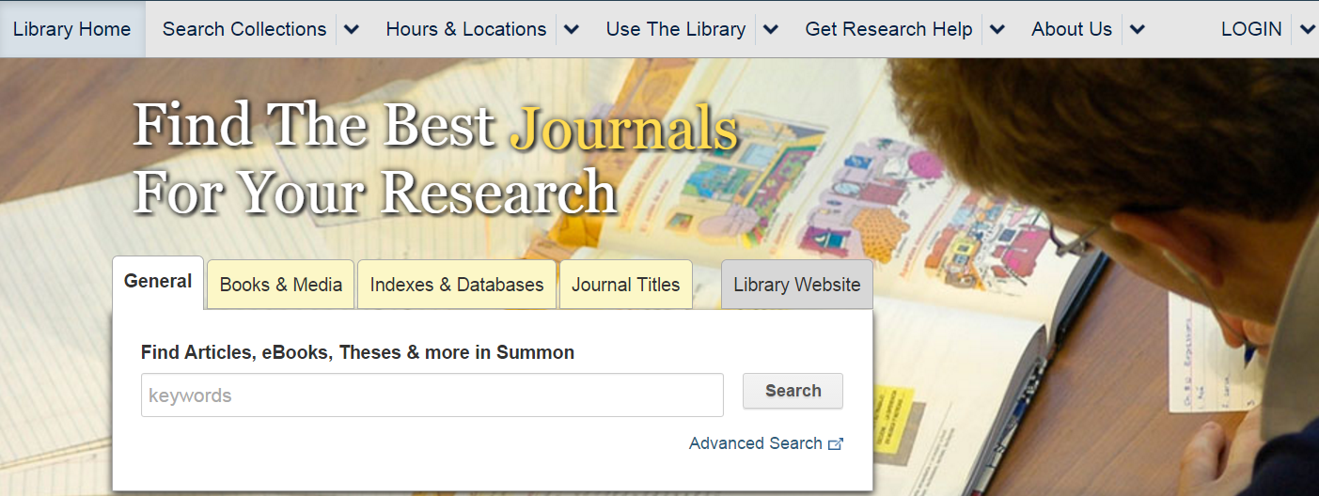
Finding the Full-Text
Summon: www.library.ubc.ca

Slide 4
Accessing Print Collections
For more practice see Library Research Skills for Land and Food Systems Module 3B.06 Print Books
Notes:
Check your understanding – call number, Document Deliver

Slide 5
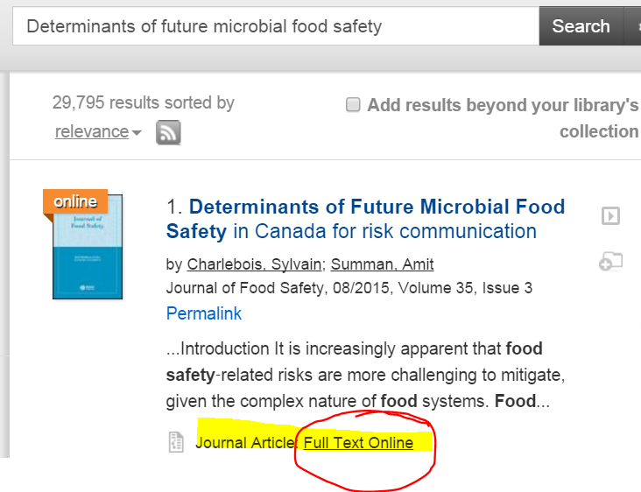
Accessing Online Collections
Charlebois, Sylvain, and Amit Summan. 2015. Determinants of future microbial food safety in Canada for risk communication. Journal of Food Safety 35 (3): 303-17.
For more practice see Library Research Skills for Land and Food Systems Module 3C.03 Finding Articles in Summon by Citation
Notes:
Check your understanding – call number, Document Deliver

Slide 6
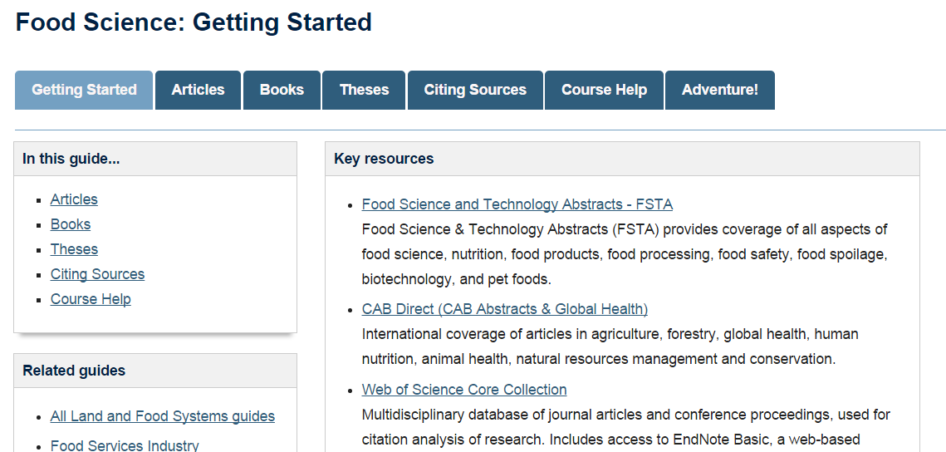
Research Guides
http://guides.library.ubc.ca/foodscience

Slide 7
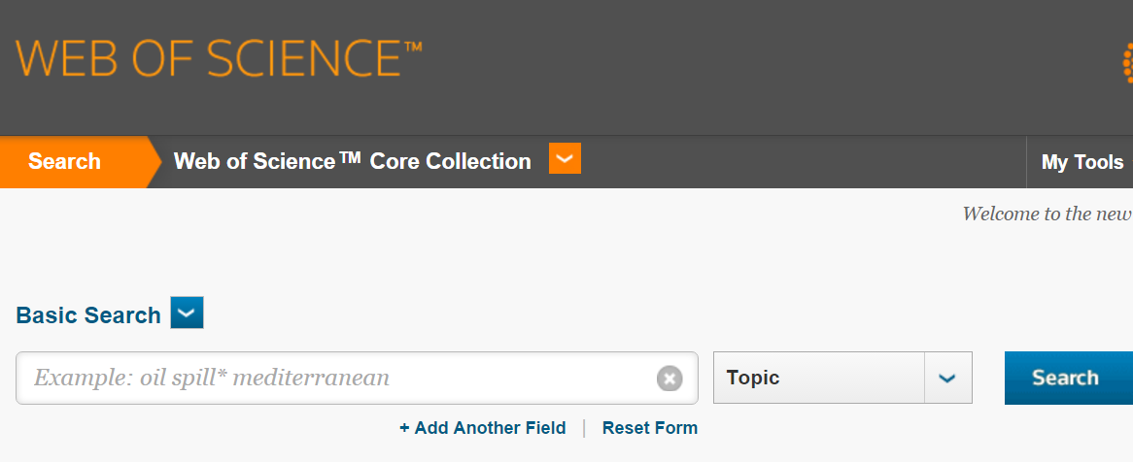
Web of Science
Multidisciplinary
Times Cited Sort
Review Papers

Slide 8
Truncation (wildcard)
What is truncation? (e.g.: canad*, polic*…)
a. an abbreviations directory
b. a search algorithm
c. a character that replaces one or more letters
For more practice see Library Research Skills for Land and Food Systems Module 2B.05 Truncation
Notes:
Check your understanding - Truncation

Slide 9
Boolean Operators
Which of these searches retrieves more results?
using the OR operator
b. using the AND operator
For more practice see Library Research Skills for Land and Food Systems Module 2B.04 Combining Concepts
Notes:
Check your understanding – Boolean operators AND, OR

Slide 10
Cited by
Cited by
Allows you to trace the impact of the literature. See the most recent studies that have built on a seminal article (pioneering research).
* Available in PubMed, Google Scholar, Web of Science

Slide 11
Cited by – Web of Science

Slide 12
Cited by - Google Scholar

Slide 13
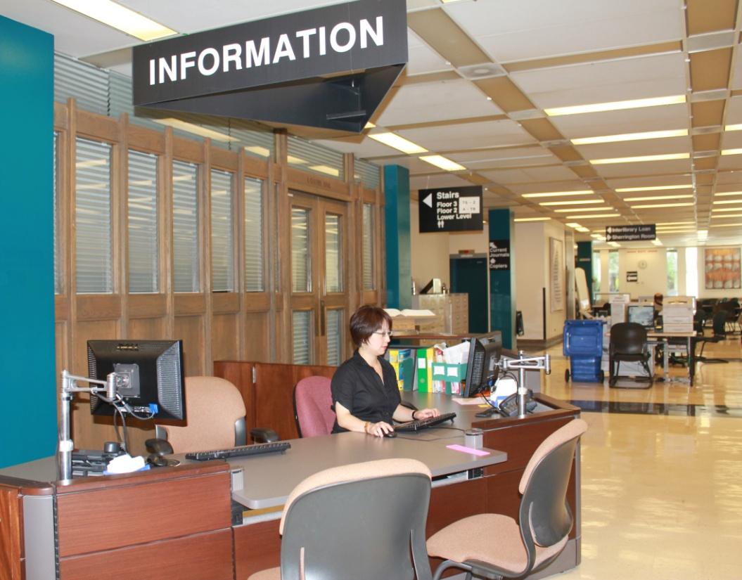
More Help!
(online chat)
Woodward Information Desk
In-person, 604-822-4440
Appointments:
Katherine Miller katherine.miller@ubc.ca
Notes:
Credit: Suzan Zagar, 2010

