Slide 1
PATH 417 – Case 4: Bacterial pathogenesis
Kendrew Leung

Slide 2
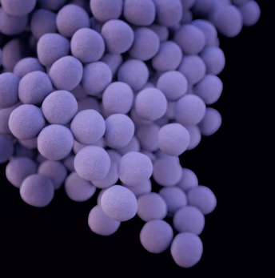
ENCOUNTER – WHAT, WHERE, HOW?
What: Staphylococcus aureus
Gram positive aerobic organism
Part of normal flora on skin – commensal and human pathogen
http://outbreaknewstoday.com/philippines-ust-microbiology-society-recognized-asm-56700/

Slide 3
ENCOUNTER – WHAT, WHERE, HOW?
Where:
Present on skin and in mucous membranes of nasal passages
Also on axillae in about 30% of health adult
Have been recovered from drinking water supplies, food manufacturing environments, farm animals, homes and hospital environments

Slide 4
ENCOUNTER – WHAT, WHERE, HOW?
How:
Part of normal flora in nasal passages and sometimes on the nipples
Break in skin secondary to breast feeding (baby’s mouth came into contact with nipple tissue)
S. aureus then establishes infection upon entry

Slide 5
ENTRY
S aureus adheres to human epithelium through Microbial Surface Components Recognizing Adhesive Matrix Molecules (MSCRAMMs)
Specifically, fibronectin-binding proteins (FbBP’s)

Slide 6
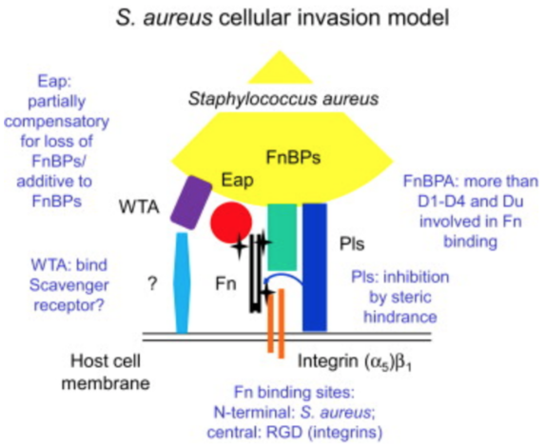
Entry
FnBPs bind to fibronectin, a constitutively-expressed component of human epithelial cell
Allows S aureus to colonize on epithelium
Clumping factors (fibrinogen binding proteins) adhere to host fibrinogen and aid in host adherence

Slide 7
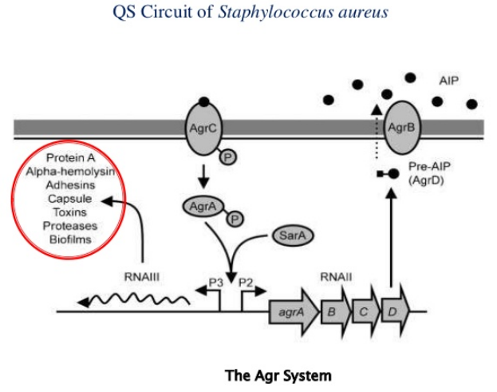
Entry
Quorum Sensing:
Mechanism that promotes bacterial adhesion
Accessory gene regulatory (agr) system promotes adhesion production to bind fibronectin for adhesion
FnBP’s are regulated by agr system, with its production at maximum during exponential phase of cell growth

Slide 8
ENTRY
Innate immune system possess components against bacterial adhesion
Antimicrobial peptides (AMPs) bind to bacterial surface structures such as lipopolysaccharide and prevents adherence to skin
Some may insert into bacterial membrane and cause lysis
Secreted by keratinocytes, hair bulb cells and sweat glands

Slide 9
Evasion, replication & spread

Slide 10
HOST EVASION
Tools to evade immune defenses
Leukocidin: Pore-forming toxin that acts against membranes of leukocytes. Eliminating neutrophils protein bacteria from host defenses
Microcapsule: Consist of surface polysaccharides, helps bacteria evade host phagocytosis and thrive in extracellular environment.
Protein A: Surface proteins that bind Fc receptors of IgG to prevent opsonisation. Allows for phagocytosis avoidance.
Staphyloxanthin: Antioxidant effects that help bacteria evade death from reactive oxygen species by neutrophils. Exact mechanism unclear.
Biofilm: Occurs when bacterial cells proliferate and secrete extracellular matrix molecules that form the biofilm. Channels allow passage of nutrients into the colonies to survive and grow in the host.

Slide 11
REPLICATION
Coagulase
Forms staphylothrombin via binding host prothrombin
Converts fibrinogen into insoluble fibrin to form clots
Clots act as physical barrier against immune cells
Enables S aureus to safely replicate and evade host defenses
Staphylokinase
Protein excreted by S aureus
Dissolves fibrin clots
Used by bacteria to dissolve clots and to be released into host circulation after replication

Slide 12
REPLICATION
Membrane-Damaging Toxins (MDTs)
Alpha-hemolysin is the most potent MDT currently
Forms heptameric rings with a central pore on susceptible cells’ membranes and induces lysis via leakage of cellular contents
Allows S aureus to further infect nearby tissues as surrounding host cells lyse
Eventually enables bacteria to enter circulation and further spread into the system

Slide 13
BACTERIAL DAMAGE

Slide 14
DIRECT BACTERIA DAMAGE to HOST
Protein A (SpA)
Expressed on surface of S aureus
Binds Fc portion of IgG and interferes with phagocytosis
Also activates necrosis factor-alpha 1 (TNFR1) signalling and induces release of pro-inflammatory chemokines and cytokines to injury site

Slide 15
DIRECT BACTERIA DAMAGE to HOST
Staphylococcal binding immunoglobulin protein (Sbi)
Homologous binding to IgG Fc portions as SpA
Increased blood flow, permeability and vasodilation to injury site
Contributes to redness and inflammation on injury site

Slide 16
DIRECT BACTERIA DAMAGE to HOST
Enterotoxins and toxic shock syndrome toxin (TSST-1)
Toxins with superantigen activity → Activates T-cells without antigen recognition
Encourage cytokine release from host cells and even apoptosis
Leads to production and release of IL-1,IL-2, TNF-alpha and other cytokines
TSST-1 found to be associated with 75% of all toxic shock syndrome cases

Slide 17
The end

