Slide 1
Case 4- A chronic cough
Bacterial Pathogenesis
Path 417
Sophia Sidi

Slide 2
Case 4
36-year-old Joseph has been suffering from multiple spells of violent coughing for 6 weeks. Prior to developing the chronic cough he had, what he describes as, a mild upper respiratory tract irritation, mild fever, runny nose and a cough that lasted about 3 days. More recently, and at the insistence of his spouse, he finally visits a drop-in clinic where the doctor asks him about his childhood vaccinations. Joseph reports that, to the best of his knowledge he had all the required shots but he admits to not having any since becoming an adult. Upon examining Joseph the doctor finds some redness in his throat but his lungs are clear and there are no enlarged lymph nodes in his neck. The doctor collects a throat swab to send to the laboratory, prescribes some codeine syrup and informs Joseph that the cough may last a few more weeks.
The laboratory is unable to detect Bordetella pertussis or any other pathogen from the swab. Despite this, Joseph is diagnosed with pertussis, commonly known as whooping cough, based on his clinical presentation and lack of adult immunization against pertussis. The coughing fits go away after another 4 weeks.

Slide 3
1. ENCOUTNER
Where does the organism normally reside, geographically and host wise? And what are the bacterial characteristics that leave it suited to these places of residence? How would our patient have come in contact with this bacteria?

Slide 4
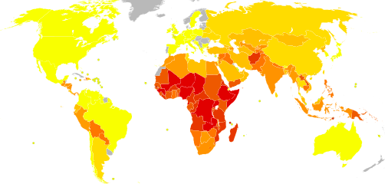
Geographic prevalence
95% of cases occur in developing countries
Early documentation of pertussis epidemics were frequent in the 16th and 17th century, possibly emerging in Europe due to imports from Korea
There was a resurgence of Pertussis outbreaks in Australia, Netherlands, United Kingdom, and United States possibly due to a decline in immunity through vaccines, and pathogen adaptation.
Wisconsin is the US state with the second highest incident rate for whooping cough.

Slide 5
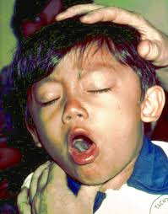
Host residence
Adults with mild illness and decreasing immunity to B. Pertussis are a major reservoir and likely transmit infections to infants that haven’t been immunized yet and have a weaker immune system.
Causes mild illness in adults, but is severe and deathly disease in infants.
The pathogen is able to survive 3-5 days on dry surfaces and clothes but requires a host as it’s optimal temperature is 35-37 degrees Celsius.
B. Pertussis inhabits respiratory epithelial cilia in humans and possibly higher primates.
Its small size and non-motility makes it suitable to enter through the human nasopharynx as it is inhaled.
Also been found in alveolar macrophages, but not known to invade tissues.
It is capable of forming a biofilm that allows it to survive host clearance and bind to the ciliated epithelium.
Bps polysaccharide is required for biofilm formation and functions as a nasal adhesion to host epithelia while resisting complement.

Slide 6
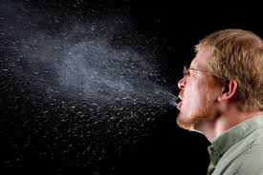
Bacteria & Infection
Like the flu, whooping cough can be passed on by coughing or sneezing from person to person.
Therefore, the more infections present, the more likely it is to spread.
Although vaccinations do prevent infection, whooping cough vaccine is only improved for children under 7 years old.
Within 10 years, antibody mediated immunity declines making adults susceptible.
However, infection in infants is more severe.
Disease is most contagious during the first two weeks of infection.
Adherence in the airway lining is mediated by FHA (filamentous hemagglutinin adhesin), pertussis toxins, fimbriae, and pertactin.

Slide 7
Cultivation
Can be cultivated on blood supplemented rich media, or synthetic medium containing buffers, salts, amino acid energy source, and growth factors like nicotinamide.
Growth is inhibited if the media contains fatty acids, metal ions, sulphides, or peroxides
Antigenic modulation occurs when there is a change environmental conditions → induces persistor state.
B. Pertussis is unable to survive in low ph conditions and is grown under aerobic conditions.
Optimal ph for bacterial growth is between 7.0 – 7.5, which is why colonization is observed in respiratory tract.

Slide 8
2. Entry
What facilitates the entry of the bacteria into the human host? What are the molecular, cellular and/or physiological factors at play in the initial entry/adherence step from the point of view of the organism and the host?

Slide 9
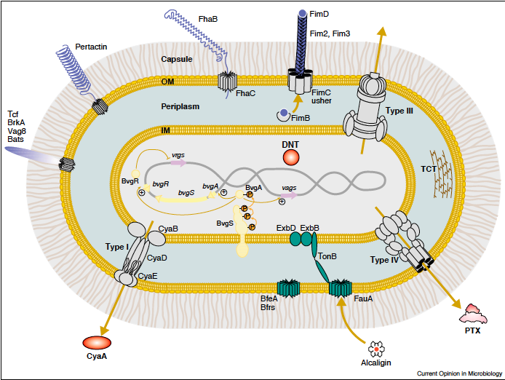
entry
B. pertussis enters through respiratory droplets and resides in the mucosa of the respiratory tract during infection
B. pertussis can alter its state depending on changes in the environment (persistent state).
They have toxins and adhesins acting as virulence factors that facilitate interactions with phagocytes and the infection progression.

Slide 10
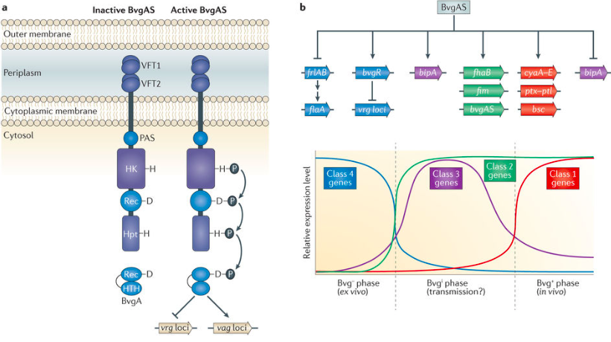
BvgA/S SYSTEM
BvgA and BvgS are members of a signal transduction system that are able to control phenotypic modulation and phase variation of the bacteria according to its environment.
BvgS: inner membrane protein that senses environmental cues. At optimal temp and in the absence of modulators, the sensor protein undergoes auto-phosphorylation.
BvgA is a transcriptional activator. Phosphorylation activates it and increases expression of virulence activated genes.
BvgR: a transcriptional regulator that represses virulence repressed genes
When conditions are not optimal, this system is inactivated.

Slide 11
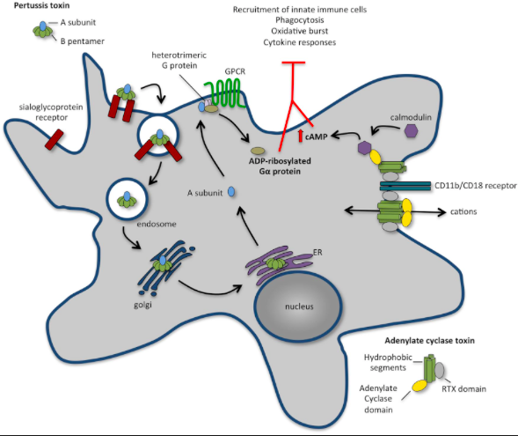
Toxins- 1
Pertussis toxin
Lymphocytosis promoting factor and an ADP-ribosylating AB5 type toxin
Toxin can bind any sialic acid glycoprotein and enters the cell via endocytosis.
Can inhibit adenylate cyclase activity and G protein enzyme regulated pathways causing an impaired immune response
Inhibits migration of neutrophils, monocytes and lymphocytes.

Slide 12
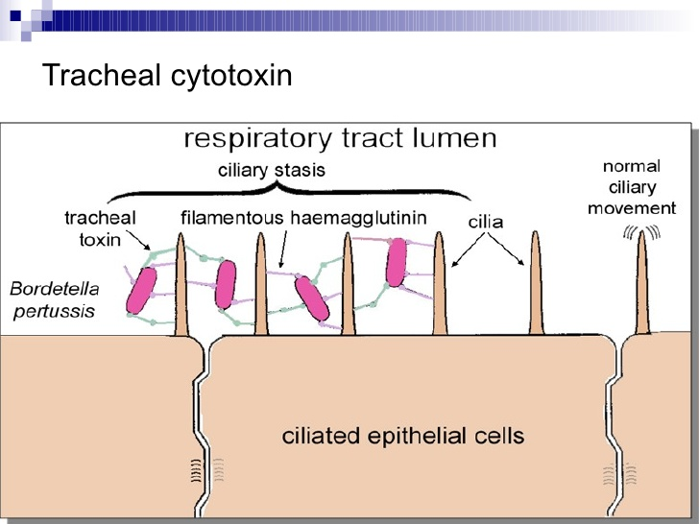
Toxins- 2
Tracheal cytotoxin
Fragment of Bordetella peptidoglycan.
Destroys ciliated epithelial cells in the respiratory tract, supporting attachment.
Cilia beating is prevented, making it difficult to clear debris from the respiratory tract causing coughing.
Inhibits DNA synthesis, therefore inducing production of IL-1 and nitric oxide.
Also causes mitochondrial damage, disruption to tight junctions, and cell blebbing.
ADENYLATE CYCLASE
Express hemolytic and calmodulin-dependent activities that mediate binding and internalization of toxins into cell.
Secretion of toxin depends on CyaB, CyaD, and CyaE.
Responsible for apoptosis and morphological cell changes.

Slide 13
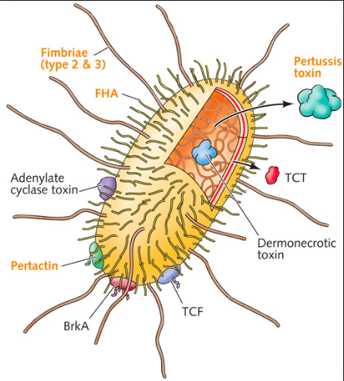
Adhesins
Filamentous hemagglutinin (FHA)
Creates filamentous structures on a cell surface and expresses 3 calcium, heparin, and integrin binding types.
Allows bacterium to bind various cells and extracellular structures in the respiratory tract.
Fimbriae
FimD subunit of the fibriae mediates binding to VLA-5 integrin, inducing upregulation of CR3.
Play a role in laryngeal mucosa infection.
Pertactin
Outer membrane autotransporter protein.
Mediates resistance to neutrophil mediated clearance therefore promoting persistence in the respiratory tract

Slide 14
3. Multiplication and spread
Does the organism remain extracellular or do they enter into cells and what are the molecular and cellular determinants of these events? Do the bacteria remain at the entry site or do they spread beyond the initial site i.e. are there secondary sites of infection and why do the bacteria hone in on these particular secondary sites?

Slide 15
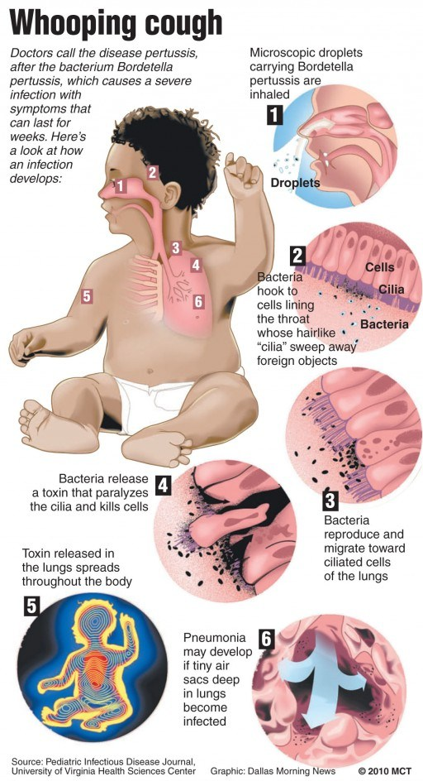
Extracellular pathogen that resides on external surface of ciliated mucous membranes in respiratory tract.
Rapidly divides within the first few weeks while adhered to the epithelial cells of the respiratory tract, spreading across mucous membranes.
Path: Nasopharynx→ Trachea → Bronchi → Bronchioles (lungs)
Virulence factors discussed previously, allow bacteria to survive and thrive in the respiratory tract.
Spread is localized to the respiratory tract (not systemic).
Growth phases:
Antigenically competent, smooth virulent phase I.
Intermediate phases II and III- mutations make them antigenically incomplete – unable to synthesize virulence factors.
Non-virulent, rough phase IV form
As they accumulates, they can produce a biofilm and exopolysaccharide matrix, making them resistant to host immune responses.

Slide 16
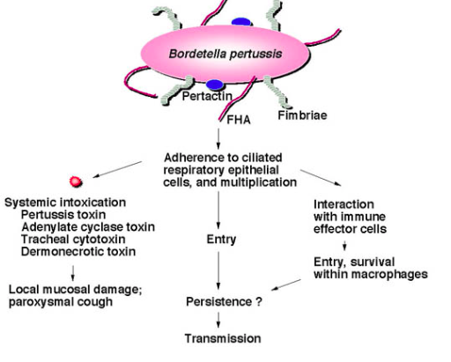
Recent findings
They can invade respiratory epithelial cells, alveolar and resident macrophages.
Host cytoskeleton rearranges to bring bacteria inside.
Internalization allows evasion of host response and antibiotics.
Surviving internalized bacteria enter Lysosome-Associated Membrane-Protein-1 negative compartments, avoiding degradation.
Also able to survive phagocytosis by macrophages.
They associate themselves within early endosomes, allowing survival and multiplication.
Able to recolonize respiratory tract after extracellular primary infection is cleared.

Slide 17
4. Bacterial damage
Do the bacteria cause any direct damage to the host (or is the damage fully attributable to the host response, as indicated below) and, if so, what is the nature of the bacterial damage? Can it be linked to any of the signs and symptoms in this case?

Slide 18
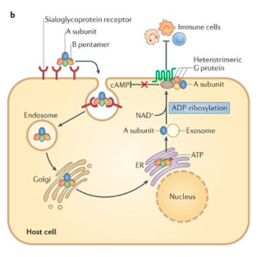
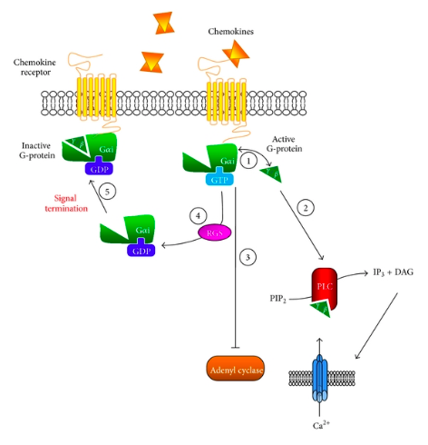
Pertussis Toxin
Secreted after bacterium adheres to epithelium, causing death of epithelial cells, a decrease in ciliary beating and accumulation of mucous and cell debris that trigger coughing.
PT enters host cell by receptor-mediated endocytosis and follows retrograde transport to the ER.
A subunit hijacks ER-associated degradation pathway to exit the ER and go to cytoplasm.
A subunit catalyzes transfer of ADP-ribose from NAD+ to G-proteins interfering with G protein activity, leading to dysregulation of immune responses.
Inhibits migration of cells expressing G protein coupled chemokine receptors, such as neutrophils, monocytes and lymphocytes.
Decreases pro-inflammatory chemokine and cytokine production
Decreases recruitment of neutrophils to the lungs and increased bacterial burden in early infection.
But at PT peak in infection there is increased inflammation and pathology in the airways.
Mediates leukocytosis with lymphocytosis and hyperinsulinemia.

Slide 19
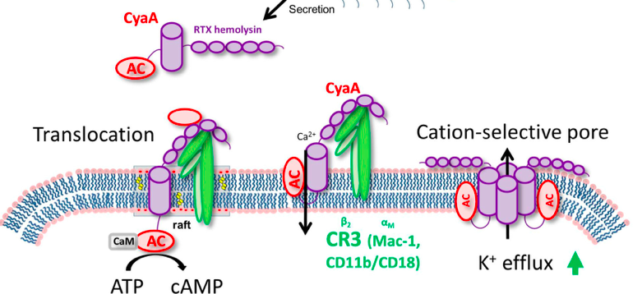
Adenylate cyclase toxin (ACT)
Secreted by the Type I secretion system
Its C-terminal RTX domain mediates binding to target cells, creating cation-selective pores in plasma membranes.
N-terminus domain is calmodulin dependent adenylate cyclase that converts ATP into cAMP.
Causes damage by adopting multiple conformations and are able to affect pore formation or adenylate cyclase translocation into host cells.
ACT affects are caused by a change in ion permeability and increased camp (causes incorrect downstream signaling), and depletion of intracellular ATP
Binds with high affinity to CR3, present on neutrophils, macrophages, and dendritic cells.
Blocks complement-dependent phagocytosis by macrophages.
Suppress activation and chemotaxis of t-cells.
Causes morphological changes in cells due to hemolytic activity.
Macrophage cytotoxicity from enzymatic activity and apoptosis causes tissue damage

Slide 20
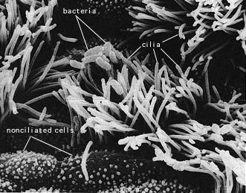
Tracheal cytotoxin (TCT)
Produced during cell wall remodeling.
Released into extracellular environment where it functions synergistically with LPS to stimulate production of pro-inflammatory cytokines and iNOS
Leads to destruction and extrusion of cilia from epithelial cells.
Inhibits DNA sysnthesis of hamster tracheal epithelial cell cultures, potentially leading to mucous accumulation and coughing.
Destruction of ciliated epithelial cells is caused by production of nitric oxide by non-ciliated, mucous secreting cells in response to TCT and LPS.
Increases body temperature through IL-1 stimulation.

Slide 21
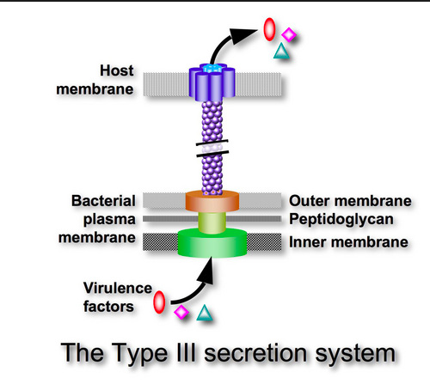
TYPE III SECRETION SYSTEMS (T3SS)
Induces necrotic cell death
Immunomodulatory function
Therefore induces huge respiratory cell damage and promotes persistence in lower respiratory tract
Helps translocated BteA- a key contributor to cytotoxicity.
DERMONECROTIC TOXIN (DNT)
Produces necrotic lesions.
Contributes to lung pathology and turbinate atrophy (destruction of particular nasal structure).
LIPOSACCHARIDE (LPS)
Sensed by TLR-4, resulting in early TNF-alpha response and recruitment of neutrophils to the lungs.
Damage to host arises due to pro-inflammatory cytokines, oxidative bursts, activation of complement, and IL1 leading to fever and hypotension.
CHRONIC COUGH
May cause decrease in oxygen to the brain which can cause severe consequences (especially in infants):
Encephalopathy
Brain Damage
Rupture of small and large blood vessels (hemorrhages)
Lung collapse
Increase intrathoracic pressure
Persistent cough may impair mucous clearance and lead to damage of alveoli leading to streptococci or pneumonia.

