Slide 1
Pathology 417 – Case 1:
Microbiology Laboratory
By: Hassan F. Sheriff

Slide 2
The Case
25-year-old Johnny has been eating raw eggs as part of his new body building diet. One week into his new diet, he develops a mild fever, severe abdominal cramps and watery diarrhea. After 4 days of diarrhea, he goes to a walk-in clinic where the doctor finds that Johnny is volume depleted and has some abdominal tenderness. She gives him a container to collect a stool sample to send to the Microbiology Laboratory and suggests that he stop eating the raw eggs. Johnny’s stool sample grows Salmonella serotype Enteriditis.

Slide 3
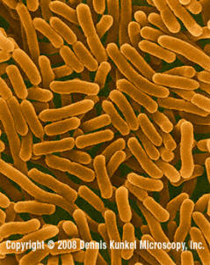
Salmonella enteritidis
Salmonella is a genus consisting of gram-negative, rod-shaped bacteria that are usually found in the intestinal tracts of animals.
Salmonella enteritidis infections usually present with diarrhea, fever, and abdominal cramps within 12 to 72 hours. These signs and symptoms usually resolve in 4 to 7 days.

Slide 4
What other bacterial pathogens are the most commonly associated with these signs and symptoms?

Slide 5
The Usual Suspects
Bacillus cereus
Campylobacter jejuni
Staphylococcus aureus

Slide 6
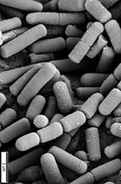
Bacillus cereus
Bacillus cereus is a species of gram-positive, rod-shaped, bacteria. It is capable of causing an emetic form of disease, with an incubation time of 1 to 6 hours. This causes vomiting and abdominal cramps.
Bacillus cereus infections can also cause a diarrheal form, which has an incubation time 8 to 16 hours. This form is usually associated with enterotoxins such as hemolysin BL, non-hemolytic enterotoxin, and enterotoxin E, causing diarrhea.

Slide 7
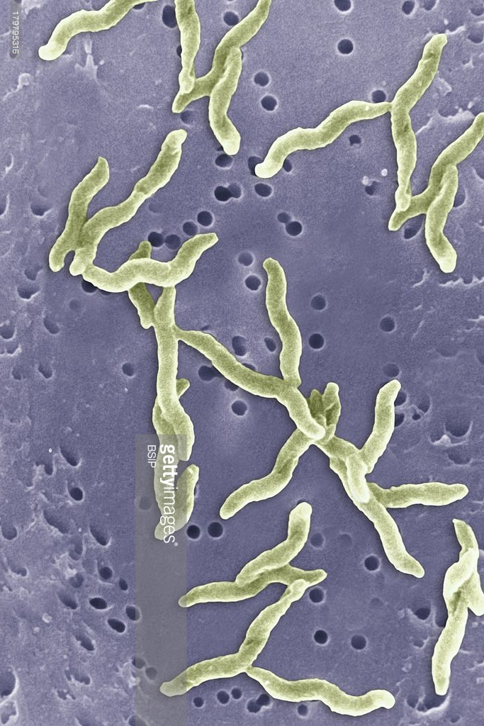
Campylobacter jejuni
Campylobacter jejuni is a species of gram-negative bacteria that is capable of causing food-borne infections. It can be found in chicken meat, eggs, and is capable of contaminating water.
Campylobacter jejuni infections can cause diarrhea, fever, cramping and abdominal pain, which can persist for up to a week.

Slide 8
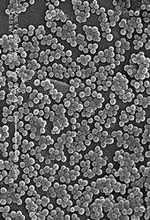
Staphylococcus aureus
Staphylococcus aureus is a species of gram-positive facultative anaerobe that is capable of causing food poisoning via the secretion of toxins.
The toxins produced by Staphylococcus aureus can cause illness 0.5 to 6 hours after ingestion, and can cause vomiting, nausea, diarrhea, and stomach cramps.

Slide 9
Other Possible Pathogens
Clostridium species
Escherichia coli
Listeria monocytogenes
Shigella species
Vibrio cholera
Yersinia species

Slide 10
What samples are taken for laboratory testing?

Slide 11
Samples to be Tested
To diagnose the pathogen responsible for the patients gastrointestinal signs and symptoms (watery diarrhea, and abdominal cramps and tenderness) a stool sample should be taken and analyzed.
As an intestinal is suspected, the stool sample is likely to contain the pathogen responsible for the patients illness.
Blood samples may also be taken if a blood infection is suspected.

Slide 12
The Importance of the Microbiology Lab
The patient’s symptoms are not specific to a single type of bacteria, and may even be caused by viral or fungal infections. This fact makes the microbiology lab very important.
Proper and effective treatment of the infection also requires a proper diagnosis of the pathogen, since different antibiotics are more effective at treating different pathogens. Also, some pathogens do not require medical intervention, while others do.

Slide 13
What tests will be performed on the samples?

Slide 14
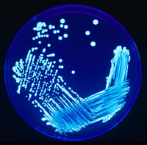
Plating
The stool sample can be diluted and then streaked onto multiple types of media:
  Blood agar
  MacConkey agar
  Eosin-Methylene Blue agar
  Bismuth Sulfite agar
  Salmonella-Shigella agar
  Brilliant Green agar
  Hektoen Enteric agar
  Xylose Lysine Deoxycholate agar

Slide 15
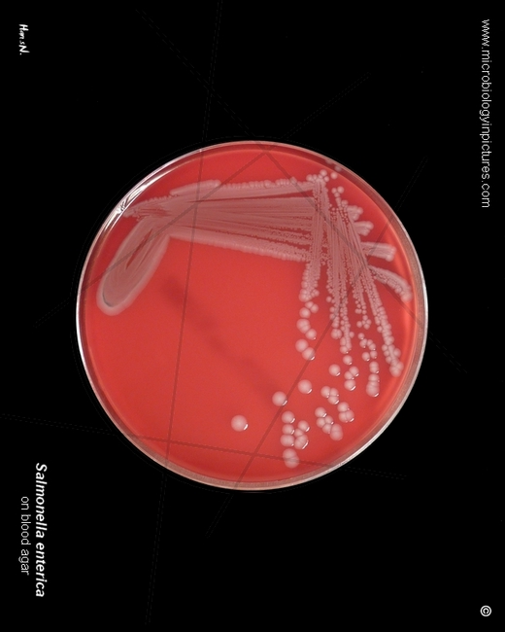
Blood Agar
When plated on Blood agar, Salmonella enteritidis produces γ-hemolytic (non-hemolytic) colonies.

Slide 16
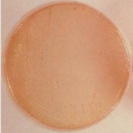
MacConkey Agar
When plated on MacConkey agar, Salmonella enteritidis produces colourless (non-lactose fermenting) colonies.

Slide 17
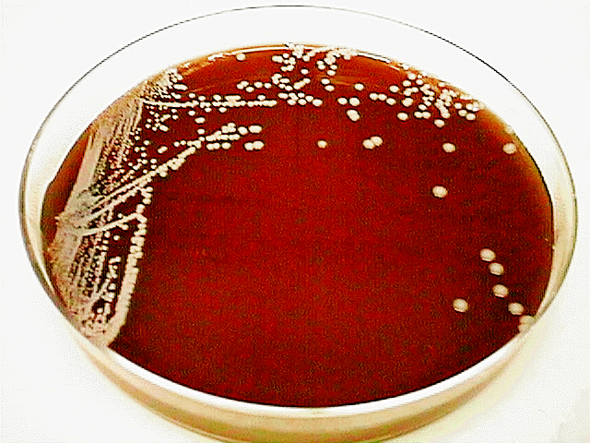
Eosin-Methylene Blue Agar
When plated on Eosin-Methylene Blue agar, Salmonella enteritidis produces colourless (non-lactose fermenting) colonies.

Slide 18
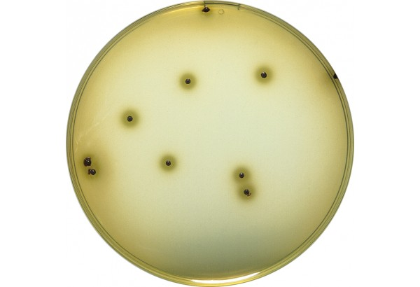
Bismuth Sulfite Agar
When plated on Bismuth Sulfite agar, Salmonella enteritidis produces black (hydrogen sulfide producing) colonies surrounded by black zones.

Slide 19
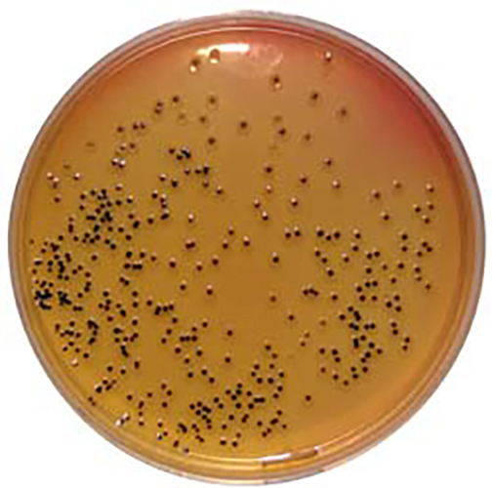
Salmonella-Shigella Agar
When plated on Salmonella-Shigella agar, Salmonella enteritidis produces produces colourless (non-lactose fermenting) colonies with black centres (due to hydrogen sulfide production).

Slide 20
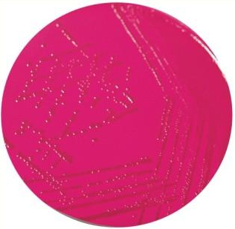
Brilliant Green Agar
When plated on Brilliant Green agar, Salmonella enteritidis produces red, pink, or white (non-lactose fermenting) colonies with reddish halos.

Slide 21
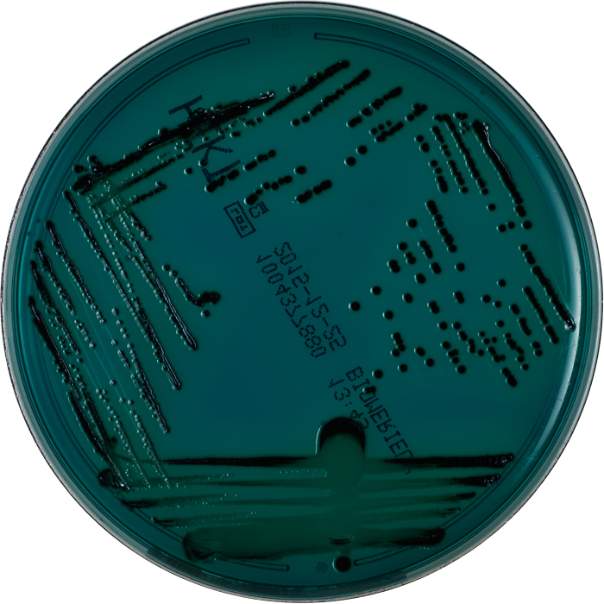
Hektoen Enteric Agar
When plated on Hektoen Enteric agar, Salmonella enteritidis produces blue to green (non-lactose fermenting) colonies with black precipitate (due to hydrogen sulfide production).

Slide 22
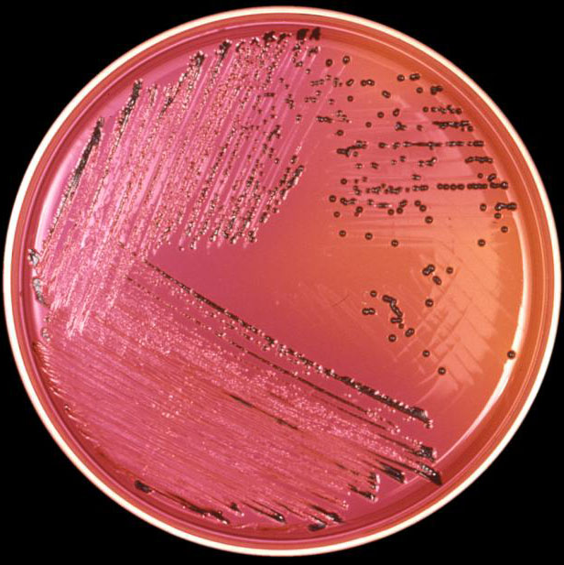
Xylose Lysine Deoxycholate Agar
When plated on Xylose Lysine Deoxycholate (XLD) agar, Salmonella enteritidis produces red (xylose fermenting) colonies with black centres (due to hydrogen sulfide production).

Slide 23
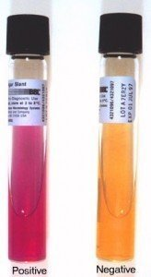
Other Tests
The stool sample can be diluted and the following tests can be performed:
  Triple Sugar Iron agar Slant test
  Indole Methyl Red Voges-Proskauer in Citrate test

Slide 24
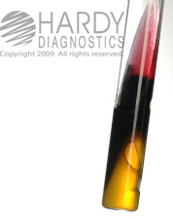
Triple Sugar Iron Agar Test
When inoculated into the Triple Sugar Iron (TSI) agar test, Salmonella enteritidis produces a red slant with a yellow bottom (due to non-lactose sugar fermentation), a blackened middle (due to hydrogen sulfide production), and the presence of a gas bubble (due to anaerobic metabolism).

Slide 25
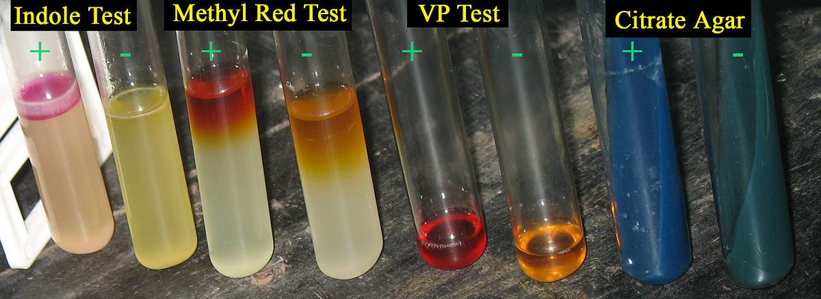
Indole Methyl Red Voges-Proskauer in Citrate Test
When inoculated into the different reagents of the Indole Methyl Red Voges-Proskauer in Citrate (IMViC) test, Salmonella enteritidis produces the following results:
  Indole test: Negative
  Methyl Red test: Positive
  Voges-Proskauer test: Negative
  in Citrate test: Positive

Slide 26
Serology
For systemic infections, blood samples can be tested for antibodies against Salmonella enteritidis.
Since Salmonella enteritidis usually causes a self-limiting illness, serological analyses are only required in extreme cases.

Slide 27
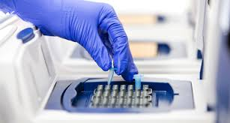
Polymerase Chain Reaction
Polymerase Chain Reaction (PCR) can be used to confirm or rule out the diagnosis of a Salmonella enteritidis only after the pathogen has been isolated.

Slide 28
Acknowledgement
Special thanks to Michaela Darjuan, Alex Hernandez, Jason Roth, and Sophia Sidi for their excellent job on the Microbiology Laboratory section of the wiki.

