Slide 1
Microbiology of Pneumonia
Chris Cheng
Case 3 week 3 summary

Slide 2
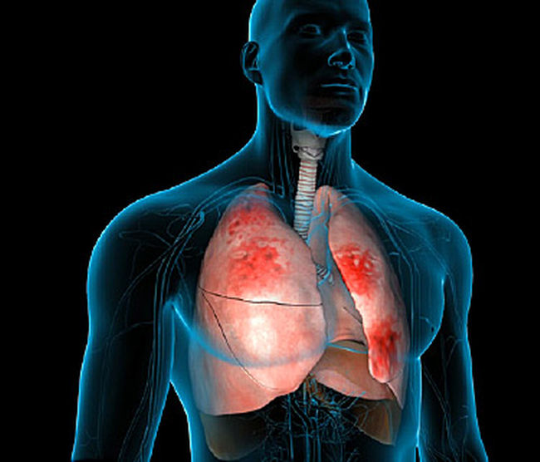
Pneumonia
Inflammatory infection of the lungs, primarily affecting alveoli
General symptoms:
Accumulation of fluid in lungs
Wet cough
Nausea
Fever
Chest pain
Confusion

Slide 3
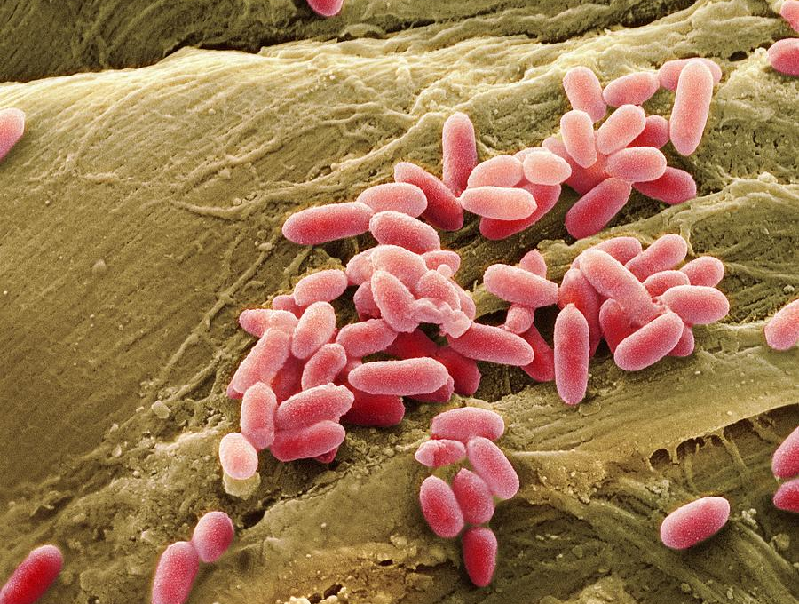
Common Associated Pathogens
Streptococcus pneumoniae
Staphylococcus aureus
Haemophilus influenza
Chlamydia pneumoniae
Pseudomonas aeruginosa
Mycoplasma pneumoniae
Legionella pneumophila
M. avium and M. intracellulare or M. Fortuitum

Slide 4
Common Associated Pathogens
Streptococcus pneumoniae
Staphylococcus aureus
Gram Positive Anaerobe
Enters lungs through inhalation or the bloodstream
Part of normal flora, only causes disease when patient becomes immunocompromised
Secretes pneumolysin which disrupts membrane integrity and leads to fluid accumulation in the lungs
Gram positive bacterium which can cause a wide variety of diseases
Extremely common hospital acquired infection
Leading cause of ventilator associated pneumonia

Slide 5
Common Associated Pathogens
Haemophilus influenza
Chlamydia pneumoniae
Gram negative anaerobe
Some serotypes are encapsulated while others are not
The capsule works by preventing phagocytosis
Can only establish infection when patients are immunocompromised
Gram negative intracellular bacterium
Spread through coughing or sneezing
Symptoms present 3-4 wks after infections
Allowing it to spread and multiply without alarming the host

Slide 6
Common Associated Pathogens
Pseudomonas aeruginosa
Mycoplasma pneumoniae
Gram Negative
Causes a variety of diseases in plants and animals
Thrive on warm and moist surfaces such as those found on medical equipment
Spread through contact with respiratory fluid
Symptoms start with coughing but can lead to brain, heart and kidney damage.
Bacteria can still persist after treatment

Slide 7
Common Associated Pathogens
Legionella pneumophila
M. avium and M. intracellulare or M. Fortuitum
Aerobic, gram negative bacteria found naturally in fresh water
Replicates within host macrophages
treated effectively with antibiotics such as tetracyclines, quinolines, and ketolides
Group mycobacteria which often establish infection in addition to one another
Commonly found in food, water and soil
Generally establish infection in immunocompromised host
Can infect the lungs, bones and intestines

Slide 8
Patients Clinical Presentation
Tom’s Symptoms
Sweating
Unproductive cough
Headache
Muscle aches
Nausea
High Fever

Slide 9
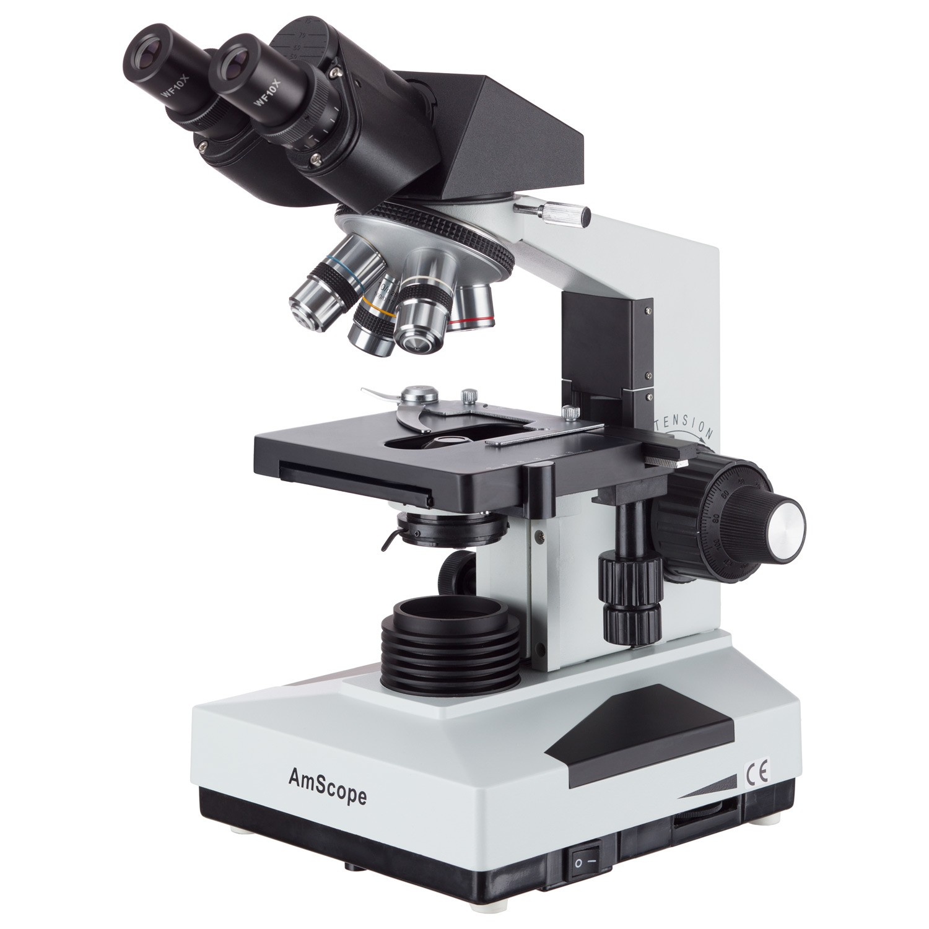
Importance of Microbiology Lab
There are several bacterial, viral and fungal causes of pneumonia
Each type will require a different method of treatment
By determining the specific cause of infection, doctors can come up with the best treatment plan for patients

Slide 10
Samples for Microbiology Lab
Lower Respiratory Tract Secretions: collect sample of sputum or bronchoalveolar lavage for analysis,
Lung Aspirates: Needle is inserted into the rib area and aspirates are suctioned in for 2-3 seconds
Pleural Fluid: Collection of fluid outside of the lungs in the pleural space
Blood: Clinicians can use blood samples to identify the serotype and inform doctors of the best treatment options
Urine: can be used for antigen detection
Exhaled breath condensate: effectiveness is still under investigation but some studies show that there may be possible diagnostic capabilities of this test

Slide 11
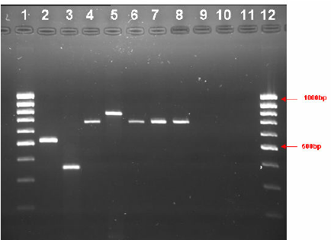
Tests that may be done on samples
Culture:
Gold Standard for legionella diagnosis
PCR, Gel electrophoresis and Sequencing
Amplifies the bacteria's genome
Direct Fluorescent Antibody
Samples are incubated with an antigen that contains a fluorescent dye to help identify the bacteria
Urinary Agent Test
EIA/ELISA
Serological Testing and Antibody Based Assays
Indirect fluorescent antibody which detects immunoglobulin IgG, IgM and IgA antibodies

Slide 12
Expected Test Results
Culture
Cultures will generally be 0.5 – 1 mm in diameter, smooth, glistening, and convex. Majority of colonies are white but can also be blue, green, or red
PCR, Gel electrophoresis and Sequencing
Compare DNA fragment sizes of a known size against the DNA ladder
Direct Fluorescent Antibody
Illumination of sample with fluorescent antibody yields a positive result
Urinary Agent Test
A LFA test strip card will present with two pink-purple coloured lines, indicating that antigen was detected
Serological Testing and Antibody Based Assays
Plate reading will give a higher fluorescence level due to presence of antibodies

