Slide 1
CASE 4 Bacterial Pathogenesis of Staphylococcus aureus
PATH 417A Karen Lin
April 6th, 2018

Slide 2
CASE 4 – A NEW BABY
Elizabeth’s pregnancy and the birth of Amanda had gone well however, Elizabeth and Amanda were now struggling with breastfeeding. Elizabeth was aware from her prenatal classes of the various reasons why breastfeeding might be difficult. On the advice of a friend she made arrangements for a lactation consultant to visit her at home. She continued trying to ‘latch’ and feed Amanda in the days leading up to the visit but stopped when she began to experience breast pain and noticed that her right breast was red all around the nipple. She was feeling stressed and tired, along with a feeling of general malaise that she attributed to the stress associated with trying to breastfeed her newborn baby.
Based on Elizabeth’s symptoms, the lactation consultant made a preliminary diagnosis of mastitis and suggested that Elizabeth see her doctor for a full diagnosis and possible antibiotic treatment. Do the symptoms that Elizabeth is experiencing concur with the preliminary diagnosis? What is the most likely bacterial cause and what are the antibiotics of choice to treat it?

Slide 3
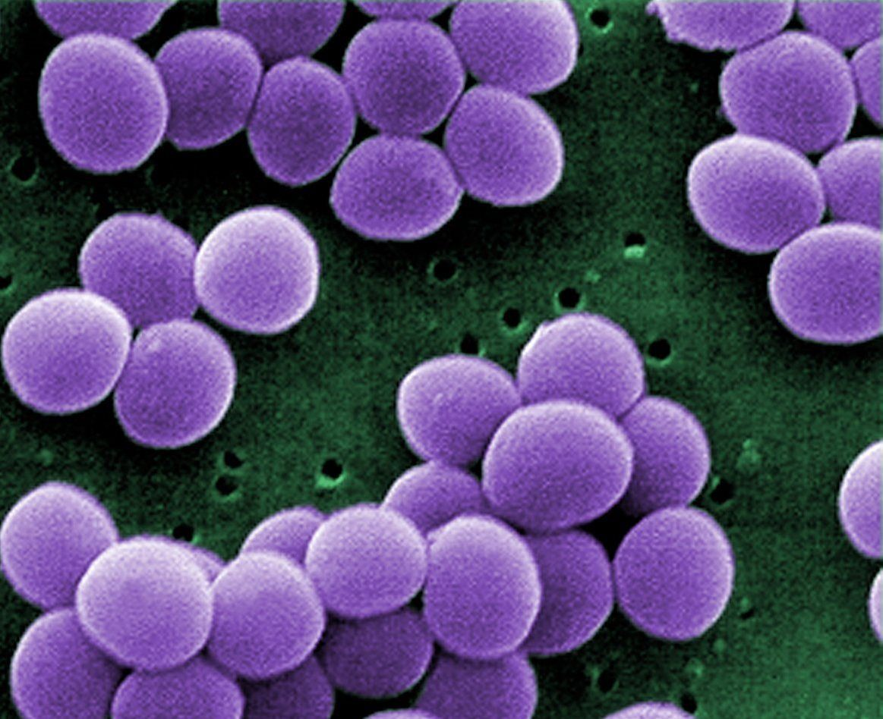
QUESTION 1 Encounter: where does the organism normally reside, geographically and host wise?
Staphylococcus aureus are gram positive, aerobic, cocci-shaped organisms. This pathogen is normally found on human surfaces, but can induce an infection in immunocompromised individuals. They are also found on a variety of environmental surfaces.
Human
Skin, mucous membranes of nasal passage, axillae
Environment
Drinking water supplies, food manufacturing environments, hospital environments
Staphylococcus aureus

Slide 4
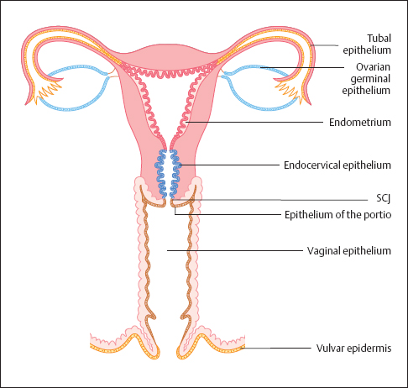
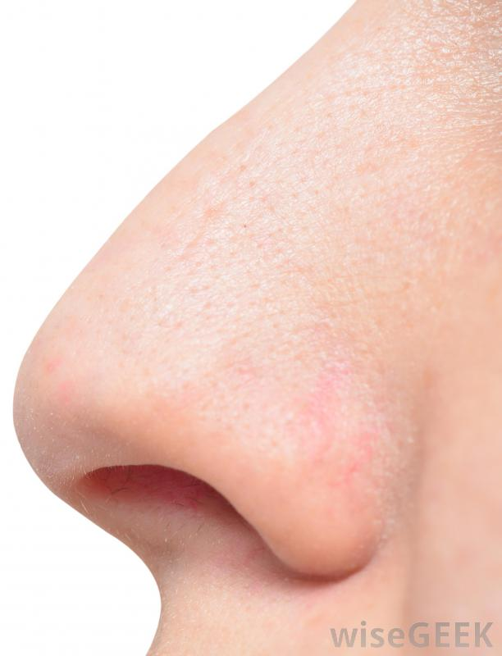
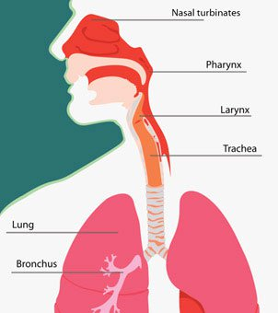
QUESTION 1 What are the bacterial characteristics that leave it suited to these places of residence?
Staphylococcus aureus commonly found in…
Nasal passage
2. Inanimate objects
3. Respiratory
tract
4. Human milk microbiota
5. Vaginal tract

Slide 5
QUESTION 1 What are the bacterial characteristics that leave it suited to these places of residence?
Staphylokinase & Membrane Lipid Modification Proteins
Allow S. aureus to evade nasal antimicrobial peptides such as defensins and cathelicidins
Peptidoglycan-specific O-acetyltransferase
Allows S. aureus to be lysozyme resistant
Protein A
Inactivates antibodies by binding the Fc region
Biofilm
Protective reservoir for S. aureus
Forms in response to release of bacterial signaling molecules via quorum sensing process
Characteristics of Staphylococcus aureus that allow for evasion of host immunity and colonization
Microbial Surface Components Recognizing Adhesive Matrix Molecules (MSCRAMMs)
Bind host fibronectin, fibrinogen, and collagen-related polysaccharides
Lipase & Glycerol Ester Hydrolase
Degrade skin lipids
Fibronectin Binding Proteins
Allow S. aureus to colonize skin and mucosal surfaces
Adhesins & Cell Wall Teichoic Acid
Help adhere to nasal epithelia

Slide 6
QUESTION 1 How would our patient have come in contact with this bacteria?
Direct Human Contact
As S. aureus are naturally located on the skin surface, lesions in the skin could permit S. aureus to enter the milk duct, for instance, and establish an infection
Other Animals or Food Products
S. Aureus may contaminate meat or dairy products, causing food poisoning in humans due to pathogenic enterotoxins
Hospital Environment
S. aureus may inhabit within biofilms on medical devices
Milk Pumps
Non-sterilized milk pumps may harbor S. aureus and act as transmission vehicles

Slide 7
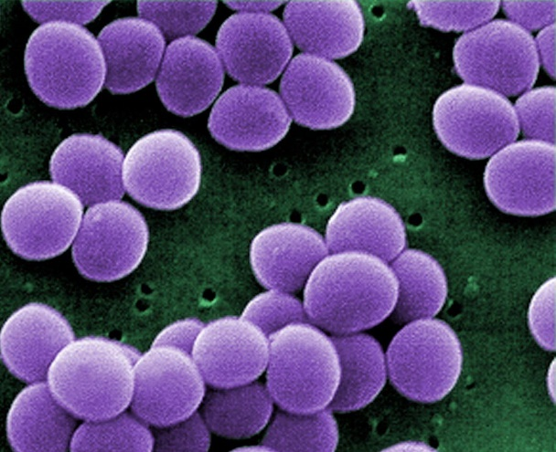
QUESTION 2 Entry: what facilitates the entry of the bacteria into the human host? What are the molecular, cellular and/or physiological factors at play in the initial entry/adherence step from the point of view of the organism and the host
S. aureus likely entered the mother through a lesion in her nipple due to infant suckling. The source of S. aureus may be the pre-existing commensal flora already present on the mother’s skin
Adhesins
Contain 3 domains: bacterial-surface binding domain, membrane-spanning domain, extracellular binding domain
Fibronectin-Binding Proteins (FnBPs)
Bind host fibronectin on epithelial cells in the extracellular matrix, allowing for colonization
Facilitate binding to host collagen, epithelium
Quorum Sensing via Accessory Gene Regulator (agr)
Promotes adhesin production
Promotes FnBP production
Promotes ∂-hemolysin for erythrocyte lysis
Properties of S. aureus that facilitated host entry and colonization

Slide 8
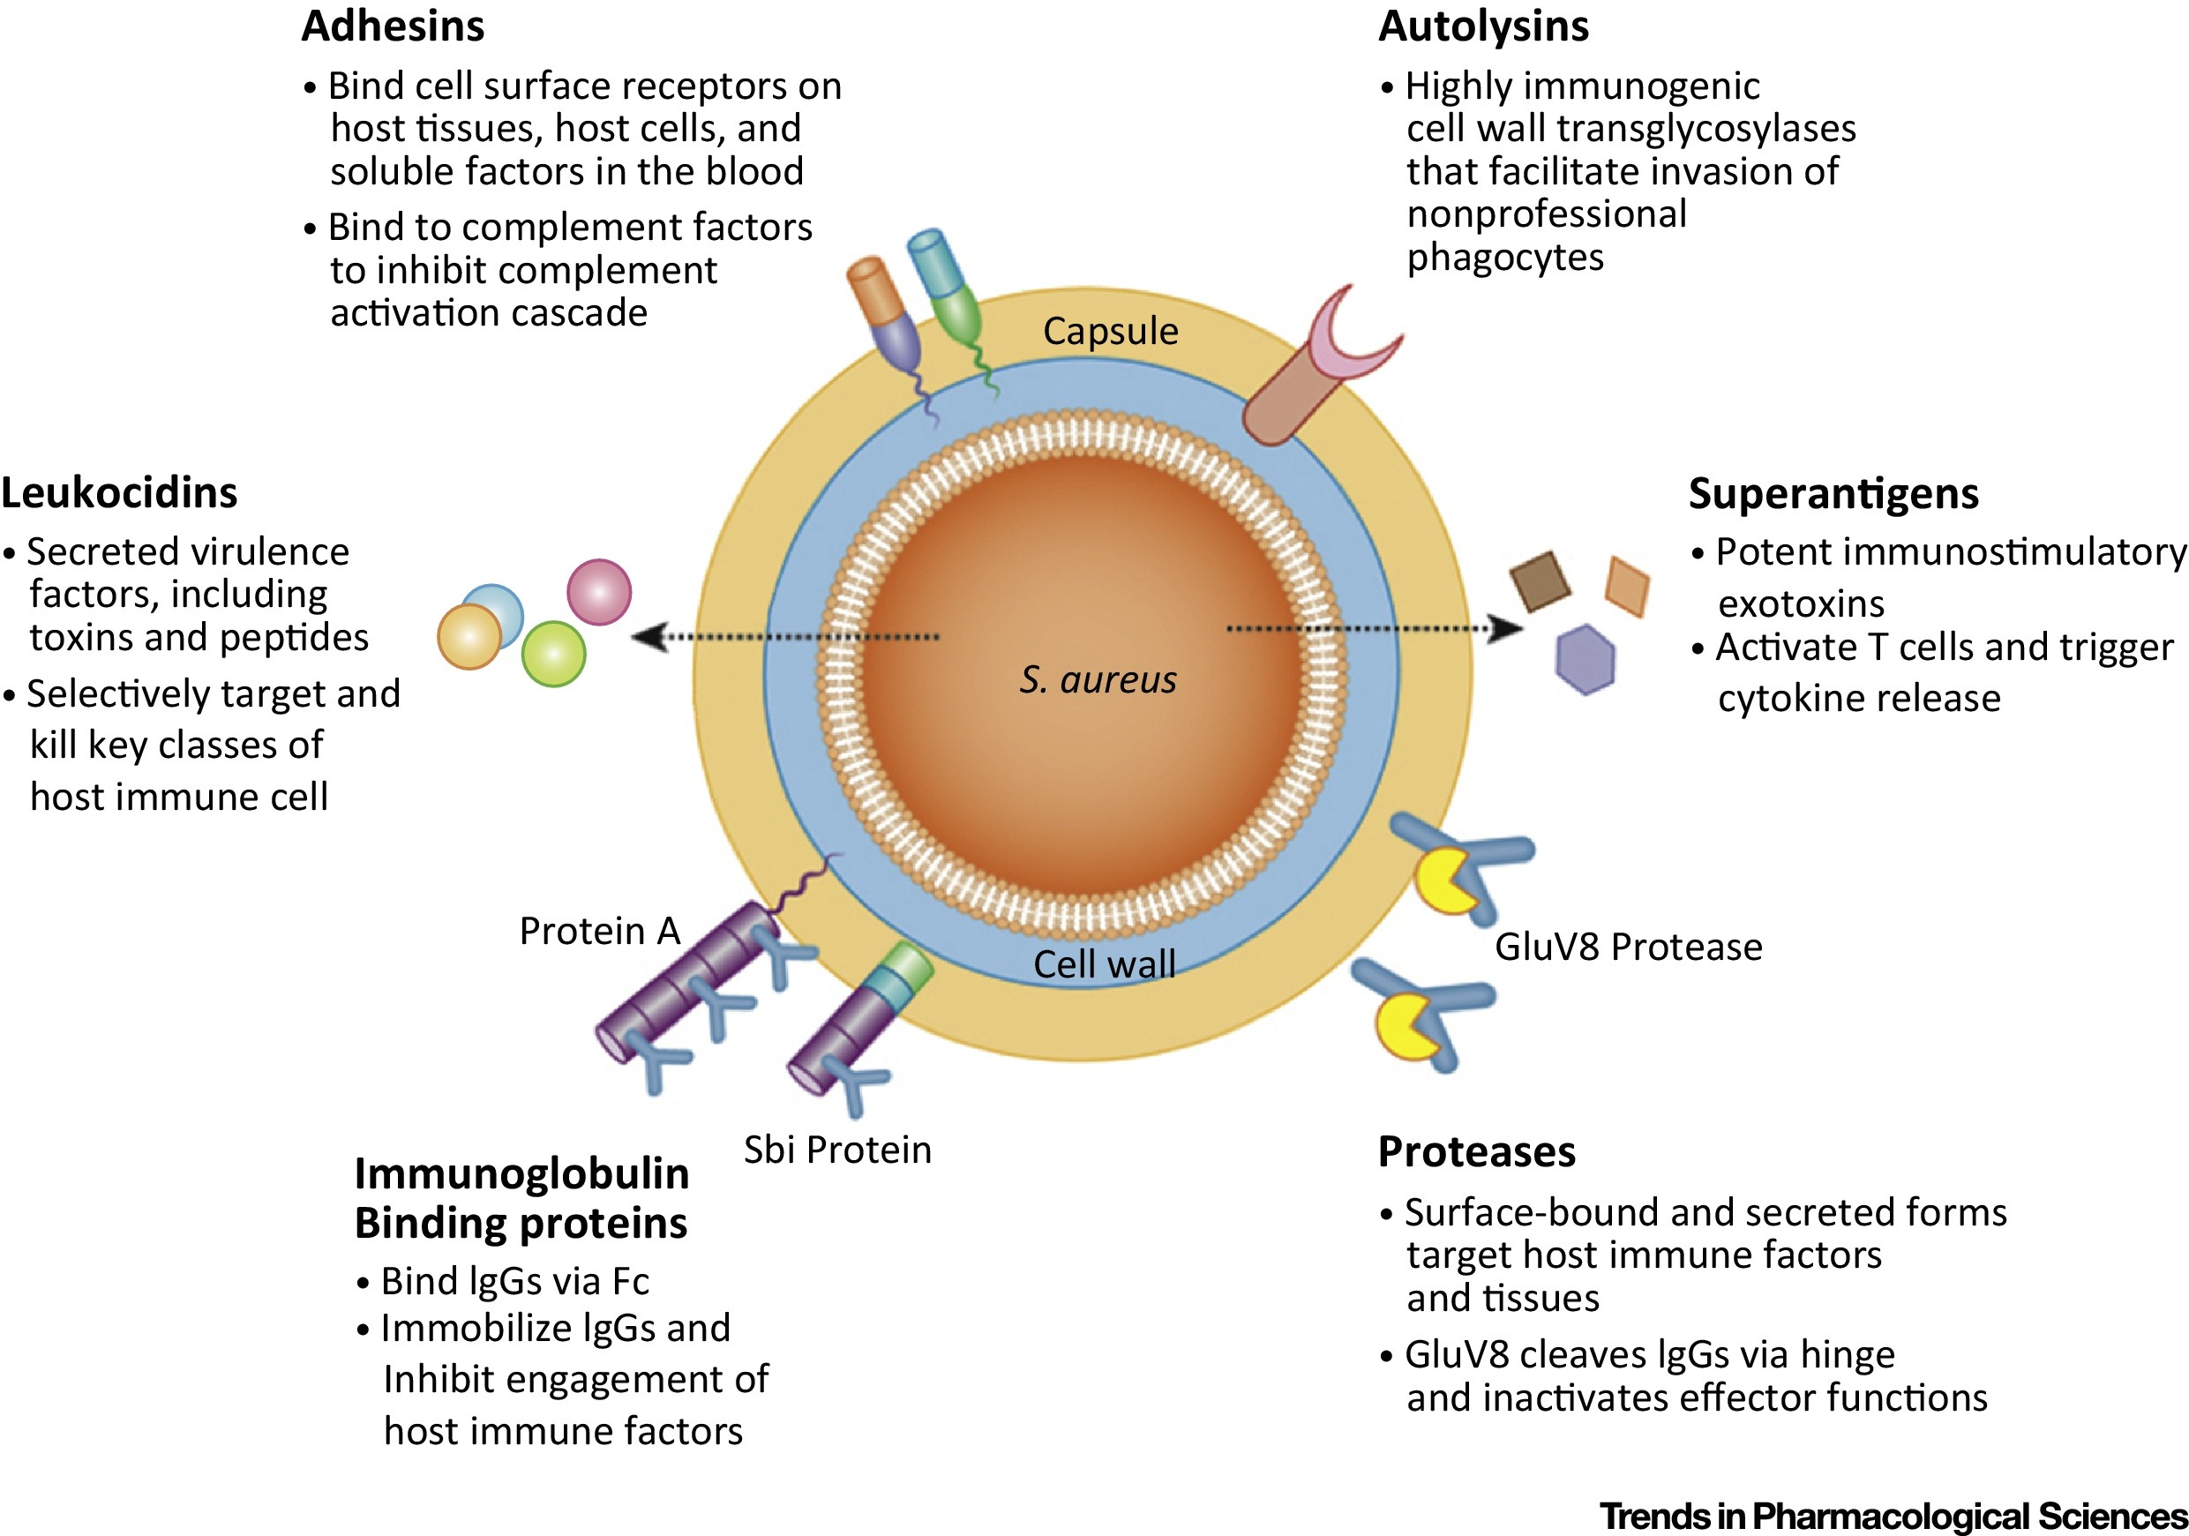
QUESTION 2 Entry: what facilitates the entry of the bacteria into the human host? What are the molecular, cellular and/or physiological factors at play in the initial entry/adherence step from the point of view of the organism and the host

Slide 9
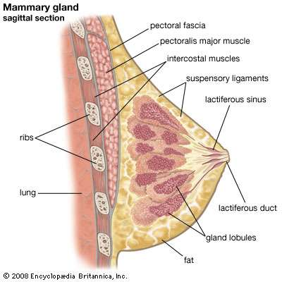
QUESTION 2 Entry: what facilitates the entry of the bacteria into the human host? What are the molecular, cellular and/or physiological factors at play in the initial entry/adherence step from the point of view of the organism and the host
S. aureus likely entered the mother through a lesion in her nipple due to infant suckling. The source of S. aureus may be the pre-existing commensal flora already present on the mother’s skin
Antimicrobial Peptides (AMPs)
Component of innate immune system
Prevent S. aureus adherence and colonization onto host cells
Due to its cationic nature, they bind bacteria’s anionic surface structures (e.g. lipopolysaccharide) and prevent bacterial adherence
Some AMPs can form pores in the bacterial cell membrane, causing lysis
Involved in cell signaling to activate T cells and dendritic cells of the adaptive immune system
Properties of humans that prevent S. aureus entry and colonization

Slide 10
QUESTION 3 Multiplication and Spread: does the organism remain extracellular or do they enter into cells and what are the molecular and cellular determinants of these events?
Staphylococcus aureus remain extracellular
Bacterial Replication
Establish severe infection in host
Biofilm Formation
Induce host phagocytosis attenuation
Express virulence factors to evade immune defenses
Provide antibiotic resistance
Induce anti-inflammatory cytokine release

Slide 11
Question 3 Multiplication and Spread: does the organism remain extracellular or do they enter into cells and what are the molecular and cellular determinants of these events?
Leukocidin
- Pore-forming toxin that acts on PMN leukocytes such as neutrophils
Microcapsule
- Capsule composed of serotype 5 or 7 surface polysaccharides
- Capsule allows evasion of host immune cells
Protein A
- Binds host Fc receptor of IgG antibody, avoiding opsonization
Staphyloxanthin
- Pigment with antioxidative properties
- Facilitates evasion of bacterial death by reactive oxidative species
Biofilm
- Extracellular matrix within which bacterial replication occurs
- Enables resistance to host phagocytosis
PIA/PNAG and Poly γ-glutamic Acid
- Surface anionic, extracellular polymers
- Inhibit phagocytosis
SepA Protease
- Degrades host bactericidal AMP
- Eliminate host neutrophils
Alpha-Hemolysin
- Membrane-damaging toxin via formation of pore, and leads to cell lysis
- Mediate bacterial spreading
Phenol Soluble Modulins
- Proinflammatory cytolysins
- Trigger biofilm detachment to travel to secondary infection sites
How does S. aureus evade the host immune response and safely replicate/spread in the extracellular environment?

Slide 12
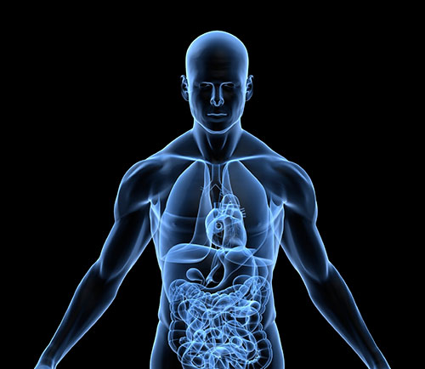
Question 3 Do the bacteria remain at the entry site or do they spread beyond the initial site? Are there secondary sites of infection and why do the bacteria hone in on these particular secondary sites?
S. aureus are able to travel beyond the initial site of infection and establish at secondary sites elsewhere in the body. Although rare, untreated lactational mastitis can progress into a systemic infection
Phenol soluble modulins facilitate the detachment of biofilms, allowing the bacterial to travel to secondary sites
Mechanical fluid forces allow for bacteria to travel from one site to the next
Membrane damaging toxins can lyse deep into host tissues, allowing the bacteria to penetrate into the bloodstream, and establish an infection at other sites within the body
Lactational mastitis
Systemic infection

Slide 13
Question 4: Bacterial Damage: do the bacteria cause any direct damage to the host, or is the damage fully attributable to the host response? If so, what is the nature of the bacterial damage? Can it be linked to any of the signs and symptoms in this case?
Protein A (SpA) and Staphylococcal binding immunoglobulin protein (Sbi) bind IgG, disrupting phagocytosis
Tumor Necrosis Factor-Alpha 1 (TNFR1) signaling
Pro-inflammatory chemokine release at injury site
Increased vasodilation, blood flow, and permeability at infection site
Nipple redness and breast pain
1.
Membrane-damaging toxins (alpha-toxin, beta-toxin, leukocidins) form porse in host membrane
Cell leakage of molecules and metabolites
Electrochemical and osmotic gradients of cell are lost
Impaired membrane integrity
Cell apoptosis
Host cell and tissue death
2.

Slide 14
Question 4: Bacterial Damage: do the bacteria cause any direct damage to the host, or is the damage fully attributable to the host response? If so, what is the nature of the bacterial damage? Can it be linked to any of the signs and symptoms in this case?
Bacterial protease, lipase, DNAse, fatty acid modifying enzymes activation
Disrupt host signaling pathways
Induce damage to host molecules
3.
Enterotoxins and toxic shock syndrome toxin (TSST-1)
T cell activation without antigen recognition
Cytokine release
IL-1, IL-2, TNF-alpha release
Host fatality
4.

