Slide 1
Body Systems – P aeruginosa infection
Kendrew Leung

Slide 2
Case
A House Fire
Rescued from a house fire Marian is hospitalized with second degree burns extending deep into the dermis layers in her upper limbs. After three days in hospital during which time she has regular changes of her wound dressings, she is released home to the care of her sister who expresses confidence in her ability to maintain the needed dressing changes. With a keen interest in natural remedies Marian and her sister treat her burn wounds with honey. A few days later Marian begins to experience pain associated with her burns and notices that they seem to be producing more fluid than before. After a bad nights sleep her sister takes her back to the hospital where the doctor notes that one of the wounds is expressing pus. A swab of the pus is sent to the laboratory and Marian is again hospitalized. The laboratory grows Pseudomonas aeruginosa from the wound and Marian is started on antibiotics.

Slide 3
Signs vs Symptoms
Signs:
objective characteristics usually noted/detected by a healthcare professional
Symptoms
subjective characteristics experienced by the patient

Slide 4
Signs and Symptoms
Signs | Symptoms
Excess fluid excretion – Burn exudate | Pain – at burn site and infection site
Pus - buildup of dead white blood cells | Insomnia - secondary to infectious symptoms such pain and discomfort

Slide 5
Body System – Integumentary System
Integumentary System:
Skin, hair, nails, sebaceous and sweat glands
Integumentary system functions to maintain:
Homeostasis
Thermoregulation
Transmission of sensation (touch, position, pain, temperature)
Protection/barrier to pathogens and injury

Slide 6
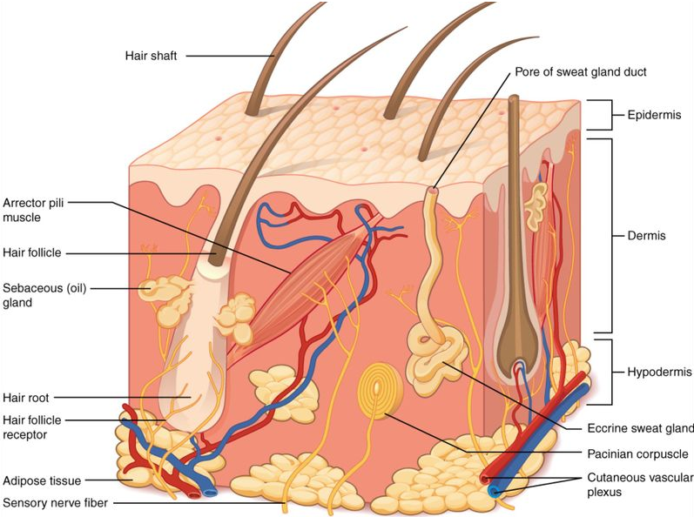
Integumentary System - Components
Epidermis
Outermost layer
Primary barrier to external stimuli and pathogens
Contains host response cells e.g. epithelial cells, keratinocytes, Langerhans cells
Dermis
Below epidermis
Contain nerve endings, lymphatic and blood vessels
Important for innate immunity – contain mast cells, macrophages

Slide 7
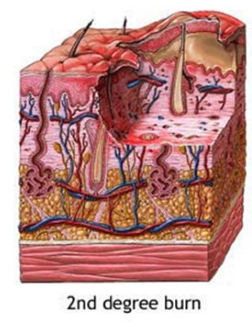
Disturbance to the integumentary system: Burns
Deep second-degree burns destroy epidermis
Which acts as a primary barrier to pathogens
Loss of Langerhans cells – dampened immune response
Risk of P aeruginosa colonization increases
Compromised blood flow
Delayed healing and increased risk of bacterial infections

Slide 8
Disturbance to the immune system: Burns
Innate Immune:
Diminished activation and activity of macrophages & natural killer cells (NKC)
Complement Cascade
May depress alternative pathway
Leads to excessive C3a & C5a → alters blood pressure and leukocyte functions
T-cell lymphocytes
Significant reduction of T-cell proliferation & functions
Notably, there is marked reduction of CD4+ T-helper cells
Other effects
May lead to immunosuppressive factors against cell-mediated immune activity
Reduced IgG

Slide 9
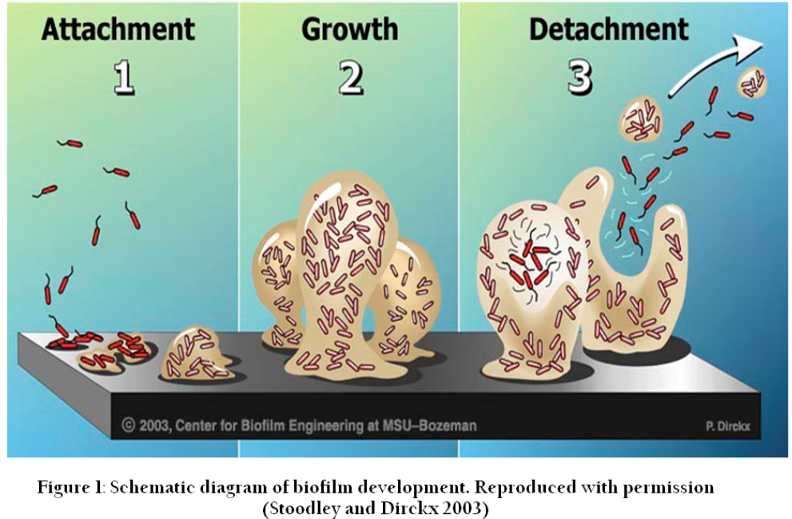
Disturbance to the immune & integumentary system: Infection
Biofilm formation:
Provides protection against immune system → Reduced phagocytosis & oxidative response
Prevents healing of skin
Prolongs inflammation of tissues

Slide 10
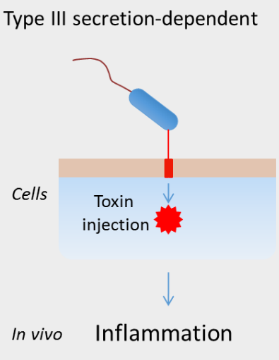
Disturbance to the immune & integumentary system: Infection
Toxins
Exotoxin pyocyanin causes apoptosis in phagocytic neutrophils, epithelial cells, fibroblasts and lymphocytes
ExoU effector protein slows healing and induces lysis in macrophages, epithelial cells and fibroblasts
Exo A triggers cell-death via ADP-ribosylation

Slide 11
Management of the infection
Antibiotics:
Antimicrobials that inhibit or interfere with bacterial cell growth
Different classes have characteristic molecular targets and different mechanisms of action
Common microbial targets
Cell wall
Cell membrane
Ribosome
DNA, RNA
Metabolic enzymatic biochemical pathways
*Resistance may develop when specific mutations that prevent antibiotics from acting on molecular target occur

Slide 12
Process of infection treatment
Culturing to determine offending pathogen
Biopsy
Evaluate drug sensitivity to determine suitable antibiotics for treatment

Slide 13
Empirical treatment for P aeruginosa
Agent options | Use
Cefazolin or clindamycin | Gram-positive coverage
Vancomycin | MRSA coverage
(vancomycin) +/- fluoroquinolone | Gram-negative and pseudomonas coverage
*As bacterial resistance becomes more common, treatment with antibiotics get more challenging. Certain infections may require combination therapy to treat. This involves the use of beta-lactam antibiotics with an aminoglycoside or fluoroquinolone

Slide 14
Antibiotic Mechanisms
Beta-lactams | Targets penicillin-binding proteins anchored in bacterial cell wall membrane and inhibits cross-linking of for cell wall synthesis
Aminoglycosides | Binds bacterial ribosomes and prevent genomic translation into proteins. Consequently blocks cell growth
Fluoroquinolones | Targets DNA gyrase enzyme at replication fork which Is responsible for unwinding DNA strands for replication. Results in inhibition of bacterial reproduction.

Slide 15
Antibiotic Resistance Mechanisms
Cell wall:
Physical barrier that may prevent large antibiotics from crossing into the cell
Efflux Pumps
Outer-membrane structures that use active transport to remove antibiotics from cell
Modification/inactivation:
Production of B-lactamases that break down core B-lactam ring in antibiotics and inactivating them
Biofilm formation
Using quorum sensing, bacteria may aggregate and form firm colonies that become very difficult to kill

Slide 16
Alternative therapies for burns
General treatment:
Remove all blisters and debris
Wash wounds and cover with antimicrobial dressing
Redress daily or twice daily
Replication of topical agents

Slide 17
Alternative therapies for burns
Occlusive dressings
Apply on fresh, clean burn wounds to speed up healing and prevent infections
Maintains moist environment which aids in healing and reduces pain
Most products have collagen infrastructure that helps the adherence of dressing to the wound to prevent it from falling off

Slide 18
Alternative therapies for burns
Surgery –debridement, grafts, splints
Considered for 3rd degree burns or when there is no rapid healing
Debridement: Removal or necrotic tissues to expose underlying viable tissues for healing
Grafts: Removing skin from one area of body to a different area (burn site)
Grafts from human donors are initial accepted by subsequently rejected 10-14 days later due to immunity
Cultured epidermal grafts are costly, fragile and takes 3-4 weeks to create. Often these are used in combination with other types of grafts

Slide 19
Alternative therapies for burns
Prevention of scarring
Main goal of burn treatment
Susceptible population: children, people of color, in areas of motion
Pressure garments of 25mm pressure in combination of silicone sheets can help
Pressure is theorized to induce hypoxia to media tissue atrophy and initiate press-induced tissue remodelling

Slide 20
Alternative therapies for burns
Curcumin
Herbal alternative with anti-inflammatory effects
Reduces wound size and inflammation at burn site
Those treated with curcumin have notably higher fibroblasts, macrophages and myofibroblasts for healing

Slide 21
Alternative therapies for burns
Hydrogel
Provides continuous burn wound area cooling
Used in pre-hospital setting or when en route to hospital for treatment
Unclear clinical effectiveness and indefinitive conclusions for its use

Slide 22
Alternative therapies for burns
Moist exposed burn ointment (MEBO)
Contains plant steroids and berberine oil
Allows burn wounds to retain moisture and promotes keratinocyte redistribution more rapidly --> more rapid healing
Provides pain relief

Slide 23
Alternative therapies for burns
Vitamin D
Shown to increase healing rates
Helps modulate genes that increase cathelicidin production → antimicrobial peptide

Slide 24
Alternative therapies for burns
Chlorhexidine
Cationic biguanide
Causes bacterial cell wall leakage by adhering to its surface
Depending on concentration, effects may be bactericidal or bacteriostatic

Slide 25
Alternative therapies for burns
Quaternary ammonium
Skin antiseptic
Controls P aeruginosa infection from spreading
Induces cell leakage and damages to bacterial membrane
Has been observed to have reducing effects due to P aeruginosa rapidly adapting and resistance development

Slide 26
Alternative therapies for burns
Betadine
Povidone-iodine
Broad coverage of bacteria
Gradually releases free iodine from povidone-iodine complex which kills cells

Slide 27
Alternative therapies for burns
Hydrogen Peroxide
Used to prevent infections on burn wounds
However it delays wound healing through disruption of capillary formation and is toxic to fibroblasts

Slide 28
Alternative therapies for burns
Acetic acid
Prevents burn wound infections by gram-negative bacteria
Delays wound healing
Changes pH in microenvironment which disrupts bacterial metabolism

Slide 29
Alternative therapies for burns
Aloe Vera gel
Anti-inflammatory, antioxidant effects, modulates immune compounds and stimulates cell growth
Contains many active compounds within product
Many P aeruginosa strains are susceptible to aloe Vera
Clinical significant is inconclusive

Slide 30
Alternative therapies for burns
Silver nitrate
Inhibits bacterial growth and prevents wound infections
Silver interacts with thiol groups used in bacterial respiration
Activity restricted to wound surface

Slide 31
Alternative therapies for burns
Green tea extract
Antibacterial activity comparable to standard antibiotics
Contain antibacterial components
May work synergistically with B-lactam antibiotics to increase effectiveness

Slide 32
Alternative therapies for burns
Honey
High osmolality gives broad antibacterial activity
High sugar concentration, low pH and generation of hydrogen peroxides also contribute
Shown benefits against P aeruginosa

Slide 33
Alternative therapies for burns
Other options
Gauze
Hydrocolloids
Alginates
Foams
Stem-cell application
Tilapia skin
Maggot therapy
Papaya topical

