Slide 1
Bacterial Pathogenesis
Case 4 Summary
Created by Christy Hui

Slide 2
Foodborne Pathogens
Foodborne pathogens enter the human host by consumption of contaminated food-products
Due to shedding of bacteria in animal feces
Colonization and invasion of digestive mucosal lining requires the bypass of the acidic environment and mucosal surface
The mucosa is comprised of three layers: epithelium, lamina propria, and a thin layer of smooth muscles
Bacteria produces proteases that target host mucins that are responsible for limiting colonization and invasion of foreign pathogens
They may also use locomotive structures such as the flagellum or be resistant to antimicrobial products
Utilize and outcompete host cells for resources within the intestinal lumen
Many bacteria replicate intracellularly, thus host cell invasion is a key component of inducing virulence factors.
Some employ adhesion mechanisms such as adhesins, pili, biofilm formation
Biofilms form a protected micro-environment against harsh conditions, they allow growth and replication of bacteria which overtime can become more resistant to host defence mechanism and antibiotics

Slide 3
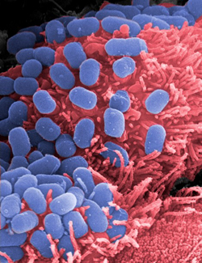
Escherichia coli O157:H7
Gram negative, rod shaped facultative anaerobe
Colonizes the intestinal tract of humans and animals
Commonly found all over the world
Infects all ages, but the young, elder and immuo-compromised are at higher risk for more severe symptoms
Bacteria is spread when cross contamination between infected water, soil or animal feces and food occurs

Slide 4
E. coli O157:H7 is able to survive in aerobic or anaerobic conditions
In anaerobic conditions, the bacteria can undergo fermentation, using nitric oxide or fumarate as final electron acceptors
They are able to survive in acidic conditions by using at least four different acid resistance (AR) systems
AR1 uses the alternative sigma factor RpoS and cyclic AMP receptor protein CRP
AR2 requires extracellular glutamate to be expressed at a pH of 2
AR3 uses arginine and AR4 uses lysine
They have a DNA plasmid, pO157 that gives rise to proteins such as haemolysin, metalloprotease, catalase-peroxidase and serine protease
Catalase-peroxidase aids in the host colonization by reducing oxidative stress
Other protein functions are not well elucidated

Slide 5
Entry of E. coli O157:H7
E. coli O157:H7 is able to bypass the acidic environment of the gut by a SdiA environmental sensor
Pili or fimbria allows the bacteria to colonize the intestinal mucosa
Shiga toxin producing E. coli (STEC) has pili that act as ligands that bind to specific carbohydrate receptors on the epithelial cell surfaces in the gut
Known as colonization-factor antigens (CFAs)
E. coli has adhesins BFP and EspA that are capable of activating the T3SS secretion system when bound
Forms attaching/effacing (A/E2) lesions in the gut lining
Changes the epithelial cell morphology and cytoskeletal structure

Slide 6
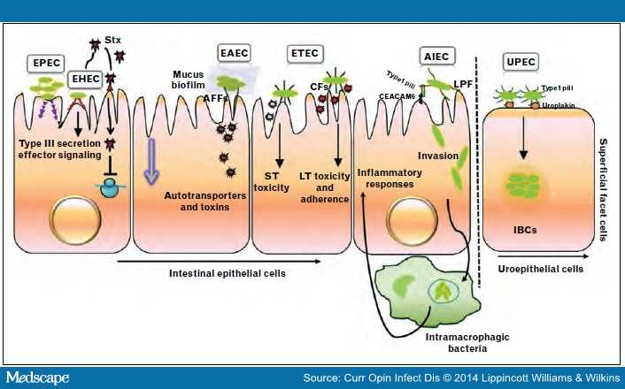

Slide 7
The bacteria injects an effector, Tir, into the host plasma membrane that acts an “anchor” for pathogenic surface proteins, known as intimin
Once bound, it recruits host cell cytoskeleton regulators such as N-WASP and actin-related protein
They remodel the actin cytoskeleton, causing the retraction of hots cell microvilli and creation of a flattened pedestal surface under the bacterium
Mutation of Tir/intimin complex results in virulent strains
E. coli also has plasmid-encoded invasion factors that invade the mucosal lining
Encoding cytotoxic enterotoxins induces tissue damage in colonization sites
DNA encoded enterotoxins can induce the secretion of water and electrolytes that allow bacterial colonization
Results in watery diarrhea in host

Slide 8
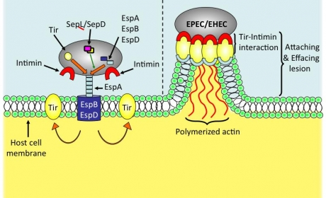

Slide 9
Multiplication & Spread
E. coli infections can be limited to mucosal surfaces, but it can also spread throughout the body
Presented in 3 clinical manifestations: diarrheal disease, urinary tract infection and meningitis
The bacteria is able to cross mucosal lining via M cells
E. coli is taken up by macrophages, but they have virulence factors that allow them to survive phagocytosis
They can multiply and induce host cell death
The lysed macrophage will release endotoxins and Shiga toxin that spread to other tissues via the bloodstream, resulting in secondary sites of infections

Slide 10
Urinary Tract Infection
E. coli is spread to the urethra where its Type I fimbriae binds to galactose disaccharides on the urethral epithelial cells and red blood cells
The fimbriae is known to enhance bacterial persistence and promote inflammatory responses
K antigens of E. coli are capsular antigens that mediate colonization by preventing complement from binding to bacterial surface

Slide 11
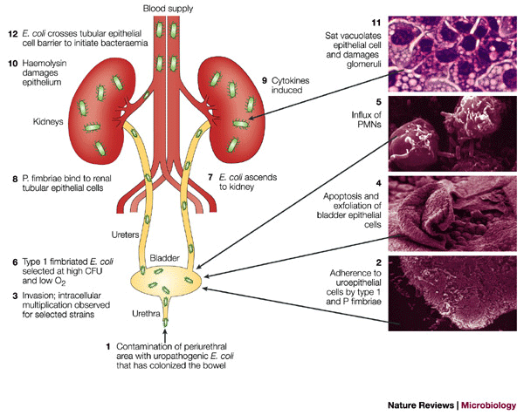

Slide 12
Meningitis
E. coli becomes disseminated and invades the meninges
K-1 antigens inhibit phagocytosis by preventing opsonisation
Allowing the bacteria to multiply and invade host cells, thus invoking a proinflammatory response

Slide 13
Damage to the Host
Direct damage to the host is mediated by Shiga toxins (Stx), causing haemorrhagic colitis
Stx initiates an inflammatory response in the gut lining at the recto-anal junction
This causes hemorrhage and edema in the lamina propria
Bloody diarrhea is caused by the necrosis of gut tissue and neutrophil infiltration
The infection can become disseminated into the kidneys
The renal endothelium has large amounts of Gb3, a glycolipid receptor for Stx
Stx induces apoptosis of the epithelial cells, causing blood to leak into the urinary space
This may lead to hemolytic-uremic syndrome (HUS)
In more severe cases, HUS may lead to acute renal failure

Slide 14
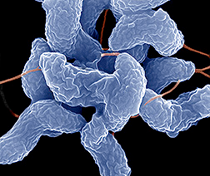
Campylobacter jejuni
Gram negative, spiral-shaped bacteria
Commonly found in most parts of the world
Colonizes the intestinal tracts of humans and animals
Capable of causing gastrointestinal diseases, including bloody diarrhea
Symptoms can occur after the consumption of contaminated poultry or unpasteurized dairy product

Slide 15
C. jejuni has a flagella that contains a basal body, hook, and filament
The filament has two proteins: flaA and flab that help the bacteria arrive at appropriate host cells
Uses chemotaxis for motility
They are attracted to mucins, fructose, serine, pyruvate, several other chemoattractants
Uses bacterial polysaccharide capsule to evade host immune system
Siderophore allows C. jejuni to acquire iron outside of host cells to promote growth

Slide 16
Entry of C. jejuni
A superficial antigen, PEB1, is a major adhesin used in intestinal colonization
Protein adhesins include CadF, FlpA and JlpA , bind to Fn glycoprotein receptors (CadF, FlpA) and HSP90 host cell receptors (JlpA)
CadF binds to host cell fibronectin and the membrane fraction so INT-407; they are crucial in mediating adherence
Also works with FlpA to target fibronectin for adherence and invasion
Peb proteins are found on the bacterial membrane; they have major immunogenic properties
Peb1 can bind to aspartate and glutamic acid, using them for pathogen colonization
Peb4 helps export bacterial protein to the outer membrane
KpsE and KpsM help produce the capsule that is implicated in invasion and colonization

Slide 17
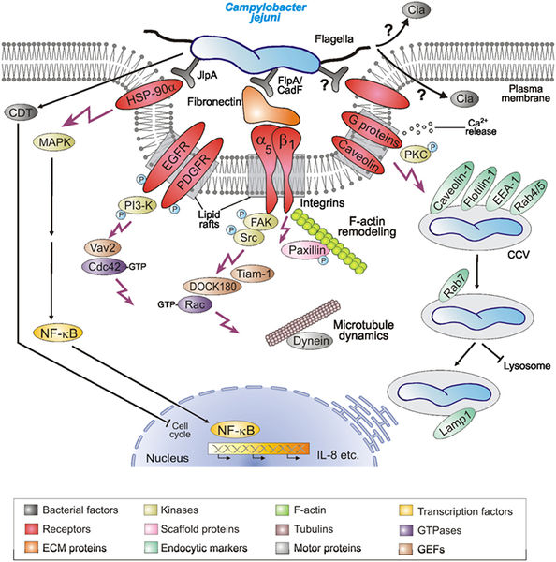

Slide 18
Multiplication & Spread
C. jejuni is capable of existing in an extracellular or intracellular state
They can survive in host epithelial cells
The bacteria forms a vesicle, called Campylobacter jejuni-containing vesicle
Prevents bacteria from being degraded in the cell lysosome
The spread of C. jejuni can cause pancreatitis, peritonitis, and cholecystitis
Binds to Fn, a glycoprotein in extracellular matrix of epithelial cells
This causes host cell invasion and colonization; although mechanism of entry is still unclear
Invasion antigen B (CiaB) increases the intracellular bacterial presence in host cells
CiaC and CiaI are also responsible for invasion and intracellular survival respectively
Infection may spread outside of the intestines
Endocarditis, septic arthritis and osteomyelitis may occur
Patients may acquire Guillain-Barre syndrome, an autoimmune disease where the immune system attacks the peripheral nervous system causing prickly sensations on the skin.

Slide 19
Damage to Host
Campylobacter infection stimulates an inflammatory response.
Blood vessels in the surrounding area becomes dilated and neutrophils are recruited to the site.
Recruited mast cells and basophils release histamine-containing granules that further aggravates vasodilation
Inflammation in the GI tract can cause bloody diarrhea and abdominal cramping consistent with gastroenteritis
C. jejuni causes damage to the host through cytolethal distending toxin (Cdt)
There are 3 subunits: CdtA, CdtB, CdtC
CdtB is the active component that act as a nuclease and enters the host nucleus to create double stranded cuts in the DNA
CdtB also terminates the growth 2 phase in host cells and induces host cell apoptosis by accumulation

