Slide 1
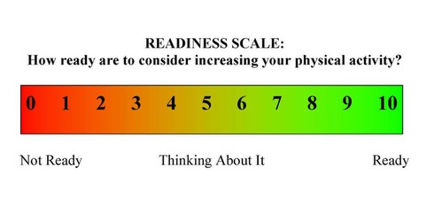
BE AWARE OF YOUR PERSONAL BIASES
(eg. vegetarian diet, weight or poverty stigma)
SLOW DOWN to aid attention and regain
session focus
ASK FOR PERMISSION when delving into
sensitive topics
Use OPEN ENDED QUESTIONS to let the client direct the conversation
EXPRESS EMPATHY and be genuine
Use AFFIRMATIONS to boost the client’s confidence
Use REFLECTIVE LISTENING (Repeating, Rephrasing, Paraphrasing) to bring self-awareness to the client
Use SUMMARY STATEMENTS to ensure that you understand correctly
DEVELOP DISCREPANCY to support health
behaviour change
ROLL WITH RESISTANCE to prevent defensive behaviour
SUPPORT SELF-EFFICACY and encourage the client to come up with their own solutions

