Slide 1
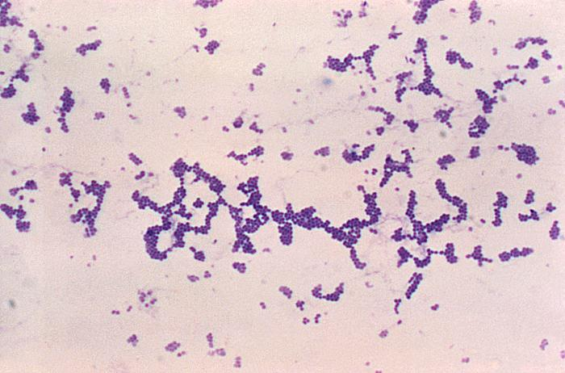
Body Systems: Case 1
‘School Sores’
Gram stain of Staphylococcus areus

Slide 2
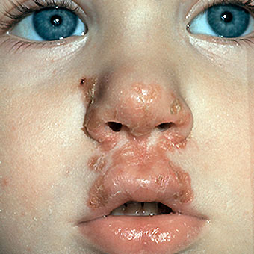
Signs and Symptoms
Sign: a characteristic observed by a third party
Symptom: a characteristic experienced by a patient
Signs | Symptoms
Presence of red sores around the mouth and nose Afebrile Lack of enlarged lymph nodes and rash in other areas | Presence of red sores around the mouth and nose

Slide 3
The Integumentary System
Stephanie presents with a rash around her nose and mouth
Bacteria is targeting the integumentary system (hair, skin, nails…)
Sores and rashes affect the dermis and the epidermis

Slide 4
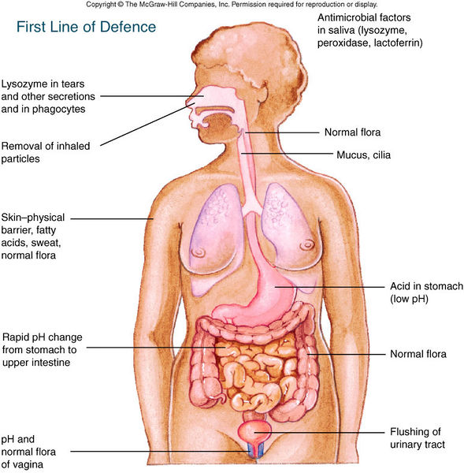
Normal Physiological Function
Skin function: protects the interior body from the external environment
Skin is one of the first lines of defense in the human immune system
Acts as a barrier against potential pathogens (fungi, bacteria, viruses, parasites, antigens…)

Slide 5
Normal Physiological Function
Epidermis | Dermis
Avascular layer Contains keratinocytes, melanocytes, merkel cells and langherhans cells Composed of several layers Keratinocytes produce keratin layer that helps prevent cuts, abrasions and other mechanical injuries | Vasculature aids in temperature regulation via vessel constriction or dilation and provide nutrients to epidermis Contains lymph vessels, nerve endings, hair follicles, and sebaceous and eccrine sweat glands Fatty acid and acidic sebaceous fluid inhibit pathogen growth Hair follicles contribute to temperature regulation and prevent water loss (prevent skin from drying out)

Slide 6
Normal Physiological Function
Normal flora: colonization of microbes in the body that do not normally cause disease
Microbial species reside in stratum corneum and upper portion of hair follicles
Live in symbiosis with the skin
Protect host against colonization of pathogenic species within the skin
Normal flora compete with pathogens and use up the host resources before the pathogens
Production of antimicrobial substances (antibodies)

Slide 7
Normal Physiological Function
Skin protects against UV rays
vitamin D synthesis occurs when keratinocytes are exposed to UV radiation
Vitamin D can regulate maturation in cells that play a role in the immune response such as dendritic cells, monocytes, and T Lymphocytes
Changes in skin are detected by nerve endings and sensory epithelial cells

Slide 8
Disruption of Normal Function
Damage to the skin decreases its capacity to function as part of the immune system
The stratum corneum would not be able to release cytokines and antimicrobial peptides
pH and dryness levels may be altered
Skin may no longer be able to protect the body against UV radiation, chemicals, and oxidative and mechanical stress

Slide 9
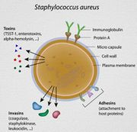
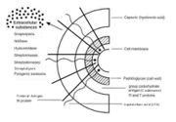
Disruption of Normal Function
Local flora is disturbed leading to a greater likelihood of pathogen invasion
Staphylococcus aureus and Streptococcus pyogenes commonly cause Impetigo
Staphylococcus aureus
Streptococcus pyogenes

Slide 10
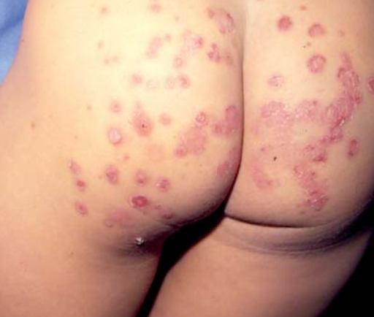
Disruption of Normal Function
Once the skin is damaged, pathogens may be able to enter the host
Stephanie has likely developed a condition called impetigo resulting from a bacterial infection

Slide 11
Disruption of Normal Function
Neutrophils accumulate underneath the stratum corneum, producing a subcorneal pustule
The pustule contains serum proteins and inflammatory cells
Bullous and Non Bullous pustules can occur
The pustules begin as a small macule near the nose and mouth

Slide 12
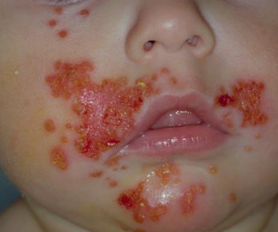
Bullous vs. Non Bullous
Bullous Impetigo (Impetigo Contagiosa)
Non Bullous Impetigo

Slide 13
Secondary Infection
There are no signs of a secondary infection in this case
Rash is limited to facial area
No swollen lymph nodes
No fever
Impetigo patients usually show no systemic symptoms

Slide 14
Secondary Infection
It is possible that patients with impetigo can develop secondary infections
Early infection appears as red sores and pustules that gradually enlarge
Pustules accumulate dead white blood cells
Sores rupture and leak a purulent discharge which allows bacteria to spread and progress to secondary infections
The spread of S. aureus and S. pyogenes bacteria can cause secondary infections such as Infectious Eczematoid Dermatitis

Slide 15
Secondary Infection
Other complications of S. aureus and S. pyogenes spread include:
Ecthyhma
Cellulitis
Furunculosis
Methicillin-resistant Staphylococcus aureus Infection
Glomerulonephritis

