Slide 1
Microbiology Laboratory testing OF Male urethritis

Slide 2
Content overview
Common pathogens that cause urethritis in men
Required Specimens
Lab tests performed & Results

Slide 3
1. Causative pathogens

Slide 4
Common Pathogens
Neisseria gonorrhea
Chlamydia trachomatis
Intracellular
Gram-negative
Cocci
Pili for adherence
Incubation period in males: 2-6 d
Common S/Sx: urethral discharge, proctitis, dysuria, testicular pain
Obligate intracellular
18 serovars (different outer membrane proteins), D-K implicated in urinary tract infection
Exist in two stages:
Elementary Bodies (EB) are non-replicating, infectious particles with a rigid cell wall that contain bacterial genome and plasmid
Reticulate Bodies (RB) are the non-infectious particles, that are formed as a result of binary fission within the endocytosed EB cytoplasmic vacuole

Slide 5
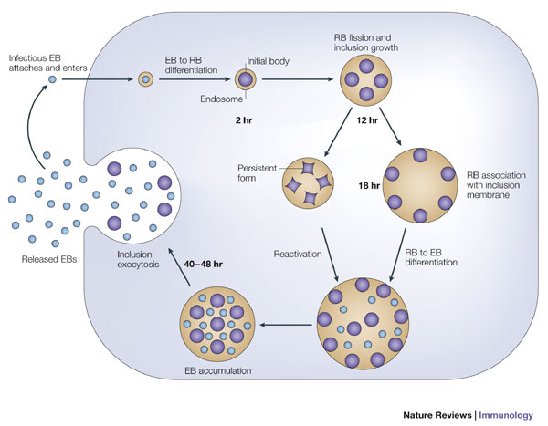
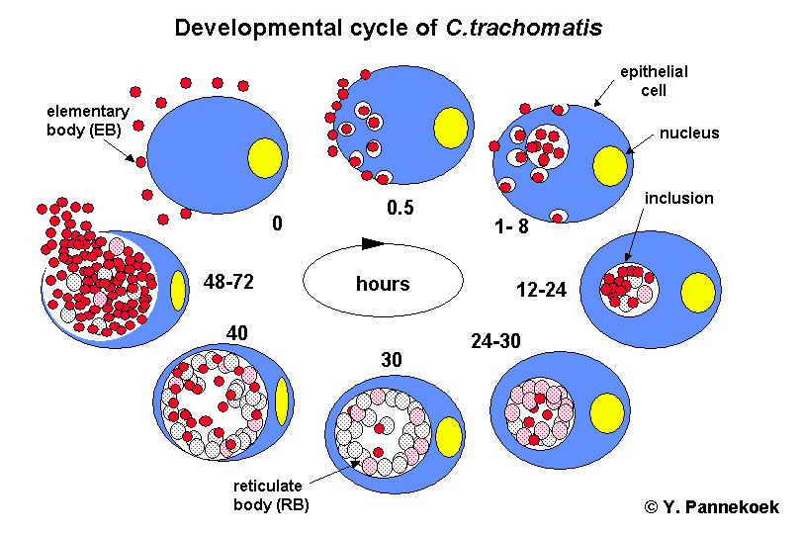
Chlamydia developmental cycle
Retrieved from:
http://www.nature.com/nri/journal/v5/n2/fig_tab/nri1551_F2.html
https://www.google.ca/url?sa=i&rct=j&q=&esrc=s&source=images&cd=&cad=rja&uact=8&ved=0ahUKEwiO2OH135bSAhUK2GMKHehCDMYQjRwIBw&url=http%3A%2F%2Fmynotes4usmle.tumblr.com%2Fpost%2F47670799230%2Fusmlepathslides-elementary-body-of-chlamydia&psig=AFQjCNEeoAGUNoHFAVxpU9jjfSv3aAEYkA&ust=1487407767260374

Slide 6
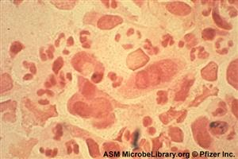
Less common pathogens
Mycoplasma genitalium
Ureaplasma urealyticum
Gram-negative
Flask-shaped
15-25% of symptomatic non-gonococcal urethritis in males
Gram-negative
Spherical / ovoid
Cocci
Retrieved from:
http://diseasespictures.com/wp-content/uploads/2015/11/Mycoplasma-Genitalium-Infection.jpg
Retrieved from: http://www.contraboli.ro/stuff/p/Ureaplasma.jpg

Slide 7
2. Specimen required

Slide 8
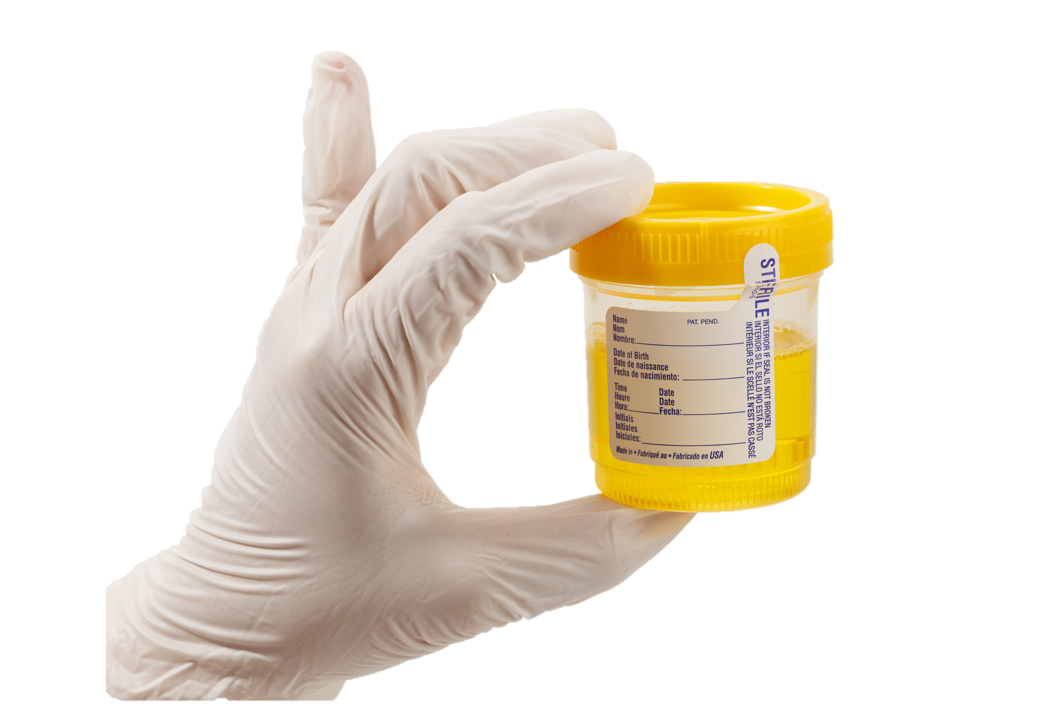
Types of specimen
Urethral swab
urine specimen
Pts should not pass urine for at least 2 hours prior to collection
2-4cm inside the urethra
Store frozen at -70’C, up to 60 days
Pts should not pass urine for at least 1-2 hours prior to collection
10 mL of first catch urine
Store refrigerated at 2-8’C, up to 30 days
Retrieved from:
http://images.slideplayer.com/25/8043625/slides/slide_16.jpg
Retrieved from:
http://www.jadco.gov.jm/images/ace-img/Sample.jpg

Slide 9
Urine or urethral swab sample
Microbiology lab testing
Identification of causative pathogen
Appropriate treatment of urethritis
Confirmed Diagnosis
➔ Timely detection, diagnosis and treatment are essential to clearing urethritis and preventing severe complications (e.g. epididymitis associated infertility, Reiter syndrome)! (However, laboratory assessment of GU vs. NGU is not considered clinically essential, as results do not alter therapy.)

Slide 10
3. Laboratory tests & results

Slide 11
Types of Lab tests
Culture tests
Non-culture tests
Gram stain
Differential media
Biochemical tests
Oxidase
Gonochek II
Acid production detection
Giemsa stain
Antigen detection by immunoassays
Direct Fluorescent Antibody
Molecular tests
Nucleic Acid Amplification tests (NAAT)

Slide 12
Gram stain
Add Crystal violet (basic dye)
Add iodine (mordant), forms an insoluble complex with crystal violet
Wash with alcohol (decolourizer)
Thick peptidoglycan layer becomes dehydrated and retains the violet complex ➔ Purple = Gram-Positive
Outer membrane becomes degraded and thin peptidoglycan layer cannot retain the violet complex ➔ decolourised = Gram-negative
Counterstain with safranin ➔ Gram-negative = pink
Retrieved from:
http://laboratoryinfo.com/wp-content/uploads/2016/01/gram-stain-procedure.png

Slide 13
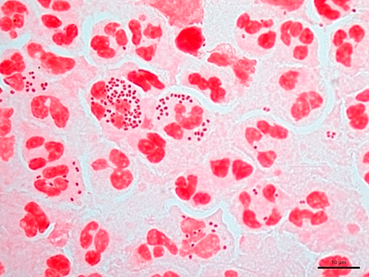
Gram stain results
Neisseria gonorrhea | Chlamydia trachomatis
pink | Not easily visualised (obligate intracellular) ➔ detection by Giemsa
 | N/A
Retrieved from:
http://hit-micrscopewb.hc.msu.edu/Microbiology/Images/5IIB2_penile_100X_3_tn.jpg

Slide 14
Differential media
Thayer Martin Agar
Mycoplasma agar
McCoy cell monolayer
2.0g beef extract
17.5g casein hydrolysate
1.5g starch
17.0g agar dissolved in 1 liter of distilled water, pH adjusted to neutral at 25 °C
5% chocolate sheep blood
+VCN inhibitor
Vancomycin kills most Gram-positive
Colistin kills non-Neisseria Gram-negative
Nystatin kills most fungi
Bacteriological peptone 10.0 g/L
Lab-Lemco powder 10.0 g/L
Sodium chloride 5.0 g/L
Mineral supplement 0.5 g/L
Agar 10.0 g/L
➔ selects Mycoplasma genitalium
Selects for obligately intracellular Chlamydia trachomatis
Expensive, slow, labour-intensive
Less preferred than non-culture detection methods

Slide 15
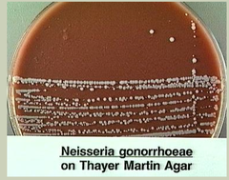
Thayer-Martin agar
Neisseria gonorrhea | Chlamydia trachomatis
Growth | No growth

Slide 16
Mycoplasma agar
Neisseria gonorrhea | Chlamydia trachomatis | Mycoplasma genitalium
No growth | No growth | Growth
N/A | N/A
Retrieved from: http://www.cell.com/cms/attachment/2007951303/2030487012/gr1.jpg

Slide 17
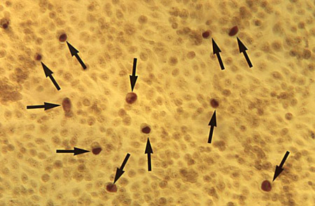
McCoy Cell monolayer
Neisseria gonorrhea | Chlamydia trachomatis
No growth | Growth
N/A
Retrieved from: http://bestpractice.bmj.com/best-practice/images/bp/en-gb/510-4_default.jpg

Slide 18
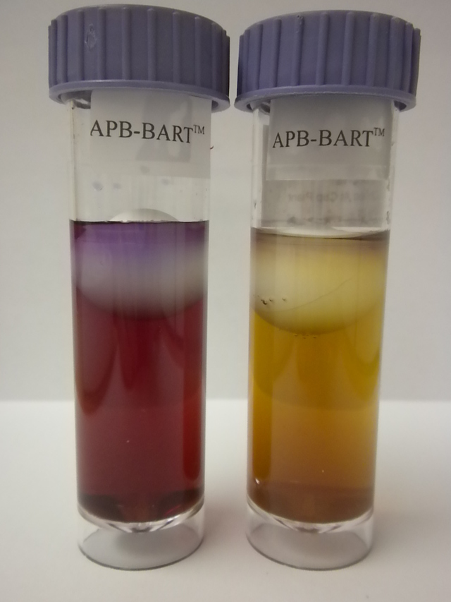
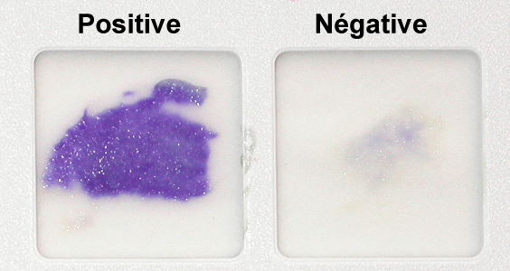
Biochemical tests
Oxidase
Gonochek II
Acid production
Positive for aerobic bacteria
Cytochrome C oxidase oxidises the test reagent (tetramethyl-p-phenylenediamine) to a purple coloured redox product (indophenol).
Positive = purple
Negative = no colour change
Differentiates Neisseria species
Single test tube contains:
B-galactoside (X-gal)
G-glutamyl-p-nitroanilide (GPNA)
Prolyl-4-methoxynaphthylamide (PMNA)
Blue = N. lactamica
Yellow = N. meningitides
Pink = N. gonorrhoeae
No colour = M. catarrhalis
Positive for Neisseria
pH indicator (phenol red) changes colour if organism produces sufficient amounts of acid from carbohydrate
Yellow = Neisseria
Red = other

Slide 19
Types of Lab tests
Culture tests
Non-culture tests
Gram stain
Differential media
Biochemical tests
Oxidase
Gonochek II
Acid production detection
Giemsa stain
Antigen detection by immunoassays
Direct Fluorescent Antibody
Molecular tests
Nucleic Acid Amplification tests (NAAT)

Slide 20
Giemsa stain
Thin urethral smear
Fix with methanol
Add dilute Giemsa (10%)
Wash, dry, examine
Giemsa stain is useful for Chlamydia trachomatis since the Gram-negative bacteria is not easily visualized by Gram stain, and culture of the strains are expensive and labour-intensive.
Giemsa staining method enables direct visualization of the organism in urethral smear, and eliminates requirement for culture.

Slide 21
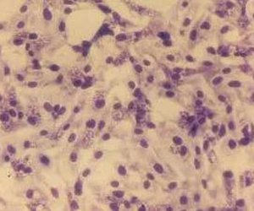
Giemsa stain results
Neisseria gonorrhea | Chlamydia trachomatis
No staining | Purple-blue
N/A
Retrieved from:
http://ecfrancis-microbiology.blogspot.ca/p/pathogenic-species.html

Slide 22
Antigen detection by immunoassay (IA)
Bacterial antigen (e.g. LPS of C. trachomatis) can be detected using anti-LPS capture antibodies, monoclonal anti-LPS primary antibodies, and enzyme-linked polyclonal secondary antibodies. Substrate is added, and the product is measured. The signal is translated into the level of antigen by using a calibration curve.
Sample specimen may be urine or urethral smear.
This type of assay is susceptible to false-positives, since antigens such as LPS may originate from bacteria other than C. trachomatis.
Retrieved from:
http://www.rajaha.com/wp-content/uploads/2011/12/Sand-wich-elisa-test.jpg

Slide 23
Direct fluorescent Antibody (DFA)
Similar to IA, DFA method detects bacterial antigens by the use of antibodies. However, in this case, the signal generated is fluorescence from the dye attached to the antibacterial antibody.
Sample specimen may be urine or urethral smear.
This type of assay is susceptible to false-positives, since antigens such as LPS may originate from bacteria other than C. trachomatis.
Retrieved from:
https://image.slidesharecdn.com/identificationofbacterialpathogens-111126232752-phpapp01/95/identification-of-bacterial-pathogens-32-728.jpg?cb=1322351153

Slide 24
Nucleic Acid Amplification test (NAAT)
Amplification and detection of the RNA/DNA of the bacteria
Used to identify the bacteria
Currently most sensitive and specific
Easier, quicker, cheaper than culture
Urine sample is sufficient

Slide 25
Retrieved from:
https://aws.labome.com/figure/te-127-4.png

Slide 26
Summary of results
Lab Test | If Neisseria gonorrhoeae only | If Chlamydia trachomatis only
Gram stain | Pink | N/A
Thayer-Martin medium | Growth | No growth
McCoy cell monolayer | No growth | Growth
Oxidase test | Positive (purple) | Negative (No change)
Gonochek II test | N/A | Pink
Acid production test | Red | Yellow
Giemsa stain | N/A | Purple
Ag detection by immunoassay | ++ | ++
DFA | ++ | ++
NAAT | +++ | +++

