Slide 1
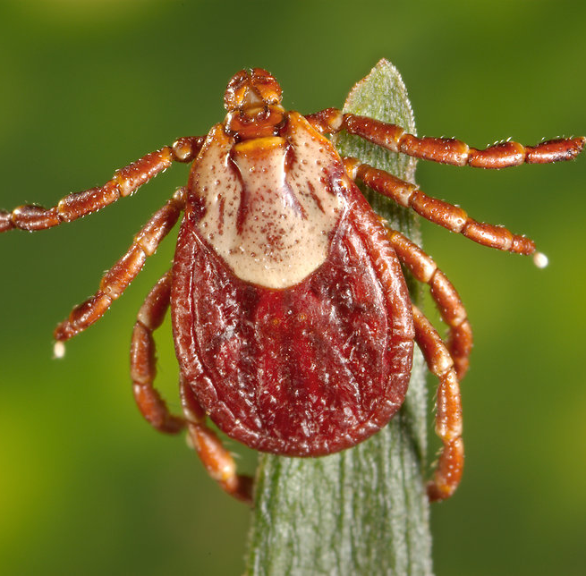
CASE 3: RICKETTSIA RICKETTSII
DISEASE: ROCKY MOUNTAIN SPOTTED FEVER

Slide 2
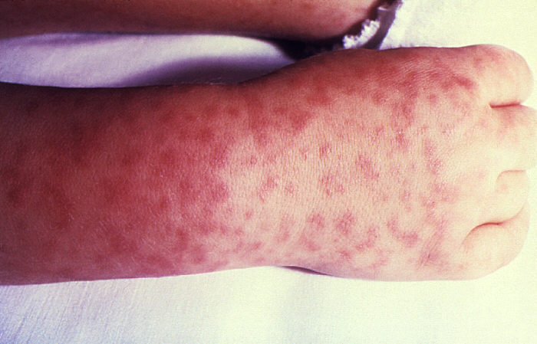
A RED RASH
Robert is a 41-year-old man who came down with a high fever, headache, abdominal pain and muscle aches. He decides to tough it out at home but after 2 days, he also develops a red rash on his arms and legs. His wife drives him to the hospital where he is assessed by the emergency physician. The doctor asks about any insect bites and Robert tells him about getting tick bites during a camping trip one week prior to developing the first symptoms. Upon examining Robert he notes the macular rash on the arms and legs. Initial bloodwork shows that Robert has a low platelet count, low sodium levels and abnormal liver function tests.
The doctor orders a microbiological serology test and starts him on intravenous antibiotics. The acute serologic test for Rickettsia rickettsii shows a low level of IgM antibodies and Rick is diagnosed with Rocky Mountain Spotted Fever. The diagnosis is subsequently confirmed when convalescent serology shows a 16-fold rise in antibody titers to R. rickettsia.

Slide 3
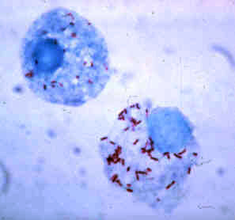
Bacterial pathogenesis: an overview
1)ENCOUNTER
2)ENTRY
3)MULTIPLICATION AND SPREAD
4)BACTERIAL DAMAGE

Slide 4
ENCOUNTER learning goals
Where does R. rickettsii normally reside geographically?
Where does R. rickettsii normally reside host-wise?
What are the bacterial characteristics that leaves it suited to these places of residence?
R. rickettsii vectors
How would our patient have come in contact with this bacteria?

Slide 5
Where does R. rickettsii normally reside geographically?
Rickettsia rickettsii is found on every continent excluding Antarctica
However, the disease (RMSF) is restricted to the Americas
Common in Southeastern/ Southcentral states in USA
Prefer warm damp places
Majority of cases occur between Apr-Oct (rainy and warm seasons)

Slide 6
Where does R. rickettsii normally reside host-wise?
R. rickettsii’s reside in the cytoplasm or the nucleus of endothelial cells
Obligate intracellular
Endothelial cells are the cells that line the blood vessels of the body

Slide 7
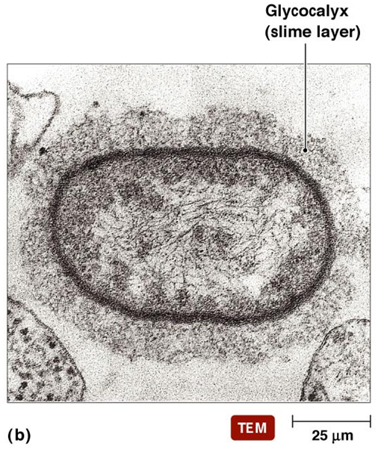
What are the bacterial characteristics that leaves it suited to these places of residence?
Slime layer: helps protect against dry environments and antibiotics
Slime layer also allows bacteria to adhere to smooth surfaces
Low infectious dose (ID)
0.2 x 0.5 micrometer size allows them to live inside cytoplasm and nucleus of endothelial cell
Ability to metabolize host-derived glutamate via aerobic respiration
Able to grow in low levels of nutrients

Slide 8
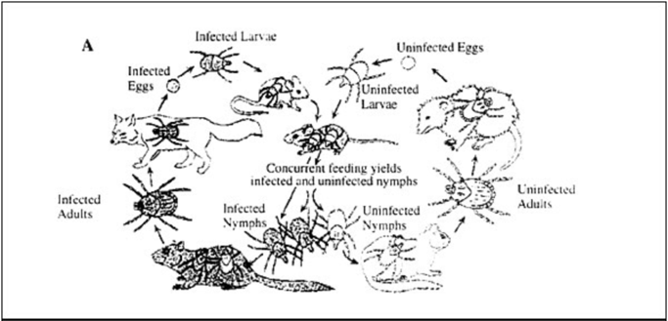
R. rickettsii vectors
Main vector for R. rickettsii are the family of Ixodildae ticks such as the American Dog Tick, Rocky Mountain Wood Tick, Brown Dog Tick
R. rickettsii must colonize tick’s midgut, bypass midgut to reach salivary gland for transmission
Once infected with R. rickettsia, the tick is infected for life
Bacterium maintained in tick via transovarian transmission
Uninfected ticks may become infected by feeding on reservoirs (ex. Rodents) = transstadial transmission

Slide 9
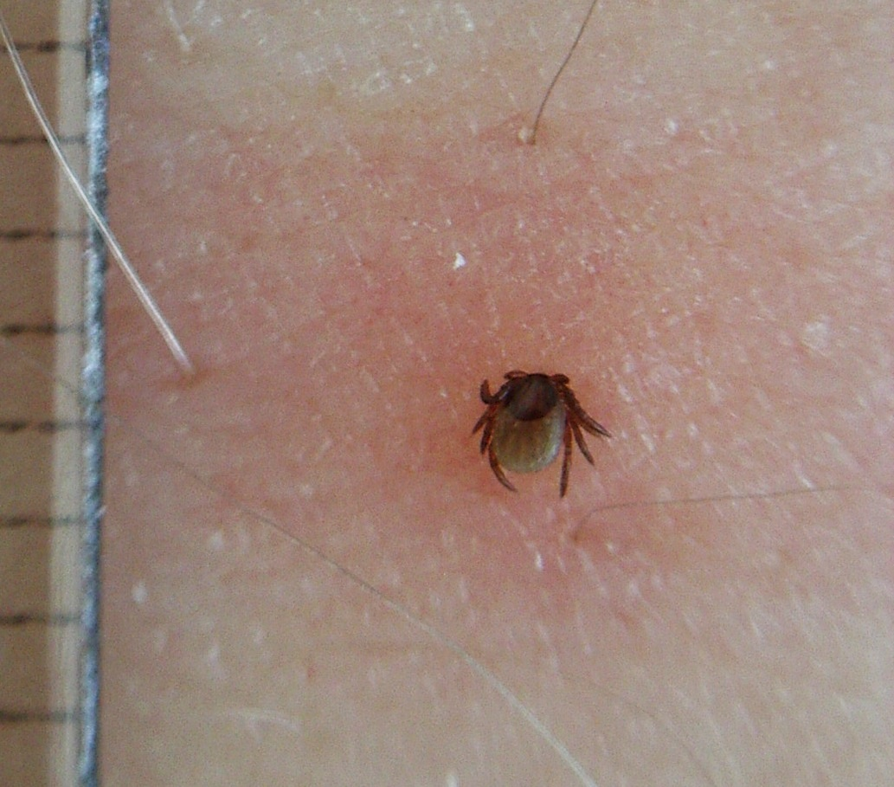
How would our patient have come in contact with this bacteria?
Robert most likely infected with R. rickettsii through a tick bite
Case history revealed tick bites one week prior to onset of symptoms
Tick needs to be attached to human for 4-6 hours to transmit the bacteria
Tick: Rocky Mountain Wood Tick

Slide 10
Entry learning goals
What are the common routes of entry?
What are the molecular, cellular and/or physiological factors at play in the initial entry/ adherence step from the POV of organism? From the host?

Slide 11
What are the common routes of entry?
Less common routes: via mucous membranes such as the conjunctiva and the lungs via aerosol
Main route of entry is through the skin at the point of a tick bite
Bacteria inoculates the dermis of the skin
With high affinity, bacteria adheres to and invades vascular endothelial cells
Puts bacteria into its obligate intracellular environment= critical step for downstream bacterial replication and spread

Slide 12
What are the molecular, cellular and/or physiological factors at play in the initial entry/ adherence step from the POV of organism? From the host?
The main mechanism of adherence is through adhesin-receptor interactions
R. rickettsia have surfaced-exposed outer membrane proteins (OMP) such as rOmpA,B that attach to host cell’s surface receptors
rOmpA mediates bacterial adherence to endothelial cells
rOmpB involved in bacterial adherence + bacterial internalization into the host cell as it acts as a bacterial ligand for ku-70
This interaction between rOmpB + ku-70 triggers downstream signalling that induces phagocytic internalization of the bacteria (MORE ON THIS LATER)

Slide 13
Multiplication and spread learning goals
Does the organism remain extracellular or do they enter into cells?
What are the molecular and cellular determinants of these events?
Do the bacteria remain at the entry site or do they spread beyond the initial site?

Slide 14
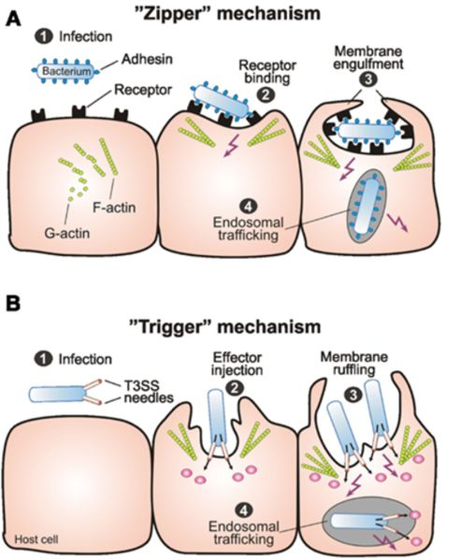
What happens after adhesion?
R. rickettsii induces host actin rearrangement to force the internalization of the bacteria for further bacterial replication
This engulfment must be induced since endothelial cells are not phagocytic
2 mechanisms of induced internalization have been proposed
The zipper or the trigger mechanism

Slide 15
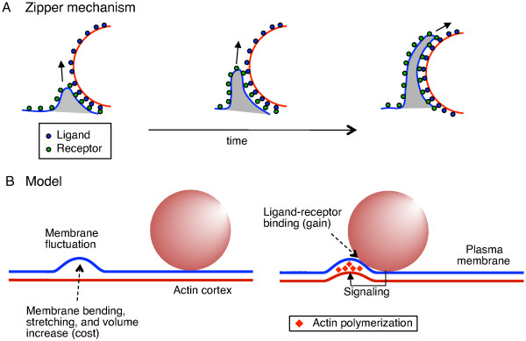
What is the zipper mechanism?
Works by having a bacterial protein bind to a host receptor on the cell surface
Once bound, interaction causes activation of cell signalling that results in the rearrangement of the cell cytoskeleton
Rearrangement causes host membrane to engulf the bacteria
Picture from https://www.researchgate.net/figure/47717187_fig1_Ratchet-model-for-the-zipper-mechanism-in-phagocytosis-A-Schematic-of-the-zipper

Slide 16
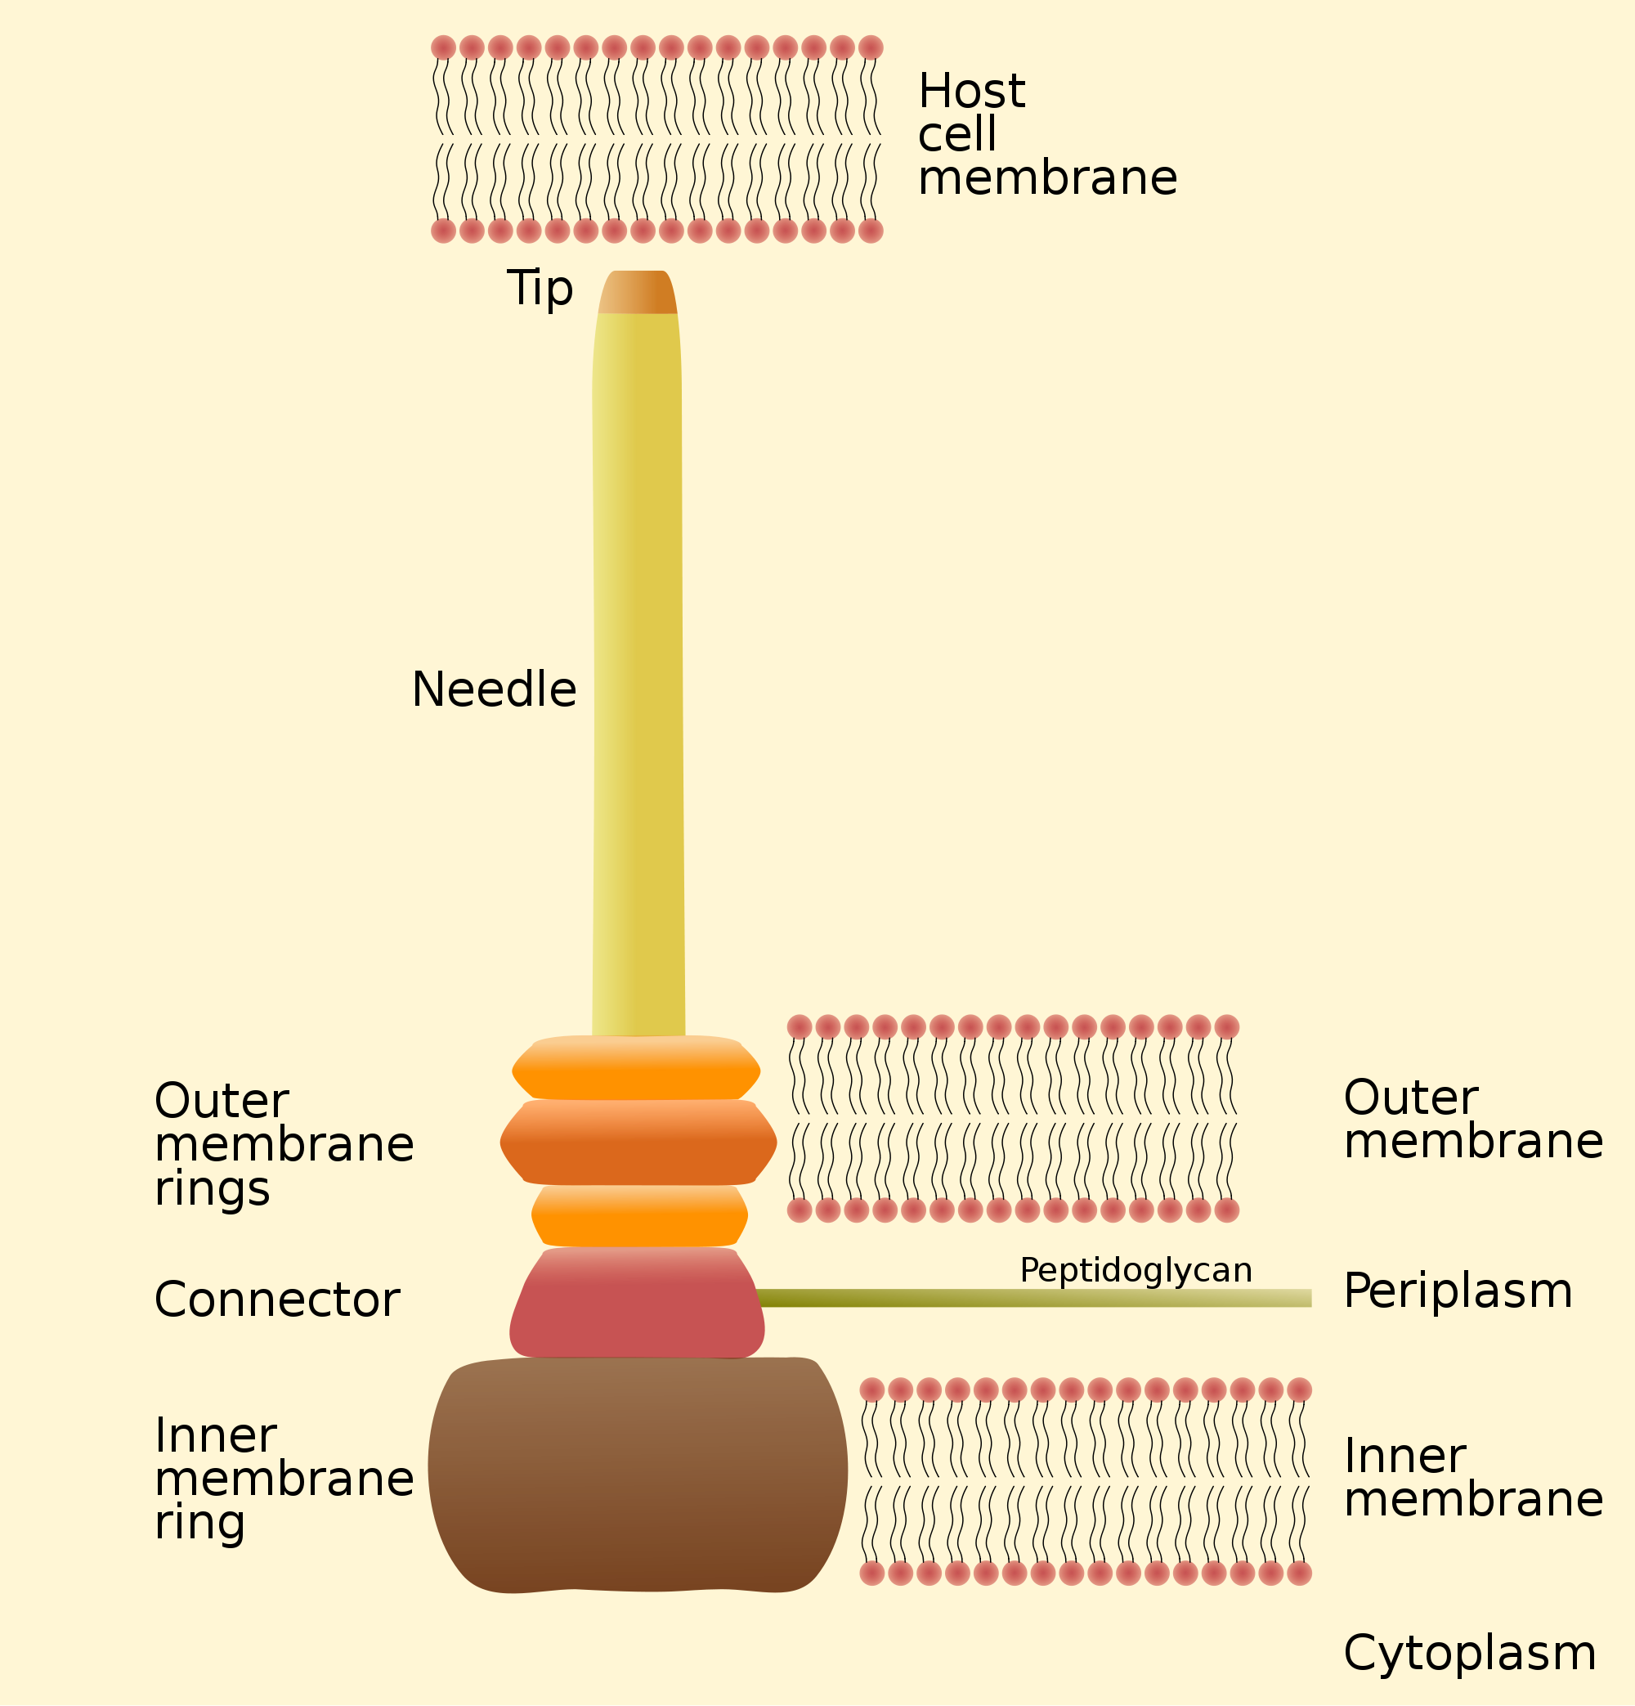
What is the trigger mechanism?
Include the involvement of a specialized invasion system that induce invasion
Called the Type III secretion system ( T3SS)
T3SS forms a needle-like structure on the bacterial surface that can pierce through the host cell membrane
One injected in the host, T3SS releases various effector proteins that interact with host cell signalling molecules to induce cytoskeletal rearrangement

Slide 17
ZIPPER OR TRIGER?
Genome analysis revealed that Rickettsia species lack genes that encode for T3SS
Zipper mechanism is used : As before, OmpB binds to Ku-70 to induce phagocytosis

Slide 18
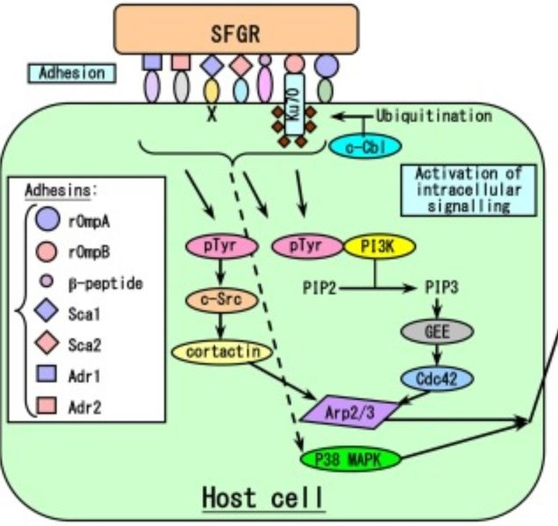
The signalling pathway
Interaction between OmpB and Ku-70 recruits c-cbl which adds ubiquitin to Ku-70
Ubiquination of Ku-70 activates CDC42, phosphoinositide- 3- kinase , C-src, Arp2/3 complex
CDC42 is a GTPase and is important in the signalling cascade
The signalling cascade culminates in Arp2/3 activation
Arp2/3 is an actin nucleating complex which instigates localized actin rearrangements that result in internalization of the bacteria

Slide 19
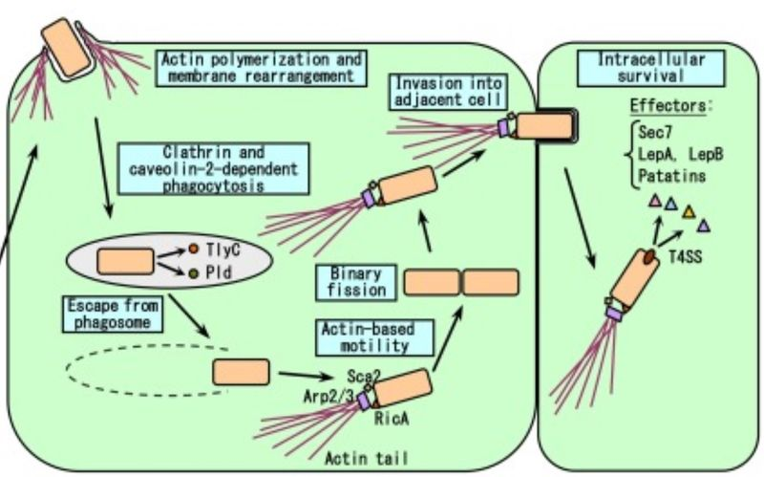
How does r. rickettsii escape the phagosome?
Once internalized, the bacteria will be inside the phagosome
In order to survive, the bacteria must escape the phagosome before it fuses with the lysosome
Escape of phagosome mediated by bacterial proteins phospholipase D and hemolysin C
These proteins have membranolytic activity
Once the bacteria escapes the phagosome, it is able to utilize the nutrients in the cytosol to its survive and reproduce

Slide 20
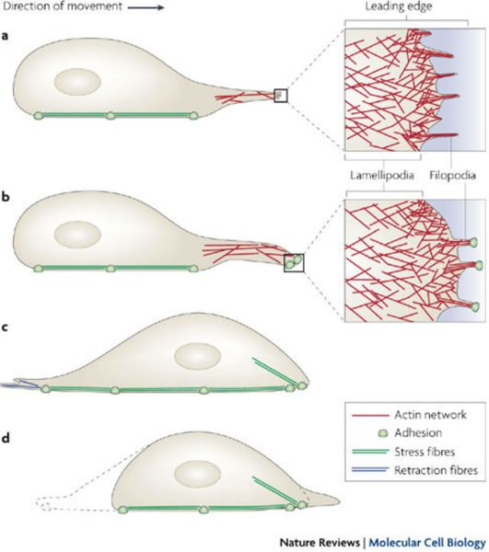
How does r. rickettsii infect adjacent cells?
Involves a signalling cascade that results in the activation of Rick A
Rick A directs actin nucleation at one end of the bacterium to form little tails
These tails mediate movement around the cytosol and gain velocity in the process
Once the tails gain sufficient velocity, there is a formation of structures called filopodia
Filopodia are long thin cell projections which pierce adjacent cells in order to infect them
If the filopodia are located on the basal side of the endothelial cell, smooth muscle cells can become infected and this is how the infection spreads to the CNS
If filopodia form on the luminal side, the bacteria spread to the blood

Slide 21
Bacterial damage learning goals
Do the bacteria cause any direct damage to the host?
Or is the damage fully attributable to the host response?
What is the nature of the bacterial damage?
Can it be linked to any symptoms in this case?

Slide 22
In order to damage the host, how does r. rickettsii manipulate the host cell’s systems?
Within the endothelial cells, R. rickettsii induce signalling cascades that causes endothelial activation
The result of these signalling cascades is the production of two host cell transcription factors: NF-KB and MAPK
NF-KB and MAPK induce expression of anti-apoptotic factors that prevents the host cell from undergoing apoptosis
This allows the bacteria to continue to survive, replicate, infect other cells and continue to damage the host cell

Slide 23
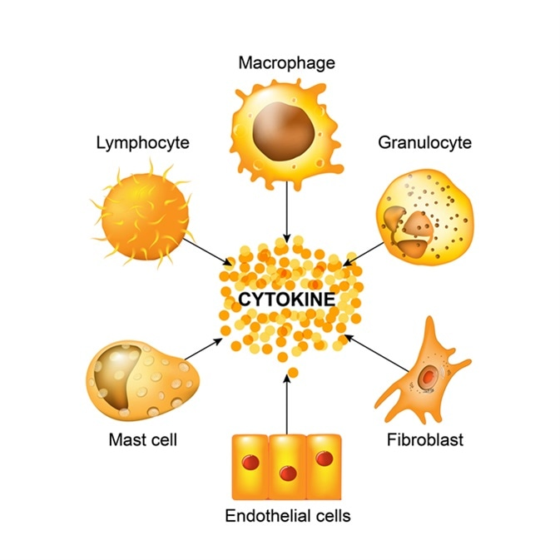
Inflammatory mediators
NF-KB and MAPK signalling cascades also results in the increased expression of IL-alpha, IL-6, chemokines IL-8, monocyte chemoattractant protein-1
These cytokines and chemokines recruit white blood cells to the site of infection in order to damage the host endothelial cell and the surrounding cells

Slide 24
Oxidative stress
R. rickettsii- infected cells can undergo oxidative stress via reactive oxygen species (ROS)
Examples of ROS include O2- andH202
These ROS are upregulated by intracellular signalling cascades that involve MAPK
R. rickettsii can also deplete the host cell’s glutathione which leads to a decrease in host cell defences against ROS- induced damage
ROS damage to the host endothelial cell includes intracellular membrane dilation, loss of osmoregulatory control and cell lysis

Slide 25
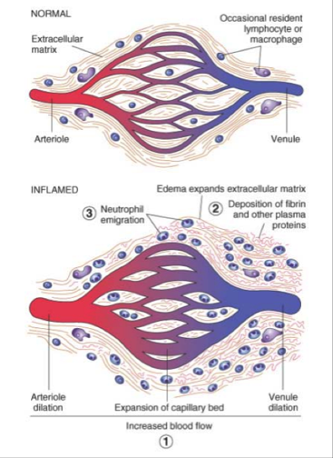
What causes the increase permeability in host endothelial cells?
Oxidative stress can increase expression of the heme oxygenase
Heme oxygenase oxidatively cleaves heme to release carbon dioxide and biliverdin
Upregulation of heme oxygenase results in increased prostaglandin which acts to increase vascular permeability and edema= cardinal signs of a Rickettsial infection
Side note: the by-product of this cleavage is biliverdin which may explain the abnormal liver function test results for Robert

Slide 26
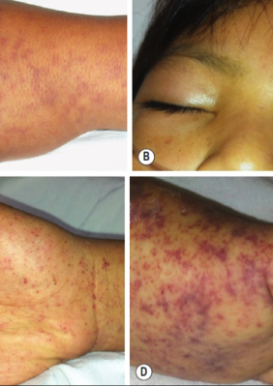
What does increased vascular permeability cause?
Leads to multisystem vasculitis, necrotic/gangrenous lesions, edema
The fluid and blood leakage in the skin leads to dermal rashes as seen on Robert’s arms and legs
Fluid leakage can also lead to hypovolemia and reduced tissue perfusion
Body’s response to hypovolemia includes the release of antidiuretic hormone which leads to hyponatremia
R. rickettsii may also cause depletion of adenosine 5- triphosphate which can lead to the failure of the sodium pump
Low Na+ levels amplifies the hyponatremia

Slide 27
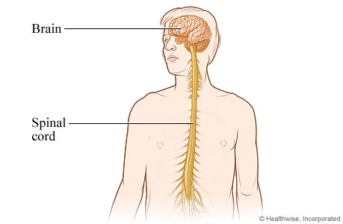
Further damage
Bacteria replicate within endothelial tissues and hinder circulatory continuity
Bleeding due to lack of platelets cause decreased blood flow into organs and causes organ damage- complications include encephalitis, non-cardiogenic pulmonary edema, interstitial pneumonia, hypovolemia, hypotensive shock and acute renal failure
R. rickettsii can also affect the CNS to cause meningismus, altered mental states, temporary deafness, lethargy and amnesia

Slide 28
Robert’s symptoms
Robert is experiencing high fever, headache, abdominal pain, muscle aches
These symptoms are consistent with a diagnosis of Rocky Mountain Spotted Fever

