Slide 1
The raw food diet
The Immune Response

Slide 2
The Case
25-year-old Johnny has been eating raw eggs as part of his new body building diet. One week into his new diet, he develops a mild fever, severe abdominal cramps and watery diarrhea. After 4 days of diarrhea, he goes to a walk-in clinic where the doctor finds that Johnny is volume depleted and has some abdominal tenderness. She gives him a container to collect a stool sample to send to the Microbiology Laboratory and suggests that he stop eating the raw eggs. Johnny’s stool sample grows Salmonella serotype Enteriditis.

Slide 3
Salmonella Enteriditis Invasion

Slide 4
Stop salmonella!

Slide 5
Host response: what elements of the innate and adaptive (humoral and cellular) immune response are involved in this infection.

Slide 6
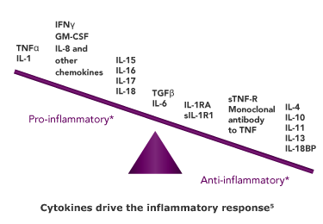
What regulates the innate & Adaptive immune response?
Signaling Equilibrium
Cytokines
Proteins that are secreted by cells and transduce actions in immune cells
Anti-inflammatory or pro-inflammatory
Signaling Equilibrium
Between opposing inflammatory responses allows for the host to clear infection while minimizing damage to self

Slide 7
How Does Salmonella Enteriditis pass the gastric acid barrier?
Gram Negative
This allows Salmonella to pass through the gastric acid barrier
The goal of the innate immune system is to reduce the number of salmonellae entering the intestine from the stomach through a variety of tactics

Slide 8
There are two types of immune responses
Innate Immune Response
Nonspecific defense
Activated rapidly following antigenic detection
Activated by PAMPs (Pathogen Associated Molecular Patterns)
Adaptive Immune Response
Specific and more complex response to antigen
Takes longer to activate (days)
Antigen processing, recognition, and attack
Generates memory

Slide 9
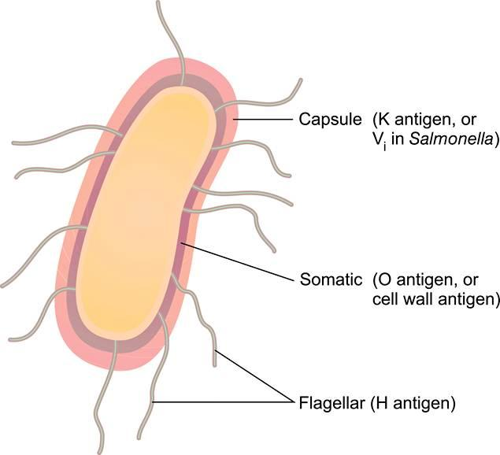
Salmonella enteriditis Pamps
LPS
PAMPs
host can recognize
Mannose
Flagellin
Peptidoglycan

Slide 10
More on LPS Structure :
LPS Endotoxin is an extremely good stimulator of the innate immune system

Slide 11
There are a variety of non-specific innate immune response defenses:

Slide 12
INNATE IMMUNE RESPONSE DEFENSES
Complement activation
Triggers inflammatory response
Gastric Acid
Lethal pH (3.5)
PRR Activation (TLR 4, 5, 9)
Peristalsis
Forward propulsion/motility
Expression of: - Defensins, cathelicidins (antimicrobial peptides)
Non-Specific Defenses
IgA Antibodies
Vasodilation
Microflora
Intestinal Mucous Proteins
Opsonization, agglutination,
Neutralization, complement activation
Macrophages secrete histamine:
- vasodilation: permits easier travel of phagocytes
Compete for space with pathogen
lactoferrin
lysozyme

Slide 13
More on Antibody functions:

Slide 14
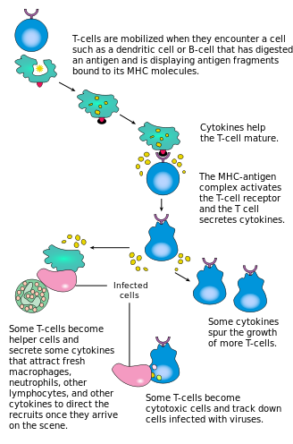
WHAT IF IT’S NOT ENOUGH? – ADAPTIVE IMMUNE RESPONSE
The Adaptive Immune Response
Requires Antigen Presenting Cells (APCs): i.e. Macrophages, Dendritic Cells (DCs),…
APCs internalize antigen and present it to un-activated T cells
T Cell Activation Specifics
DCs migrate to mesenteric lymph node and activate CD4+ T Cells
CD4+ T Cells → Activate B Cells → B Cells Secrete Antibodies specific for Salmonella

Slide 15
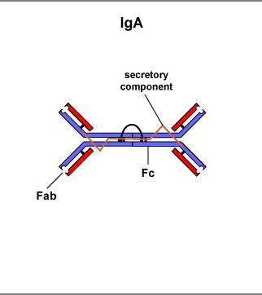
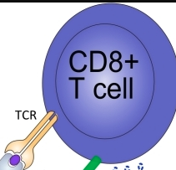
More Elements of the adaptive immune response
Mucosal Surface
IgA coats bacteria and prevents it from crossing epithelial lining
Increased intestinal CD8+ T Cells
Remove primary infection
Increase resistance

Slide 16
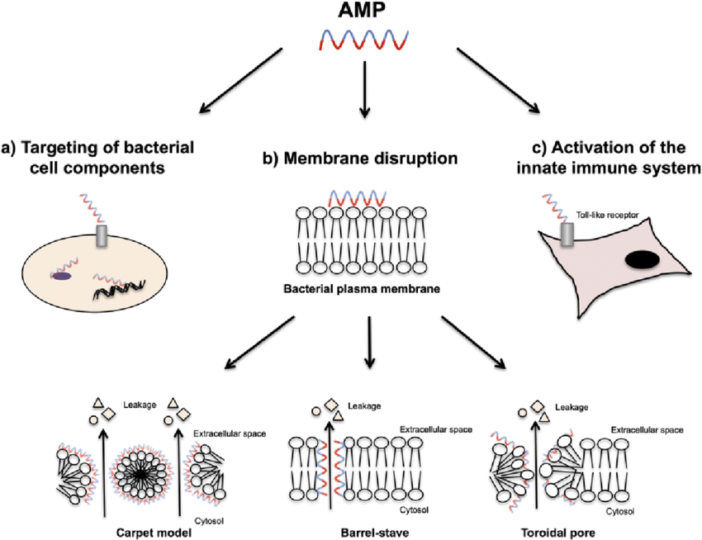
More Elements of the adaptive immune response
Gut Lumen Barriers.
1. Glycocalyx Layer
2. Antimicrobial peptides

Slide 17
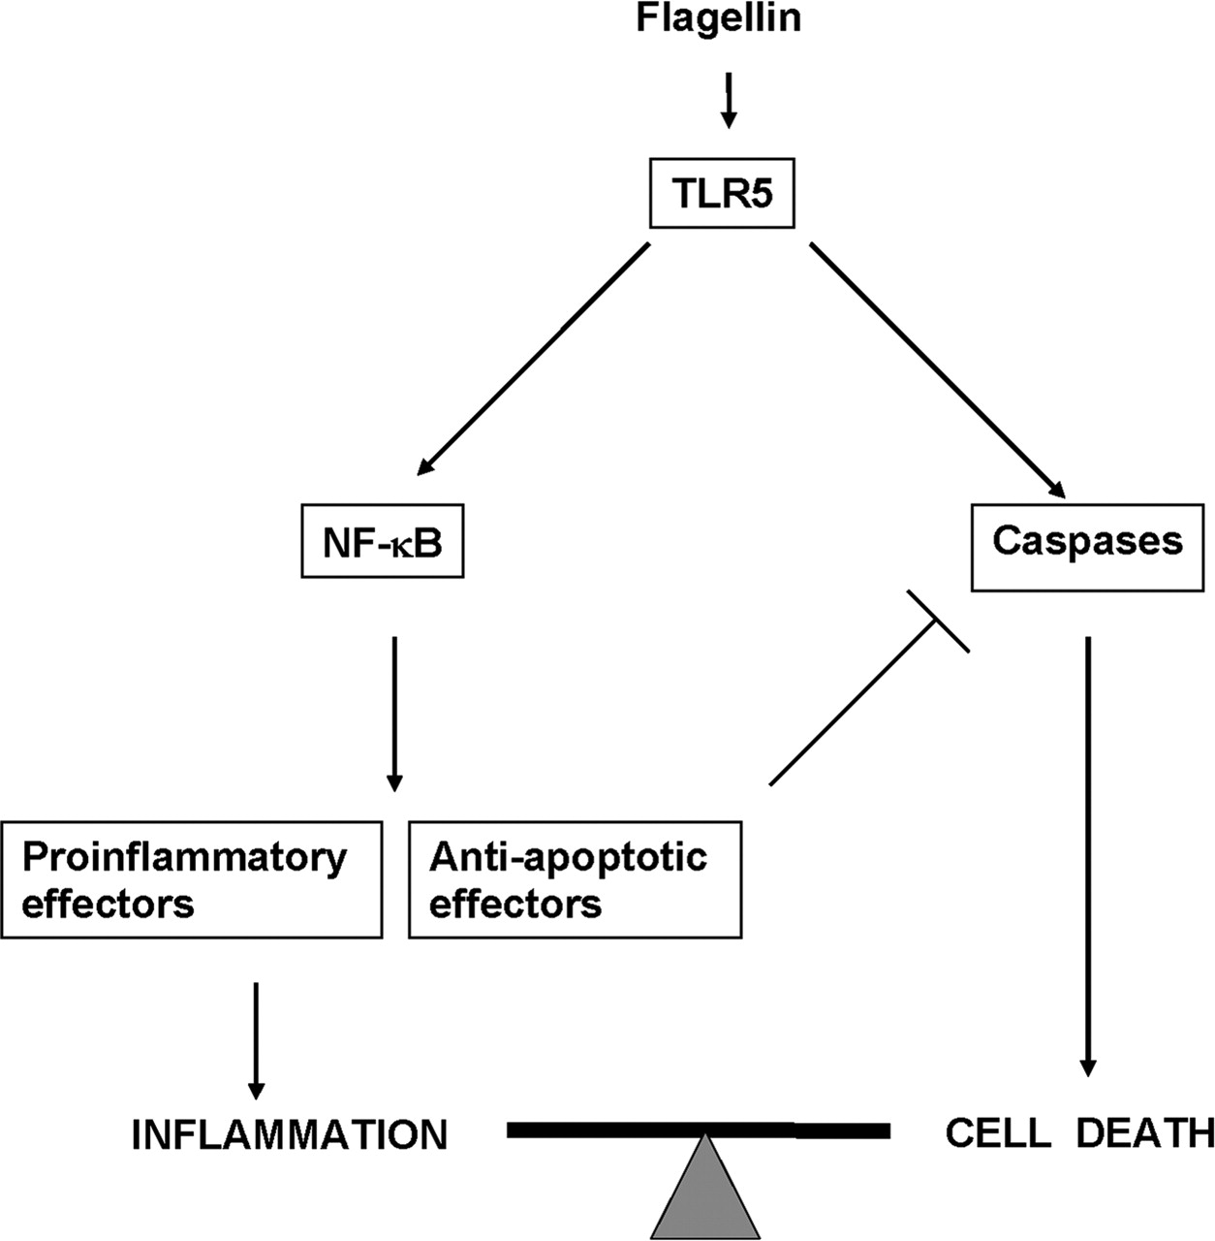
More Elements of the adaptive immune response – TLr5 - FLic
TLR5 – FLiC (Flagellar Structure) Interaction
Bacteria are taken up by DCs or M cells and cross the membrane
Bacterial expression of FliC binds TLR5 and stimulates inflammatory response : i.e. immune cell recruitment (macrophages, DCs, neutrophils)

Slide 18
What happens following TLR5 - flic signals inflammatory response?
Degradation/phagocytosis by neutrophils/macrophages
Immune cell recruitment
Phagocytosis of Salmonella by DCs or Macrophages
Salmonella taken up into vacuole for transport to liver or spleen

Slide 19
Host damage: what damage ensues to the host from the immune response?

Slide 20
Damage to the host
2 types of damage occur
Host response damage
Salmonella pathogenic damage

Slide 21
Damage to the host – host response damage
1. Reactive Oxygen Species Production
2. Infection outside of the GI Tract
3. Prolonged Innate immune response
4. Vasoactive Compounds

Slide 22
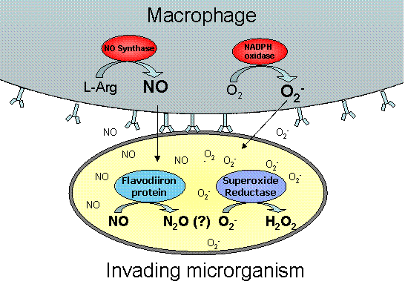
Damage to the host – host response damage
1. Reactive Oxygen Species Production
Made by macrophages and neutrophils
Kill invaders but are non-discriminatory toxic molecules – cause self tissue damage as well

Slide 23
Damage to the host – host response damage
2. Infection outside of the GI Tract
Rare, but bacteria can enter bloodstream and cause a humoral response :
Immune complexes accumulate in blood
Causes conditions ~ arthritis after Salmonella infection is cleared

Slide 24
Damage to the host – host response damage
3. Prolonged Innate immune response
[pro-inflammatory molecules]
High concentration → Negative effects on peripheral tissues
The pro-inflammatory and coagulative factors can enter the blood stream, where they can cause systemic inflammation and intravascular coagulation

Slide 25
Damage to the host – host response damage
4. Vasoactive Compounds = constrict and dilate blood vessels – allow more immune cells to reach the site of infection
Tissues
Vasoactive compounds result in activation of the alternative complement pathway → dilates blood vessels to allow immune cell entry
Immune cell entry is accompanied by fluid influx, which results in tissue damage and inflammation
Fluid Influx
Immune cell

Slide 26
Damage to the host – Pathogenic damage
Salmonella’s Assault
cytotoxins
exotoxins

Slide 27
Damage to the host – Pathogenic damage
Salmonella’s Assault
cytotoxin
Enterotoxin
Disturbs electrolyte balance in the intestine
Efflux of water into intestinal lumen
Diarrhea → dehydration
Localizes to small & large intestines
cytotoxins
exotoxins
Upon lysing, LPS is released – if released in bloodstream, overstimulation of macrophages → septic shock
Results in:
- Damage, death, enterocolitis
– protein synthesis inhibition in the GI tract
endotoxin
LPS

Slide 28
Bacterial evasion: how does the bacteria attempt to evade these host response elements.

Slide 29
Salmonella evasion tactics- how does salmonella evade the immune system defenses?
Active crossing of the epithelia
Exploitation of DCs to aid in barrier crossing
Bacterial mediated endocytosis
Membrane rearrangement
Secondary infection mechanism
Mediation of the SPI2 system
RPoS Dependent stress responses
AMP resistance schemes
Salmonella has developed many ways to take advantage
of and/or evade the immune system

Slide 30
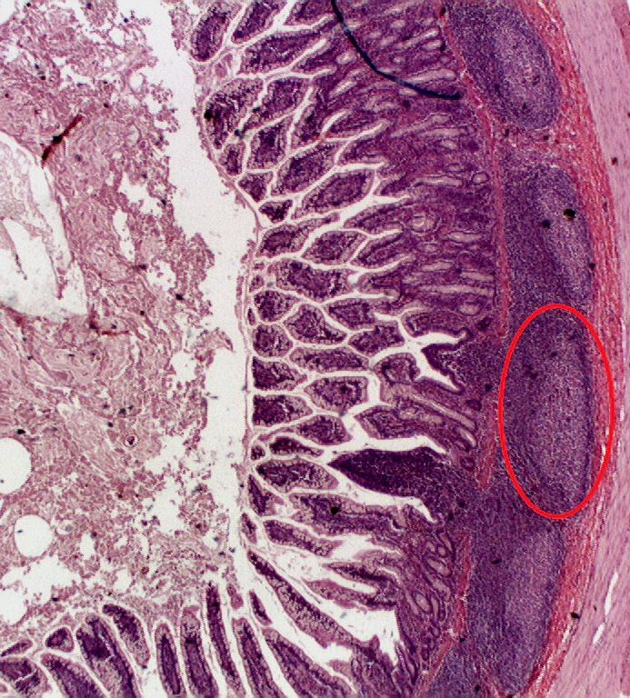
More on Membrane rearrangement :
In Peyer’s patch of small intestine
Fimbrial Adhesion
Bacteria adhere to mucous membrane in the lower intestine and induce membrane rearrangement so that they can easily translocate across the epithelial barrier and migrate to lymphoid tissues
What are the results of bacterial membrane rearrangement?
→ disruption of tight junctions (i.e. tight seals to restrict the movement of ions, water, & immune cells are disrupted)

Slide 31
More on secondary infection
Sustained bacteria following initial infection prompts the secondary infection:
Characterized by the dissemination of bacteria to other organs : gall bladder, liver, spleen
Salmonella re-invades epithelial cells via the basolateral surface → returns to the intestine, replicates, and prompts further infection

Slide 32
More on Mediation of the SPI2 system
Salmonella survives in the phagosome through mediation of SPI2
The connection between vacuoles containing salmonella and toxic lysosomes is STOPPED (as a result of Salmonella PhoP- PhoQ two component signal transduction system) :
By encrypting the type III secretion system salmonella STOPS movement of toxic killing reactive oxygen species and reactive nitrogen intermediates
Vacuole with salmonella
Reactive species movement are stopped and salmonella survives

Slide 33
More on RPoS Dependent stress responses
Suboptimal environments as a part of the host defenses (~ low stomach pH) challenge Salmonella’s ability to grow –pathogen placed under environmental stress
Large stress conditions → cause bacterial upregulation of the acid stress response mechanism called RpoS - dependent stress responses
RPOS - global regulator of gene expression
Instead of blocking the inflammatory response, salmonella secrete effectors to increase the inflammatory response and use recruited host cells to promote the infection.

Slide 34
More on AMP resistance schemes
Intracellular Salmonella resist cationic antimicrobial peptides secreted by macrophages and neutrophils by :
1. Modifying lipid A → decreases recognition by TLR2/4
2. Expressing PgtE outer membrane protease → cleaves alpha helices of AMPS
3. Encoding a locus that settles AMP resistance

Slide 35
Outcome: is the bacteria completely removed, does the patient recover fully and is there immunity to future infections from this particular bacteria?

Slide 36
Will Johnny make a full recovery?
For the most part, yes he will!
Signs/symptoms last 2-7 days
Diarrhea - up to 10 days
Illness : 4 – 7 days : usually no need for antibiotics or hospitalization
Bowels can take months to return to normal however
Bacteria should be cleared

Slide 37
What if Johnny was extremely old, extremely young, or immunocompromised?
Then SEVERE illness could result from the pathogen
The infection could spread to the blood stream and cause death without antibiotics
Some can develop reactive arthritis for months – years ~ difficult to treat

Slide 38
But once I have it, I can’t get it again, right?
Wrong.
Some protective immunity is developed but there are over 2,300 serovars; in a future case you would most likely contract a different serovar than the first encounter

