Slide 1
Case 3: Bacterial Pathogenesis
A Red Rash
Robert is a 41-year-old man who came down with a high fever, headache, abdominal pain and muscle aches. He decides to tough it out at home but after 2 days, he also develops a red rash on his arms and legs. His wife drives him to the hospital where he is assessed by the emergency physician. The doctor asks about any insect bites and Robert tells him about getting tick bites during a camping trip one week prior to developing the first symptoms. Upon examining Robert he notes the macular rash on the arms and legs. Initial bloodwork shows that Robert has a low platelet count, low sodium levels and abnormal liver function tests.
The doctor orders a microbiological serology test and starts him on intravenous antibiotics. The acute serologic test for Rickettsia rickettsii shows a low level of IgM antibodies and Rick is diagnosed with Rocky Mountain Spotted Fever. The diagnosis is subsequently confirmed when convalescent serology shows a 16-fold rise in antibody titers to R. rickettsia.

Slide 2
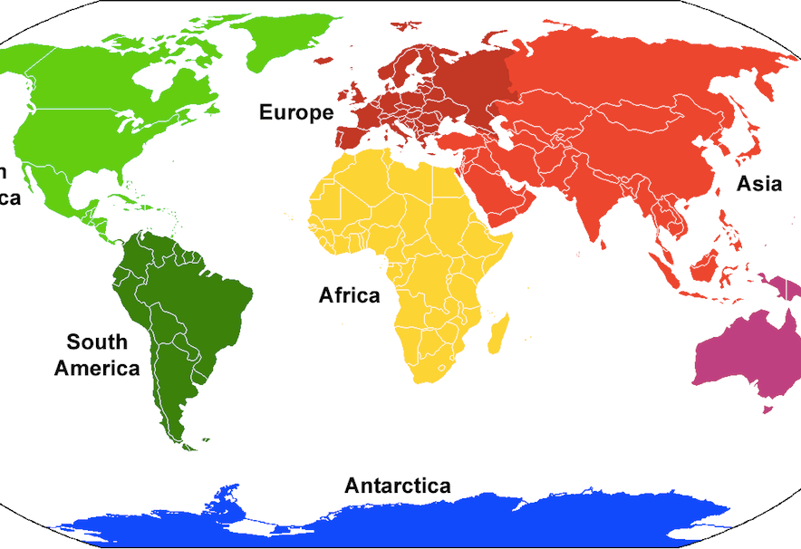
Geographical Distribution
Rickettsia rickettsii can be found on almost every continent except Antarctica
Disease, however, is restricted to the Americas (most common in southeast/southcentral states in N.A.)
Prefer warm damp places
Majority of infections occur between April and October (during rainy and warm seasons)

Slide 3
Bacterial Characteristics
Gram-negative, coccobacilli, with no flagella
Have LPS, peptidoglycan, and slime layer
Slime layer:
a) Allows bacteria to adhere to smooth surfaces
b) Helps protect bacteria against desiccation and antibiotics
Divide by binary fission inside host organism (cytoplasm or nucleus)
Metabolize host-derived glutamate via aerobic respiration and TCA cycle
Able to grow in levels of nutrients with exponential growth phase without lag period

Slide 4
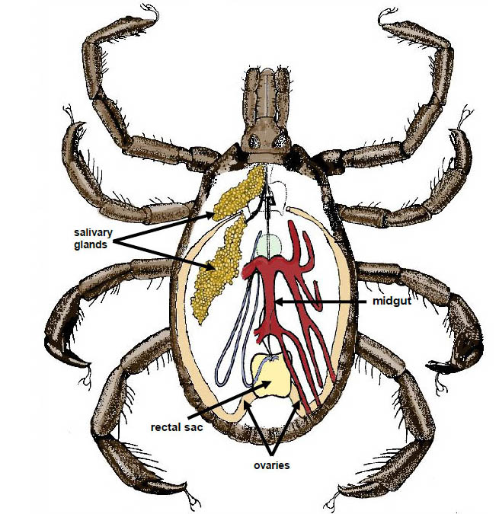
Vector Characteristics
Ixodidae (“hard-bodied”) ticks are the main vector
1) R. rickettsii must colonize the midgut
2) Bypass the tick’s midgut
3) Reach the salivary glands for transmission via tick bite
Other factors:
Bacteria must overcome vector’s defenses (phagocytosis by hemocytes, antimicrobial peptides, RNA interference)
Compete with other species of Rickettsia
Maintained in the vector by transovarial transmission (i.e. mother lays infects eggs)

Slide 5
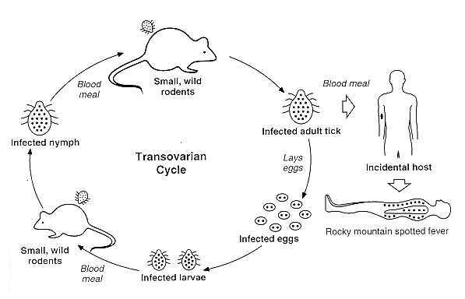
Vector Characteristics (Cont’d)
Occasionally uninfected ticks may become infected by feeding on reservoirs (small mammals that carry R. rickettsii in their bloodstream)
Infection mainly occurs through tick bite
Less likely ways of transmission: contact with infected tick’s saliva, blood, bodily fluids, or feces, or through contact with mammals infected with bacteria

Slide 6
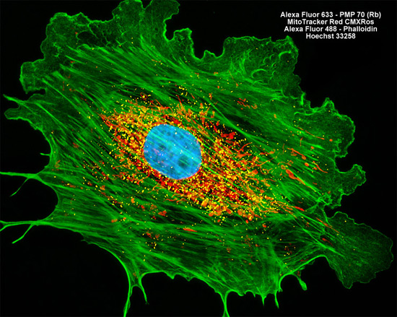
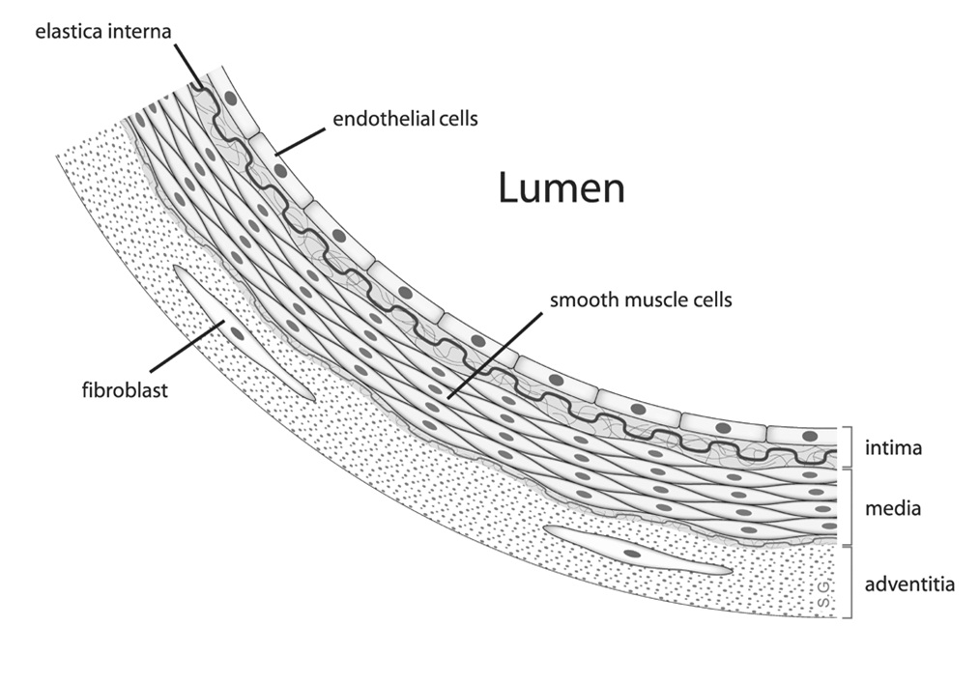
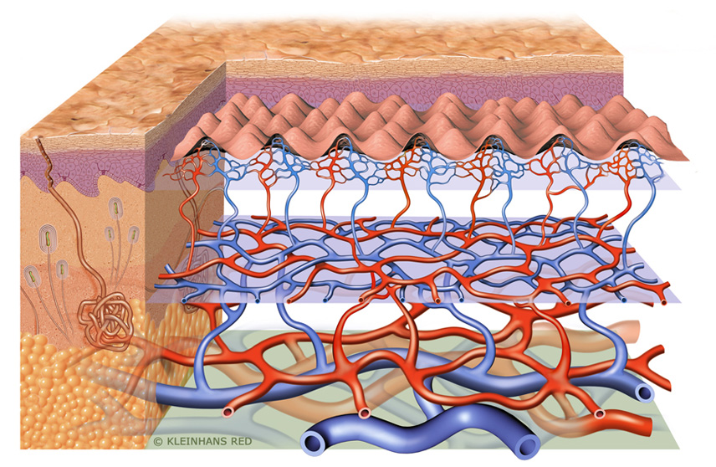
Bacterial Pathogenesis: Overview
(1) Bacteria enters host through skin at point of tick bite
Note: Can enter through mucous membrane and lugs (less likely)
(2) With high affinity, adheres to and invades vascular endothelial cells linking small and medium sized blood cells
(3) Replicates intracellular before spread

Slide 7
Bacterial Pathogenesis: Mechanism of Adherence
Main mechanism of adherence is adhesin-receptor interaction
rOmpA and rOmpB are the bacterial adhesins
Host cell receptors have not yet been identified
rOmpB also has a role in bacterial internalization into host cell
Host endothelial cell
rOmpA
?
R. rickettsii
rOmpB
?

Slide 8
Bacterial Pathogenesis: Entry
d) Signaling cascade culminates in activation of Arp 2/3 (actin nucleating complex); instigates localized actin rearrangement and engulfment of R. rickettsii
R. rickettsii likely uses the zipper mechanism for invasion:
a) Binding of OmpB to Ku-70 (a nuclear DNA-dependent protein kinase on host cell membrane)
b) Ubiquitination of Ku-70 via c-Cbl
c) Induction of mass host cell signaling events via activation of various effector proteins
R. rickettsii

Slide 9
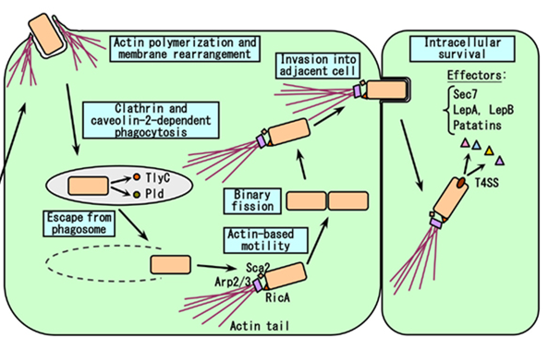
Bacterial Pathogenesis: Multiplication & Spread
Once internalized, R. rickettsii is inside a phagosome
Bacteria escapes phagosome via membranolytic phospholipase D and hemolysin C (and possibly phospholipase A2)
Once out into the cytosol, the bacteria can survive, grow and multiply using host nutrients

Slide 10
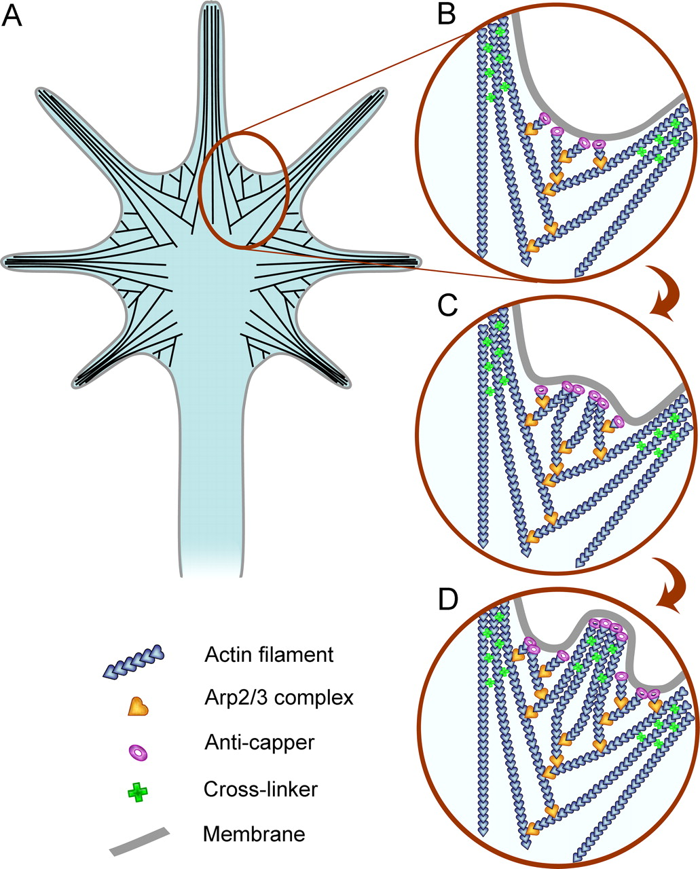
Bacterial Pathogenesis: Multiplication & Spread (Cont’d)
Infection of neighboring cells requires activation of bacterial Rick A protein by host Arp 2/3
Rick A directs actin nucleation at one end of bacterium to form little tails
Tails mediate movement around cytosol, once the bacterium gains sufficient velocity → formation of filopodia
Filopodia pierce into the adjacent cell → infection of neighboring cell

Slide 11
Maintaining Host Cell Integrity: “Endothelial Activation”
R. rickettsii
Increase NF-κB gene expression in infected endothelial cells
Directly interact with inactive form of NF-κB in host cytoplasm
MAP-Kinase (MAPK) pathway
Alter expression of B-cell lymphoma-2 (Bcl-2) family of proteins; includes anti-apoptotic and pro-apoptotic mitochondrial proteins
Inhibition of caspase-8/9 mediated apoptotic pathways
Net anti-apoptotic effect

Slide 12
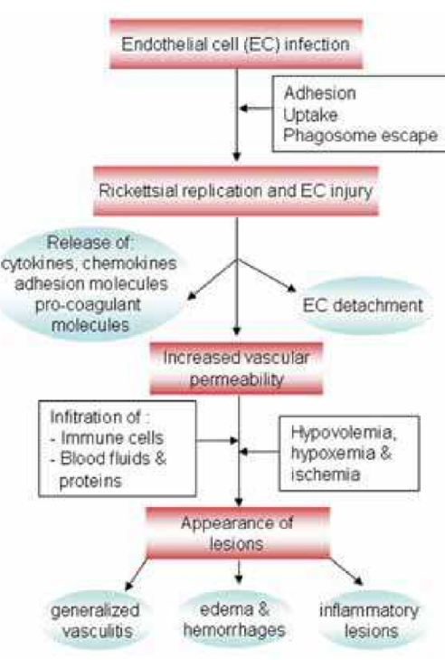
Bacterial Pathogenesis: Host Damage
R. rickettsii damages vascular endothelial cells
This can lead to multisystem vasculitis, necrotic lesions, and infiltration by perivascular mononuclear cells
Basically there is going to be a lot of blood/fluid leakage into the adjacent tissues

Slide 13
Bacterial Pathogenesis: Host Damage (Cont’d)
The consequences of this includes the dermal rash as well as…
Hypovolemia, reduced tissue perfusion
Coupled with decreased number of circulating platelets (via vascular leakage)…
There can be severe organ damage (due to decreased amounts of blood flowing to organs)
But how do we get here? (See summary of events on the next slide)

Slide 14
R. rickettsii
↓ Cellular glutathione (↓ Host defenses)
↓ Cellular adenosine 5-phosphate
↑ NF-κB Pathway
↑ MAPK Pathway
↑ Inflammatory mediators (e.g. IL-1, -6, -8) *accounts for fever
↑ Oxidative stress (↑ ROS e.g. O2-, H2O2)
Failure of Na+ Pump
↑ Heme oxygenase (HO-1) – (Regulator of vascular cyclooxygenase system) *by-product biliverdin may account for abnormal liver function test
↑Membrane Dilation, Loss of osmoregulatory control, cell lysis
↑ COX-2 & prostaglandin (PGE2/I2
↑Vascular permeability & Edema

Slide 15
THE END ☺

