Slide 1
Pathology 417 Case 1 Microbiology Laboratory
By: Sabrina budhwani

Slide 2
CASE 1: Traveling in India
Fulfilling a long held travel dream, Robert has taken six months off work and is making his way through India taking in the sights, experiencing local festivals and making time to get to know the people. He is cautious in his hygiene, eating and drinking habits but despite this he contracts a diarrhea with voluminous outpouring of fluid accompanied by vomiting. He suspects cholera and with the help of a fellow traveler gets himself to a local hospital where a stool sample is examined and his presumptive diagnosis is confirmed. He stocks up on appropriate fluids and stays put at the hostel he has booked into for a few days, experiencing some minor leg cramping along with the diarrhea. His curiosity about his illness has him reading up on the organisms when he returns to North America and he is left wondering what serotype of Vibrio cholerae he might have contracted, should he have been prescribed antibiotics, was there anything more he could have done to prevent contracting the organism and might he now be a carrier?

Slide 3
Q1: Other than the stated bacterial cause, what are the most common bacterial pathogens associated with this type of infectious scenario in Asia and in North America?

Slide 4
Usual Suspects in Asia (in order of prevalence)
Campylobacter
Shigella
Escherichia coli
Salmonella

Slide 5
Usual Suspects in North America (in order of prevalence)
Campylobacter
Salmonella
Shigella
E.coli

Slide 6
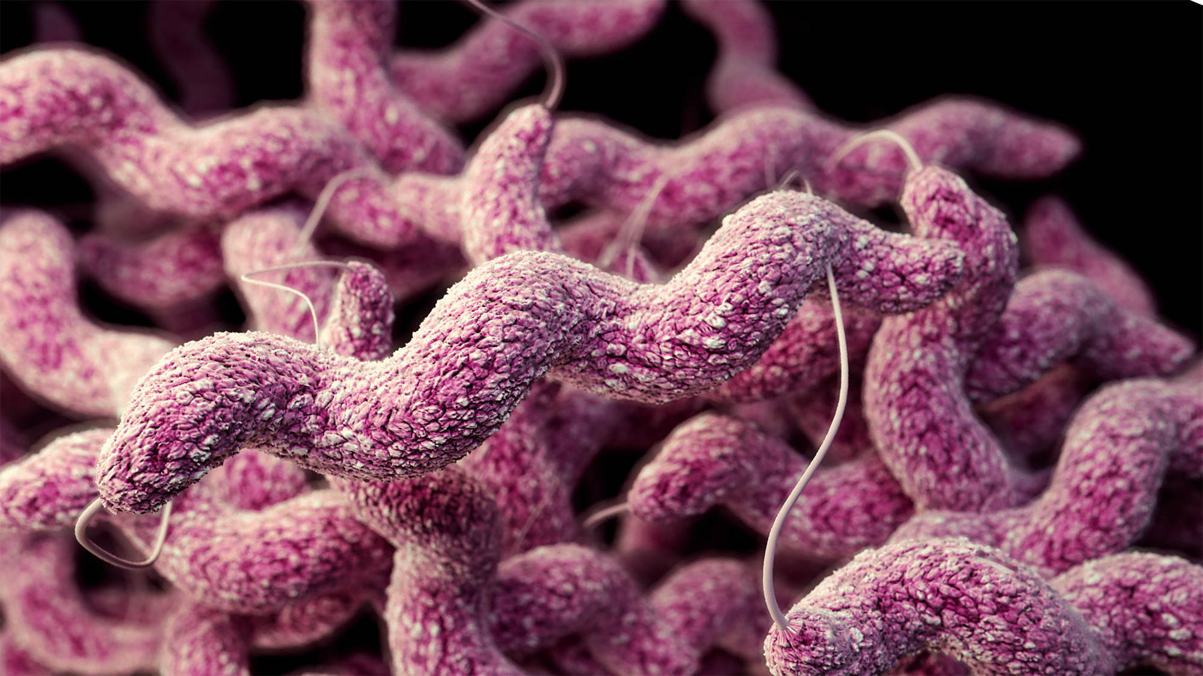
Campylobacter
Campylobacter is the leading cause of foodborne diseases in Southeast Asia – infecting 20 million people/year and is also the leading foodborne disease in North America – infecting 1.3 million people/year (WHO 2015)
Campylobacter infects the large and small intestines
Symptoms:
diarrhea, abdominal pain, fever, nausea, and vomiting
Figure 1. Campylobacter is a s-shaped, motile gram negative bacteria (CDC 2016)

Slide 7
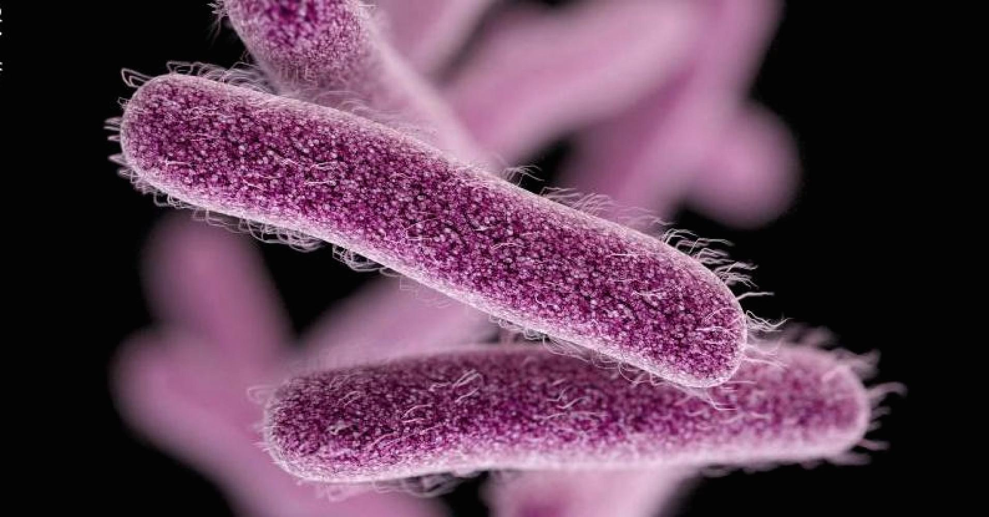
Shigella
Intestinal disease
Symptoms
Tenesmus, abdominal pain, watery diarrhea, fever, vomiting, dehydration, dysentery and convulsions
Figure 2. Shigella is a gram-negative, non motile, rod shaped bacteria (CDC 2016)

Slide 8
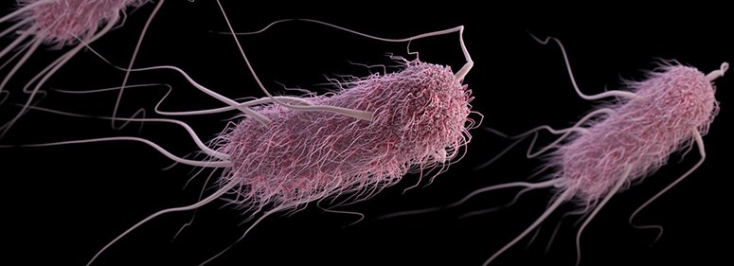
Escherichia coli
E.coli is harmless and is part of our healthy gut flora
E.coli can become virulent due to mutations leading them to produce Shiga toxin
Enteropathogenic E.coli is an important cause of infant diarrhea, and Enterotoxigenic E.coli is the cause of travelers diarrhea
Symptoms
Severe stomach cramps, bloody diarrhea, vomiting and fever
Figure 3. E.coli is a rod shaped, gram-negative coliform bacterium (CDC 2018)

Slide 9
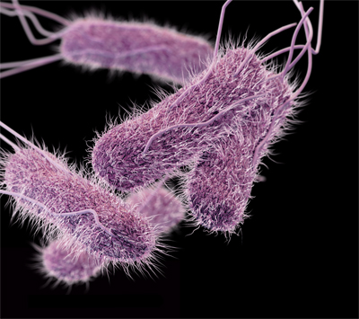
Salmonella
Due to undercooked poultry – causes salmonellosis
One of the most common causes of food borne illness
Symptoms
Diarrhea, abdominal cramps, fever and can lead to life threatening febrile systemic illness
Figure 4. Salmonella is a rod-shaped gram negative bacteria (CDC 2014)

Slide 10
Q2: What samples are taken for laboratory testing in these cases and how important is the Microbiology Laboratory in the diagnosis of this particular infectious disease?

Slide 11
Stool Sample
To determine the pathogen causing diarrhea, a stool sample must be collected since the stool sample is likely to have the pathogen present
Since cholera has symptoms similar to those of other food borne illness causing pathogens (e.g. Salmonella, E.coli), it is necessary to distinguish the pathogen of interest
In order for Robert to give a stool sample, he must ensure he has followed certain restrictions prior to this test
Dietary restrictions 72 hours before taking the sample to make sure drugs and chemicals are not present in the body

Slide 12
Importance of the Microbiology Laboratory for Diagnosis
In order to provide the correct treatment to Robert, it is crucial to identify the pathogen causing his symptoms.
It is also important to provide treatment in a timely manner due to the detrimental effects of diarrhea and in order to avoid further complications.
Providing accurate treatment is also crucial since providing the wrong treatment can lead to further illness or even increase the virulence of the pathogen.

Slide 13
Q3: Explain the tests that will be performed on the samples taken in order to detect any of the potential bacterial pathogens causing this disease. What about Roberts question regarding serotype- how is this answered in the laboratory?

Slide 14
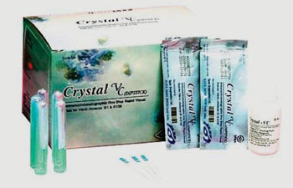
Tests Performed on the Stool Sample prior to reaching the laboratory
As a quick initial screening process the Crystal VC dipstick is used to detect LPS of the O1 and O139 serotype V.cholerae. If positive results arise then these are transported to the labs for further investigation.
During this transport, the following transport mediums are used to preserve and allow growth of V.cholerae
Cary-Blair or Alkaline peptone water (APW)
Figure 5. Crystal VC Dipstick is a rapid immunochromatographic test. (Labmedica 2016)

Slide 15
Tests Performed on the Stool Sample after reaching the laboratory
Cultures from the transport medium are plated onto a petri dish or a glass slide containing thiosulfate-citrate-bile salts-sucrose (TCBS) agar in order to isolate V. cholerae. Using the streaking technique, single bacteria colonies form and then the stool samples are incubated in the medium.
Further confirmation steps are undertaken to confirm the presence of V.cholerae
The oxidase test: using oxidase reagents on the petri dish/glass slide – change of color to purple yields a positive test result
String test: to rule out Aeomonas, sodium deoxycholate is added
Gram stains: morphology of V.cholera can be identified by a microscope
PCR: targets virulence genes or DNA sequences specific to the pathogen
Growing bacteria on various media

Slide 16
Serotyping
In order to determine the serotype sterile saline is dropped onto a glass slide and a suspension of V.cholerae is added.
Next, a drop of antiserum specific for O1 group V.cholerae is added
If there is agglutination within 1 min, this is a confirmatory result for O1 serotype. IF there is no agglutination the sample can be tested with O139 antisera.
If it is a O1 serotype then it can then be further tested on to determine which of the three O1 serotypes it is

Slide 17
Q4: What are the results expected from these tests that might allow the identification of the bacteria named in this case?

Slide 18
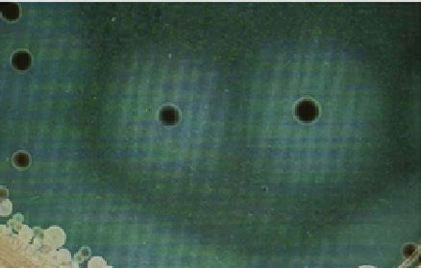
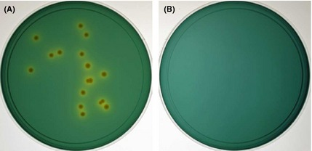
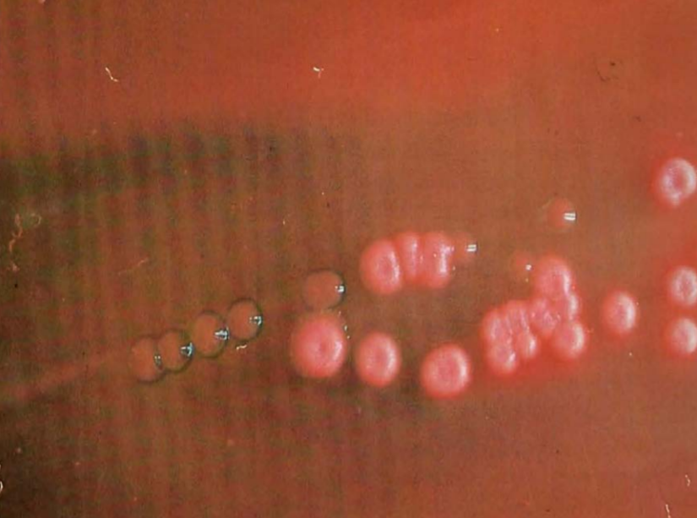
Cultures
Depending on the culture used, one could expect various results
If cultured on Taurocholate-tellurite-gelatin agar (TTGA), colonies will be approx. 1-2mm in diameter and have a black center.
If cultured with thiosulphate citrate bile salts sucrose agar (TCBS), colonies will be yellow and shiny
If cultured with MacConkey medium, colonies will be colorless to pink (though not all strains of V.cholerae O1 is able to be cultured using this medium)
(A)
(B)
Figure 6. (A) Shows TTGA culture with the black centers. (B) shows the – and + test results of the TCBS culture which are yellow. (C) shows the MacConkey culture.
(C)

Slide 19
ELISA/FLISA & Immunocapture Agglutination Assay
Enzyme-linked immunosorbent Assay (ELISA) is used to identify the Cholera toxin or virulence factor Mucinase by using an enzyme substrate which changes colour when it binds to an antigen bound antibody.
FLISA (Fluorescence-linked immunosorbent Assay) is similar to ELISA except that a fluorophore-tagged antibody is used which emits light when an epitope-antigen binding occurs.
Immunocapture Agglutination Assay can be used for V.cholerae associated antigens (CT), if the antigens are present then large clumps form because of the antibodies cross linking between antigens.
* Note: these methods are used mainly in research facilities and diagnostics outside of Canada

Slide 20
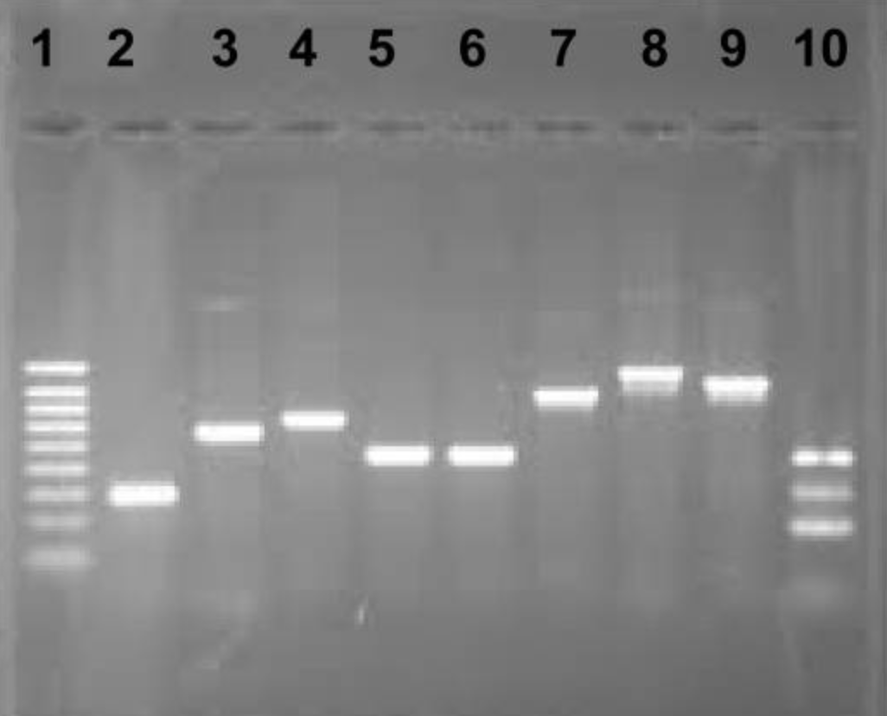
Polymerase chain reaction (PCR) and Non-inhibitory Detection Methods
Figure 7. PCR results for V.cholerae showing Lane 1, Hyperladder IV (Bioline); lane 2, V. cholerae-specific ITS; lane 3, ctxA (pCTA); lane 4, tcpA of V. cholerae O1 Classical, lane 5, tcpA of V. cholerae O1 El Tor; lane 6, tcpA of V. cholerae O139; lane 7, toxR; lane 8, zot; lane 9, ompU; lane 10, O1-O139/ctxA multiplex of V. cholerae O1 and O139. (Huq et al, 2013)
PCR amplifies genomic regions using PCR primers specific to V.cholera. Strains of V. cholerae can be screened for genes associated with virulence. PCR products are analyzed by gel electrophoresis and visualized under UV light with ethidium bromide.

Slide 21
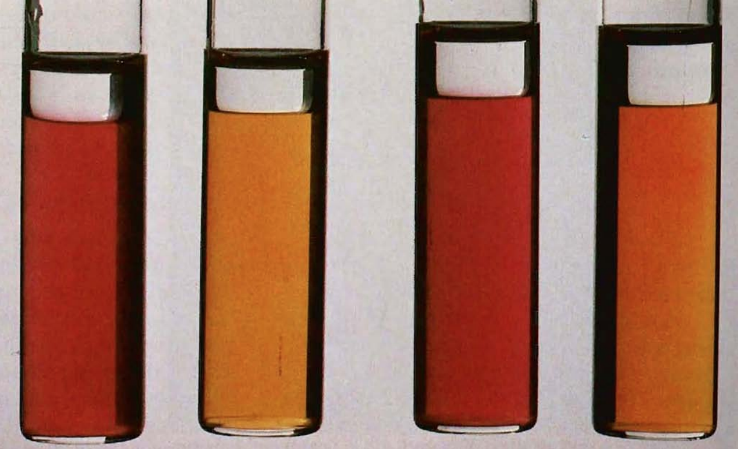
Non-inhibitory Detection Methods
Decarboxylase/dihydrolase reactions- bromcresol purple and cresol red are used as indicators. V. cholerae is positive for lysine decarboxylase and ornithine decarboxylase while being negative for arginine dihydrolase.
The indicators produce a dark orange colour for a positive result for the lysine and ornithine, and a yellow colour for the negative arginine result.
Kligler’s iron (KIA) agar or triple sugar iron (TSI) agar contain carbohydrates and are mediums used to identify V.cholerae.
V.cholerae ferment the sugars (carbohydrates) in these mediums and a pink colour indicates acid production using an Andrade indicator.
Figure 8. Decarboxylase and dihydrolase reactions for V. cholerae are, from left to right, lysine (+), arginine (-), ornithine (+), and control (-) (CDC 2018)

Slide 22
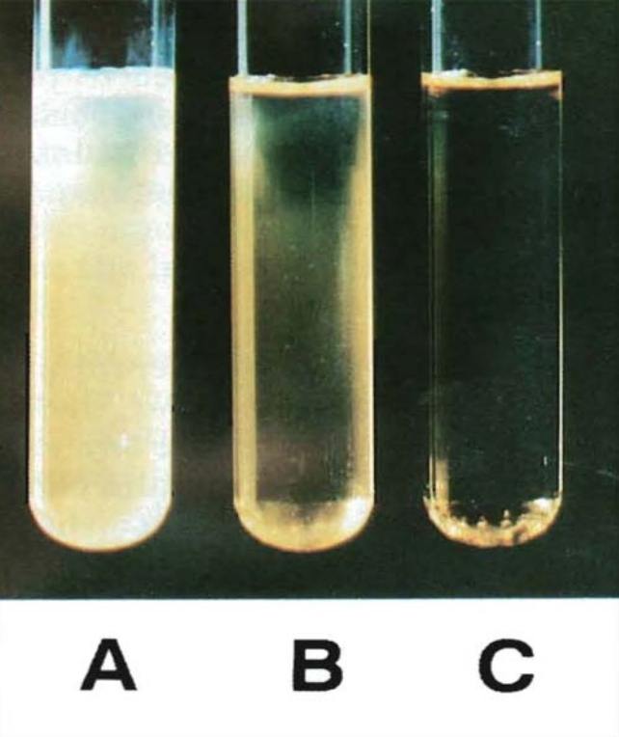
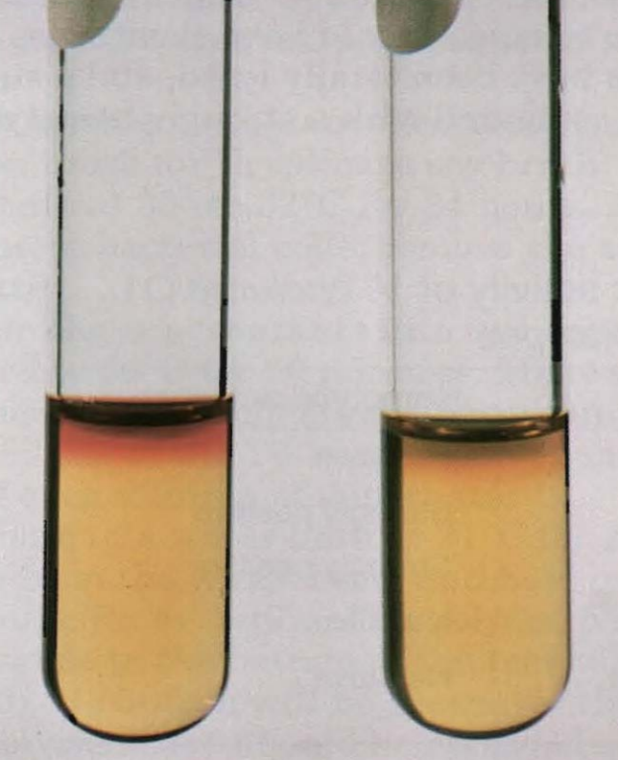
Non-inhibitory Detection Methods Cont.
Salt broths: V. cholerae grows without NaCl, but addition of 1% NaCl can stimulate growth. This growth can be detected visually.
Voges-Proskauer tests: increases its sensitivity to vibrios. A positive reaction is indicated by a cherry red colour.
Figure 9. V. cholerae grows in the absence of NaCl (tube B) but growth is stimulated with addition of 1% NaCl (tube A). Tube C shows 0% NaCl, inoculated with V. parahaemolyticus, and no growth, (CDC 2018)
Figure 10. V. cholerae produces acetoin, which is detected in the Voges-Proskauer test, giving a red (positive) reaction (left). A negative reaction is on the right (CDC 2018).

