Slide 1
L. pneumophila: The body system PATH 417 – GOY Isabelle - UBC

Slide 2
CASE: A Cruise Holiday
To celebrate Tom’s retirement his wife and two adult children accompany him on a long anticipated cruise. Tom’s asthma flares up a few days before the cruise but with a corticosteroid nebulizer in tow he feels well enough to join the cruise. Even more than the rest of his family, Tom enjoys the various hot tubs aboard the massive ship those first few days, relishing the relaxation after a busy final year at work.
On the fifth day of the cruise, Tom wakes up in a sweat with a cough that continues throughout the day. As the day wears on he feels worse with a headache, muscle aches and nausea accompanying the cough. His wife arranges for the cruise doctor to visit him in his cabin. The doctor examines Tom, notes his high temperature, relatively nonproductive cough and recent history of asthma and corticosteroid therapy. She takes a full history including taking note of his activities during the first days of the cruise and diagnoses Tom with a pneumonia. She explains that her presumptive diagnosis is that of Legionnaires disease and leaves Tom’s wife with a sterile sample container to collect whatever fluid Tom might cough up for delivery to her. She explains that she can do a microscopic examination on the respiratory fluid which will help in the diagnosis.
In the meantime she starts Tom on erythromycin and lets the family know that she will check in on Tom regularly over the next few days to monitor his progress. More people are diagnosed with a similar pneumonia over the next two days, mostly in people who came aboard with a slightly compromised immune system, like in Tom’s case. The cruise ship alerts the hospital at their next port of call in case any of the patients worsen enough to require hospitalization. When they arrive at port blood samples are collected from all of the patients and delivered to the hospital laboratory for serology. The ship also takes extra time in port to allow for a full scale sterilization regime to be performed on all of the hot tubs. At this stage Tom is feeling well enough to continue on the cruise, although at a slower pace than when he first boarded.

Slide 3
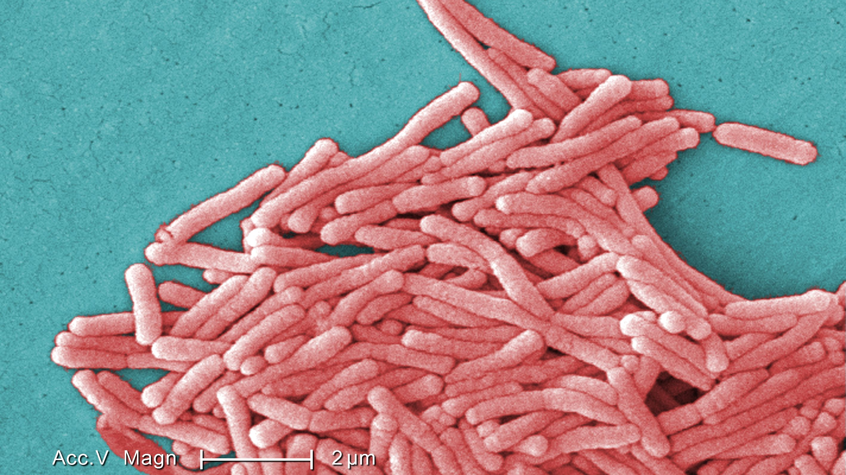
Gram-negative, non-enteric, opportunistic bacilli
Nosocomial cause of infections
5% of those exposed to Legionella bacteria will develop Legionnaires’ disease
Found in aquatic environment (natural ones or artificial water systems):
free or intracellular parasite of Amoeba species or humans, where they reside into the alveolar macrophages
Tolerant to heat, chlorine and acid
Forms biofilms:
their survival rate in external environments
2 ways of contracting Legionella:
Aspirating contaminated water (which goes into the trachea instead of the oesophagus)
Inhalation of air with water droplets containing the bacteria
L. Pneumophila ID

Slide 4
Who’s more susceptible ?
Immunocompromised people
People with a pulmonary deficiency
Old people
Our patient, Tom, is an old person, has asthma and is taking corticosteroids, which weakens his immune system. All these factors predispose him to contract the disease.

Slide 5
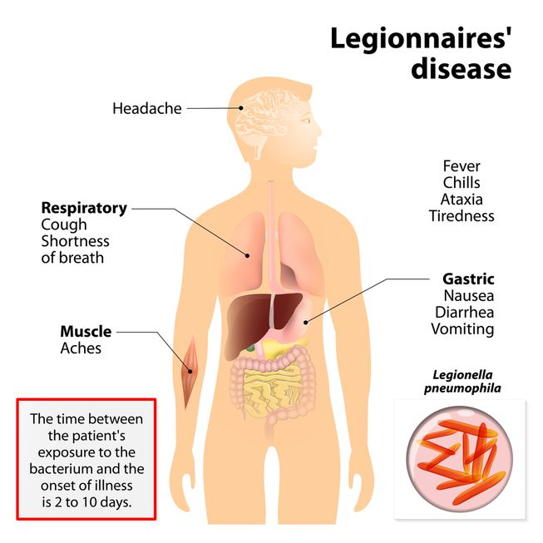
Legionnaires’ disease symptoms and signs
Malaise, lethargy, and weakness
Non-productive cough → changes to one with produced mucus and sputum over several days
Shortness of breath →Bradycardia as the illness progresses
High fever
Might also be observed: chest pain and progressive dyspnea
Extrapulmonary symptoms: diarrhea, nausea and vomiting, myalgias (muscle pain) and arthralgias (joint pain)
Symptoms are very similar to other bacterial pneumonias → difficulty for diagnosis

Slide 6
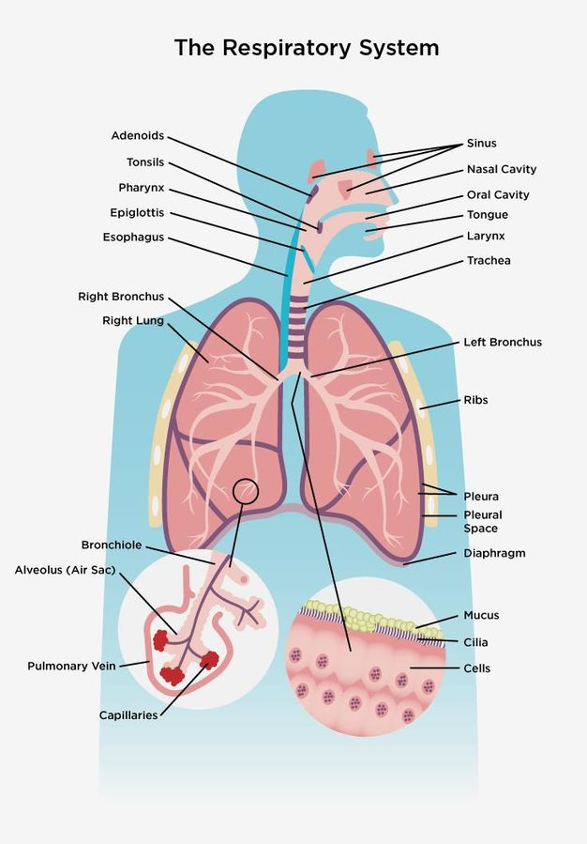
Body system affected
Legionella colonizes and infects the respiratory system
Normal physiological functions of the respiratory tract : flow of oxygen and carbon dioxide in and out of the body
Legionnaires’ disease targets the lungs
Alveoli: small sacs which are innervated by many capillaries and are the location for oxygen to enter the blood and carbon dioxide to leave the blood
Other essential functions run by the lungs: monitoring and controlling the pH of the blood and maintaining blood pressure

Slide 7
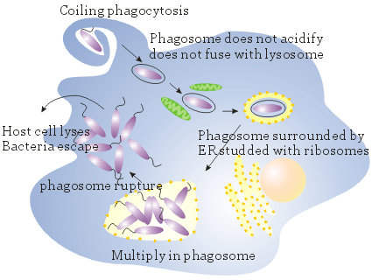
Body system: what goes wrong
Immune response from the host: Legionella is engulfed by alveolar macrophages: Legionella:
lives within a replicative phagosome
retards the regular phagosome-lysosome fusion pathway by:
Altering the LCV (Legionella containing vacuole) proteins’ composition
Modifying the trafficking pathway with the ER to accumulate food supplies
Leads the lyse of the macrophage which allows the spreading of the pathogen to other surrounding cells

Slide 8
Body system: What goes wrong ?
When Legionella infection occurs: alveoli of the lungs become inflamed as they are filled with fluids
Why ? Leukocytes migrate and accumulate forming alveolar exudate filled with neutrophils, macrophages, monocytes, pus and fibrin
Consequences: Difficulty of getting oxygen into the blood system for transport to cells and organs.
→ Necessity to increase blood’s flow → has to work harder → becomes weaker → blood’s flow decreases → kidney failure
If left untreated, it could lead to death

Slide 9
How to fight Legionella ? Erythromycin
Semisynthetic macrolide antibiotic
Used to treat a variety of mild-to-moderate bacterial infections
Bacteriostatic
Prevents bacterial cells from growing and multiplying by interfering with their ability to make proteins without targeting host cells
How ? : Through the binding of the 50S bacterial ribosome subunit

Slide 10
Would this be considered an outbreak, is it reportable and to what official body?
Outbreak: occurrence of more disease cases than would be expected in a given area considering a specific group of people over a particular period of time.
Tom’s case: localized outbreak of Legionnaires’ disease which should be report and be given immediate attention
Legionnaires’ disease is considered as an outbreak if at least 2 people are infected
Proper procedure should be followed to inform the Public Health Agency of Canada in order to execute the subsequent action against the disease.
Finally, they will ensure the infection is contained and no further spread progresses.

Slide 11
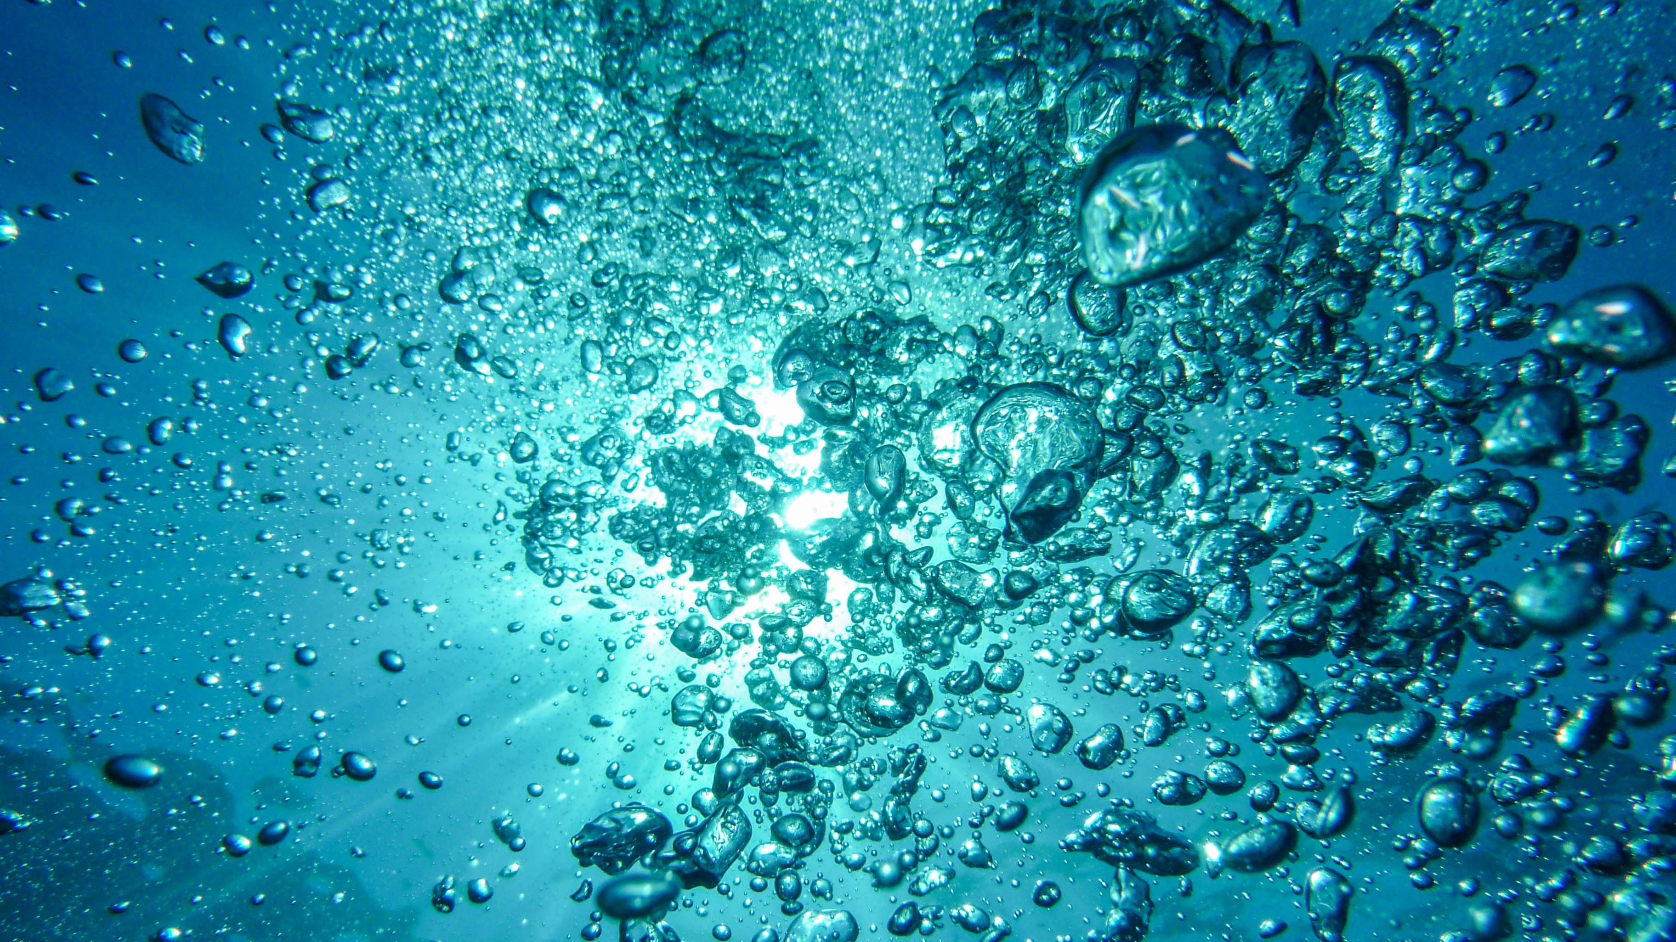
What role might the hot tub have played in this infectious scenario?
It might have acted as a water reservoir for the bacteria
→ Proper sterilization and re-evaluation of hygienic measures must be taken
→ Full scale sterilization regime of all hot tubs must be done

