Slide 1
Microbiology Laboratory
Week 2

Slide 2
The Patient
Naser G.
Age: 21
The clinical presentation suggests urethritis, commonly present in sexually transmitted infections such as Chlamydia and Gonorrhoeae

Slide 3
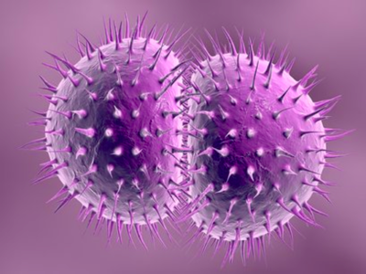
Common Bacterial Pathogens
Neisseria gonorrhoeae
Intracellular, gram-negative, cocci bacteria
Usually seen in pairs
Contains pili that aid adherence
0.6-1.0 μm in diameter
Incubation period of 2-6 days
Commonly infect the cervix,
urethra, rectum, pharynx,
and conjunctiva
N. gonorrhoeae

Slide 4
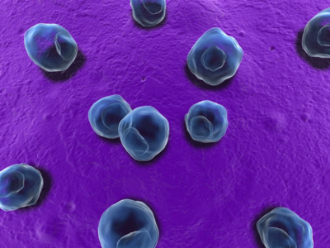
Common Bacterial Pathogens
Chlamydia trachomatis
Non-motile, obligate intracellular bacterium
Elementary Bodies: non-replicating, infectious
0.24-0.3 μm, rigid cell wall, DNA genome and plasmid
Released from ruptured infected cells
Reticulate Bodies: Non-infectious, form in the cytoplasmic vacuole of elementary bodies
0.5-0.6 μm
Hemagglutinin facilitates cell adhesion
18 serovars
A-K serovars limited to surface
D-K associated with
urinary tract infections
L serovars are invasive
C. trachomatis

Slide 5
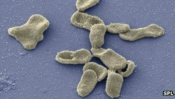
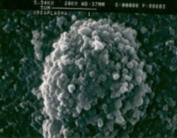
Less Common Bacterial Pathogens
Mycoplasma genitalium
Gram negative, flask shaped
0.2-0.7 μm
Contains ribosomes, plasma membrane, double-stranded circular DNA
Contribute to nongonococcal urethritis, cervicitis, and pelvic inflammatory disease
Ureaplasma urealyticum
Gram negative cocci
No cell wall
Produces urease
0.2-0.8 μm, spherical
M. genitalium
U. urealyticum

Slide 6
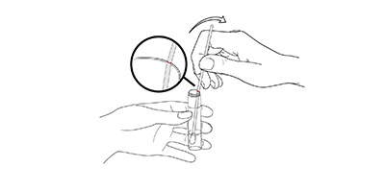
Methods for Diagnosing a Sexually Transmitted Infection
Urethral Smear
Massage the urethra from proximal to distal
plastic loop
Urine Sample
Standard for STI testing
Non-invasive; preferred by patients
The microbiology laboratory is important to determine cause and treatment of the infection
Early detection and treatment can reduce complications

Slide 7
Specimen Guidelines
 | Urethral Swab | Urine Sample
Collection: | Patients should not pass urine >2 hours prior Rotate 1-2 times 2-4cm inside the urethra | Patients should not pass urine 1-2 hours prior to collection 10ml of “first catch urine”
Transport: | In swab specimen transport tube at 2-30°C | Transported in a properly labeled container with secure lid
Storage: | Keep frozen up to -70°C, up to 60 days | Keep refrigerated at 2-8°C up to 30 days

Slide 8
Laboratory Tests
Culture Tests | Non-Culture Tests
Gram stain | Giemsa stain
Differential media - Thayer Martin agar - Mycoplasma agar - Mccoy cell monolayer | - Immunoassay
Biochemical tests - Oxidase - Catalase test - Acid production test | Molecular tests - Nucleic Acid Amplification test

Slide 9
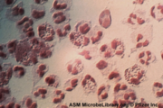
Gram Stain
Crystal violet (basic dye)
Adding iodine (mordant), forms an insoluble complex
Alcohol wash for decolourization
Safranin counterstain
Results:
Purple = Gram-Positive
pink = Gram-negative
Gram stain of N. gonorrhea

Slide 10
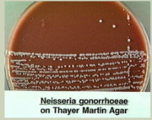
Thayer Martin Agar
2.0g beef extract
17.5g casein hydrolysate
1.5g starch
17.0g agar dissolved in 1 liter of distilled water, pH adjusted to neutral at 25 °C
5% chocolate sheep blood
Results:
N. gonorrhoeae shows growth
C. trachomatis will not show growth
Presence of N. gonorrhoeae

Slide 11
Mycoplasma Agar
10.0 g/L Bacteriological peptone
10.0 g/L Lab-Lemco powder
5.0 g/L Sodium chloride
0.5 g/L Mineral supplement
10.0 g/L Agar
Results:
N. gonorrhoeae shows no growth
C. trachomatis shows no growth
M. genitalium shows growth

Slide 12
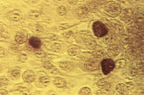
McCoy Cell Monolayer
Tests for Chlamydia trachomatis
Labour-intensive, slow and expensive
other non-culture detection methods
Results:
N. gonorrhoeae shows no growth
C. trachomatis shows growth
C. Trachomatis on McCoy monolayer

Slide 13
Oxidase
Determines if a bacterium contains Cytochrome C oxidase
tetramethyl-p-phenylenediamine turns purple when oxidized
Results:
Positive = purple
Purple indicates positive for N. gonorrhoeae
Negative = no colour change
Positive for aerobic bacteria
Presence of N. gonorrhoeae

Slide 14
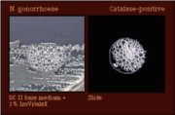
Catalase Test
Detects the ppresence of the enzyme catalase
H2O2 → H2O + O2
Results:
The presence of N. gonorhhoeae will produce bubbles (+)
The presence of C. trachomatis will produce bubbles (+)
Presence of N. gonorrhoeae

Slide 15
Acid Production Test
Phenol red will change colour if an organism produces sufficient amounts of acid by utilizing glucose
Results:
N. gonorrhoeae indicated by yellow
Other bacteria indicated by red
Presence of N. gonorrhoeae

Slide 16
Giemsa Stain
Can be used to detect C. trachomatis
Stain contains azure II-eosin, azure II-glycerin, and methanol
Results:
C. trachomatis indicated by purple colour

Slide 17
Immunoassay
Bacterial antigen can be detected using antibodies
Antibody binds to LPS on bacterial cells
Substrate is added to a specimen and the product is measured
Results:
Presence of C. trachomatis will be indicated by a positive result

Slide 18
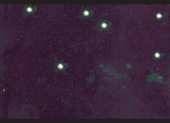
Direct Fluorescent Antibody
Uses antibodies to detect bacterial antigens
Fluorescent dye attaches to antibody
Detects LPS on bacteria
Results
Will be positive in the presence of N. gonorrhoeae and C. trachomatis
Presence of C. trachomatis

Slide 19
Nucleic Acid Amplification Test
Amplification and detection of the RNA/DNA of the bacteria
Looks for specific base pair sequences
Results:
Can detect N. gonorrhoeae and C. trachomatis

