Slide 1
Choose your own research adventure
(RE)SEARCH FOR CORDACAE
BY KATHERINE MILLER AND MAGGIE FABER

Slide 2
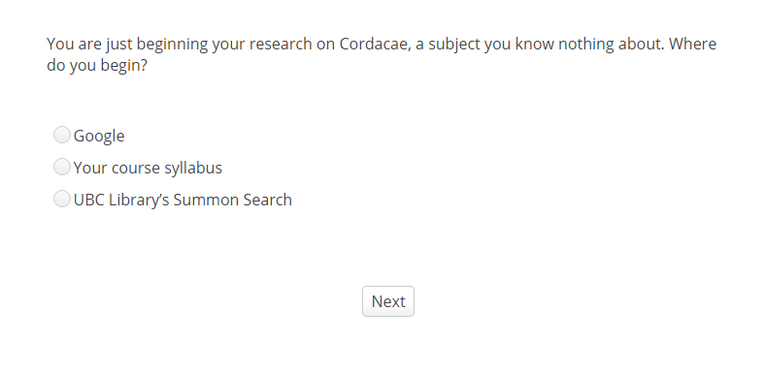
Choose Your own research adventure

Slide 3
AGENDA
Background
Challenges
Successes
Recommendations

Slide 4
AGENDA
Background
Challenges
Successes
Recommendations

Slide 5
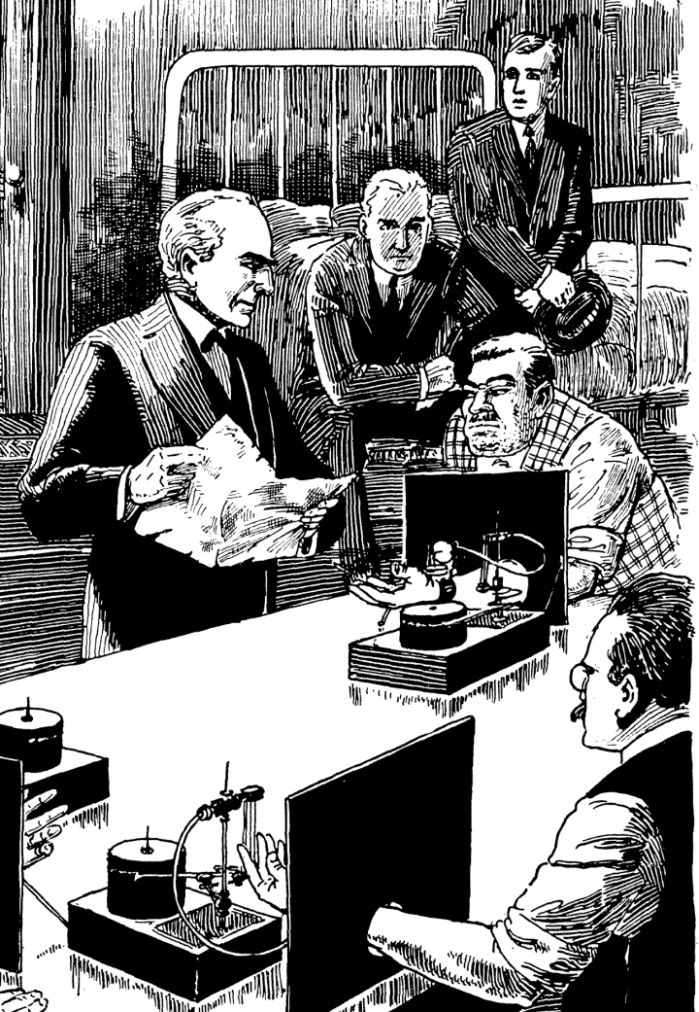
Problem Statements
No way to get use data out of Connect
No way to track student (dis)engagement
No way to represent complexity and flexibility of research process
…

Slide 6
Problem Statements
Most of the students apologized at some point for either their research process or how they sorted information, and some of them indicated that they thought they were doing research ‘wrong’. The process seems to be intimidating to them, and one that they want to do correctly but fear doing poorly.

Slide 7
Desired outcomes
Reinforce student choices/build confidence
Build best practices into pre-existing work habits
Demonstrate applied Information Literacy skills in practice
Get a sense of where students were having questions, problems, & lack of interest in tutorial
Quick, fun, non-intrusive

Slide 8
AGENDA
Background
Challenges
Successes
Recommendations

Slide 9
AGENDA
Background
Challenges
Successes
Recommendations

Slide 10
Design challenges
Built in FluidSurveys using Skip Logic to display questions
42 Questions/content nodes
116 Possible responses
59 Branching rules governing skip logic

Slide 11
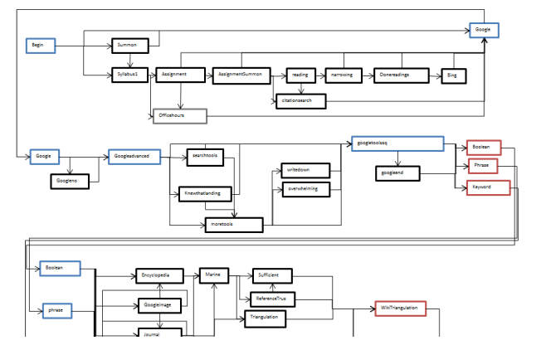
Reporting Challenges

Slide 12
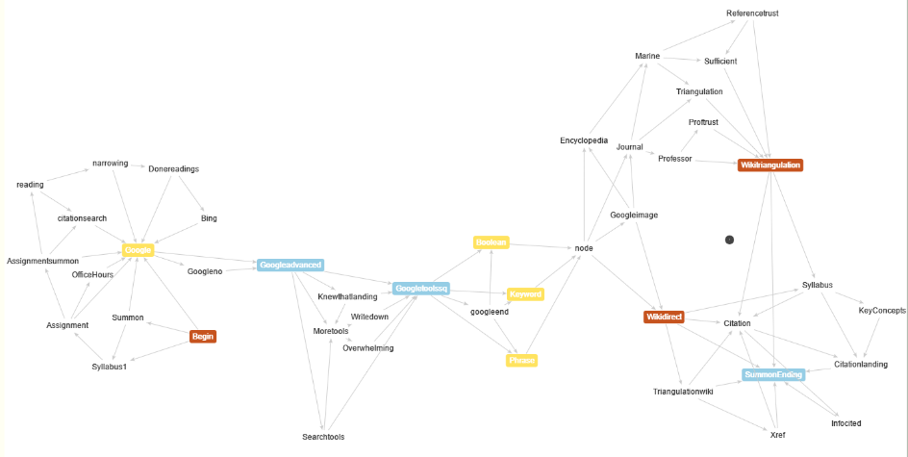
Reporting Challenges

Slide 13
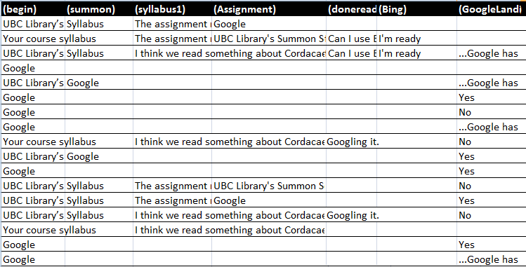
Analysis Challenges

Slide 14
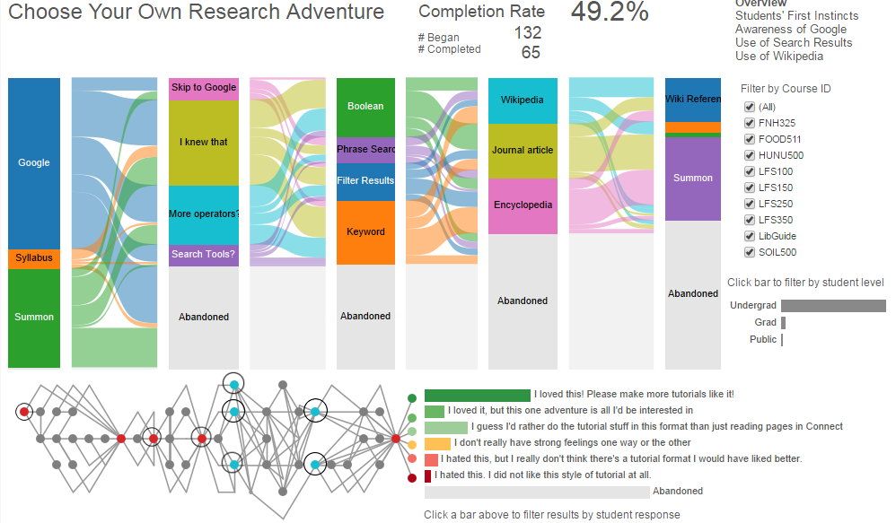
Analysis Challenges

Slide 15
AGENDA
Background
Challenges
Successes
Recommendations

Slide 16
AGENDA
Background
Challenges
Successes
Recommendations

Slide 17
Initial Results
78% Positive response, with 49% requesting additional content
49% Completion Rate
Of the abandoned responses, 70% left after the first question

Slide 18
AGENDA
Background
Challenges
Successes
Recommendations

Slide 19
AGENDA
Background
Challenges
Successes
Recommendations

Slide 20
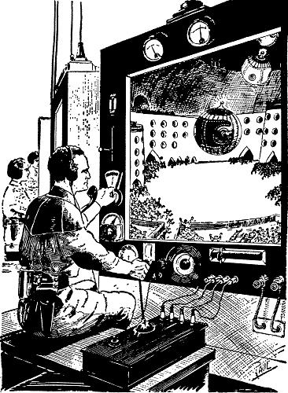
Prioritize key tasks
In-depth assessment vs. sustainability
Comprehensiveness vs. development demand

Slide 21
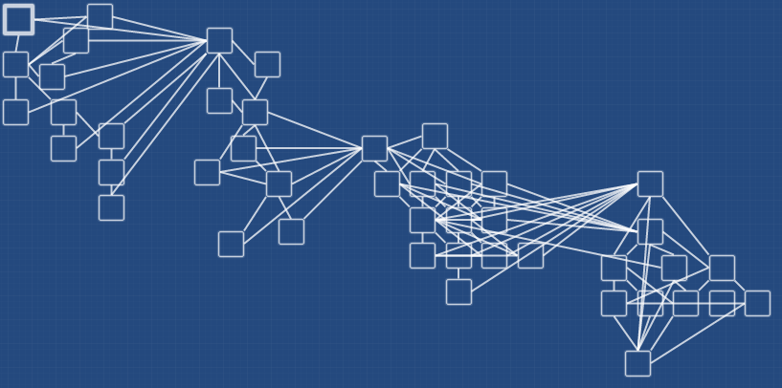
Use the right tools
Twine

