Slide 1
Case 4 – A Chronic Cough
Bacterial Pathogenesis
By: Michaela Darjuan

Slide 2
1. Encounter
Where does the organism normally reside, geographically and host wise, and what are the bacterial characteristics that leave it suited to these places of residence. How would our patient have come in contact with this bacteria?

Slide 3
95% of cases in developing countries Resurgence of outbreaks in Australia, Netherlands, UK, and US Due to decline in immunity and mutated strains that produce more toxins

Slide 4
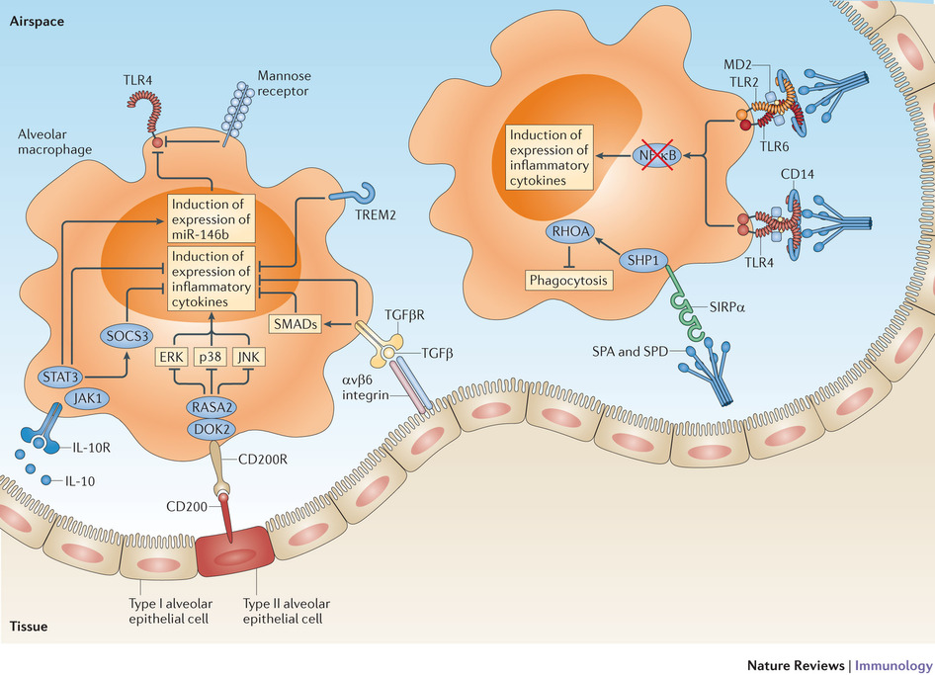
Hosts
Inhibits respiratory epithelial cilia
Found in alveolar macrophages
Small and non-motile
Suitable to enter and rest through nasopharynx (provides moisture and warmth)
Can form a biofilm to help it bind to the ciliated epithelium and survive host clearance
Bps polysaccharide is required for biofilm formation and functions as a nasal adhesion while resisting complement
Promotes adherence to nasal epithelia but not the lungs

Slide 5
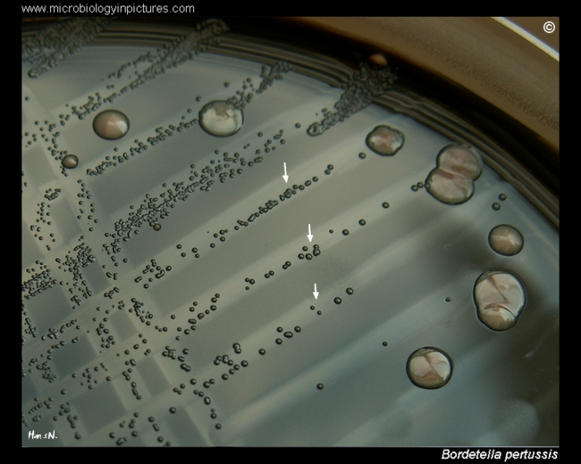
Cultivation
Can be cultivated on blood supplemented rich media
Antigenic modulation under stressful conditions (low temperature and high nicotinic acid) cause it to be avirulent (loss of capacity to create toxic and structural components)
Grown in aerobic conditions and pH 7-7.5 making the respiratory tract a good place to reside

Slide 6
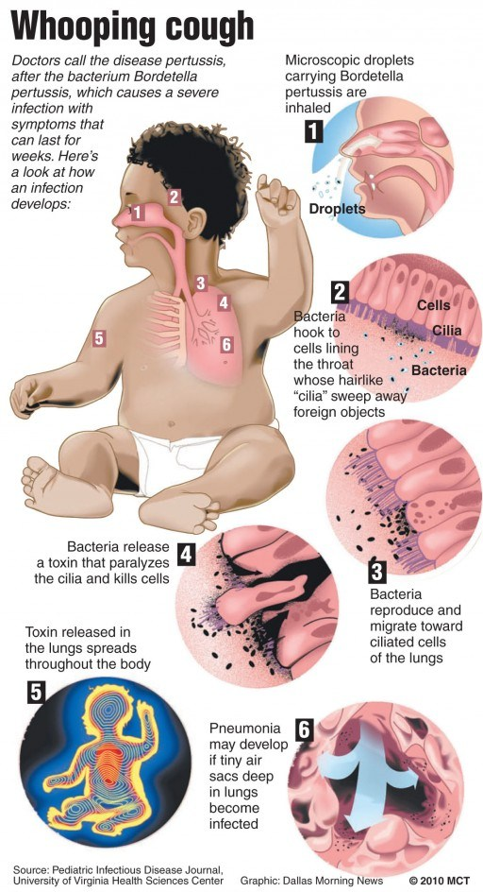
Pathogenesis
Passed on by coughing or sneezing from person to person
More B. pertussis DNA is found in the nasopharygeal swabs more in children compared to adults
Adherance in the airway lining is mediated by FHA (filamentous hemagglutinin adhesin), pertussis toxins, fimbriae, and pertactin

Slide 7
2. Entry
What facilitates the entry of the bacteria into the human host? What are the molecular, cellular and/or physiological factors at play in the initial entry/adherence step from the point of view of the organism and the host.

Slide 8
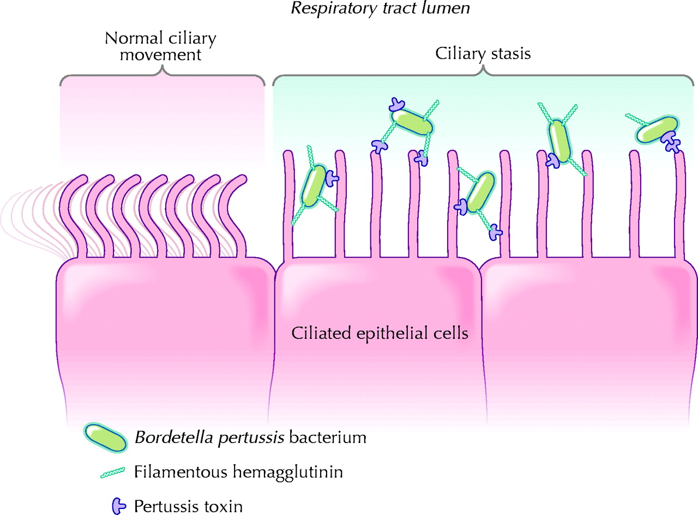
Enters through respiratory droplets and resides in the mucosa of the respiratory tract during infection
Virulence factors facilitate the interaction with phagocytes and persists with epithelial cells
Adhesins:
Fimbriae
Pertactin
FHA (filamentous hemagglutinin)
Creates filamentous structures on the cell surface and binds to calcium, heparin, and integrin
Responsible for colonization of bacteria within the respiratory tract

Slide 9
Role of Pertussis Toxins to Immune Cells
Pertussis Toxin PT:
Lymphocytosis promoting factor and ADP-ribosylating AB5 type toxin
Enters host cell via endocytosis
Inhibits adenylate cyclase activity and G protein enzyme, leading to impaired immune response
Inhibits neutrophil, monocytes, lymphocyte migration

Slide 10
BvgS
Inner membrane sensor protein
Senses environmental cues
Undergoes autophosphorylation = transfers phosphate groups to the amino-terminal domain of the BvgA
BvgA
Transcription activator
Phosphorylation responsible for the activation of BvgA and increases affinity of output for DNA sequences in the promoter regions of the vag genes (virulence activated genes)
Triggered through interaction between carboxyl terminus of BvgA and RNA polymerase
Vrg (virulence repressed genes)
Mediated by transcriptional repressor BvgR
In low temperatures and nicotinic acide BvgA/BvgS system is inactivated, vags not expressed and vrgs are depressed

Slide 11
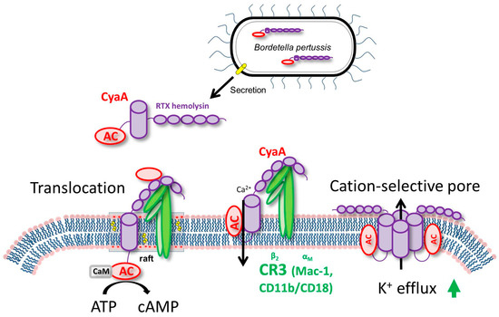
Adenylate Cyclase (AC)
Expresses hemolytic and calmodulin dependent activities. Help internalization of toxins into the cell
Responsible for apoptosis and morphological cell changes
Tracheal cytotoxin
Fragment of Bordatella peptidoglycan
Destroys ciliated epithelial cells within the respiratory tract
Induce production of IL-1 and nitric oxide
Cause mitochondrial damage, tight junction disruption, cell blebbing, and loss of ciliated cells
Prevents ciliated cells from beating. They can't clear debris from the lungs

Slide 12
3. Multiplication and Spread:
Does the organism remain extracellular or do they enter into cells and what are the molecular and cellular determinants of these events. Do the bacteria remain at the entry site or do they spread beyond the initial site i.e. are there secondary sites of infection and why do the bacteria hone in on these particular secondary sites.

Slide 13
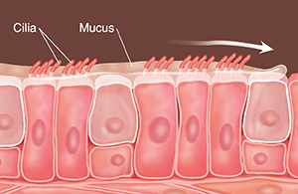
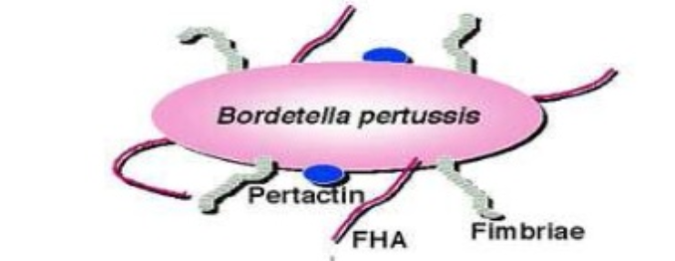
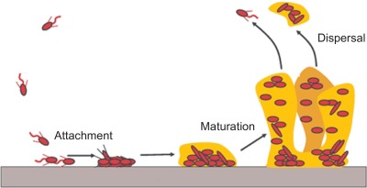
Primarily an extracellular pathogen (on external ciliated surface of mucous membranes
Rapidly divides and spreads across the mucous membranes
Nasopharynx to trachea, bronchi, and bronchioles
pertussis toxin, filamentous hemagglutinin, pertactin, tracheal cytotoxin, adenylate cyclase toxin
Infections don't become systemic
Antigenically competent, smooth virulent phase I
Antigenically incomplete, non-virulent
Inability to synthesize pertussis toxin
Biofilim and exopolysaccharide matrix make them resistant to the immune response and antibiotic therapy
Internalization used to evade host immune response and antibiotics

Slide 14
4. Bacterial Damage:
Do the bacteria cause any direct damage to the host (or is the damage fully attributable to the host response, as indicated below) and, if so, what is the nature of the bacterial damage. Can it be linked to any of the signs and symptoms in this case?

Slide 15
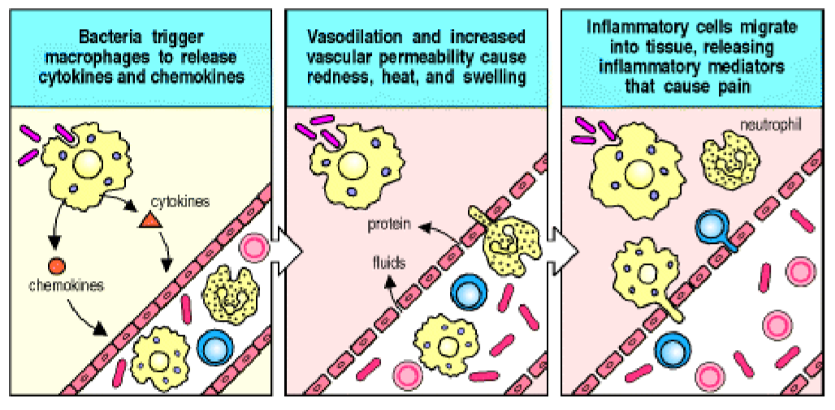
Pertussis Toxin (PT)
PT leads to decreased proinflammatory chemokine and cytokine production, decreased neutrophils to the lungs to establish infection in the early stage
PT at the peak of infection leads to increased inflammation and pathology in the airways
It enters the host cell by receptor-binding mediated endocytosis and follows a retrograde transport pathway to the Golgi apparatus and the endoplasmic reticulum
Hijacks the ER-associate degradation pathway that expels misfolded proteins

Slide 16
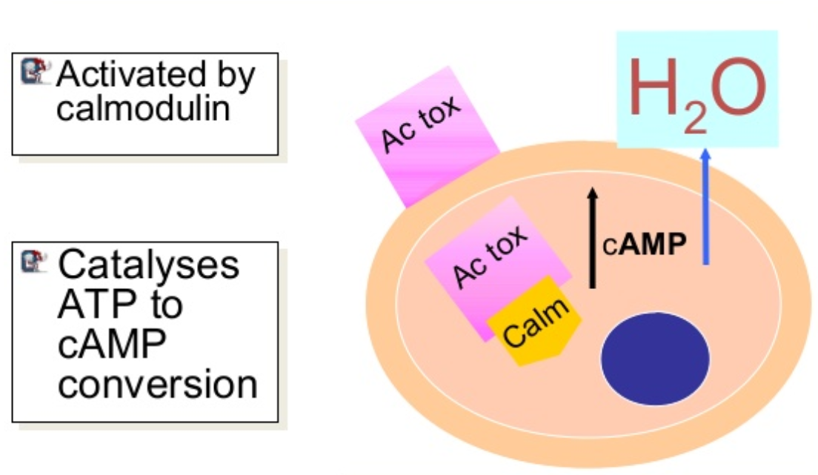
Adenylate Cyclase toxin (ACT)
Secreted by a Type 1 secretion system
Causes damage by adopting multiple confomations and affect pore formation or adenylate cyclase translocation into the host cell
Can bind with high affinity to CR3 in neutrophils, macrophages, and dendritic cells
May have a role in resistance to neutrophil mediated clearance
hemolytic activity = cell morphological changes
Macrophage cytotoxicity from enzymatic activity and apoptosis of cells induces tissue damage

Slide 17
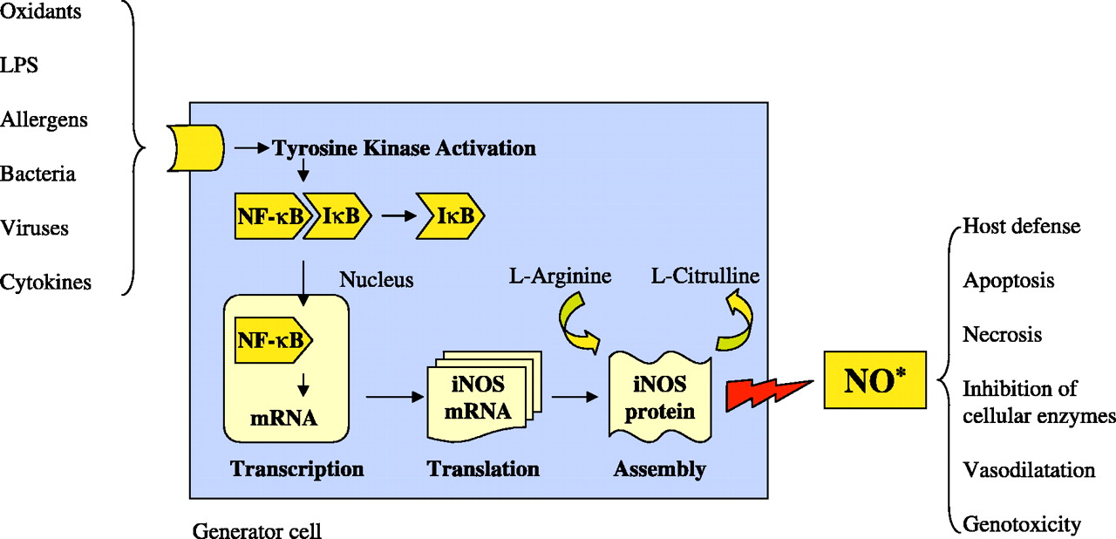
Tracheal cytotoxin (TCT)
Functions with lipopolysaccharide (LPS) to stimulate proinflammatory cytokine production (TNF-a, IL-1, and IL-6 and iNOS) and recruitment of neutrophils to the lungs
Cause paralysis and destruction and extrusion of ciliated cells from epithelial surface
Nitric oxide by non ciliated mucus secreting epithelial cells in response to TCT and LPS

Slide 18
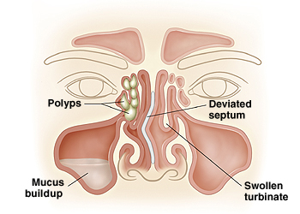
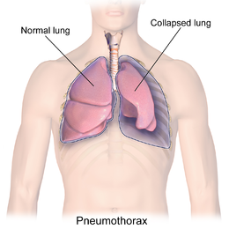
Chronic coughing
Can cause severe consequences (especially in infants)
Encephalopathy caused by anoxia due to paroxysms
Brain damage
Pneumonia
Lung collapse
Rupture of small and large blood vessels (hemorrhages)
Increase in intrathoracic pressure
Dermonecrotic Toxin (DNT)
Promotes necrotic lesions and turbinate atrophy

