Slide 1
CASE 3 LEGIONELLA PNEUMOPHILA The Microbiology Laboratory
March 17th 2018
PATH 417A
Karen lin
32041139

Slide 2
A Cruise Holiday
To celebrate Tom’s retirement his wife and two adult children accompany him on a long anticipated cruise. Tom’s asthma flares up a few days before the cruise but with a corticosteroid nebulizer in tow he feels well enough to join the cruise. Even more than the rest of his family, Tom enjoys the various hot tubs aboard the massive ship those first few days, relishing the relaxation after a busy final year at work. On the fifth day of the cruise, Tom wakes up in a sweat with a cough that continues throughout the day. As the day wears on he feels worse with a headache, muscle aches and nausea accompanying the cough. His wife arranges for the cruise doctor to visit him in his cabin. The doctor examines Tom, notes his high temperature, relatively nonproductive cough and recent history of asthma and corticosteroid therapy. She takes a full history including taking note of his activities during the first days of the cruise and diagnoses Tom with a pneumonia. She explains that her presumptive diagnosis is that of Legionnaire’s disease and leaves Tom’s wife with a sterile sample container to collect whatever fluid Tom might cough up for delivery to her. She explains that she can do a microscopic examination on the respiratory fluid which will help in the diagnosis. In the meantime she starts Tom on erythromycin and lets the family know that she will check in on Tom regularly over the next few days to monitor his progress. More people are diagnosed with a similar pneumonia over the next two days, mostly in people who came aboard with a slightly compromised immune system, like in Tom’s case. The cruise ship alerts the hospital at their next port of call in case any of the patients worsen enough to require hospitalization. When they arrive at port blood samples are collected from all of the patients and delivered to the hospital laboratory for serology. The ship also takes extra time in port to allow for a full scale sterilization regime to be performed on all of the hot tubs. At this stage Tom is feeling well enough to continue on the cruise, although at a slower pace than when he first boarded.

Slide 3
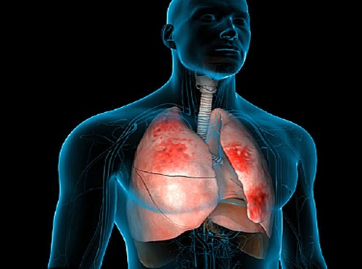
Brief Overview of Pneumonia
Typical Community Acquired Pneumonia
Symptoms: fever and chills, pleuritic chest pain, productive cough
Atypical pneumonia
Symptoms: body aches, fever, headaches, unproductive cough
Signs: elevated leukocyte levels, C reactive protein levels, and erythrocyte sedimentation rate
Signs: leukocyte, C reactive protein levels, and erythrocyte sedimentation rate are normal or slightly elevated
Often caused by S. pneumoniae, H. influenzae, Chlamydia pneumoniae, P. aeruginosa
Often caused by M. pneumoniae, L. pneumophila, or Chlamydia spp.
What is pneumonia?
Lung infection caused by bacteria, viruses or fungi
These pathogens cause alveolar inflammation
Infected alveoli are filled with fluids, causing difficulties in breathing

Slide 4
What’s happening to Tom? Based on these factors, Tom has been diagnosed with pneumonia caused by Legionella pneumophila.
Atypical Pneumonia
Hot tub exposure
Hot Tub Exposure
L. Pneumophila can tolerate heat in water systems
Recent asthma flare-up
Symptoms
Fever Non-productive cough Headache Nausea Myalgia

Slide 5
QUESTION 1 Other than the stated bacterial cause, what are the most common bacterial pathogens associated with this type of infectious scenario
Streptococcus pneumoniae
Enter lungs through inhalation or bloodstream
Staphylococcus aureus
Main virulence factor is the pore-forming cytotoxin
Haemophilus influenza
Most important virulence factor is its capsule that can prevent the bacteria from leukocyte phagocytosis
Commonly present in oral and nasal cavities of healthy individuals, but can cause infection in immunocompromised people
Cause infection in immunocompromised individuals by adhering to alveolar epithelium and secreting pneumolysin toxin
Results in disruption of membrane integrity and fluid accumulation in lungs
Infections can be easily treated with intravenous or oral antibiotics
Common cause of pneumonia
Transmission occurs via direct contact with respiratory droplets from sneezing or coughing

Slide 6
Chlamydophila pneumoniae
Transmission via water droplets from coughing or sneezing
Pseudomonas aeruginosa
Mycoplasma pneumoniae
Transmitted through direct contact with respiratory fluids
Less common etiological agent of pneumonia, but primarily infects immunocompromised individuals
Infection most commonly seen in children
Long incubation period – person may be infected but symptoms do not appear until 3-4 weeks after initial exposure
Ability to thrived on warm, moist surfaces – e.g. biomedical devices
Known to cause atypical pneumonia through secretion of cytotoxins
Often associated with asthma
Extremely contagious
Ability to mimic host cell surface composition allows it to evade host immunity
Mycobacterium avium, Mycobacterium intracellulare, and Mycobacterium Fortuitum
These bacteria form the mycobacterium avium complex (MAC)
Commonly infects immunocompromised individuals
Often involved in respiratory diseases such as pneumonia, chronic obstructive pulmonary disease, bronchitis, cancer
Transmitted when aerosolized droplets are inhaled into the respiratory tract

Slide 7
QUESTION 2 How important is the Microbiology Laboratory in the diagnosis of this particular infectious disease?
These tests cannot clinically differentiate between L. pneumophila and other pathogens that cause pneumonia!
Therefore, the microbiology laboratory process is crucial in diagnosing the cause of pneumonia
Clinical presentation
History
Physical exams
Medical imaging

Slide 8
QUESTION 2 What are all the samples that could be taken for laboratory testing (including the blood and ‘sputum’ in this case)?
Common samples used for pneumonia diagnosis
LOWER RESPIRATORY TRACT (LRT) SECRETION
Sputum secretions from the LRT commonly used to diagnose pneumonia
BLOOD
Safe and routine method of detecting infectious disease
Collection: taken in small volumes using appropriate phlebotomy techniques
URINE
Timing: collected within 7 days of pneumonia symptom onset
Timing: preferably collected before using antibiotics
Collection: patient will rinse their mouth, and expectorate the sputum sample into sterile container
Transportation and storage: sample should be stored at 2-5°C until ready to be plated; long-term storage in -70°C
Examination of blood helps physicians identify the most effective antibiotic against bacteria in question
Transportation and storage: sample should be kept at 4°C until ready for testing; long-term storage in -80°C
Collection: 10-20 mL of the sample stored in sterile container
Transportation and storage: sample should be kept at 4°C until ready for testing; long-term storage in -20 to -70°C
Urine samples undergo antigen detection tests
Very effective in Legionella antigen detection in adults

Slide 9
QUESTION 2 What are all the samples that could be taken for laboratory testing (including the blood and ‘sputum’ in this case)?
Less common samples used for pneumonia diagnosis
LUNG ASPIRATES
Invasive procedure that involves percutaneous needle insertion into rib area
PLEURAL FLUID
Useful for pneumonia cases that involve fluid entering the pleural space (pleural effusion)
EXHALED BREATH CONDENSATE (EBC)
No standardized technique for EBC collection yet
Not practical for clinical laboratory
EBC of different individuals have different protein spectrums → potentially be used in future diagnostic tests

Slide 10
QUESTION 3 + 4 Explain the tests that will be performed on the samples in order to detect any of the potential bacterial pathogens causing this disease. What are the results expected from these tests allowing for the identification of the bacteria named in this case?
1. Bacterial Culturing
3. Direct Fluorescent Antibody (DFA)
4. Urinary Antigen Test (UAT)
5. Serological Testing and Antibody-Based Assays
2. PCR, Sequencing, Gel Electrophoresis

Slide 11
QUESTION 3 + 4 Explain the tests that will be performed on the samples in order to detect any of the potential bacterial pathogens causing this disease. What are the results expected from these tests allowing for the identification of the bacteria named in this case?
BACTERIAL CULTURING
Initial gram stain performed to confirm presence of any gram negative pathogens, such as L. pneumophila
Sample incubation on agar with charcoal yeast extract and α-ketoglutarate to support L. pneumophila growth
MacConkey agar often used for isolating gram negative bacteria
Cycloheximide, polymyxin B, or vancomycin can be added to inhibit of the growth of other pathogens, while not affecting L. pneumophila
RESULTS
Smooth 0.5-1 mm diameter colonies that appear white under normal light
Different bacteria fluoresce at different colours under UV light
L. pneumophila culture under UV light

Slide 12
QUESTION 3 + 4 Explain the tests that will be performed on the samples in order to detect any of the potential bacterial pathogens causing this disease. What are the results expected from these tests allowing for the identification of the bacteria named in this case?
PCR, GEL ELECTROPHORESIS, AND SEQUENCING
DNA primers of L. pneumophila genes of interest and DNA polymerase added to sample of Legionella DNA
Samples undergo repeated temperature changes of
94°C → 40-60°C → 70-74°C
to allow for DNA denaturation, annealing, and elongation, respectively
Primers and polymerase used to amplify the DNA area of interest
L. pneumophila DNA sequenced using Sanger sequencing techniques for verification
Amplified DNA segments visualized with gel electrophoresis
PCR products run on agarose gel and resulting bands observed with UV light

Slide 13
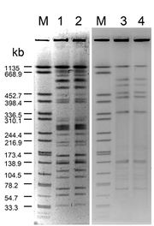
QUESTION 3 + 4 Explain the tests that will be performed on the samples in order to detect any of the potential bacterial pathogens causing this disease. What are the results expected from these tests allowing for the identification of the bacteria named in this case?
PCR, GEL ELECTROPHORESIS, AND SEQUENCING
RESULTS
Using gel electrophoresis, DNA bands of varying lengths are compared to the controls and the DNA ladder to confirm that the gene of interest has been amplified, and that the DNA belongs to that of L. pneumophila.
Sanger Sequencing results can be compared to sequences found in the NCBI BLAST database, which provides a score for likelihood of alignment → higher homology between the sequenced DNA and that in NCBI BLAST helps to confirm the bacterial cause of pneumonia.
Example of gel electrophoresis of L. pneumophila sample

Slide 14
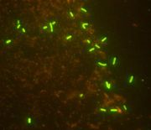
QUESTION 3 + 4 Explain the tests that will be performed on the samples in order to detect any of the potential bacterial pathogens causing this disease. What are the results expected from these tests allowing for the identification of the bacteria named in this case?
DIRECT FLUORESCENT ANTIBODY
This method is not to be used alone for the identification of L. pneumophila because of its chance of producing false positive or negative results.
Sputum, respiratory secretions, blood, or tissue samples are placed under a microscope in a well plate
Incubate the sample with fluorescently-tagged antibodies specific to various L. pneumophila serogroups
RESULTS
When antibodies bind to target L. pneumophila antigen, they are illuminated, confirming the presence of L. pneumophila in the sample
L. pneumophila culture illuminated using direct fluorescent antibody

Slide 15
QUESTION 3 + 4 Explain the tests that will be performed on the samples in order to detect any of the potential bacterial pathogens causing this disease. What are the results expected from these tests allowing for the identification of the bacteria named in this case?
URINARY ANTIGEN TEST
This method is efficient and provides rapid results upon testing. Even during or after the use of antibiotics, it is able to detect the presence of L. pneumophila antigens in the urine.
Urine sample placed into immunochrom-atographic test card with a swab
Sample flows downwards to release pad
RESULTS
The sample and control lines indicate presence or absence of the antigen. A positive result would show a line at the sample, indicating presence of L. pneumophila serotype 1
Alere Legionella Urinary Antigen Card

Slide 16
QUESTION 3 + 4 Explain the tests that will be performed on the samples in order to detect any of the potential bacterial pathogens causing this disease. What are the results expected from these tests allowing for the identification of the bacteria named in this case?
SEROLOGICAL TESTING AND ANTIBODY-BASED ASSAYS
These tests detect
L. pneumophila IgG, IgM, and IgA antibodies in serum. The results are analyzed under a fluorescence microscope or a plate reader.
RESULTS
High fluorescence levels indicate presence of L. pneumophila antibodies in the serum
Indirect Fluorescent Antibody test
Micro-ELISA
Counterimmuno-electrophoresis
Microagglutination
ELISA kits

Slide 17
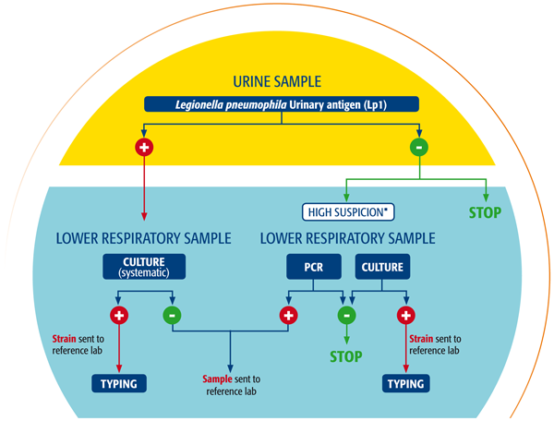
This suggested schema can be used towards the identification of L. pneumophila in pneumonic patients.

