Slide 1
A Pearl for Uterine Fibroids – or not quite there yet?
Ulipristal for Uterine Fibroids
Elaine, BPharm, MSc (Clin Pharm), BCPS
Doctor of Pharmacy Student
Faculty of Pharmaceutical Sciences
University of British Columbia
Elaine.lo@alumni.ubc.ca

Slide 2
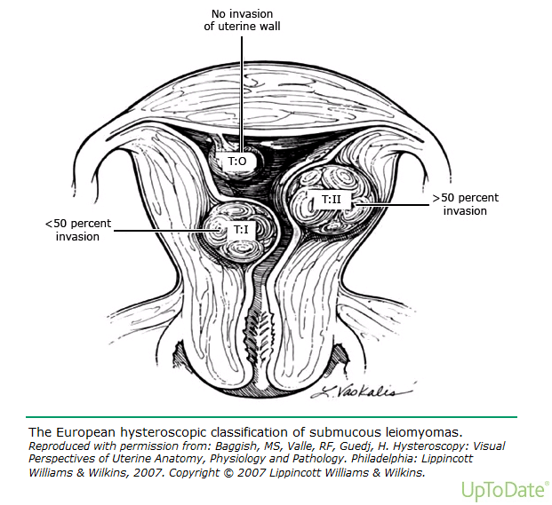
Uterine fibroids

Slide 4
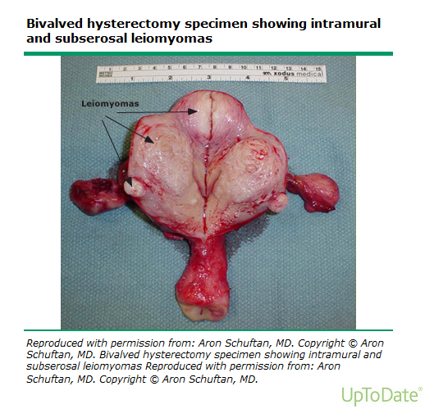

Slide 5
Uterine fibroids
Benign, hormone-sensitive, smooth muscle tumours of the uterus
Most common tumour of the female reproductive tract in pre-menopausal women:
35-55 y.o.: 40%
Black > white women 2-3x
American Journal of Clinical Pathology 1990; 94: 435
American Journal of Epidemiology 1998; 147: S90
Notes:
smooth muscle cells of the myometrium
HC SBD
E – agument EGF-R expression in leiomyoma cell
P4 leimyoma cell growth through regularing EGF, IGF-I – stimulate cell proliferation and inhibit apoptosis
The myomatous uterus has increased numbers of arterioles and venules, as well as venular ectasia (dilation). In addition, the angiogenic growth factor fibroblast growth factor-2 and its receptor appear significantly altered in the leiomyomatous uterus.
Leiomyomas can be viewed as a fibrotic process with abnormalities of the extracellular matrix
Uptodate

Slide 6
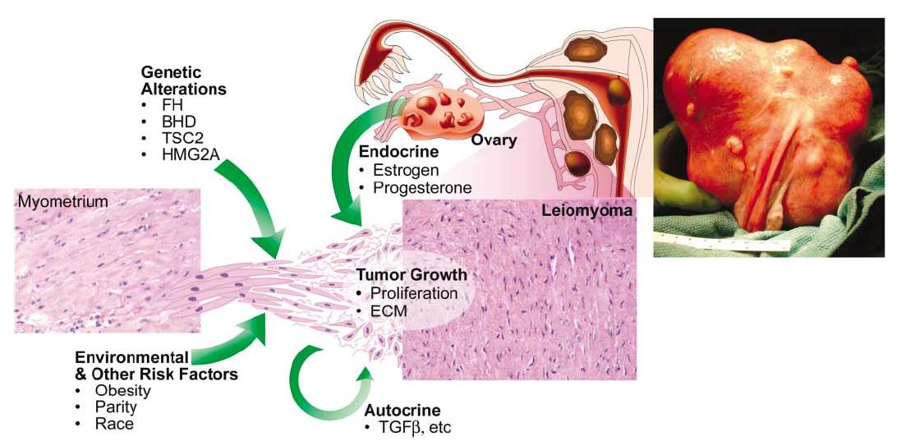
Pathogenesis
Science 308.5728 (2005): 1589-1592
1. Transformation to abnormal myocytes
2. Growth
Hormone: estrogen & progesterone
Genetics/ Vascular abnormalities/ Fibroid factor
Notes:
Fibroids are often described according to their location in the uterus (submucosal, intramural, subserosal, cervical).
Dx based on enlarged, mobile uterus with an irregular contour on bimanual pelvic examination.
Confirmed by imaging study e.g. transvaginal ultrasound
Uptodate
Images from Uptodate

Slide 7
Signs and Symptoms
often asymptomatic, but when symptomatic:
uterine bleeding, anemia
abdominal pressure/ pain, increased urinary frequency
infertility
significant impairment of QoL
Notes:
HC SBD
3 categories

Slide 8
Treatment
Surgery: current mainstay, most commonly: hysterectomy
Asymptomatic – watch & wait
Premenopausal women who desire fertility
Myomectomy
Women who do not desire fertility
Hysterectomy
HealthlinkBC, accessed on 1/11/13
Uptodate, accessed on 22/10/13
Notes:
Submucosal leiomyomas -- hysteroscopic myomectomy for symptomatic → allows future childbearing; abdominal myomectomy if significant symptoms and a submucous leiomyoma(s) not amenable to hysteroscopic resection
Consider other options when women for whom risk of intraoperative conversion to hysterectomy is high, or women who are considering a future pregnancy but will accept impaired fertility in exchange for an expedited recovery phase, other
Laparoscopic myomectomy: a uterus less than 17 weeks' size or with a small number of subserosal or intramural leiomyomas. Future childbearing is possible; however, the integrity of the uterine incision during pregnancy has not been evaluated adequately and may be inferior to abdominal myomectomy. Due to reports of uterine rupture in pregnancy following some laparoscopic myomectomies, surgeons should discuss the risks and benefits of each option with patients, including possible risk of uterine rupture, as well as provide information regarding their experience with laparoscopic suturing. While robotic assistance may alleviate these problems, there are currently little data to support this contention.
uptodate

Slide 9
Role of Medical Treatment
 | Symptoms | Fibroid volume reduction | Remarks
Levonorgestrel intrauterine device NSAID Tranexamic | √ | X
GnRHa | √ | √ | Climacteric effect, limited to 3-6m
Expert opinion on pharmacotherapy 14.15 (2013): 2079-2085
Notes:
NSAID, tranexamic acid – Sx reduction only

Slide 10
Ulipristal

Slide 11
As an emergency contraceptive
US, Europe, India
30mg PO within 120h after unprotected intercourse/ contraceptive failure
Notes:
Prevent by 60% more than with levonorgestrel

Slide 12
Ulipristal (Fibristal)
Treatment of moderate to severe S & S of uterine fibroids in adult women of reproductive age who are eligible for surgery
Duration < 3 months
5mg daily PO
Notes:
6-2013

Slide 13
Ulipristal MOA
Selective progesterone receptor modulator (SPRM)
Progesterone antagonist
Direct effect on myometrial and endometrial tissue
Insignificant effect on estradiol level
↓ size through inhibition of cell proliferation and induction of apoptosis
Notes:
The safety and efficacy ≥65 or <18 not established
3 months due to lack of long term data

Slide 14
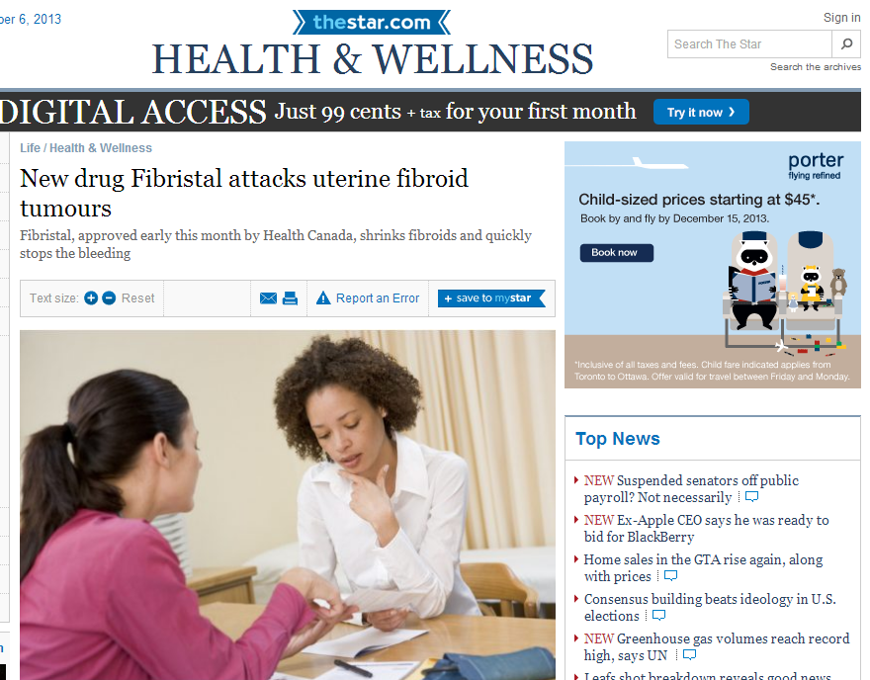
From the media…
http://www.thestar.com/ accessed on 1/11/2013
Notes:
http://www.thestar.com/life/health_wellness/2013/08/30/new_drug_fibristal_attacks_uterine_fibroid_tumours.html

Slide 15
From the media…
There’s good news for women who suffer from uterine fibroids.
For the first time, the benign tumours that cause heavy bleeding, pain, bloating and infertility in 30 per cent of women, can be treated with medication instead of surgery.
The drug has the potential to save thousands of women from surgery, as fibroids are the leading cause of hysterectomies. About 25 per cent of women with fibroids require treatment.
After that, if surgical intervention is still needed, it’s likely to be a less invasive procedure with fewer possible complications, she says.
http://www.thestar.com/ accessed on 1/11/2013

Slide 16
Clinical trials

Slide 17
Clinical Question
P | Women with uterine fibroids
I | Ulipristal
C | Placebo/ standard of treatment
O | Efficacy: Symptoms Fibroid size Surgery need/ type QoL | Safety: ADE Withdrawal due to ADE

Slide 18
Search Strategy
Databases | Medline, PubMed, Embase, Cochrane, Google Scholar, IPA
Search Strategy | Ulipristal, Uterine fibroids
Limits | English, Humans
Results | 2 phase II RCT 2 phase III RCT

Slide 19
Summary of Trials
 | Levens et al 2008 | Nieman et al 2011 | Donnez et al 2012 | Donnez et al 2012
Phase | II | II | III | III
Comparator | Placebo | Placebo | Placebo | Leuprolide 3.75mg/month
Obstetrics and gynecology 111.5 (2008): 1129.
Fertility and sterility 95.2 (2011): 767-772.
New England Journal of Medicine 366.5 (2012): 409-420.
New England Journal of Medicine 366.5 (2012): 421-432.
Notes:
Type it yourself

Slide 20
Summary of Trials
 | Levens et al 2008 | Nieman et al 2011 | Donnez et al 2012 | Donnez et al 2012
Phase | II | II | III | III
Comparator | Placebo | Placebo | Placebo | Leuprolide 3.75mg/month
Obstetrics and gynecology 111.5 (2008): 1129
Fertility and sterility 95.2 (2011): 767-772
New England Journal of Medicine 366.5 (2012): 409-420
New England Journal of Medicine 366.5 (2012): 421-432
Notes:
Type it yourself

Slide 21
Phase II Trials
 | Levens et al 2008 |  |  | Nieman et al 2011
Design | R DB PC
Tx | U 10mg, U 20mg, Placebo
N | 8,8,6 |  |  | 12,13,13
Duration | 90-102 days
Primary outcomes | Fibroid volume P 10mg 20mg | + 6% - 36% - 21% (p = 0.01) |  | + 7% 17% 24% (p = 0003)
Sec outcomes | % amenorrhea change in Hgb & Hct QoL |  | ↑ NS NS | ↑ ↑ ↑
ADE | NS Cystic glandular hyperplasia
Notes:
Published by the National Institute of Child Health and Human Development
(-11% in tx 2)
Levens: only ½ completed questionnaire – 12
Proportion of amenorrhea (P –normal menses, only 1 episode in treatment group), change in Hgb & Hct (unchanged), ovulation inhibition (U 20% placebo 83%), QoL (non significant)
Estradiol lower in U
QoL- SF 36, UFS
Amenorrhea – 0 vs 20/26
QoL – SF36, role physical and mental; UFS

Slide 22
Phase II Trials
Results:
↓ fibroid volume
↓ abnormal bleeding
10mg = 20mg
PRM associated endometrial changes (PAEC) in 5mg?
Notes:
But study 2 (Nieman) – Hgb>10
Limited by small number

Slide 23
Phase II Trials
Criticism:
Black women
Levens 72.2% Nieman 84%
Generalizability
∆Hgb, Hct : Before and after ulipristal vs Placebo and ulipristal (Niemen)
Sample size too small for ADE (22, 38)

Slide 24
Summary of Trials
 | Levens et al 2008 | Nieman et al 2011 | Donnez et al 2012 PEARL I | Donnez et al 2012 PEARL II
Phase | II | II | III | III
Comparator | Placebo | Placebo | Placebo | Leuprolide 3.75mg/month
Obstetrics and gynecology 111.5 (2008): 1129
Fertility and sterility 95.2 (2011): 767-772
New England Journal of Medicine 366.5 (2012): 409-420
New England Journal of Medicine 366.5 (2012): 421-432
Notes:
Type it yourself

Slide 25
Phase III Trials
 | PEARL I 2012 | PEARL II 2012
Design | R DB PC | R DB non-inferiority
Tx | U 5mg, U 10mg, Placebo +Fe 80mg | U 5mg, U 10mg, Leuprolide 3.75mg
N | 95,94,48 | 93,95,93
Duration | 12 weeks
Patients | Menorrhagia Fibroid associated anemia Uterus <16wk gestation size Eligible for surgery | Same except anemia not an inclusion criteria
Notes:
Industry sponsored

Slide 26
Phase III Trials
OR
Journal of Reproductive Medicine and Endocrinology 10.1 (2013): 82-101

Slide 27
Phase III Trials
 | PEARL I 2012 |  | PEARL II 2012
Primary outcomes | Uterine bleeding control P = 19% 5mg = 91% 10mg = 92% (p < 0.001) |  | Uterine bleeding control L = 89% 5mg = 90% 10mg = 98% (NS)
 | Fibroid volume P = + 3%, 5mg = - 21% 10mg = - 12% (p = 0.002-6) |  | Fibroid volume (3 biggest) L = -53% 5mg = -36% 10mg = -42% (NS)
Sec outcomes | % Amenorrhea Uterine vol ↓ ∆ Hgb & Hct QoL | ↑ ↑ ↑ ↑ | NS favoured L NS NS
ADE | NS (headache, breast pain) |  | ↓ hot flushes (40% vs 10% vs 11%) Estradiol, CTX favoured U
PAEC | ~60% on U at 3m, returned to baseline 6m after stopping
Surgery | ~1/2 patients regardless of tx
1º
2º
Notes:
Industry sponsored

Slide 28
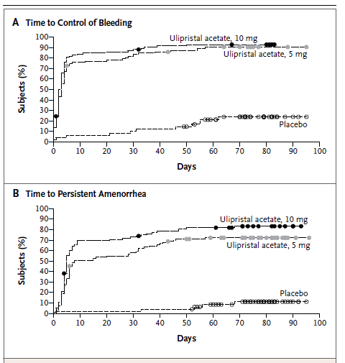
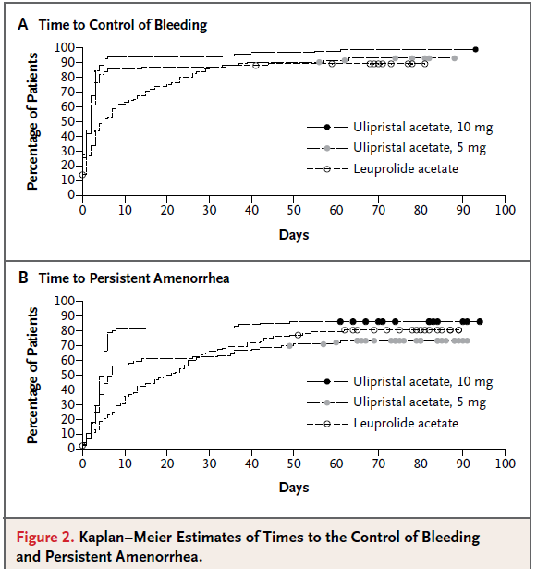
Phase III Trials
PEARL I
PEARL II
New England Journal of Medicine 366.5 (2012): 409-420
New England Journal of Medicine 366.5 (2012): 421-432

Slide 29
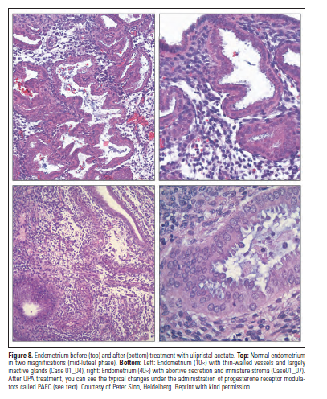
PRM- associated endometrial changes (PAEC)
Not the same as endometrial hyperplasia
Benign changes of
endometrial stroma:
Cyst formation
Atrophy
Abortive secretory
changes of glands
Abnormal endometrial
vascularization
Journal of Reproductive Medicine and Endocrinology 10.1 (2013): 82-101

Slide 30
PAEC
 | PEARL I |  |  | PEARL II
% | Placebo | U 5mg | U 10mg | L | U 5mg | U 10mg
Baseline | 0 | 6.5 | 1.3 | 2.5 | 2.6 | 3.8
Wk 13 | 7.9 | 59.8 | 56.4 | 13.9 | 54.4 | 61.3
Wk 38 | 2.6 | 7.8 | 5.1 | 6.3 | 6.5 | 6.3
Reversible
Lack of long term observations → significance?
Journal of Reproductive Medicine and Endocrinology 10.1 (2013): 82-101

Slide 31
Strengths
Data collection and analysis by independent organizations (ICON, MDSL)
Bonferroni correction made for multiplicity
3 pathologists to evaluate uterine changes with defined diagnostic criteria

Slide 32
Critique for both studies:
Methodology:
1. Uterine bleeding control as primary endpoint
2. Short duration
Safety, efficacy?? Implication?
Generalizability
1. Black women
2. Severity of uterine fibroid
Industry Sponsored
Notes:
Modified intention to treat – good for superiority: excluded one women who didn’t receive any drug (PEARL I)
(PEARL II – 5 patients excluded)
http://www.trialsjournal.com/content/12/1/58 – industry funded, conflict of interest
PEARL I – questionnaire developed by sponsor – dx specific QoL not available in languages of those countries (Oct, 2008 PEARL I, UFS-QoL pub in Nov, 2008) http://www.hqlo.com/content/6/1/99

Slide 33
Uterine bleeding control
Assessed with Pictorial Bleeding Assessment Chart (PBAC)
Excessive blood loss = PBAC >100 (~80 mL)
Uterine bleeding control = PBAC <75
Amenorrhea = PBAC <2
Notes:
Phase III
http://onlinelibrary.wiley.com/doi/10.1002/9781444303490.app2/pdf

Slide 34
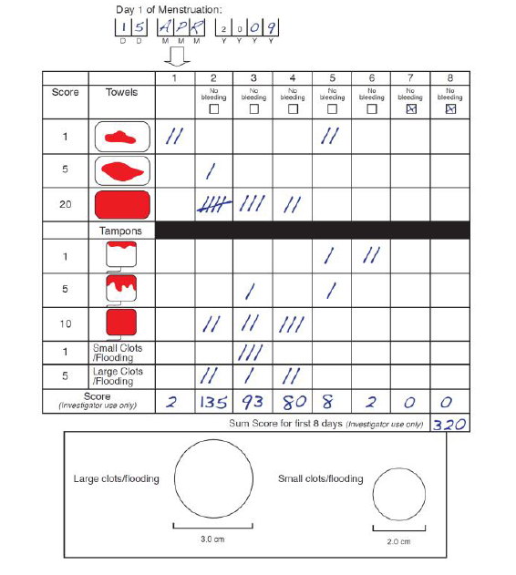
PBAC
British Journal of Obstetrics and Gynecology (1990); 8: 734-739
New England Journal of Medicine 366.5 (2012): 409-420
Notes:
LNG- IUD
correlated with menstrual blood loss assessed by a standard
chemical method i.e. alkaline haematin (r=0.847).
Semi-quantitative assessment of blood loss by comparing sanitary item stain with given diagrams (Pictorial Blood Loss Assessment Chart, PBAC) [15] is another method to assess blood loss. Using an appropriate cutoff point, Janssen et al. reported predictive values with respect to menorrhagia up to 85.9% for positive tests and 84.9 for negative tests [16]. Unfortunately reproducibility of results of PBAC was challenged [17]. Nonetheless, a recent study found that PBAC is a simple and accurate tool for semi-objective measurement of menstrual blood loss [18]. The correlation between pictorial assessment results and values measured by the alkaline-hematin-method is quite good, however the amount of blood not captured by sanitary items is considerable [19].

Slide 35
PBAC<75 as primary end point
Reporter bias – subjective measure, rely on patient compliance in reporting
GnRHa – Fibroid vol, % Amenorrhea
caution in interpretation
PEARL I | PEARL II
Uterine bleeding control (PBAC <75)
P = 19% 5mg = 91% 10mg = 92% (p < 0.001) | L = 89% 5mg = 90% 10mg = 98% (NS)
% Amenorrhea (PBAC<2)
P = 6% 5mg = 73% 10mg = 82% (p < 0.001) | L = 80% 5mg = 75% 10mg = 89% (NS)

Slide 36
Critique for both studies:
Methodology:
1. Uterine bleeding control as primary endpoint
2. Short duration
Safety, efficacy?? Implication?
Generalizability
1. Black women
2. Severity of uterine fibroid
Industry Sponsored
Notes:
Modified intention to treat – good for superiority: excluded one women who didn’t receive any drug (PEARL I)
(PEARL II – 5 patients excluded)
http://www.trialsjournal.com/content/12/1/58 – industry funded, conflict of interest
PEARL I – questionnaire developed by sponsor – dx specific QoL not available in languages of those countries (Oct, 2008 PEARL I, UFS-QoL pub in Nov, 2008) http://www.hqlo.com/content/6/1/99

Slide 37
Critique for both studies:
Methodology:
1. Uterine bleeding control as primary endpoint
2. Short duration
Safety, efficacy?? Implication?
Generalizability
1. Black women
2. Severity of uterine fibroid
Industry Sponsored
Notes:
Modified intention to treat – good for superiority: excluded one women who didn’t receive any drug (PEARL I)
(PEARL II – 5 patients excluded)
http://www.trialsjournal.com/content/12/1/58 – industry funded, conflict of interest
PEARL I – questionnaire developed by sponsor – dx specific QoL not available in languages of those countries (Oct, 2008 PEARL I, UFS-QoL pub in Nov, 2008) http://www.hqlo.com/content/6/1/99

Slide 38
Generalizability
1. Under representation of black women
0% in PEARL I, 9.4% in PEARL II
↑prevalence, ↑ severity, earlier onset
2. Small uterine volume
Fibroid <10cm, uterine <16wk gestation
Study | Uterine vol (cm³)
PEARL I | 318.8-337.6
PEARL II | 197.8-199.9
UAE | 579-701
MRgFUS | 595
Science 308.5728 (2005): 1589-1592
New England journal of medicine 356.4 (2007): 360-370
Fertility and sterility 85.1 (2006): 22-29
Notes:
Uterine Artery Embolization
Magnetic Resonance guided focus ultra sound
#49 http://www.nejm.org/doi/pdf/10.1056/NEJMoa062003
#50 http://www.ceverj.com.br/conteudo/publucacoes/10.pdf

Slide 39
Critique for both studies:
Methodology:
1. Uterine bleeding control as primary endpoint
2. Short duration
Safety, efficacy?? Implication?
Generalizability
1. Black women
2. Severity of uterine fibroid
Industry Sponsored
Notes:
Modified intention to treat – good for superiority: excluded one women who didn’t receive any drug (PEARL I)
(PEARL II – 5 patients excluded)
http://www.trialsjournal.com/content/12/1/58 – industry funded, conflict of interest
PEARL I – questionnaire developed by sponsor – dx specific QoL not available in languages of those countries (Oct, 2008 PEARL I, UFS-QoL pub in Nov, 2008) http://www.hqlo.com/content/6/1/99

Slide 40
Industry sponsored
PregLam
Study designed by sponsor
Editorial support funded by sponsor

Slide 41
Critique for PEARL I:
Methodology:
1.Discomfort questionnaire – not validated
2. modified intention to treat
Results:
Fe seems to improve anemia > U
P = iron 3.10+1.68
U 5mg = 4.25+1.90
U 10mg = 4.20+1.83 (p < 0.001)
Notes:
Modified intention to treat – good for superiority: excluded one women who didn’t receive any drug (PEARL I)
(PEARL II – 5 patients excluded)
http://www.trialsjournal.com/content/12/1/58 – industry funded, conflict of interest
PEARL I – questionnaire developed by sponsor – dx specific QoL not available in languages of those countries (Oct, 2008 PEARL I, UFS-QoL pub in Nov, 2008) http://www.hqlo.com/content/6/1/99

Slide 42
Critique for PEARL II:
Methodology:
1. Addition of iron at discretion of physician (% not reported) – Hbg NS
2. Assessment of fibroid volume
Results:
1. Fibroid volume less in Leuprolide
2. Uterine volume less in Leuprolide
3. 5 out of 98 withdrew in U 10mg – reason not provided
Notes:
Modified intention to treat – good for superiority: excluded one women who didn’t receive any drug (PEARL I)
(PEARL II – 5 patients excluded)
http://www.trialsjournal.com/content/12/1/58 – industry funded, conflict of interest
PEARL I – questionnaire developed by sponsor – dx specific QoL not available in languages of those countries (Oct, 2008 PEARL I, UFS-QoL pub in Nov, 2008) http://www.hqlo.com/content/6/1/99

Slide 43
Critique for PEARL II:
Methodology:
1. Addition of iron at discretion of physician (% not reported) – Hbg NS
2. Assessment of fibroid volume
Results:
1. Fibroid volume less in Leuprolide
2. Uterine volume less in Leuprolide
3. 5 out of 98 withdrew in U 10mg – reason not provided
Notes:
Modified intention to treat – good for superiority: excluded one women who didn’t receive any drug (PEARL I)
(PEARL II – 5 patients excluded)
http://www.trialsjournal.com/content/12/1/58 – industry funded, conflict of interest
PEARL I – questionnaire developed by sponsor – dx specific QoL not available in languages of those countries (Oct, 2008 PEARL I, UFS-QoL pub in Nov, 2008) http://www.hqlo.com/content/6/1/99

Slide 44
Uterine fibroid volume
PEARL II
US – instead of MRI
Performed at each centre – instead of central reading by radiologist unaware of group assignments
Only for 3 largest fibroids
Secondary outcome!!

Slide 45
Critique for PEARL II:
Methodology:
1. Addition of iron at discretion of physician (% not reported) – Hbg NS
2. Assessment of fibroid volume
Results:
1. Fibroid volume less in Leuprolide
2. Uterine volume less in Leuprolide
3. 5 out of 98 withdrew in U 10mg – reason not provided
Notes:
Modified intention to treat – good for superiority: excluded one women who didn’t receive any drug (PEARL I)
(PEARL II – 5 patients excluded)
http://www.trialsjournal.com/content/12/1/58 – industry funded, conflict of interest
PEARL I – questionnaire developed by sponsor – dx specific QoL not available in languages of those countries (Oct, 2008 PEARL I, UFS-QoL pub in Nov, 2008) http://www.hqlo.com/content/6/1/99

Slide 46
Results
 | U 5mg | U 10mg | L | U 5mg vs L | U 10mg vs L
Vol of 3 largest myoma
% | -36 | -42 | -53
Ratio to screening vol | 0.66 | 0.61 | 0.54 | 1.23 (0.99-1.52) | 1.12 (0.91-1.38)
Uterine vol
% | -20 | -22 | -47
Ratio to screening vol | 0.84 | 0.8 | 0.57 | 1.48 (1.25-1.74) | 1.41 (1.19-1.66)
Lack of power
Under powered
What if sample size calculated based on fibroid volume reduction?
Notes:
PEARL II Based sample size on the requirement to show nonferiority with a prespecified margin of 20% - didn’t say which end point (primary?)
PEARL I based sample size on superiority to demonstrate fibroid volume change
Surgery type

Slide 47
Critique for PEARL II:
Methodology:
1. Addition of iron at discretion of physician (% not reported) – Hbg NS
2. Assessment of fibroid volume
Results:
1. Fibroid volume less in Leuprolide
2. Uterine volume less in Leuprolide
3. 5 out of 98 withdrew in U 10mg – reason not provided
Notes:
Modified intention to treat – good for superiority: excluded one women who didn’t receive any drug (PEARL I)
(PEARL II – 5 patients excluded)
http://www.trialsjournal.com/content/12/1/58 – industry funded, conflict of interest
PEARL I – questionnaire developed by sponsor – dx specific QoL not available in languages of those countries (Oct, 2008 PEARL I, UFS-QoL pub in Nov, 2008) http://www.hqlo.com/content/6/1/99

Slide 48
What promises does ulipristal bring?
1. Conservative medical treatment
Ultimate dream – X surgery
Rapid and remarkable control – sustained?
Long term safety? vs LNG-IUD
2. Pre-operative bridge
vs GnRHa?
↓fibroid/ uterine size → ↓surgical need/ risk
3. Preserve fertility?
Contra-indicated for pregnancy
Menstruation returned after 31-34 days
New England Journal of Medicine 366.5 (2012): 421-432

Slide 49
From the media…
http://www.thestar.com/ accessed on 1/11/2013
Notes:
http://www.thestar.com/life/health_wellness/2013/08/30/new_drug_fibristal_attacks_uterine_fibroid_tumours.html

Slide 50
From the media…
There’s good news for women who suffer from uterine fibroids.
For the first time, the benign tumours that cause heavy bleeding, pain, bloating and infertility in 30 per cent of women, can be treated with medication instead of surgery.
The drug has the potential to save thousands of women from surgery, as fibroids are the leading cause of hysterectomies. About 25 per cent of women with fibroids require treatment.
After that, if surgical intervention is still needed, it’s likely to be a less invasive procedure with fewer possible complications, she says.
http://www.thestar.com/ accessed on 1/11/2013

Slide 51
From the media…
There’s good news for women who suffer from uterine fibroids.
For the first time, the benign tumours that cause heavy bleeding, pain, bloating and infertility in 30 per cent of women, can be treated with medication instead of surgery.
The drug has the potential to save thousands of women from surgery, as fibroids are the leading cause of hysterectomies. About 25 per cent of women with fibroids require treatment.
After that, if surgical intervention is still needed, it’s likely to be a less invasive procedure with fewer possible complications, she says.
YET TO BE PROVEN
http://www.thestar.com/ accessed on 1/11/2013

Slide 52
Unanswered questions
Long term efficacy & safety
Surgical need/ type

Slide 53
Up and Coming
PEARL III
4 cycles of 3 months ulipristal
PEARL IV
On-off treatment of 18 months
Pre-op treatment
SAE, AE
http://clinicaltrials.gov
Notes:
Each separated by a drug free period

Slide 54
Thanks~ Q&A

