Slide 1
Case 2: Microbiology Laboratory Summary
A Stiff Neck
18-year-old Mary has just moved into the dormitory at her university. One day, her roommate finds her lying in bed under her sheets. She is complaining of fever, chills, bad headache and a stiff neck. She is staying under the covers because the light is hurting her eyes. Her roommate calls 911 and an ambulance takes Mary to the local hospital. The emergency room physician asks Mary about her recent vaccinations and she reports that she has not had any since she was in elementary school. The physician documents a fever of 39.2°C and low blood pressure. He sends blood and cerebral spinal fluid to the Microbiology Laboratory. She is started immediately on intravenous antibiotics. Mary’s blood and cerebral spinal fluid grow Neisseria meningitidis and she is diagnosed with meningococcal meningitis

Slide 2
Possible Bacterial Causes for Mary’s Infection Scenario
Streptococcus pneumoniae
Group B Streptococcus (GBS)
Mary’s Disease
Listeria monocytogenes
Haemophilus influenzae
Escherichia coli
Neisseria meningitidis
Neisseria gonorrhoeae
** Those bacteria in the green bubbles are the most common causes of meningitidis and what we would consider to be the most likely; those in the blue bubbles are less likely but also possible

Slide 3
 | Neisseria meningitidis | Haemophilus influenzae | Streptococcus pneumoniae
Bacterial Characteristics | Gram-negative Paired cocci Reside in human nasopharynx; spread via respiratory droplets and aspiration | Gram-negative Distinguished by polysaccharide capsule | Gram-positive Lancelet-shaped Capsule forming Resides in upper respiratory tract; spread via respiratory droplets
Associated Signs & Symptoms | Fever, headache, neck stiffness, fatigue, purpuric rash due to septicemia | Meningitis-associated symptoms: Fever, light sensitivity, headache, stiff neck nausea, confusion/altered mental status Symptoms of pneumonia: Fever/chills, coughing, difficulty breathing, chest pain, headaches, fatigue, muscle aches | Associated with: Pneumonia, ear infections, sinus infection, bacteremia, and meningitis Fever, stiff neck, photophobia, chest pain, confusion, shortness of breath, sleeplessness, irritability, joint pain

Slide 4
 | Group B Streptococcus (GBS) | Listeria monocytogenes | Neisseria gonorrhoeae | Escherichia coli
Bacterial Characteristics | Gram-positive Cocci Can be passed on from mother to baby during labor (early-onset) | Gram-positive Rod-shaped Spread by ingestion of contaminated food Infection can cross placenta Can infect gut | Gram-negative Diplococcus Spread primarily by sexual contact | Gram-negative Rod-shaped
Signs & Symptoms | Meningitis, sepsis, pneumonia | Meningitis, sepsis Headache, stiff neck, fever, muscle aches, loss of balance | Vaginal discharge, discharge from penis lower abdominal pain, pain with sexual intercourse, burning sensation during urination, meningitis* | Nausea, vomiting, photophobia, confusion, meningitis*
Reasons why it is unlikely | More commonly found in newborns and babies | Marry doesn’t seem to be experiencing commonly reported loss of balance | *Not commonly associated with meningitis (only seen in severe cases) | Meningitis is very rate; increased risk in those with compromised immune system, head injuries, recent head surgeries

Slide 5
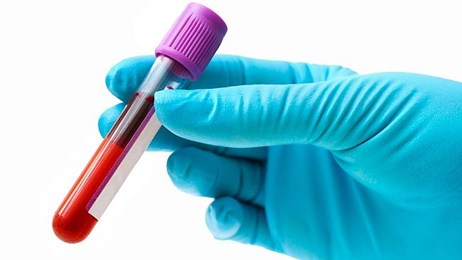
How do we detect which of these potential bacterial pathogens is causing this disease?
Step 1: Collect Samples, Perform Cell Count & Examine Glucose Levels
CSF
Meningitis is an inflammation of the meninges – i.e. bacteria are crossing the blood-brain-barrier and can be found in both blood and the cerebrospinal fluid.
CSF can be collected via lumbar puncture
Limitations: in rare cases (bleeding disorder, increased intracranial pressure), lumbar puncture may be contraindicated → just use blood sample
CSF sample containing over 1000-5000 leukocytes/mm3, with neutrophil dominance of 80-95% → good indication of bacterial cause
CSF to Glucose ratio < 0.4 highly indicative of bacterial meningitis
Blood

Slide 6
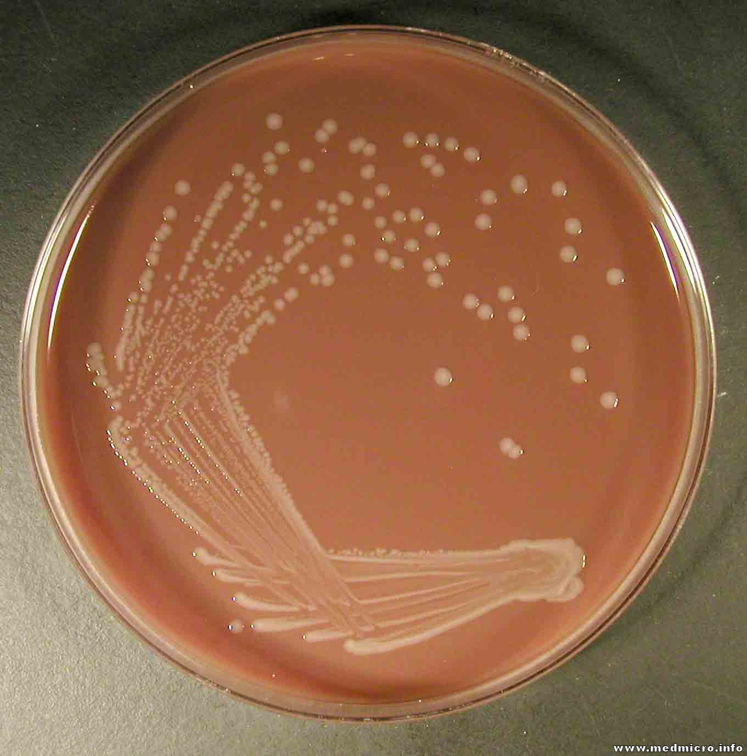
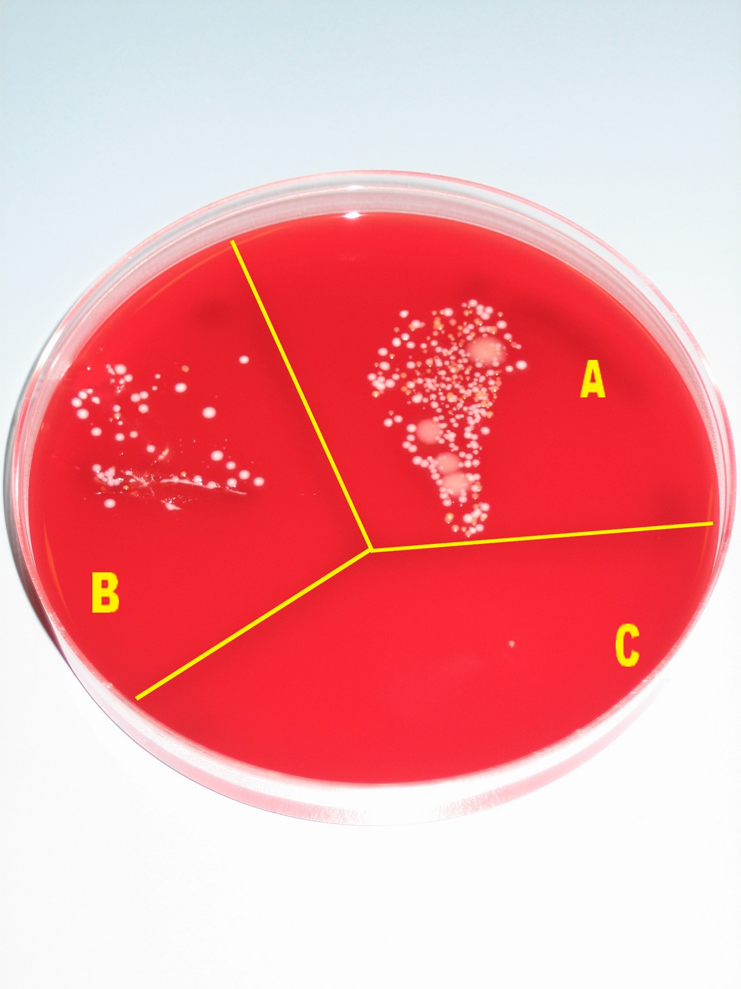
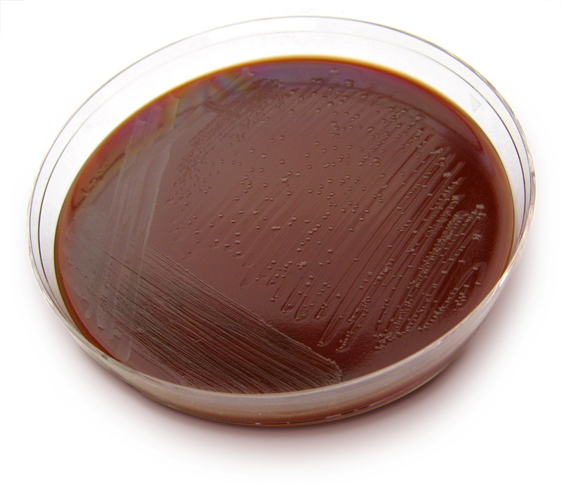
Step 2: Culture
A. Chocolate Agar Plate
If growth → rule out viral cause
B. Blood Agar Plate
N. meningitides is hemolytic → growth
H. influenzae is unable to lyse red blood cells → cannot grow
C. Thayer-Martin Agar Plate
Use of antibiotics and fungicides to select for Neisseria bacteria

Slide 7
At this point…
We can narrow it down to two potential bacterial causes:
N. meningitides and S. pneumoniae
In order to differentiate between the two we would…

Slide 8
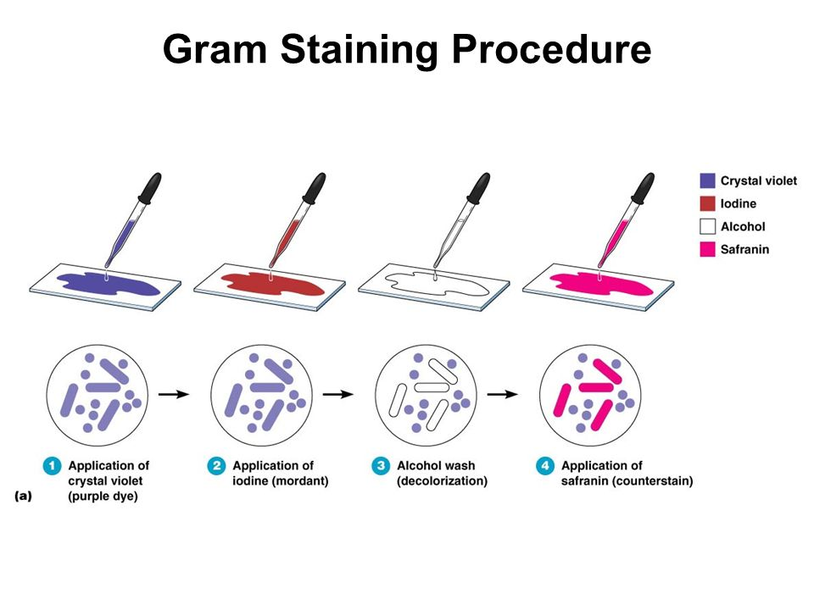
Step 3: Perform gram-staining
Gram-positive bacteria (S. pneumoniae) have thick, relatively impermeable wall with peptidoglycan → resistant to decolorization → retain the purple color of the original crystal violet dye, even after safranin application
Gram-negative bacteria (N. meningitides) have a thin peptidoglycan layer with an overlying outer lipid membrane → susceptible to decolorization by the original crystal violet dye → bacteria will lose the crystal violet dye when rinsed → adopt the pink/red color of safranin

Slide 9
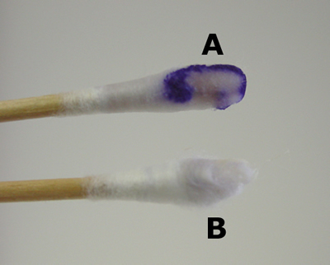
Clinical Confirmation of N. meningitides
Step 4: Kovac’s Oxidase Test
This test detects whether the microorganism produces cytochrome c oxidase → i.e. test for use of aerobic respiration
N. meningitides is typically strictly aerobic
Test reagent should turn purple
Oxidase Test can confirm if organism belongs to Neisseria genus… to verify species we turn to….

Slide 10
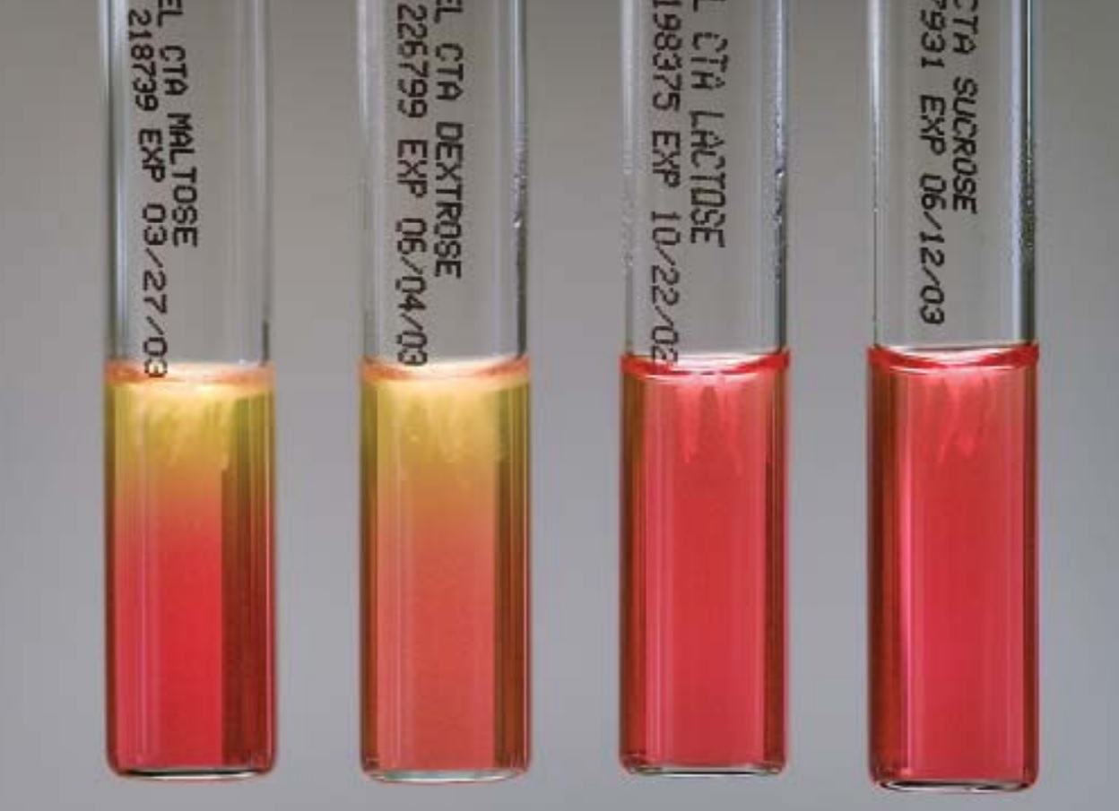
Step 5: Carbohydrate Utilization Test → Can the bacteria ferment specific carbohydrate substrates?
N. meningitides can ferment:
maltose
glucose
but not:
lactose
sucrose

Slide 11
Additional tests we can perform to confirm N. meningitides
 | Polymerase Chain Reaction (PCR) | Latex Agglutination Test
How it works… | Gene amplification using oligonucleotide primers and DNA polymerase crgA gene indicates (→) N. meningitidis | Binding of capsular antigens to serogroup-specific antibody
Pros | Can be used to determine particular serotype: SiaD gene → serotypes B, C, Y or W135 mynB gene → serotype A High sensitivity and specificity | Quick (little as 15 minutes) High sensitivity
Cons | Inconsistent data of its clinical importance High cost Limited availability | Susceptible to variances in the manufacturer of antibody, density of antigen in CSF sample, and pathogen being tests Does not significantly impant clinical decision

Slide 12
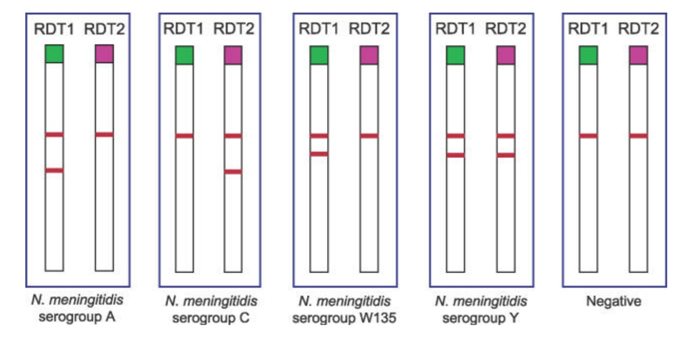
Rapid Diagnostic Tests (RDTs) for Use in the Field
Quick and simple
Directly tests the CSF
Not as sensitive or specific
2 lines = positive result
1 line = negative result

Slide 13
The End! ☺

