Slide 1
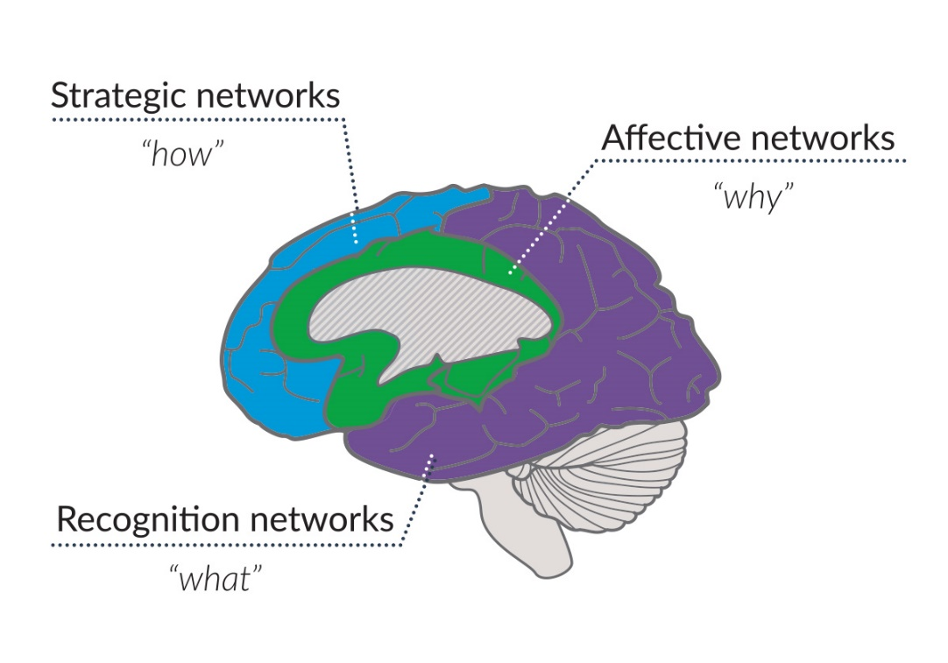
Introduction to
Universal Design for Learning (UDL):
A Teacher's Perspective
ANTOINE COULOMBE, Instructor, UBC School of Social Work
This presentation was adapted from: “UDL-Universe: A Comprehensive Faculty Development Guide: Two-hour UDL Workshop” retrieved from https://enact.sonoma.edu, August 2019

Slide 2
I would like to acknowledge that we are located on the traditional, ancestral, and unceded territory of the Musqueam people.

Slide 3
Agenda
What is UDL?
  Origins
  Guidelines
  How it Works
UDL Course design – An Example
Practice and Discussion

Slide 4
Learning Outcomes
At the end of this UDL workshop, you will be able to:
Explain how the main theoretical elements of UDL can enhance accessible course design.
Apply the UDL framework in practical ways when reviewing your course design.
Situate UDL with other pedagogical frameworks and build synergies between methods.

Slide 5
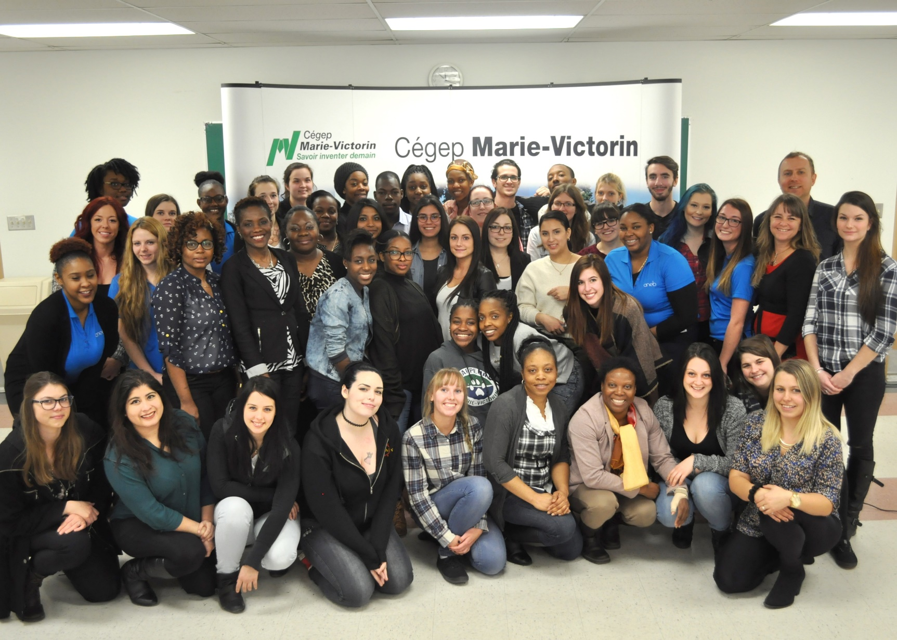
About me: SW, Montreal, Diversity, Values, UDL, …

Slide 6
About diversity of students
Canadian Universities have experienced termendous growth since 1980 – enrollements expanded by 81% - to now 2 million students.
A significant portion of these enrolment gains come from a diverse group of students who’s participation in higher education was previously limited
  Students with Indigenous background
  Students with disabilities
  First generation students (over 200 origins)
  Etc.
From: Cox, D. G. H., Strange, C. C., Scholars Portal Books: Canadian University Presses 2016, & desLibris - Books. (2016). Serving diverse students in canadian higher education. London;Kingston;Chicago;Montréal;: McGill-Queen's University Press.

Slide 7
UDL and working with diversity
Teachers often share similar concerns:
  Teach everyone.
  Be fair to everyone.
  Help everyone feel included.
  Etc.
A challenge we encounter: the complexity of diversity.
A question UDL asks: How to build inclusive education for all abilities?

Slide 9
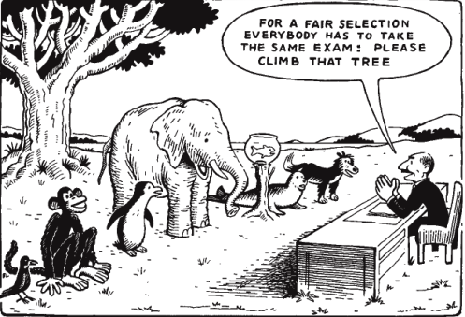
Social Model of Disability
It is the environment that reveals the disability;
disability is not a condition in itself but a condition in a situation.

Slide 10
Social Model of Disability
In the classroom
  Universally Disabling Presenttaion
  Disabling presentation for some
  « Normal » presentation (disabling without glasses)
  Inclusive presentation

Slide 11
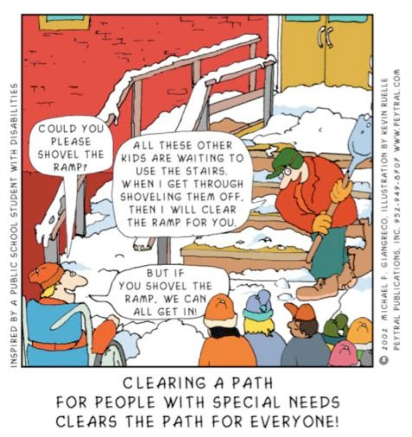

Slide 12
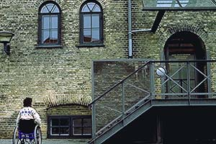
Universal Design
Is our physical environment welcoming?
Architectural term coined
by R. Mace
Physical environment design
for access
Stairs as access feature/barrier
  Physical Disabilities
  Elderly
  Children
  Strollers/Carts
Retrofitting for physical access
remains a design afterthought
DisWeb © 2000 Karen G. Stone

Slide 13
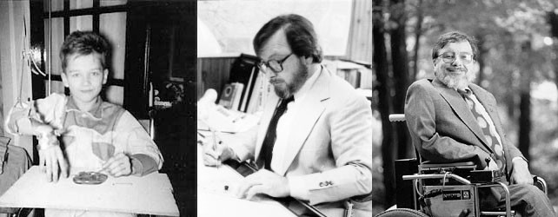
Origin: Universal Design (UD)
Is our physical environment accessible?
Ronald Lawrence Mace, FAIA (1941 – June 29, 1998) was an American architect, product designer, educator, and consultant. He is best known for coining the term universal design and for his work advocating for people with disabilities. Instead of adding accessibility adaptations, the physical environment is immediately conceived as accessible, within the design of the building. (from Wikipedia).
Want to know more: Podcast Exclusive “interview” with the late Ron Mace, father of universal design

Slide 14
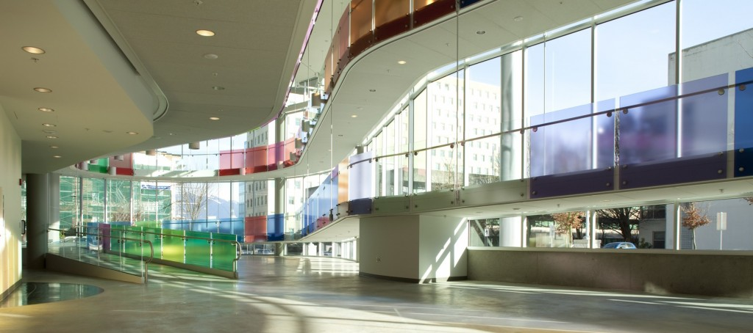
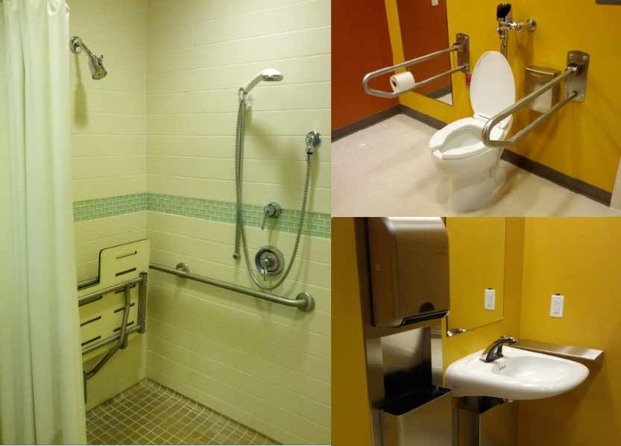
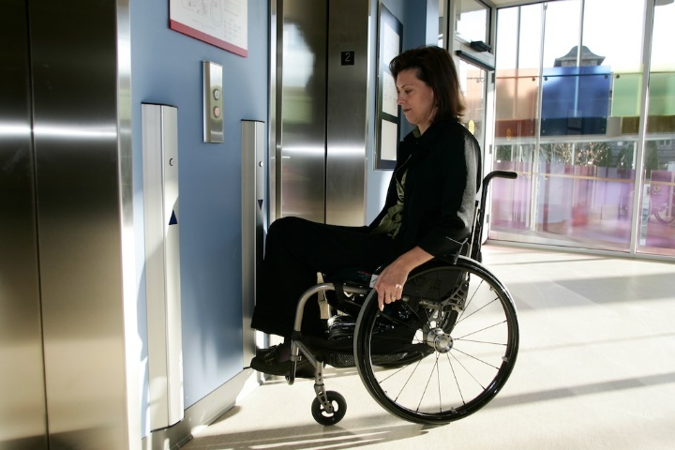
Universal Design Solutions
Blusson Spinal Cord Centre
https://icord.org/our-facility/building-accessibility/
Universal Design:
Intentional approach to design
Anticipates a variety of needs
Broadens usability to public
More economical
Respects human diversity

Slide 15
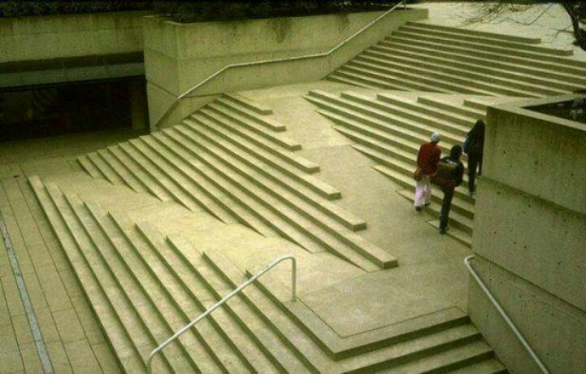
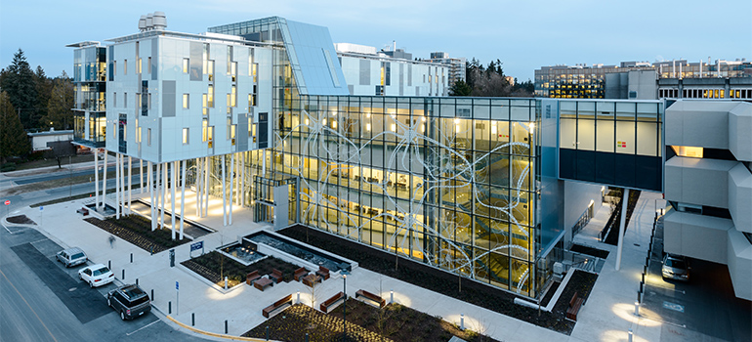

Slide 16
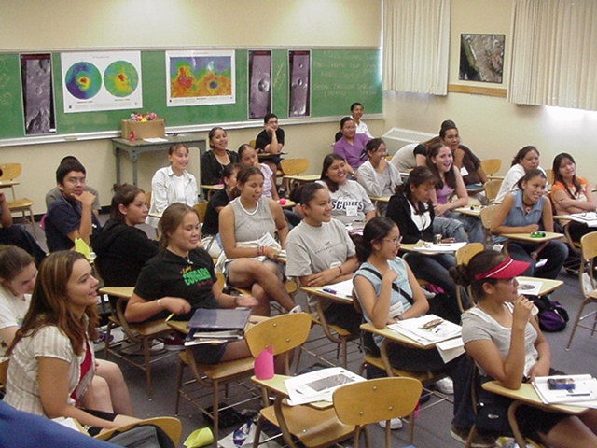
Universal Design for Learning
Is our pedagogical environment welcoming?
UDL is the proactive design of our courses to ensure they are educationally accessible regardless of learning style, physical or sensory abilities.
Just as physical barriers exist in our physical environment,
curricular barriers exist in our instructional environment.

Slide 17
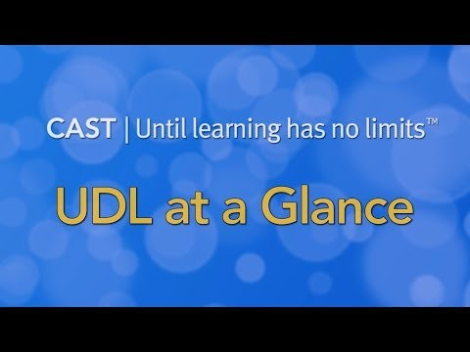
UDL at a Glance – cast.org https://youtu.be/U1B6yQXsr0c

Slide 18
UDL Guidelines

Slide 19
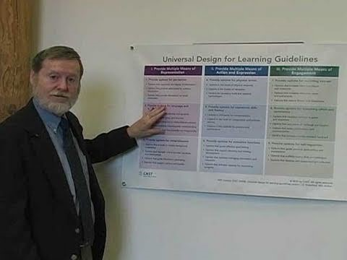
UDL Guidelines Structure

Slide 20

Multiple Means of Engagement
Affective Networks The « WHY » of Learning
Learners differ markedly in the ways in which they can be engaged or motivated to learn.
Recruiting Interest: Spark excitement and curiosity for learning.
  Barrier: Offer one choice.
Sustaining Effort & Persistence: Tackle challenges with focus and determination.
  Barrier: Complex task, lack of clarity.
Self Regulation: Harness the power of emotions and motivation in learning
Barrier: No opportunities for self-reflection.

Slide 21
Multiple means of Representation
The « WHAT » of learning
Learners differ in the ways that they perceive and comprehend information that is presented to them.
Perception: Interact with flexible content that doesn't depend on a single sense like sight, hearing, movement, or touch.
Barrier: Only access to paper copies of texts.
Language & Symbols: Communicate through languages that create a shared understanding.
Barrier: Frequent use of “slang” and local knowledge.
Comprehension: Construct meaning and generate new understandings.
Barrier: Assume every student has the
same academic knowledge.

Slide 22
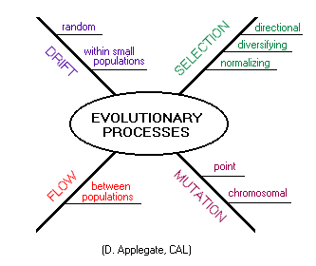
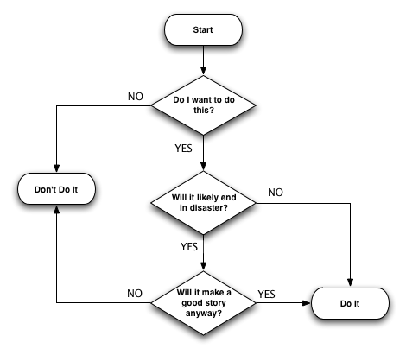
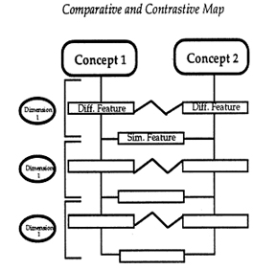
Sample Graphic Organizers

Slide 23
Multiple means of Action & Expression
The « HOW » of learning
Learners differ in the ways that they can navigate a learning environment and express what they know.
Physical Action: Interact with accessible materials and tools.
Barrier: Only hand written exam.
Expression & Communication: Compose and share ideas using tools that help attain learning goals.
Barrier: Everyone will do a class presentation.
Executive Functions: Develop and act on plans to make the most out of learning.
Barrier: Complex task with no guidelines.

Slide 24
UDL process
Establish Clear Learning Outcomes
Anticipate Learner Needs
Measurable Outcomes and Assessment Plan
Instructional Experience
Reflection and New Understanding
Use UDL to:
Identify Barriers in Course Design
Identify “Big Ideas” that increase accessibility
Representation
Expression & Action
Engagement

Slide 25
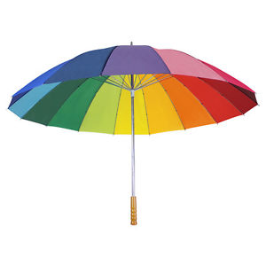
UDL : an umbrella

Slide 26
Benefits of UDL Practices
Enables you to reach a diverse student population without necessarily modifying your course requirements or academic expectations.
Provides you the tools to consider what and how you teach in a structured and systematic manner.
Increases student participation, achievement, and satisfaction.
Notes:
UDL benefits for faculty

Slide 27
UDL, CoP and Montreal Research Project
Montreal UDL Research Project
More here: Projet CUA http://pcua.ca/
Collaboration with 5 Higher Education Institutions (UdeM, UQAM and 3 CEGEP)
Community of Practice (CoP) and Pilot Projects over a period of 2 years (2014-2015).

Slide 28
Social Work with Groups (2014)
By the end of this course, you will be able to apply :
• Social Work with group theories in practice;
• Roles and tasks of the group Social Workers;
• Process of Implementing of a group: planning, implementation and evaluation.
About the students
Very diverse: cultural backgrounds, age, learning styles and abilities, academic background.
Social Work with Groups is a challenge for most of them (stress of talking in front of a group, being a leader, etc.).

Slide 29
Multiple Means of Representation
Analysis of what is offered in the course:
  Diverse means of representation are offered in class
  Outside of class, learning relies heavily on one book and articles
Goal: Diversify accessible options for Representation outside class
  Create a Course Blog with multiple accessible means of representation (e.g. videos, real examples of practice, case studies, stories, assignement models, maps, etc.)
  Praxis et l’art du travail social: https://praxistravailsocial.wordpress.com/

Slide 30
Multiple Means of Action and Expression
Analysis of what is offered in Course experience:
Main assignment offers multiple means of action and expression
Two assignments could offer more options
Goal: Diversify means of action and expression
Assignment 1 – Text analysis of a Social Work with Group practice – Offer 3 options: analyze an article (shorter text); analyze a thesis (longer text); or analyze a document film (video).
Assignment 2 – Prepare Social Work with Group Plan: Students can chose to do a Text or Video.

Slide 31
Multiple Means of Engagement
Analysis of what is offered in course :
Analysis showed this is a strength in the course’s design. Students demonstrated strong engagement because of the group project.
A challenge for many students is the complexity of the project. This will have an impact on their engagement.
Goal: Improve support options in group project.
Offer students different tools to organize their work in the group project:
Offer a detailed calendar and map of steps to organize project (accessible on any device)
Breakdown last assignment in steps

Slide 32
Impacts and Lessons Learned from my Teaching Experience
Students became more independent/empowered and had less questions during the semester.
Students were more engaged and less stressed.
Students who usually struggle a lot were more successful.
Technology can be very helpful in creating accessibility.
Diversifying options is good, when done strategically.
Preparing accessible course design prior to semester, and adapt to needs during semester.
UDL is a process with a good central question : Is my course design and learning environment accessible/universal?

Slide 33
Exercise
In small groups, take turns doing these steps:
  Introduce your course: main learning outcomes
  Present some key characteristics of your students, strenghts and common barriers
  Select an aspect of your course that would benefit from improved accessibility
  Identify which “Means” it relates to:
    Means of Representation
    Means of Action
    Means of Expression
  Discuss options and ideas
  Write main ideas on flip chart

Slide 34
Other options to learn about UDL
GOOD WEBSITES
http://www.cast.org/
http://enact.sonoma.edu/udl
A List and Review of Best UDL Books:
https://hillaryhelpsulearn.com/5-must-have-books-for-educators-on-udl/
A Free Ebook:
Bracken, S., & Novak, K. (2019). Transforming higher education through universal design for learning: An international perspective (1st ed.). Milton: Routledge.
A CONFERENCE – Coming in October 2019 Victoria, BC
THIRD PAN-CANADIAN CONFERENCE ON UNIVERSAL DESIGN FOR LEARNING https://www.udlcanada.ca/index.html

Slide 35
References
This presentation was adapted from:
UDL-Universe: A Comprehensive Faculty Development Guide: Two-hour UDL Workshop
https://enact.sonoma.edu/c.php?g=789377&p=5650621

Slide 36
Thank you for your engagement and participation!
Please take a moment to complete the session feedback form, bearing in mind that the facilitator’s practice and future programming of CTLT Institutes will benefit from your thoughtfulness.
There are many relevant sessions in this Summer Institute that you may be interested:
    Writing a Learner-Centered/Inclusive Syllabus
    August 22, 2019; 9:00 - 11:00
    Developing Classroom Guidelines: Thoughtful and Critical Approaches August 22, 2019; 11:30 - 1:30
    Working with TAs to Support Inclusive Teaching
    August 22, 2019; 2:00 - 4:00
    Creating Inclusive Science Classrooms: Student Voices
    September 6; 2:00 - 4:00
Please consult the Summer Institute Schedule for the full program.
Should you like to evaluate your students’ learning and/or the impact of your teaching practice, feel free to reach out to the Institute for the Scholarship of Teaching and Learning.
https://isotl.ctlt.ubc.ca/about/contact/ | ctlt.isotl@ubc.ca

