Slide 1
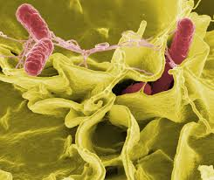
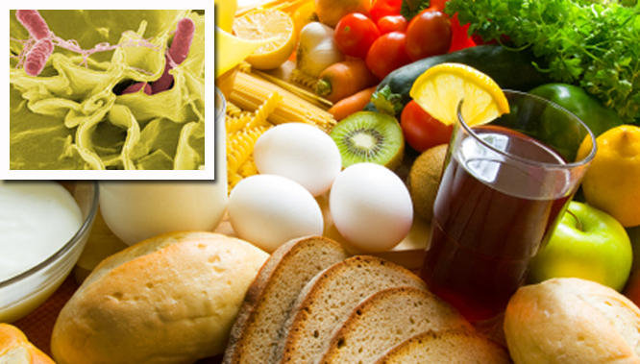
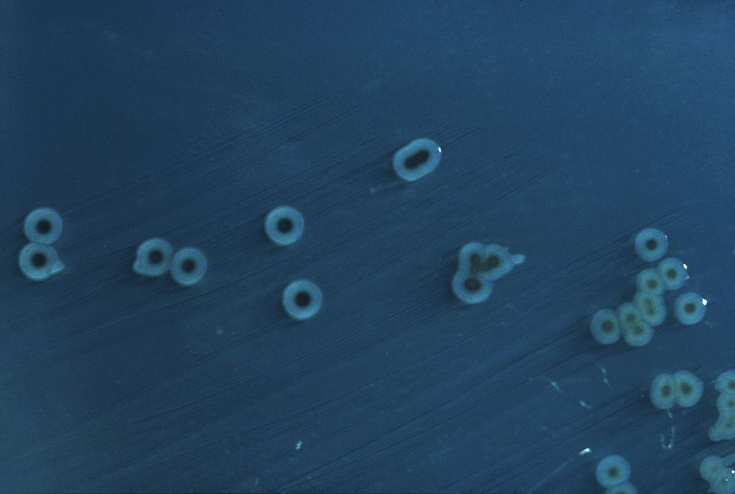
Case 1: Salmonella Enteritidis, Impact on Body Systems
By: Riley Ty

Slide 2
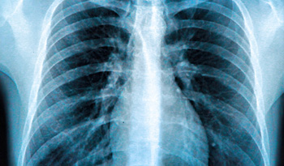
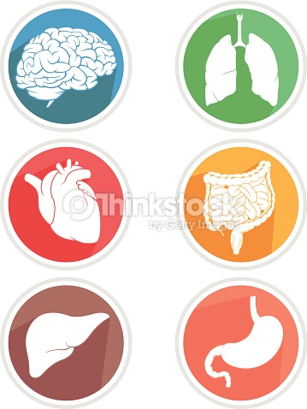
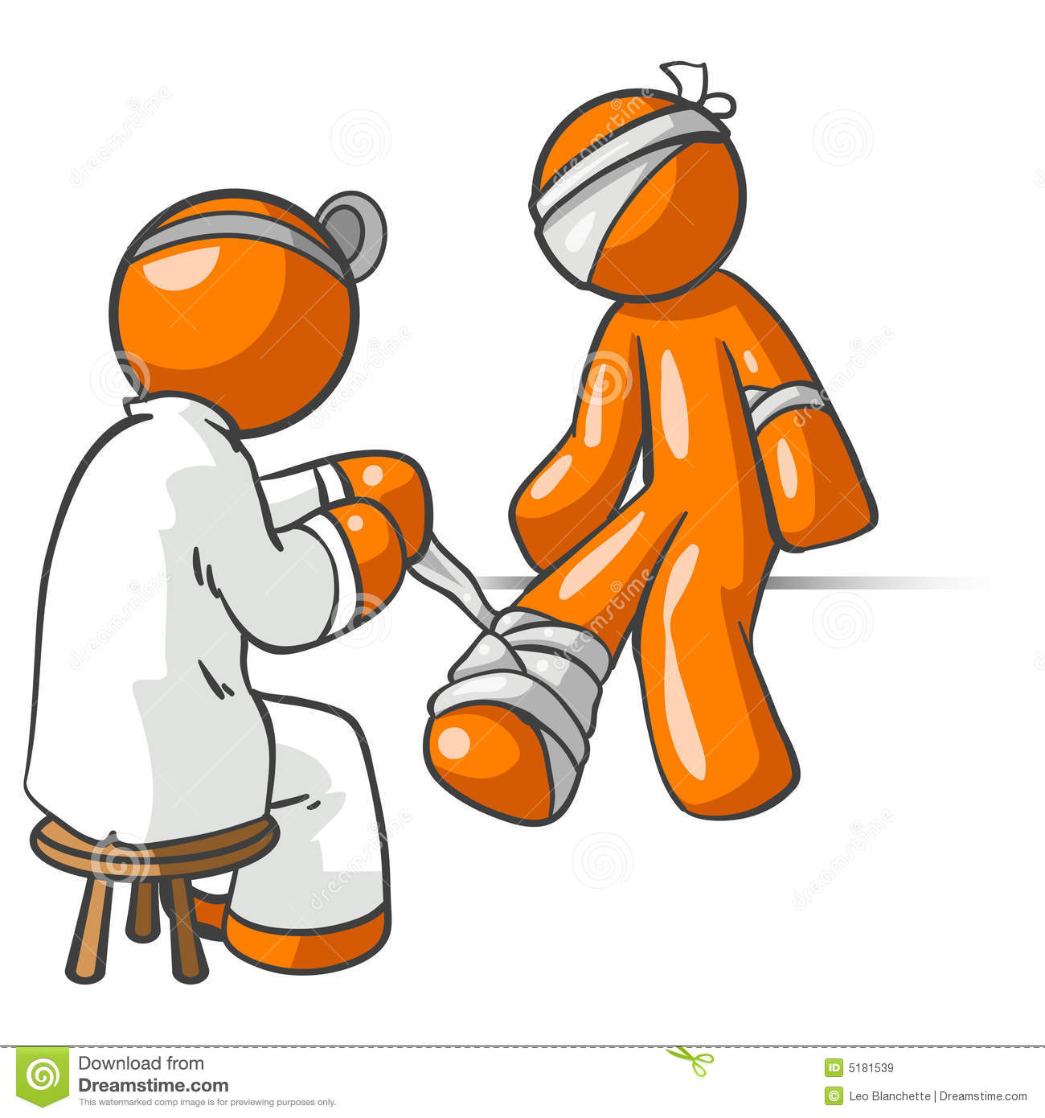
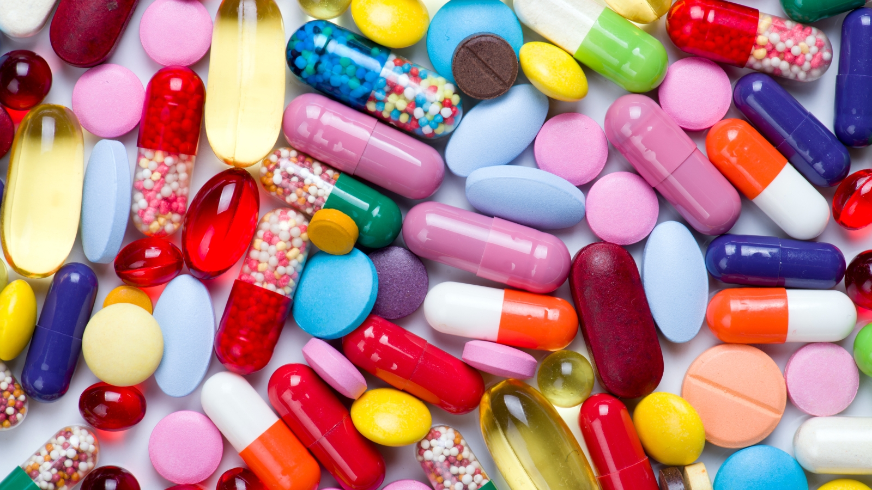
Overview of Concepts
Case:
Johnny, Age 25
Started ingesting raw eggs as part of
new body building diet
After one week in his new diet, Johnny suffers severe abdominal cramps, mild
fever and watery diarrhea
After 4 days of diarrhea, he goes to a drop in clinic to consult a doctor.
1. Signs &
Symptoms
2. Afflicted Body
Systems
3. Disruption of
Normal Functions
4. Recommended Treatment
6. Common Antibiotics for Enteritidis
5. Worst Case Scenario

Slide 3
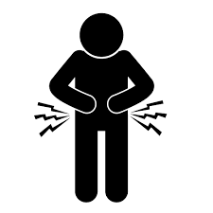
Signs and Symptoms Experienced by Johnny
Signs (Impartial attributes noticed by an outside observer) | Symptoms (Attributes felt by the afflicted individual)
Watery Diarrhea Fever Volume Depletion Abdominal Tenderness | Mild Fever Abdominal Cramps Watery Diarrhea
Key Findings:
Patient is 25 years old, healthy with no pre existing conditions.
Symptoms began shortly after patient started consuming raw eggs in his diet.
Stool sample grows Salmonella enteritidis.
Conclusion: Patient has Salmonella enteritidis, most likely due to raw egg consumption, a common source of Salmonella.

Slide 4
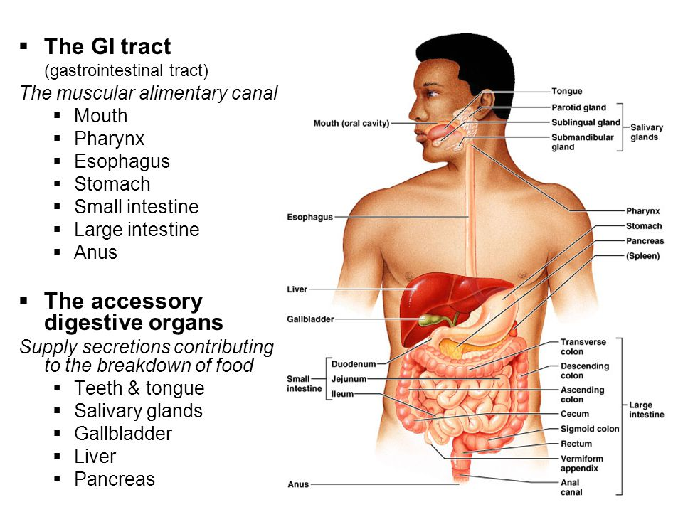
Afflicted Body Systems
Afflicted System: Gastrointestinal Tract (GI Tract)
Location: Organs running from mouth to anus (shown in diagram).
Normal Physiological Functions:
Mainly contributes to the ingestion, digestion and excretion of food.
Accessory Organs (noted in the diagram), have specific functions such as:
Small Intestine: Enzymes, epithelium and villi absorb nutrients
Large intestine: Absorbs water and excretes undigested remainder.
Other Functions:
Provides environment for multiple host micro flora, mainly anaerobic microbes, with increasing amounts further down the GI tract.
Site for multiple non-specific and specific host defenses against foreign microbes, includes:
Gastric acid in stomach (non-specific)
Short-chain fatty acids produced by resident micro flora, which are harmful to foreign microbes (non-specific)
T cells in mucosa lining GI tract (specific)
T cells, B cells, dendritic cells, macrophages and mast cells in Lamina propria (specific)

Slide 5
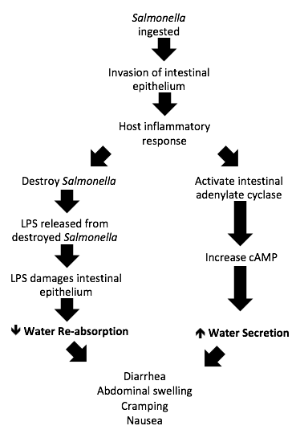
Disruption of Normal GI tract, mainly Intestinal, Functions
Area of Colonization: Small and Large Intestine, specifically area between ileum and the proximal colon.
Post Invasion/Disruption Events:
Invasion (degeneration of microvilli and binding of cell receptors) triggers host inflammatory response (cytokine release and neutrophil recruitment) and kills many bacteria, releasing lipopolysaccharide (LPS) endotoxin from bacterial envelope.
Also leads to increased cAMP levels, disrupting regulated water secretion and leads to an increase of secretion.
LPS damages epithelial cells and disrupts (i.e. decreases) water reabsoprtion.
End result: Diarrhea (Further detail given on the right)

Slide 6
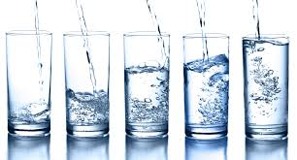
Recommended Treatment
For most cases (i.e. healthy individuals such as Johnny) treatment is rather simple and doctors recommend:
Keeping hydrated and drinking plenty of fluids to make up for the fluid and electrolyte lost due to diarrhea.
Get plenty of rest to help your immune system.
The reasoning for such simple treatment is because a significant number of Salmonella servovars are self limiting:
The bacteria is unable to survive beyond the GI tract and will be flushed out by both diarrhea and a healthy host’s immune system within 4-7 days.
Therefore there is no need for medication, unless…

Slide 7
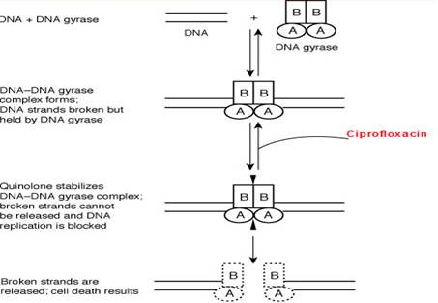
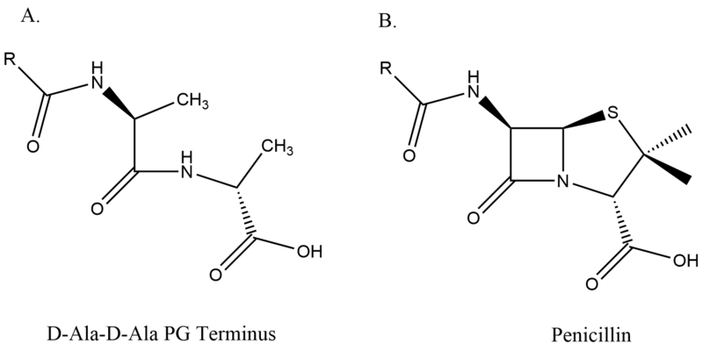
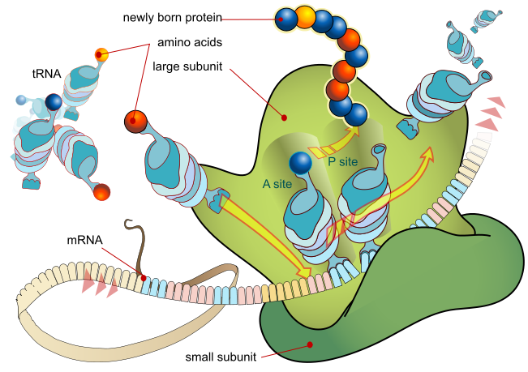
Worst Case Scenario and Treatment
If Johnny’s case is severe or the doctor believes the bacteria can spread into the blood (bacteremia), then antibiotics may be prescribed.
Antibiotics (ABs) are considered a last resort for a number of reasons:
They can disrupt normal flora within the GI tract, worsening the disease
Lead to the development of antibiotic resistance
Decrease amount of normal flora and allow for other opportunistic bacteria to invade and cause more infections
For these reasons and more, ABs are mainly used for immunocompromised individuals and as a last resort for Salmonella Enteritidis.

Slide 8
Common ABs for Salmonella enteritidis
Name of Antibiotic | Antibiotic Mechanisms
Ampicillin | Ampicillin mimics the main substrate of transpeptidase and binds to it irreversibly, preventing bacterial cross linking of peptidoglycan units to the bacterial cell wall. This compromises the cell wall structure and leads to cell lysing.
Ciproflaxacin | It inhibits DNA gyrase by acting on the A subunits of DNA gyrase and therefore disables the enzyme’s ability to ligate DNA strands back together. This prevents DNA replication and kills the bacteria.
Chloramphenicol | Cleaves 23S rRNA at ribosomal A site, thereby blocking pepetidyl transferase and stopping protein elongation, but does not kill bacteria.
Trimethoprim-Sulfamethoxazole (TMP/SMX) | TMP inhibits dihydrofolate reductase and SMX prevents synthesis of precursor dihydrofolic acid. This leads to a lack of tetrahydrofolic acid, which leads to inhibition of thymidine synthesis, which halts DNA and RNA synthesis, thereby killing the cell.

