Slide 1
Measuring Anti-Xa: Does Activity Predict Outcome?
Greg Egan PharmD Student
Doctor of Pharmacy UBC Seminar
January 23rd, 2014

Slide 2
Objectives
Describe the pharmacodynamic and pharmacokinetic properties of LMWH
Describe how anti-factor Xa activity is measured
Review clinical studies of LMWH where anti-factor Xa was measured
Describe the relationship between anti-factor Xa and clinical outcomes

Slide 3
LMWH
 | Xa : IIa activity | Peak Anti-Xa (+/SD) U/ml | Target (U/ml)
Enoxaparin 1 mg/kg | 3.7 : 1 | 0.9 | 0.6-1.0
Enoxaparin 1.5 mg/kg |  | 1.1 | > 1.0
Dalteparin 5000 U | 2.8 : 1 | 0.49 (0.13)
Dalteparin 200 U/kg |  | 1.2 (0.43) | > 1.05
Tinzaparin 3500 U | 6 : 1 | 0.15
Tinzaparin 75 U/kg |  | 0.34
Tinzaparin 150 U/kg |  | 0.70 | > 0.85
Large molecule
Polysaccharide polymer typically < 18 units
Mean 6,000 daltons
Hydrophobic
Complexes with antithrombin
Inhibits factor IIa and Xa
Greater propensity for Xa
Fragment length of < 15 subunits will not inhibit IIa
Notes:
Enzymatic depolymeration of UFH

Slide 4
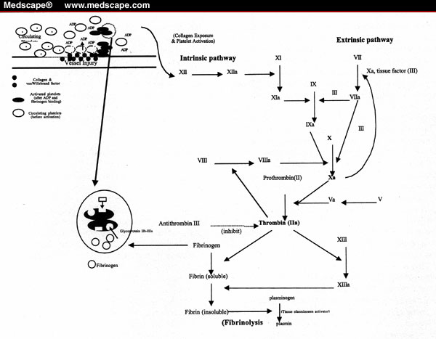
Other effects of heparin on coagulation:
Inhibits activated coagulation factors – VII, IX, XI, XII
Interacts with endothelial cells and alters secretion of von Willebrand factor
Notes:
Other effects of heparin on coagulation:
Also inhibits other factors – VII, IX, XI, XII
Endothelial cells and plasma proteins, minimal release of vWBf

Slide 5
LMWH
Absorption | No oral absorption 100% bioavailability after SC administration Peak activity after SC administration 3 to 4h
Distribution | Vd 0.06L/kg (mean of enox, dalt and tinza) Protein binding >95%
Metabolism | None
Elimination | Primarily renally eliminated Glomerular filtration 1st order elimination

Slide 6
Anti-Xa Monitoring
Peak activity
Approx. 4h after administration
Trough activity
Immediately prior to next dose
Random activity
Arbitrary amount of time after administration
Laboratory availability
Tertiary and quaternary care facilities
Samples are sometimes batched

Slide 7
Anti-Xa Monitoring
Chromogenic assay
Add excess fXa & chromogenic reagent to sample
LMWH + thrombin complex binds fXa
Reagent competes with LMWH for fXa
Releases chromophore upon binding
Compare to known [standard] of LWMH
Reagent
WHO has standard reagent
Interlab variation < 5%
Many chromogenic assay kits available
Inter-kit variation up to 40%

Slide 8
Anti-Xa Monitoring
Chest 2012
“…if monitoring is required, the anti-Xa level is the recommended test.”
“Coagulation monitoring is not generally necessary, but some authorities suggest that monitoring be done in obese patients and in those with renal insufficiency.”
Target range for treatment of VTE
peak anti-Xa levels 0.6 – 1.0 U/ml
Notes:
This seminar reviews the issues of anti-Xa level and clinical outcome in ‘normal’ patients
To review anti-Xa monitoring in special populations requires an understanding of anti-Xa activity and its relationship to clinical outcome

Slide 9
Clinical Question
Patient | Requiring treatment of DVT, PE or ACS Prophylaxis of DVT and PE Non-pregnant, normal weight and renal function
Intervention | LMWH fixed or weight adjusted Anti-Xa monitoring ± titration of dose to target anti-Xa level
Control
Outcome | Mortality Bleeding Thrombosis

Slide 10
Literature Search
Databases | Pubmed, Medline, Embase, Cochrane, Google Scholar, International Pharmaceutical Abstracts
Search Terms | LMWH or enoxaparin or dalteparin or tinzaparin or logiparin or parnaparin or bemiparin or nadroparin Anti-factor Xa or anti-factor Xa monitoring or anti-factor Xa activity or anti-factor Xa assay Venous thromboembolism or pulmonary embolism or deep-vein thromboembolism or acute coronary syndrome
Limits | English, Human
Results | RCT Prophylaxis – 9 studies Treatment – 3 studies Cohort Treatment – 1 study

Slide 11
Levine et al. 1989
Design | Data analyzed from 3 related RCTs Determine whether a relationship exists between anti-Xa levels and clinical outcome of wound hematoma and thrombosis
Patient | Consecutive patients from 1 hospital in France VTE prophylaxis after total hip replacement
Intervention | Enoxaparin 40mg SC daily or 60mg SC daily
Control | UFH 5,000U SC twice daily
Outcome | Anti-Xa level taken 12h after dose on day 3 Compared between patients experiencing an event and not Regression analysis for 1) Wound hematoma 2) Occurrence of thrombosis
Thrombosis and Hemostasis. 1989:62(3);940-944
Notes:
100U/mg

Slide 12
Levine 1989
3 RCTs
1) Enox 30mg BID vs. 60mg daily
2) Enox 20mg BID vs. 40mg daily
3) Enox 40mg daily vs. UFH 5,000U BID
All patients managed by same surgeon and anesthetist
First dose 12h pre-op
Only patients who received a single daily injection of enoxaparin in these studies are included in the analysis

Slide 13
Levine 1989
Blood sampling
Collected 12h post-dose
Post-op day 1, 3 and 6
Chromogenic assay used (Strachrom® assay)
Outcome
Hematoma
Collection of blood causing dehiscence of wound
Delay in hospital discharge, delay of suture removal
Surgical intervention
Thrombosis
Venography on days 3 and 6

Slide 14
Levine 1989
Analysis
Compare anti-Xa level and clinical outcome
Logistic regression
Relationship between anti-Xa level and clinical outcome
174 patients received once-daily enoxaparin
11 pts did not have anti-Xa levels (n=163pts)
None of these patients experienced a clinical outcome
Final numbers:
Enox 40mg (n=113)
Enox 60mg (n=50)

Slide 15
Relationship between anti-Xa level and hematoma
Anti-Xa (U/ml) | Hematoma | No hematoma | Risk on LMWH (%)
≤ 0.05 | 0 | 8 | 0
0.06-0.1 | 0 | 30 | 0
0.11-0.15 | 3 | 38 | 7.3
0.16-0.2 | 3 | 31 | 8.8
> 0.2 | 12 | 37 | 24.5
*used highest anti-Xa level from days 1 and 3 Anti-Xa > 0.2 vs. ≤ 0.2; p<0.0004
Relationship between anti-Xa level and thrombosis
Anti-Xa (U/ml) | Thrombosis | No thrombosis | Risk on LMWH (%)
≤ 0.05 | 6 | 26 | 18.8
0.06-0.1 | 6 | 44 | 12.0
0.11-0.15 | 4 | 45 | 8.2
0.16-0.2 | 1 | 19 | 5.0
> 0.2 | 0 | 11 | 0
*used lowest anti-Xa level from days 1 and 3 Anti-Xa > 0.2 vs. ≤ 0.2; p<0.0008
Notes:
Least conservative approach – bias analysis to show difference

Slide 16
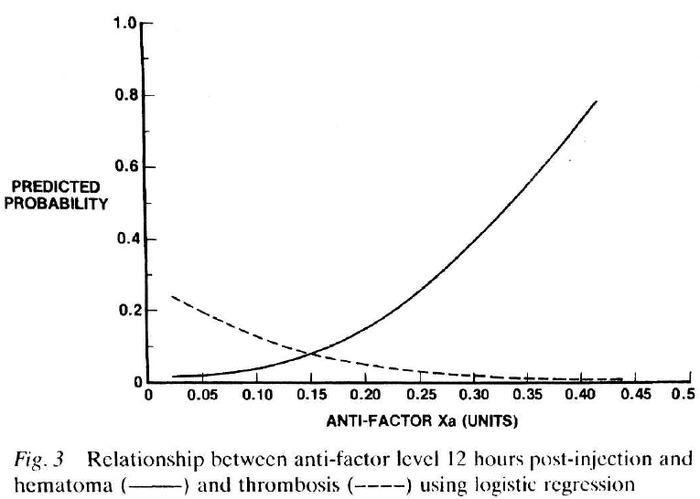
Notes:
Did not report equation for regression
What factors were included in the analysis?
Difficult to interpret as these are 12h post dose anti-Xa
Suggests that impaired clearance is a risk factor for elevated anti-Xa and increased risk of hemorrahge -> predictable

Slide 17
Conclusion
“… the results of the regression analysis suggest that anti-factor Xa levels are predictive of outcome, and more so than dose. These findings suggest that the efficacy and safety of enoxaparine and possibly other low molecular weight heparins might be enhanced if anti-factor Xa levels are maintained within a defined range.”

Slide 18
Levine 1989
Limitations
Cohort
Not randomized, clinical heterogeneity
Random anti-Xa level
Radiographic thrombosis
Major and minor bleeding not differentiated
Logistic regression
Did not report clinical factors, regression coefficient and confidence interval
Patient characteristics not reported
Risk factors for clinical outcomes
Homogenous group of THR patients
One hospital and one surgeon
Prophylactic doses of enoxaparin once daily

Slide 19
Bara 1992
Design | Double blind study to investigate efficacy and safety of logiparin for the prevention of VTE Blood samples collected on day 3 and 5 approx. 3h post-dose
Patient | 1290 patients undergoing general surgery
Intervention | Logiparin 2,500U SC daily Logiparin 3,500U SC daily For 7-10 days
Control | UFH 5,000U SC twice daily
Outcome | Correlation of anti-Xa level to clinical outcome Expressed as anti-Xa U/kg
Thrombosis Research. 1992:65;641-650

Slide 20
Bara 1992
Daily radiolabelled fibrinogen uptake test (FUT) performed on day 2 to day 7 to detect DVT
Positive FUT triggered venography used to confirm diagnosis of DVT
Bleeding evaluated clinically
Hematoma size, increased surgical drain output, hemoglobin levels
Severe hemorrhage – required transfusion, re-operation or D/C drug
Laboratory tests
Chromogenic assay
Standard obtained from National Biological Board, London
Statistical analysis
Student t-test and logistic regression

Slide 21
Bara 1992
 | UFH (n=420) | LMWH 2,500U (n=431) | LMWH 3,500U (n=430) | p*
FUT +ve | 18 (4.2%) | 34 (7.9%) | 16 (3.7%) | 0.01
Venogram +ve | 13 (3.0%) | 24 (5.6%) | 10 (2.3%) | 0.03
Severe hemorrhage | 14 (3.3%) | 9 (2.1%) | 13 (3.0%) | 0.5
*one-way analysis of variance (ANOVA)
No post-hoc test
Incidence of death, pulmonary embolism and re-operation was small and similar in all 3 groups

Slide 22
Bara 1992
Anti-Xa (mean,SEM) | UFH | LMWH 2,500U | LMWH 3,500U
Day 3* | 0.034 (0.003) | 0.097 (0.003) | 0.161 (0.004)
Day 5* | 0.032 (0.003) | 0.111 (0.003) | 0.161 (0.004)
Discharge* | 0.024 (0.003) | 0.082 (0.005) | 0.148 (0.006)
*one-way analysis of variance (ANOVA) (p<0.001)
> 360 samples per group

Slide 23
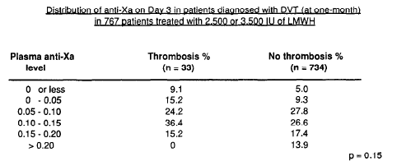
Bara 1992
ANOVA
Notes:
ANOVA for anti-Xa groups and thrombosis outcome
No post-hoc test

Slide 24
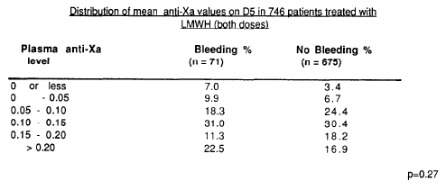
Bara 1992
ANOVA

Slide 25
Bara 1992
Logistic regression
Thrombosis
Stepwise multivariate regression; p=0.045
Hemorrhage
Stepwise multivariate regression; p=0.13
*adjusted for other prognostic factors

Slide 26
Bara 1992
Limitations
No reporting of baseline characteristics
Risk factors for thrombosis or hemorrhage
Intensive investigations to detect thrombosis
Not practical in real world
No sample size calculation
Adequate # of events to detect a small, clinically important difference
Comparison of groups by ANOVA
No post-hoc test
Dalt 7,500U group is distinct from the other two groups
Logistic regression
Other factors included in model
Regression coefficient plus confidence interval

Slide 27
Alhenc-Gelas 1994
Design | Fragmin-Study Group Multicentre RCT
Patient | 122 consecutive patients requiring treatment of DVT
Intervention | Dalteparin 100U/Kg SC BID then adjusted to peak Anti-Xa 0.5-1.0U/ml (n=64) x 10/7 “Group B”
Control | Dalteparin 100U/kg SC BID (n=58) x 10/7 “Group A”
Outcome | Hemorrhagic events Marder Score
Thrombosis and Haemostasis 1994:71(6);698-702

Slide 28
Alhenc-Gelas
Methods
11 centres
Enrolled recent DVT (last 10 days)
1 case of PE
Heparin IV infusion initial therapy
Oral anticoagulant started on day 7
Allocation concealment described
Excluded:
SCr > 300µmol/L, active bleed, thrombolytic therapy, vena cava filter, thrombocytopenia (<100), surgery w/in 5 days

Slide 29
Alhenc-Gelas 1994
Outcomes
Hemorrhage
Daily clinical evaluation
Severe = interruption of treatment or death
Thrombosis
Venography on pre-randomization and Day 10
Marder Score
Radiological based on change of thrombus on venogram
Blind radiology assessment
Notes:
Marder score 40 pt scale – thrombus on initial venogram; improved decrease of > 2pts, unchanged difference < 2 pts, worsening, increase > 2 pts

Slide 30
Alhenc-Gelas 1994
Anti-Xa measurements
Peak activity on day 2, day 6 and day 10 in all patients
Chromogenic assay
Inter-assay coefficient of variation 14%
Analysis
Correlation of Marder score and anti-Xa activity
Notes:
Mean dose in weight base dose 100.09 U/kg
Anti-Xa adjusted 103.53 U/kg

Slide 31
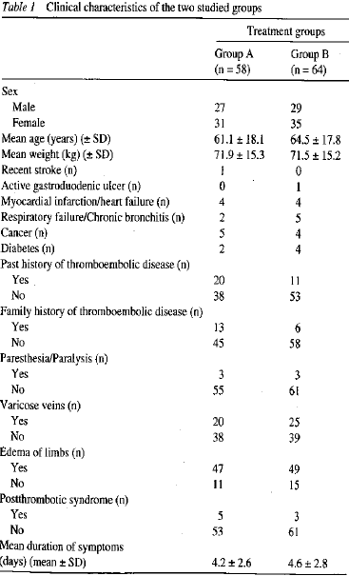

Slide 32
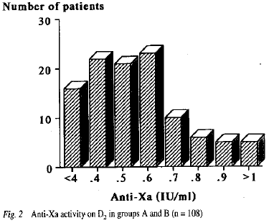
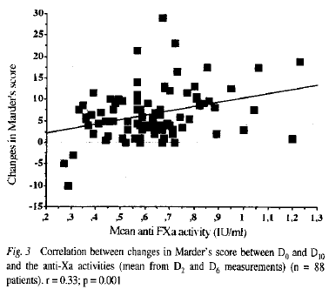
No patients experienced recurrent DVT
Group A
1 episode of parietal hematoma
Group B
3 minor bleeding episodes
Notes:
No patients had a symptomatic recurrent episode or DVT
No difference in marder score between group

Slide 33
Alhenc-Gelas 1994
Limitations
Short duration
10 days, bridging to oral anticoagulant
Very few events
No recurrent thrombosis and 4 bleeds (1 major)
Small difference in mean dalteparin dose
100.03 ±0.8 U/kg vs. 103.8 ±10.2 U/kg
Wide interpatient variability in anti-Xa level
No description of blinding
Clinicians adjusted dose based on anti-Xa
How was blinding maintained?

Slide 34
Summary
Association between anti-Xa and clinical outcome established in small trial
Gaps in reporting of study details (? internal validity)
Outcome was radiographic assessment of thrombosis
Larger RCTs
No association between anti-Xa level and clinical outcome
No benefit from titration of LMWH dose to target anti-Xa level vs. empiric weight-based

Slide 35
Bottom-line
No routine monitoring required in normal weight and normal renal function
Anti-Xa level most likely to affect clinical decision-making in treatment doses of LMWH being given over a longer time-period
Correlate anti-Xa level with clinical event:
Patient experiencing an otherwise unexplained hemorrhage or therapeutic failure
There is significant inter-assay and interpatient variability
Inhibition of factor Xa is only one mechanism by which LMWH alters coagulation

Slide 36
Questions?

Slide 37
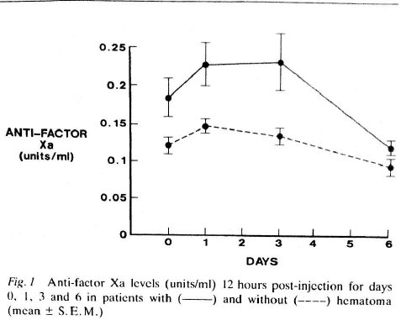
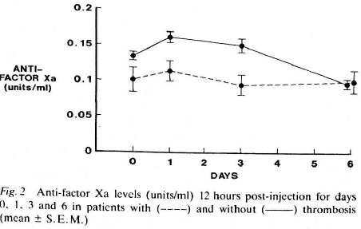

Slide 38
Obesity
Definition
Body mass index (BMI) >30 kg/m²
BMI 30-34.9 Class I or mild obesity
BMI 35-39.9 Class II or moderate obesity
BMI >40 Class III or severe obesity
Size Descriptors
Total Body Weight (TBW)
Does not distinguish between lean mass and adipose tissue
Lean body weight (LBW) estimate of fat free mass
Males, LBW (kg) = 1.1013 x TBW- 0.01281 x BMI x TBW
Females, LBW (kg) = 1.07 x TBW- 0.0148 x BMI x TBW
Adjusted body weight (ABW) or Dosing body weight
Purported to be more physiologic
ABW = [IBW + CF (TBW-IBW)]

Slide 39
Obesity
Absorption | Minimal change ? Delay peak serum concentration after SC administration
Distribution | More adipose tissue ↑ % mass fat, ↓ % mass lean ↑ ECF volume
Metabolism | ↑ Cardiac output ↑ Hepatic blood flow Fatty liver
Elimination | ↑ renal blood flow ↑ glomerular filtration rate

Slide 40
Obesity
Effect on LMWH PK
Volume of Distribution
Vd is ~ intravascular volume
In obesity intravascular volume does not increase proportionally to TBW
Dose-capping recommended with body weight > 100kg by manufacturer
Clearance
Possible ↑ renal clearance due to↑ renal blood flow

Slide 41
Clinical Question
Patient | Obese patients BMI > 30kg/m² or TBW > 100kg
Intervention | LMWH Fixed dose regardless of weight Dosing by TBW vs. dose capping Anti-Xa target
Control
Outcome | Mortality Bleeding Thrombosis Anti-Xa level Vd and Cl

Slide 42
Literature Search
Databases | Pubmed, Medline, Embase, Cochrane, Google Scholar, International Pharmaceutical Abstracts
Search Terms | LMWH or enoxaparin or dalteparin or tinzaparin or logiparin or parnaparin or bemiparin or nadroparin Obesity or morbid obesity Anti-factor Xa or anti-factor Xa monitoring or anti-factor Xa activity or anti-factor Xa assay
Limits | English, Human
Results | 4 PK studies [Yee 2000, Hainer 2002, Sanderink 2002] RCT [Imberti 2008 (R, parna)] Cohort [Borkgren-Onkonek 2008 (C, enox), Simone 2008 (C, enox), Jiminez (C, enox 40mg/day, weight), Wilson 2001]

Slide 43
Imberti 2009
Design | Obese pts undergoing surgery at 5 sites in Italy Randomized to parnaparin for VTE prophy Starting 12hrs pre-op Objective – determine pharmacodynamic parameters of parnaparin
Patient | BMI >36kg/m2 Excluding: Renal dysfunction (SCr > 106 mcmol/L) aminotransferases > 3 x UNL, thrombocytopenia (<100,000)
Intervention | Parnaparin 4250 U/day Parnaparin 6400 U/day Mean 9 + 2 days
Control
Outcome | Anti-Xa concentration
Thrombosis Research 124 (2009) 667–671
Notes:
Bariatric surgery – bypass surgery, gastric bypass, jejunoileal bypass, gastric banding

Slide 44
Imberti 2009
Measurement of Anti-Xa activity
Centralised
Chromogenic assay
Parnaparin calibration curve used with 3 standards (0, 0.6, 1.2 U/ml)
Measured peak anti-Xa on days 4 and 6
Statistical analysis
Spearmans correlation coefficient
Enrolled 60 patients as a sample of convenience
Compared BMI >45kg/m2 to < 45kg/m2

Slide 45
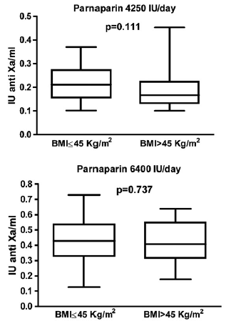
Baseline Characteristics
 | Parnaparin 4250 U/day | Parnaparin 6400 U/day
N | 36 | 30
Sex (M/F) | 3/30 | 6/24
Age (mean) | 38 | 42
Cr Cl (ml/min) | 92.85 | 86.65
Spearman Correlation to BMI
Parn 4250: -0.232 (95% CI -0.467 - 0.034)
Parn 6400-0.118 (95% CI -0.383 - 0.166)
Box represents 25th to 75th %ile
Bars represent the range of values

Slide 46
Imberti 2009
Limitations
5 centres in Italy
VTE prophylaxis after bariatric surgery
No power calculation
Small number of patients (n=66)
No clinical outcomes

Slide 47
Yee 2001
Design | Pharmacokinetic study sampling serum dalteparin concentrations at steady-state Objective – to determine if there are significant differences in Vd and Cl of dalteparin in obese vs. normal weight pts
Patient | 10 obese and 10 normal weight volunteers (BMI>30kg/m2) Matched for age, gender and LBW
Intervention | Dalteparin 120U/kg BID Dalteparin 200U/kg OD *dosed based on TBW or LBW based on prescriber
Control
Outcome | Mean Cl and Vd compared between obese and normal weight

Slide 48
Yee 2001
Previous studies
First-order, one-compartment model
Linear relationship between peak [plasma] and bleeding
Rates of bleeding are highly variable in studies
Apparent V
Expected to be close to plasma volume
↑ MW, ↑protein binding and hydrophobic

Slide 49
Yee 2001
Included:
Unstable angina 9 pts, Pulmonary embolism 8 pts, DVT 3 pts
Only 1 pair of patients matched for disease states
Excluded:
Coagulation disorder, recent childbirth, renal dysfunction
LBW = (height)150 cm) x 0.9 + 45 kg (female) or +50 kg (male)
ABW = (ABW) . LBW + CF x (TBW-LBW) where CF . 0.4

Slide 50
Yee 2001
Venous samples taken on 2nd or subsequent dose
Assuming t1/2 5hrs
Peak (4h) and another prior to next dose
Assay
Chromogenic, samples run in duplicate
Samples > 1 U/ml were diluted
r2 of the standard curve was 0.988
Coefficient of variation 7%

Slide 51
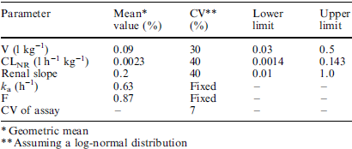
Pharmacokinetic Parameters
Baseline Characteristics

Slide 52
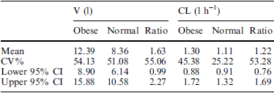
Results
Vd larger in 7 obese pts and smaller in 3
1.6x higher in obese pts
Not statistically significant but perhaps clinically significant (Type 2 error)
Mean values for Cl was larger in obese grp by <20% and not clinically significant

Slide 53
Limitations
Small sample
Not all patient pairs matched to indication
No reporting of clinical outcome
Numerical different in Vd, large enough to be clinically significant but not statistically significant
Reported Vd by total L and not L/kg

Slide 54
Sanderink 2002
Design | Pharmacokinetic study of healthy volunteers to compare PK in obese and nonobese Randomized, open-label, 2-way crossover
Patient | 48 volunteers - 24 obese with BMI 30-40kg/m2 and 24 normal weight Matched for gender, age and height Excld: coagulation disorder, no recent pregnancy or childbirth, contraindication to LMWH
Intervention | Enoxaparin 1.5mg/kg SC daily x 4 days Enoxaparin 1.5mg/kg IV infusion over 6 hrs
Control
Outcome | Cl and Vd

Slide 55
Sanderink 2002
Venous samples
Anti-Xa activity
SC:
Pre-dose, 0.5, 1, 1.5, 2, 3, 4, 6, 9, 12, 15, 24 hours then days 2 & 3 predose and 3hours post-dose
IV:
Pre-dose, 0.5, 1, 2, 3, 4, 6, 6:10, 6:20, 6.5, 7, 8, 9, 12, 15 and 24 hours

Slide 56
Sanderink 2002
Chromogenic assay
Calibration from 0.025U/ml and 0.40U/ml
Precision was better than 8.6%
PK analysis
Non-compartmental by WinNonlin
Calculated Vd and Cl
Absolute bioavailability calculated using different methods of administration

Slide 57
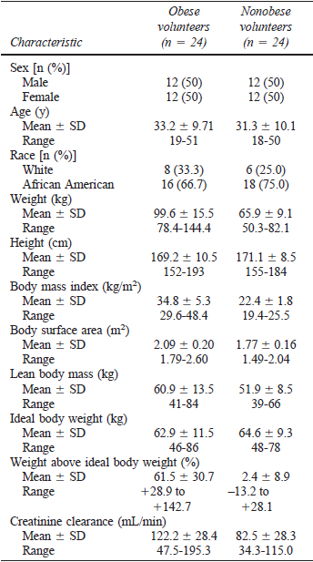
Baseline Characteristics

Slide 58
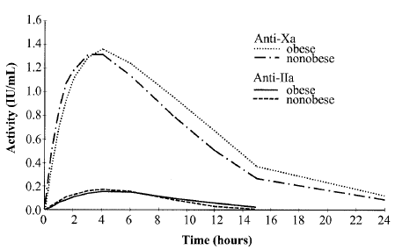
Higher AUC with obese patients
Vd (L/kg) lower in obese vs. non-obese
Author’s conclusion:
“SC enoxparin yields similar exposure in obese and nonobese so can dose based on TBW up to 40kg/m2

Slide 59
Sanderink 2002
Limitations
Healthy volunteers
No clinical outcome
One regimen of enoxaparin

Slide 60
Hainer 2002
Design | Pharmacodynamic study Randomized open-label crossover study (1 week washout)
Patient | 37 Healthy volunteers 100-160kg Excld: Antiplatelet (10 days), NSAIDs (3 days), anticoagulants (4 weeks) Smoker (>2ppd) Historical ‘normal’ weight controls
Intervention | Weight-based dosing of tinzaparin Single doses of: 175U/kg SC 75U/kg SC
Control
Outcome | AUC, Cl, Vd
Thromb Haemost 2002; 87: 817–23

Slide 61
Hainer 2002
Venous sampling
Sample times relative to administration
-0.25, 0, 0.25, 0.5, 0.75, 1, 1.5, 2, 3, 4, 5, 6, 8, 12, 16, 24 and 30hours
Chromogenic assay
Analysis
Sample size to detect a 20% difference in anti-Xa (95% CI)
Historical normal-weight controls receiving tinza 4500U SC
Assumed linear pharmacokinetics

Slide 62
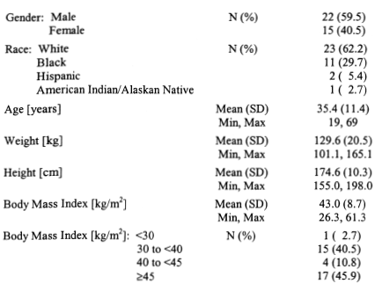
Hainer 2002

Slide 63
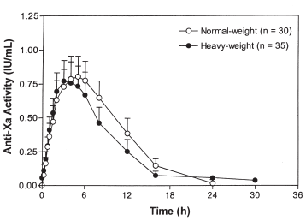
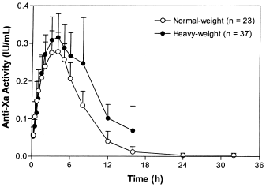
Hainer 2002
Tinza 175U/kg SC
Tinza 75U/kg SC

Slide 64
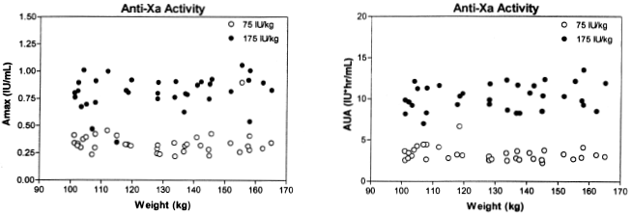
Hainer 2002
Heavy subjects only; Amax – peak serum anti-Xa activity; AUA – area under curve for anti-Xa activity
Conclusion:
Anti-Xa activity is consistent over 100kg to 170kg body weight when dose based on TBW

Slide 65
Hainer 2002
Limitations
Single dose
Historical controls
Different dose given
Proportional PK assumed

Slide 66
Study | Design | Participaints | Intervention | Control | [Anti-Xa] (U/ml) mean ± SD | Outcome
Borkgren-Onkonek et al. 2008 | Prospective open label n= 223 | Bariatric surgery mean 50.4 kg/m² | Enox 40mg BID if BMI < 50 + m/kg² mechanical | Enox 60mg BID if BMI > 50 + m/kg² mechanical | Peak 4h concs: < 50 m/kg² BMI 0.32 (0.10) > 50 m/kg² BMI 0.26 (0.13) NSS | 1 non-fatal VTE (0.45%) and 3 major bleeds (1.79%)
Simone et al. 2008 | prospective cohort n=40 | Bariatric surgery | > 100kg = Enox 60mg BID < 100kg = Enox 40mg BID |  | <100kg 0.21 vs. >100kg 0.43 (p<0.001) | Only 1 hemorrhagic event reported
Jiminez et al. 2008 | Prospective cohort n=112 | Medical patients 21% were obese | Enox 40mg / day x mean 7 days |  | Peak 4h on day 3 BMI <23 kg/m² 0.28 + 0.23 BMI 23-26 kg/m² 0.23 + 0.35 BMI 26-29 kg/m² 0.15 + 0.09 BMI > 29 kg/m² 0.13 + 0.11 | No major bleeding occurred 2 proximal DVT occurred with anti-Xa < 0.10 U/ml
Wilson et al. 2001 | Prospective cohort anticoagulation bridging n= 37 | A- within 20% IBW B- 20-40% IBW C- > 40% IBW | Dalt 200 U/kg dosed by TBW x 5 days |  | Peak (4h) day 3 A- 1.01 + 0.20 B- 0.97 + 0.21 C- 1.12 + 0.22 (p >0.2) | No thromboembolic or hemorrhagic events occurred at 90 day follow up

Slide 67
Koller 1986
Design | 2 related RCTs Double-blind, randomized First-dose 1h pre-op then Q12h for ≥ 5 days
Patient | General surgery Excluding thoracotomy or coagulation disorder
Intervention | Dalteparin 7,500U SC daily (n=23) Dalteparin 2,500U SC daily (n=74)
Control | UFH 5,000U SC twice daily (n=20 & 72)
Outcome | Hemorrhagic event DVT Peak (4h) anti-Xa level
Thrombosis and hemostasis 1986:56(3);243-246

Slide 68
Koller 1986
Screening for DVT
Daily fibrinogen uptake test (FUT)
Venography every other day
+ve test prompts testing on subsequent day
2 +ve venograms = DVT outcome
f/up for DVT occurred up to 30 days post-op (clinical assessment only after discharge)
Anti-Xa assay completed 4 hours after dose on post-op day 4
Chromogenic assay used
Coatest® Chromogenix assay

Slide 69
Bleeding Complications | LMWH 7,500U | UFH
No of pts.* | 11 (47.8%) | 2 (10%)
Decrease in HgB (g/L) δ pre-op to post-op day 3 (mean ± SD) | 23.2 ± 1.66 | 15.6 ± 1.33
# blood transfusions | 20 (5pts) | 4 (1pt)
Heparin D/C’d | 6 | 1
Hematoma | 7 | 5
Wound evacuated | 4 | 2
Increased post-op drainage | 5 | 1
GI bleed | 2 | 0
Day 4 | LMWH 7,500U | UFH
Anti-Xa (U/ml)* | 0.48 ± 0.12 | 0.01 ± 0.02
aPTT (s) | 31.6 ± 3.3 | 30.7 ± 3.8
Thrombin time (s) | 17.1 ± 4.1 | 14.7 ± 1.9
* p < 0.01 (LMWH 7,500U vs UFH)
LMWH 2,500U NSS different in bleeding compared to UFH
Only 1 DVT occurred in LMWH group

Slide 70
Koller 1986
Limitations:
Reporting of study design incomplete
Randomization, allocation, blinding
Baseline characteristics
Dalteparin 7,500U study stopped early
No stopping rules described
Risk of overestimating effect
No analysis of anti-levels in patients who bled
Prophylaxis of DVT post-operatively
Dalteparin 7,500U & 2,500U compared
Common regimen dalteparin 5,000U

