Slide 1
Immune Response in a Food-borne Bacterial Infection
PATH 417A
Jen Yong

Slide 2
Case: Food-borne bacterial infection
“One Too Many Hamburgers”
10-year-old Ronnie McDonald has developed abdominal cramps, bloody diarrhea and a low grade fever. His parents take him to see the family doctor. The doctor asks about what Ronnie may have eaten in the past week and his parents recall that last weekend at a neighbor’s barbecue they were concerned that the hamburgers may not have been cooked thoroughly and Ronnie had eaten two burgers.
The doctor performs a physical examination noting no rebound tenderness just some mild periumbilical tenderness. He asks the parents to collect a stool sample for the Microbiology Laboratory and to take Ronnie to the local lab for some routine bloodwork.

Slide 3
Pathogen Identification: Which bug is causing Ronnie’s illness?
There are several pathogen candidates that could be causing Ronnie’s illness in this case. Common pathogens indicated in food-related illnesses include:
Escherichia coli (especially Enterohaemorrhagic E. coli (EHEC) O157:H7)
Salmonella typhi
Campylobacter jejuni
Shigella spp.
Of these possibilities, this presentation will discuss EHEC and Salmonella.

Slide 4
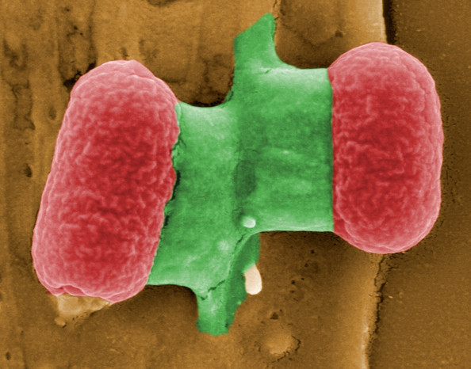
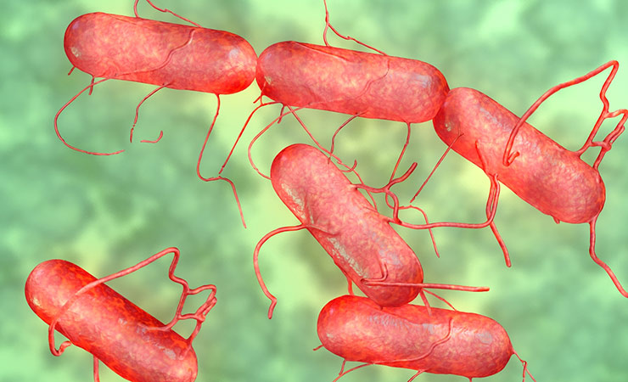
Possible bacterial causes
EHEC 0157:H7
Gram negative
Rod-shaped
Facultative anaerobe
Part of the GI normal flora
Salmonella typhi
Gram negative
Rod-shaped
Facultative anaerobe
NOT part of the GI normal flora
https://usercontent1.hubstatic.com/6006334.jpg
http://canadajournal.net/wp-content/uploads/2015/10/Canadian-Salmonella-Outbreak-Sends-34-To-Hospital-In-Eight-Provinces-photo.jpg

Slide 5
Overview of Content
Host immune response
Damage by immune response
Bacterial evasion
Outcome

Slide 6
Host immune response: Big picture
There are a number of components that are involved in the host immune response. They can be grouped into 3 systems as illustrated below:
Physical barriers
Innate immune
Adaptive immune

Slide 7
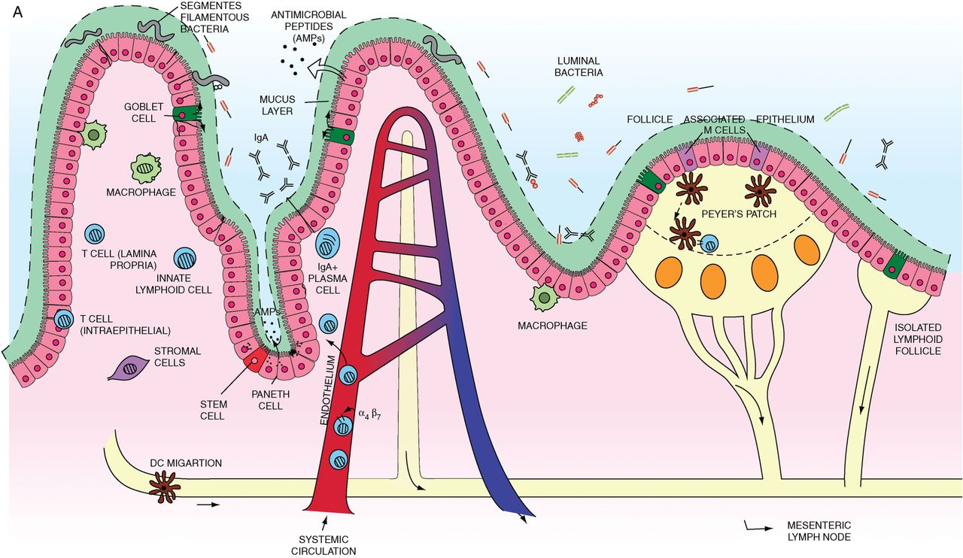
Host immune response: Physical barriers
http://gut.bmj.com/content/gutjnl/62/11/1653/F1/graphic-1.large.jpg

Slide 8
Host immune response: Physical barriers
Mucosal barrier is secreted by goblet cells in the GI epithelial layer. The mucus immobilises the pathogen and prevents adherence.
Antimicrobial peptides (AMPs) are secreted by Paneth cells. Some examples of the AMPs secreted by Paneth cells include:
Defensins (positively-charged substances that destabilise and form pores in the negatively-charged bacterial membrane)
Cathelicidins (bind and neutralise LPS)
Lactoferrin (similar membrane destabilising effect as cathelicidins + sequestering of free ions to limit bacterial use for growth)
http://gut.bmj.com/content/gutjnl/62/11/1653/F1/graphic-1.large.jpg

Slide 9
Host immune response: Physical barriers
Mucosal barrier is secreted by goblet cells in the GI epithelial layer. The mucus immobilises the pathogen and prevents adherence.
Antimicrobial peptides (AMPs) are secreted by Paneth cells. Some examples of the AMPs secreted by Paneth cells include:
Defensins (positively-charged substances that destabilise and form pores in the negatively-charged bacterial membrane)
Cathelicidins (bind and neutralise LPS)
Lactoferrin (similar membrane destabilising effect as cathelicidins + sequestering of free ions to limit bacterial use for growth)
GI normal flora limits colonization by pathogenic bacteria such as EHEC and Salmonella.
sIgA in the GI lumen neutralise bacterial agents.
Tight junctions of enterocytes preserve the epithelial cell barrier and limit bacterial invasion of GI lamina propria.
Once bacteria have invaded lamina propria, immune cells in gut-associated lymphoid tissue (GALT) / the Peyer’s patches function to eliminate the bacteria.)
http://gut.bmj.com/content/gutjnl/62/11/1653/F1/graphic-1.large.jpg

Slide 10
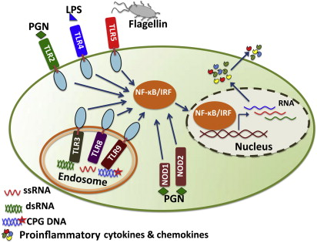
Host immune response: Innate immune system
PAMP + PRR
Pathogen-Associated Molecular Patterns
LPS
Flagellin
Peptidoglycan (PGN)
CpG DNA
Pattern-Recognition Receptors expressed on immune cells:
TLRs (Toll-Like Receptors) 2/4/5
NOD (Nucleotide-binding Oligomerization)-like receptors
E.g. LPS + TLR4, flagellin + TLR5 ➔ Activation of NF-kB pathway
E.g. intracellular PGN + NOD1/2 ➔ Activation of NF-kB pathway
http://ars.els-cdn.com/content/image/3-s2.0-B9780128012383001069-f00171-01-9780128012383.jpg?httpAccept=%2A%2F%2A

Slide 11
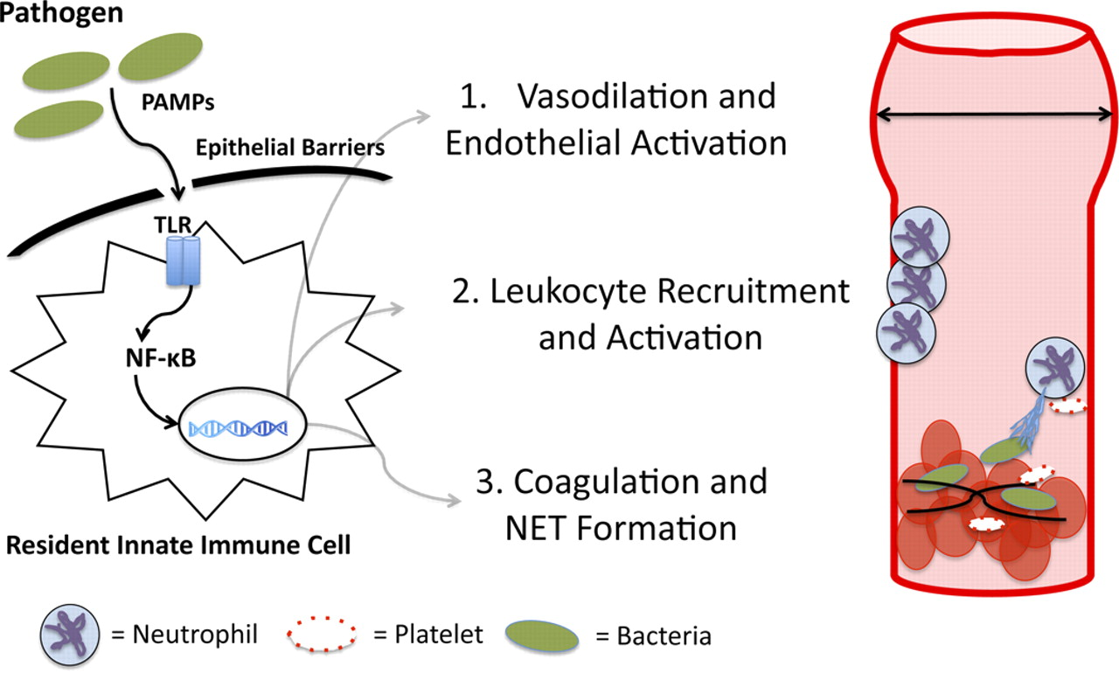
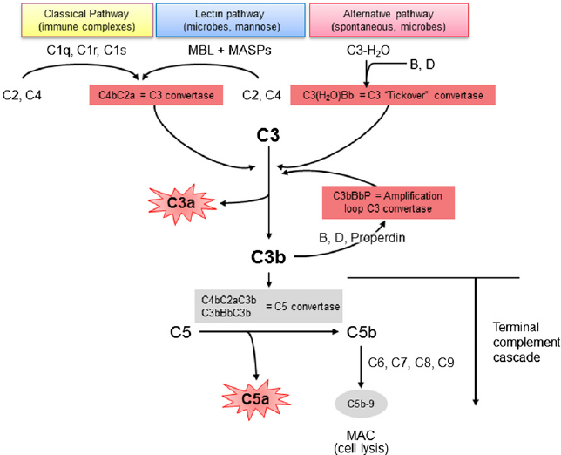
Host immune response: Innate immune system cont’d…
https://www.researchgate.net/profile/Fernando_Fervenza/publication/280117443/figure/fig1/AS:284489612840960@1444839017046/Figure-1-The-normal-complement-cascade-The-complement-system-can-be-activated-by-the.png
http://ajplung.physiology.org/content/ajplung/303/5/L355/F2.large.jpg
Cytokine release
Pro-inflammatory
Vasodilation
Leukocyte recruitment
E.g. IL-8 secreted by resident macrophages attracts PMN to the site
Complement response
May occur through all 3 pathways (classic, lectin, alternative)
C3a, C5a, C4a are anaphylatoxins
Membrane Attack Complex (MAC) formation leads to bacterial cell lysis.

Slide 12
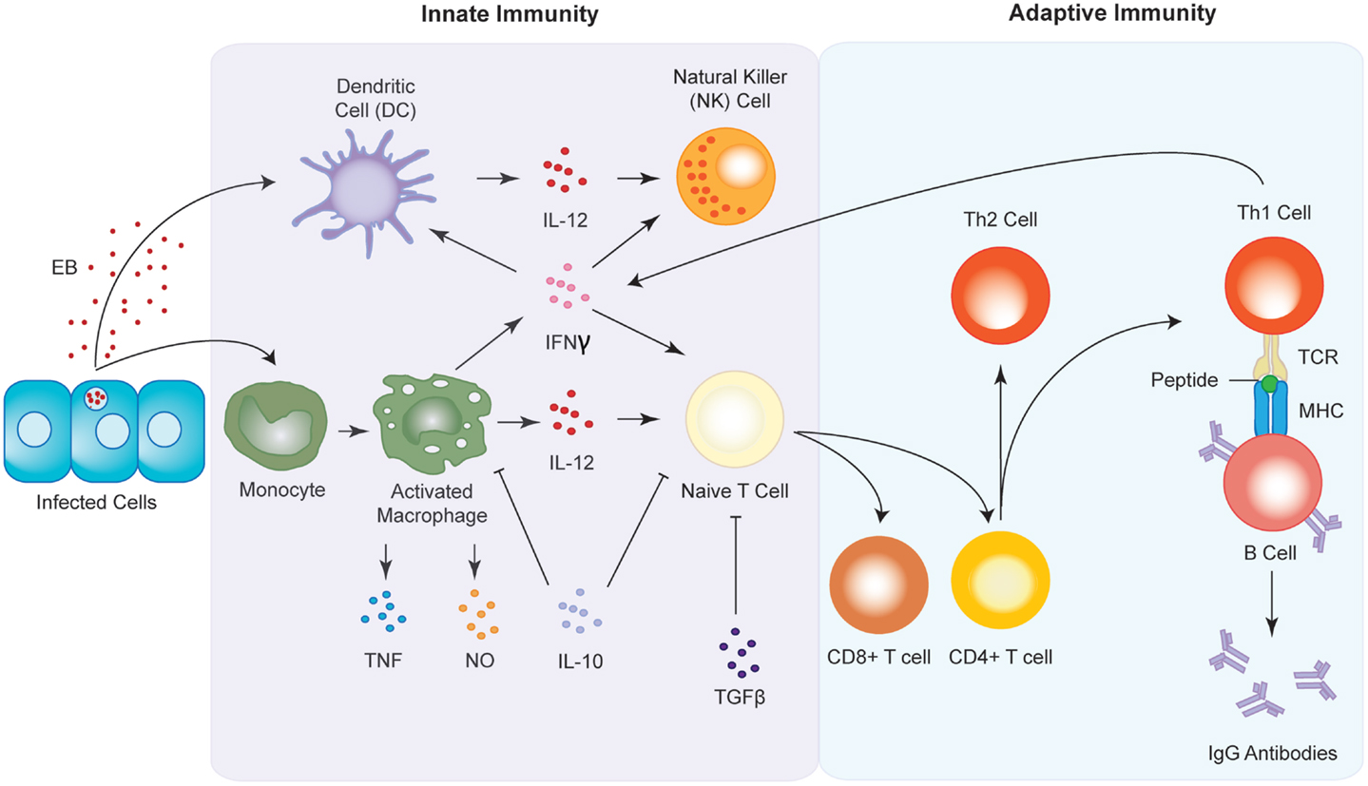
Host immune response: Innate to Adaptive
http://www.frontiersin.org/files/Articles/107989/fimmu-05-00534-HTML/image_m/fimmu-05-00534-g004.jpg

Slide 13
Host immune response: Adaptive Immune system
Cell-mediated
Antigen-presenting cells process antigens and present them on MHC2 to CD4+ T cells
Dendritic cells (DCs)
Macrophages (MPs)
Activated MPs also secrete cytokines (IL-18, IL-12 facilitate IFNg-dependent Th1 production)
T cells differentiate and expand…
Helper T cells (Th) get activated by APCs
Naïve T cells differentiate into various subtypes
Th17 cells recruit and activate neutrophils
Th1 cells are antigen-specific and enable B cell class switching (IgM → IgG/A)
CD8+ Cytotoxic T cells (CTLs) induce apoptosis of infected cells
Humoral
Antigen recognition by BCR (B cell receptor) is the first step of B cell activation.
CD4 T cells recognise the Ag presented on B cell MHC2, and secrete cytokines that fully activate the B cell into a plasma cell.
Ab are released in the basolateral side of the gut epithelium, which then translocate into the gut lumen by binding to Ig receptors on gut epithelium (transcytosis).
Without help from Th1 cells, B cell activation yields plasma cells that secrete IgM but not other classes of Ig.

Slide 14
Host immune response: Adaptive Immune system vs. E. coli
Cell-mediated
Activated DCs and MPs secrete IL-2, IL-12, IFNg which induce differentiation of CD4+ T cells into Th1.
Th1 cells are antigen-specific and are specialised to eliminate intracellular bacteria.
In addition to stimulating T cell differentiation, IFNg induces the production of NO which directly kills intracellular E. coli.
Humoral
Ab induce the C’ pathway by binding to E. coli-specific antigens such as Tir (Translocated Intimin Receptor).
Activated C’ pathway results in the lysis of the bacteria through the formation of the MAC (membrane attack complex).
Ab also opsonize E. coli and promote clumping, which aids phagocytosis and hence the elimination of the pathogen.
T cell-dependent B cell activation promotes Ig class switching, and yields IgA and IgG production.

Slide 15
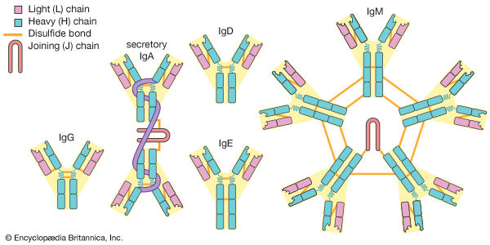
Host immune response: Adaptive Immune system vs. Salmonella
Cell-mediated
CD4+ T helper cells specific to Salmonella are activated in the Peyer’s patches.
Following activation, CD4+ T cells differentiate into Th1 subset, which produce IFNg, TNF-a, and IL-2.
These Th1-secreted cytokines activate macrophages which are efficient at killing intracellular pathogens like Salmonella.
CD8+ CTLs are activated when Salmonella antigens are presented to their NKG2D receptors by MHC I molecules (MIC-A & MIC-B).
Humoral
Mostly IgA, and some IgG and IgM
IgA & IgM are released into and bind the gut mucosal layer where they act to neutralize enteric pathogens and the toxins they produce.
https://media1.britannica.com/eb-media/95/20895-004-65CA4E0B.jpg

Slide 16
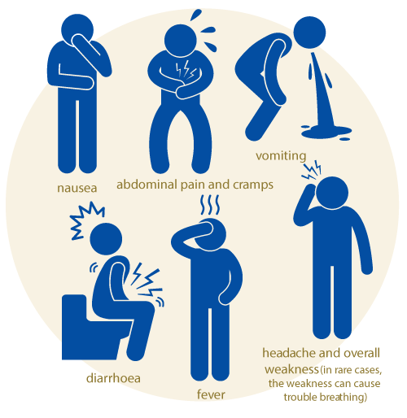
What damage does the immune response inflict upon the host?
Ronnie presented with:
Abdominal cramps
Diarrhea
Bloody stool
Low grade fever
Mild peri-umbilical tenderness
In addition to pathogen-mediated damage, the immune response targeted to eliminate the pathogen can also inflict damage to self.
http://mypositiveparenting.org/wp-content/uploads/2015/12/signs-of-food-poisoning.png

Slide 17
Immune damage: Abdominal cramps
Inflammatory response is part of the non-specific innate immune response to bacterial infection. Factors of innate immune response can both target pathogens but also harm the host.
Infiltrating neutrophils contribute to inflammation and loss of epithelial barrier function. Neutrophil recruitment causes tissue damage.
Further damage to the host tissue can ensue from the release of toxic substances (e.g. antimicrobial peptides).
Pro-inflammatory agents such as bradykinin and histamine stimulate nerve endings and cause pain / abdominal cramps.
http://blog.listentoyourgut.com/blog/blogimages/2011/03/child-tummy-ache.jpg

Slide 18
Immune damage: Diarrhea
The bacterial enterotoxins suppress nutrient absorption which stimulates the mucosal cells to secrete a large volume of water into the GI lumen. The type of diarrhea caused in such cases are watery.
Neutrophils contribute to diarrhea by stimulating chloride (Cl-) secretion from epithelial cells. Negative charge builds up within the GI lumen, and attracts sodium (Na+) to across the GI wall into the lumen, to balance charges. The effect is generation of a large osmotic gradient, which draws water into the gut lumen and results in diarrhea.
Furthermore, neutrophils can cause necrosis of the ileum and colon. For instance, in E. coli infection, neutrophil recruitment leads to loss of microvilli due to the rearrangement of the host cell cytoskeleton. Loss of microvilli leads to malabsorption and osmotic diarrhea.
Diarrhea is persistent, chronic and is accompanied by fever, as exhibited by Ronnie.

Slide 19
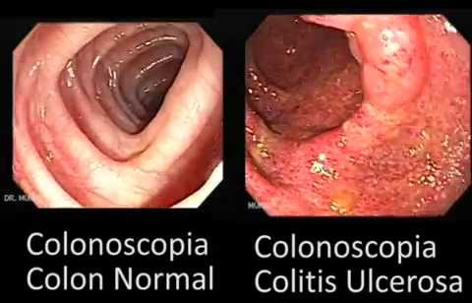
Immune damage: Dysentery (Bloody stool)
Severe host immune response can result in GI ulceration. GI ulceration is more often than not associated with bleeding in the ileocecal area (haemorrhagic colitis).
In E. coli infection, the bacteria colonize and infect the recto-anal junction (RAJ). Ulceration and bleeding from this area would be detected by bloody stool.
Moreover, bacteria-containing enterocytes and M cells are targeted by the immune system to kill and disintegrate. This further compromises the integrity of the gut epithelium, allowing blood to enter the GI lumen.
Dysentery is often co-presented with fever.
Infectious dysentery is usually self-limited.
https://encrypted-tbn3.gstatic.com/images?q=tbn:ANd9GcQD13qDqD3XjH1OhIYjNN8i-et-3fDSS3ofHZB9ThjZi79bm2kZ

Slide 20
Immune damage: Mild fever
High level of pro-inflammatory cytokines (e.g. IL-1, IL-6, TNF-a, IFN-a, IFN-B, IFN-y) are responsible for the low grade fever that the patient is experiencing.
Pathogenic invasion of epithelial cells stimulates release of pro-inflammatory cytokines. Persistent infection of M cells compromise their role and allows access of the bacteria into deeper tissue and eventually to blood.
The fever may progress to become persistent and high grade by the end of the second week.

Slide 21
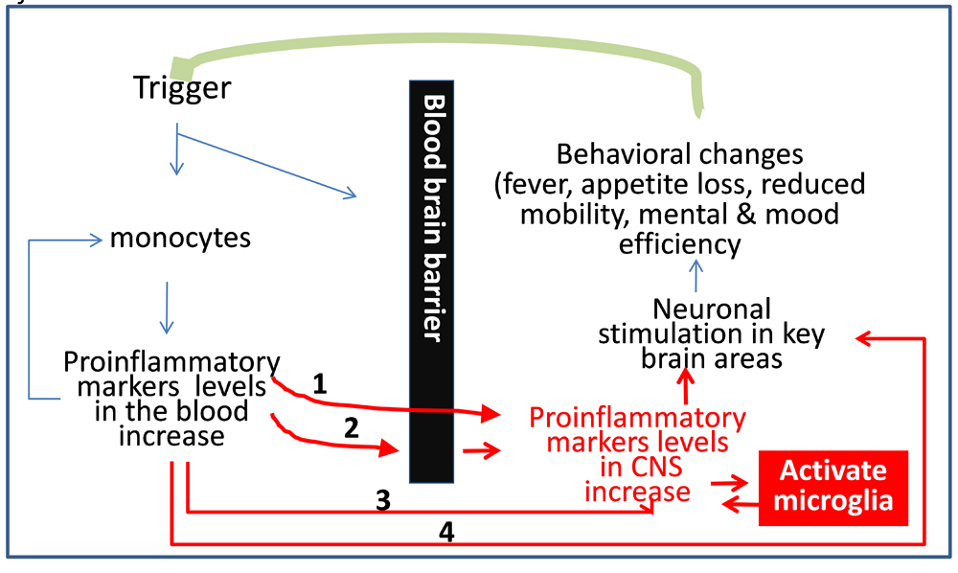
Immune damage: Mild fever
How peripheral infections trigger fever…
http://www.aginganddisease.org/fileup/2152-5250/FIGURE/2012-3-1/Images/AD-3-1-16-Figure2.png

Slide 22
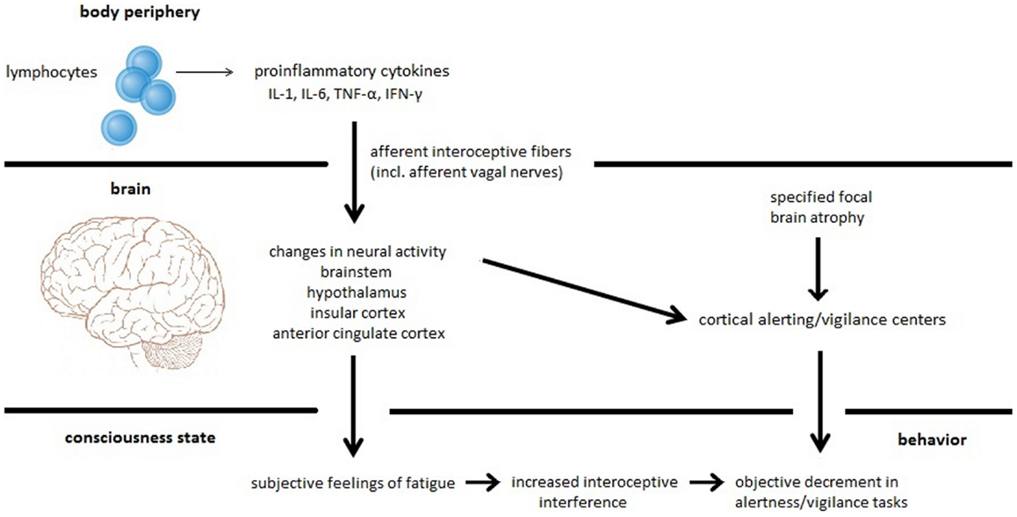
Immune damage: Mild fever
How peripheral infections trigger fever…
http://www.frontiersin.org/files/Articles/117785/fneur-05-00264-HTML/image_m/fneur-05-00264-g001.jpg

Slide 23
Immune damage: Mild periumbilical tenderness
Mild periumbilical tenderness may be attributed to localised tissue damage and intensified inflammation in the gastrointestinal tract.
This symptom the patient experiences is consistent with other aspects of the patient’s clinical presentation. It will most likely be self-limited, although antibiotics therapy will certainly help patient feel better sooner.

Slide 24
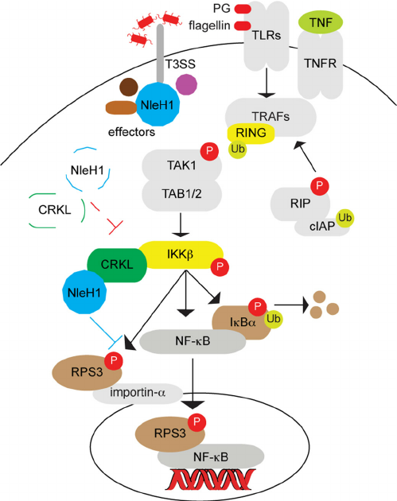
Bacterial evasion strategies: E. coli
Secretion of NleH1
Inhibits activation of NF-kB pathway ➔ suppressed immune response in M-cells
Enables the pathogen to produce proteins such as catalase and peroxidase, which counteract the superoxidase and other hyperactivate oxidase that destruct the bacteria cell wall
Shiga-like toxins (Stx1A and Stx2A)
Suppress IFNγ-mediated Stat-1 tyrosine phosphorylation which in turn inhibits activation of macrophages and release of pro-inflammatory cytokines.
Zinc metalloprotease
Inhibits the complement pathway by acting as an endopeptidase (render the complement proteins ineffective)
https://www.researchgate.net/profile/Thanh_Pham4/publication/258063953/figure/fig5/AS:297558132969482@1447954795510/FIGURE-5-Model-illustrating-the-potential-role-of-CRKL-in-recruiting-NleH1-to-inhibit.png

Slide 25
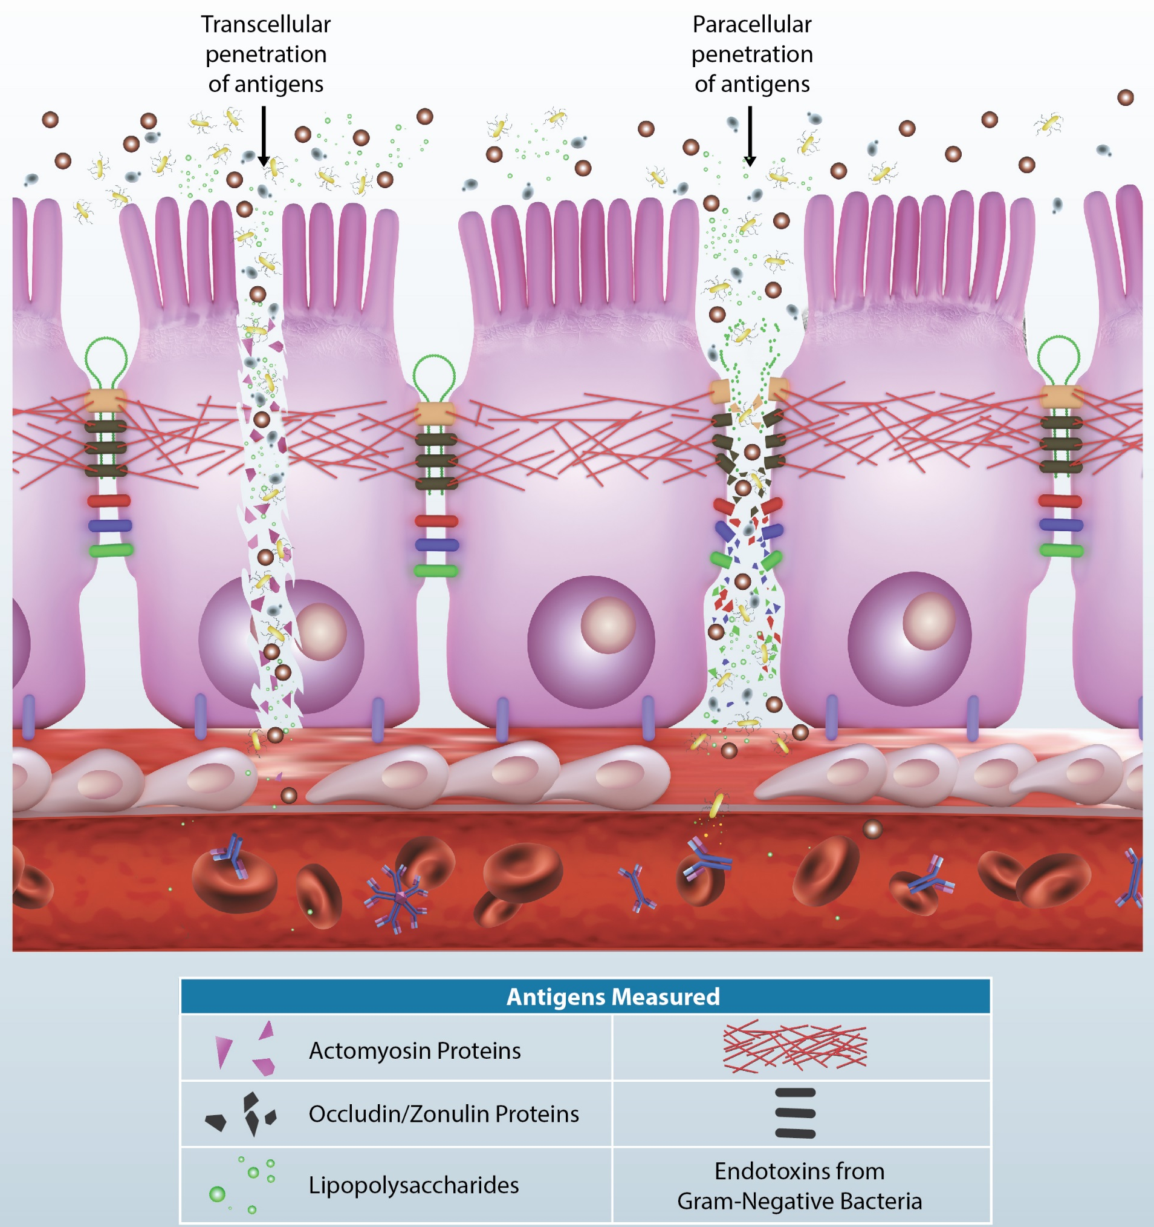
Bacterial evasion strategies: Salmonella
Production of tetrathionate (sulfide molecule that enables salmonella to respire instead of fermenting)
Compete with the normal flora (part of the physical barrier)
Iron binding protein Ent
Uses a different mechanism than lipocalin-2 mechanism for iron acquisition
Removal of occuludin from epithelial tight junctions
Increased permeability, easier access to the basolateral side of the epithelial cell monolayer
SPI2 T3SS rod protein, Ssal
primary protein structure changes which let the bacteria evade detection by NLRC4
Furthermore, SPI2 T3SS expression causes downstream suppression of the flagellin protein & reduce pyroptosis
PhoP-PhoQ system
prevents fusion with acidified endosomes
Modification of LPS
Inhibits recognition by TLR2 of APCs
http://drmeaghandishman.com/wp-content/uploads/2016/01/Array-2-Illustrations.jpg

Slide 26
Outcome: E. coli
The infectious colonies of bacteria can be removed completely by the host immune systems.
Treatment is usually supportive (e.g. consistent hydration and rest), as most immunocompetent individuals fully recover without antibiotic therapy, within a week from the onset of s/sx.
Similar to salmonellosis, E. coli infection yields B lymphocytes proliferation into plasma cells and memory B cells.
Upon re-infection, the presence of antibodies and memory B cells specifically against E.coli O157:H7 will act quicker than the initial encounter to the pathogen.
Other serovars of E.coli may not induce the same immune response if they don’t share particular antigenic sequence recognized by antibodies and memory B cells.

Slide 27
Outcome: Salmonella
Salmonellosis is usually self-limited, and treatments are not required in most cases unless infected individual is immunocompromised (elderly, pregnant, infants, chronically ill).
Immunocompromised patients may be given antibiotics to assist the clearance of bacteria. However, some studies indicate that the usage of antibiotics can prolong the duration of illness, therefore, not seen as necessary.
Immunity to future re-infections will develop if B cells receive sufficient activation during the short window of when the pathogen enters the extracellular space (to infect neighbouring cells).
Upon re-infection, memory cells and circulating antibodies will be able to respond quickly to the same serovar of Salmonella. However, the host is not protected by memory cells / pre-made Ab’ against other serovars, as they do not contain the same antigenic motifs recognized by the immune system.

