Slide 1
THE IMMUNE RESPONSE
PATH 417A – CASE 1
Chris Cheng

Slide 2
The Case
Fulfilling a long held travel dream, Robert has taken six months off work and is making his way through India taking in the sights, experiencing local festivals and making time to get to know the people. He is cautious in his hygiene, eating and drinking habits but despite this he contracts a diarrhea with voluminous outpouring of fluid accompanied by vomiting. He suspects cholera and with the help of a fellow traveler gets himself to a local hospital where a stool sample is examined and his presumptive diagnosis is confirmed. He stocks up on appropriate fluids and stays put at the hostel he has booked into for a few days, experiencing some minor leg cramping along with the diarrhea. His curiosity about his illness has him reading up on the organisms when he returns to North America and he is left wondering what serotype of Vibrio cholerae he might have contracted, should he have been prescribed antibiotics, was there anything more he could have done to prevent contracting the organism and might he now be a carrier?

Slide 3
Host Response - Innate Immune Response
Pathogen Recognition Receptors (PRR’s) are responsible for the recognition of Pathogen Associated Molecular Patters (PAMPS)
Binding of PRR and PAMP results in….
Recruits neutrophils, leukocytes and eosinophils to the site of infection
Activates complement cascade
Removal of foreign substances
Physical and chemical barrier against infection agents

Slide 4
Host Response - Innate Immune Response
Stomach Acid: V. cholerae is sensitive to acid (pH 6) and most will die when reach the stomach
Peristalsis: wave like muscle contractions of the intestine to expel food and pathogens
Adenylate cyclase enzyme
Activated by binding of cholera enterotoxin to glycolipid
Results in an increase in intracellular cAMP, H2O, Na, K+, Cl- and HCO3-
Final result is watery diarrhea

Slide 5
Host Response – Adaptive Immune Response
Antigen specific defense takes days to respond
Humoral immunity: consists of the production of antibodies by B lymphocytes
Cell mediated immunity: production of cytotoxic T lymphocytes , activated macrophages and NK cells and cytokines
Cholera infections mainly activate humoral immune response but Th1 and Th17 helper T cells (cell mediated) are also needed to develop B-cell Immune response

Slide 6
Host Response – Adaptive Immune Response
B cells are activated in the presence of an antigen (membrane protein, flagellar protein or the enterotoxin)
Activated B cells result in the production of antibody producing plasma cells
Antigen presenting cells (APC) such as dendritic cells, macrophages and B cells process and present antigens to T cells
Breastfeeding provides infants with passive immunity towards V. cholera
In cholera infections…
Cholera Toxin (CT) increases IL1 production which increases antigen presentation by macrophages
Mainly involves IgA and IgG which provide long term immunity to V. cholerae
IgA prevents attachment of the vibrio's to the mucosal surface

Slide 7
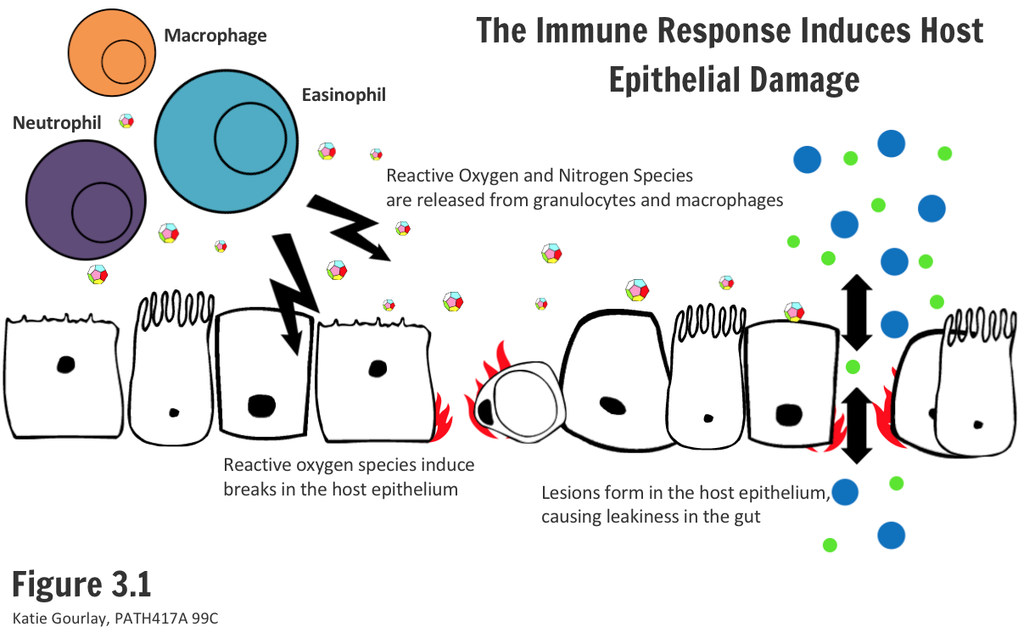
Host Damage from the Immune Response
Result of an exaggerated immune response
Neutrophils and macrophages can induce damage through the release of Reactive nitrogen and oxygen species which can cause lysis of host cells
Cytolysin:
Secreted by V. cholerae and promotes inflammation and increased permeability of epithelium to allow for entry of leukocytes
Induces Beta barrel pore formation and causes cell lysis
At high concentrations, lesions in the epithelium can occur, resulting in cell damage and gut malfunction

Slide 8
Host Damage from the Immune Response
TNF-Alpha and IL-1
Cholera toxin
Upregulated in host cells when they come in contact with Gram negative bacteria such as V. cholera
Activates MyD88 and TRIF pathways which activates NFkB and produce inflammatory cytokines
Cytokines recuit neutrophils to the site of infection which releases cytotoxic granules that can cause damage to the host
In severe cases, fever and cytotoxic shock can occur
Has two main subunits
B subunit which binds with high affinity to GM1 receptor in the intestinal tract
Binding of the B subunit allows A subunit access to the cell where it will interfere with the adenylate cyclase pathway
Once inside, A subunit dissociates into A1 and A2
A1 catalyzes the transfer of ADP ribose complex to the stimulatory G protein region of the adenylate cyclase resulting in elevated cAMP
Excess cAMP drives H2O, sodium and other ions to be secreted by the mucosal cells which can lead to severe dehydration and diarhea

Slide 9
How does V. cholerae evade the host immune response??
Secondary Enterotoxin (ZOT)
LPS
Quorum Sensing and Film production
Production of extracellular matrix
MHSA
Nucleases
Protein products
Adhering to the Brush Border
Accessory Toxins
Hemolysin
Hemagglutinin(HA)/Protease
MARTX
Cytolysin

Slide 10
Accessory Toxins
Hemolysin: Creates pores in target cells and induces formation of vacuoles and then cell lysis
HA.Protease: degrades host proteins and mucin which will permit the bacteria to detach from the epithelium and spread
Multifunctional auto processing repeats-in-toxin (MARTX): depolymerizes and cross links actin which disables phagocytosis (targets macrophages)
Cytolysin: forms pores in host cells. Creates a positive feedback loop where neutrophils are penetrated, releasing proteolytic compounds which can activate other Cytolysin and effect other nearby cells.

Slide 11
Secondary enterotoxin (ZOT)
Zona Occludens Toxin (ZOT)
Damages tight junctions within the small intestine
Tissue specific for the small intestine
Decreases G-Actin pool while increases the F actin pool which disrupts actin filament polymerization
Tight junctions are responsible for confining pathogens in the lumen so damage to tight junctions can lead to further infection.
Causes water and electrolytes to enter the lumen and diarrhea results

Slide 12
Lipopolysaccharide (LPS)
Major component of the outer membrane of gram negative bacteria
Prevents it from being phagocytosed by macrophages and neutrophils
Prevents antibody/complement accumulation

Slide 13
Quorum Sensing and Film Production
Helps regulate virulent gene expression in relation to total bacterial cell density
Final result is a formation of a biofilm which is a microbial community associated with a surface
Mediated by auto inducer molecules at low density
Formation of the biofilm allows some individuals to pass through the acidic environment in the stomach and into the small intestine

Slide 14
Production of Extracellular Matrix
Forms as a result of formation of anti-LPS antibodies
Provides protection for V. cholerae against secondary complement mediated attack
composed of O-specific polysaccharide and some Vibrio polysaccharide

Slide 15
Mannose Sensitive Hemagglutinin (MHSA) and Nucleases
MHSA
Nucleases
Evades humoral response by preventing binding of IgA by only allowing expression of MHSA when its favourable
By binding to IgA, V. Cholerae cannot penetrate the mucus barrier and attach itself due to MHSA
V. cholerae can down regulate MHSA because of ToxT
By only expressing MHSA in later stages of infection, it can maximize host colonization while minimizing the humoral response
DNS and XDS
Break down the DNA in neutrophil extracellular traps (NETs) and therefore evades the innate response
NETs are responsible for trapping and killing pathogens

Slide 16
Protein Products
V. cholera produces a single protein that has multiple functions
Promoting epithelial attachment
Destroying host elements such as Fibronectin, Mucin, Lactoferrin
Fibronectin: binding extracellular matrix proteins and attachment to host cells as well as opsonization
Mucinase: helps penetrate the mucus layer to access epithelial sites
Lactoferrin: limits essential iron

Slide 17
Brush Border
V. cholerae can inhabit the small intestine due to the presence of adhesins on the pathogen itself
Bacteria adheres to the brush border of the billi or in developing intestinal crypts
Able to evade the force of intestines motility by adhering to villi and crypts
protect the bacteria from being shed

Slide 18
Final Thoughts
Is the Bacteria Completely removed and will the patient make a full recovery?
Symptoms can range from asymptomatic, mild and severe. Patients with asymptomatic infections tend to clear the infection without any medical assistance. Where as heavier infections may require medical assistance. However, with correct treatment, a patient should make a full recovery.
Is there immunity to future infections?
During the first infection, the immune system produced antibodies against V. cholera. Therefore, there is a protective immunity for subsequent infections (effective for up to 3 years after initial infection). However there are two serotypes of V. cholera so it depends if they catch the same serotype as the original.

