Slide 1
cIRcle 101: Referrals
Tara Stephens
cIRcle Librarian
August 26, 2013

Slide 2
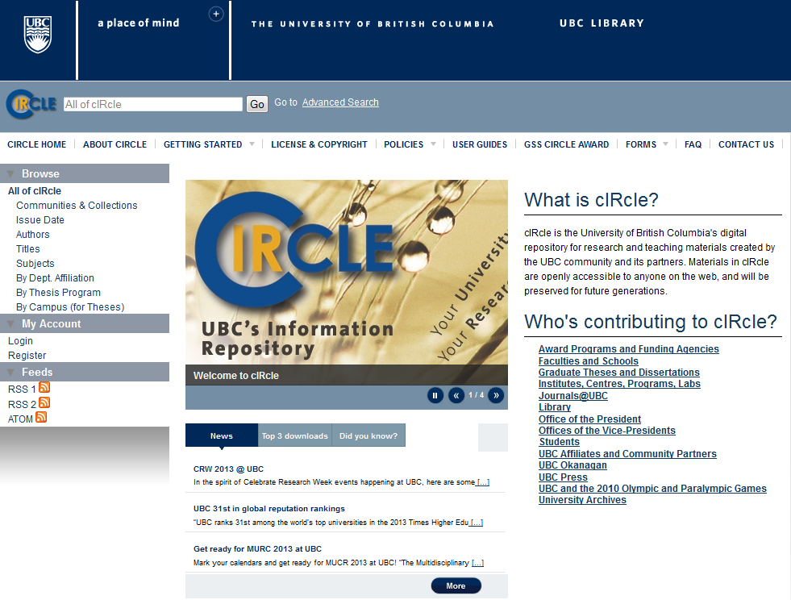

Slide 3
Overview
What services does cIRcle provide?
What’s in cIRcle?
What kinds of questions might you get?

Slide 4
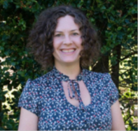
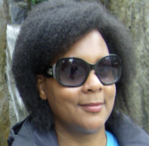
cIRcle Staff
ubc-circle@interchange.ubc.ca
Hilde Colenbrander,
cIRcle Coordinator
Tara Stephens,
cIRcle Librarian
Julia Thompson,
cIRcle Digital Repository Specialist
https://circle.ubc.ca
This work is licensed under a Creative Commons Attribution-NonCommercial-ShareAlike 2.5 Canada License

Slide 5
cIRcle services
Support the UBC research community (faculty, researchers, students, partners) by making their work openly accessible in cIRcle
Assign persistent links to all items in cIRcle
Take care of UBC research work long term (digital preservation)
Track usage statistics for all items in cIRcle

Slide 6
What’s in cIRcle?
Research, academic, teaching, creative materials
By members of the UBC community and its partners
Published or unpublished, peer reviewed or not
http://circle.sites.olt.ubc.ca/policies-2/acquisition-policy/

Slide 7
What kinds of questions might you get?
Submitting a thesis or dissertation (ETD)
Accessing content in cIRcle

Slide 8
UBC Theses & Dissertations
Graduate students submit theses online to cIRcle since 2008:
~6,696 titles
Theses digitized retrospectively 1919-2007 by University Archives:
~32,000 titles
Total UBC theses & dissertations in cIRcle:
~38,699 titles

Slide 9
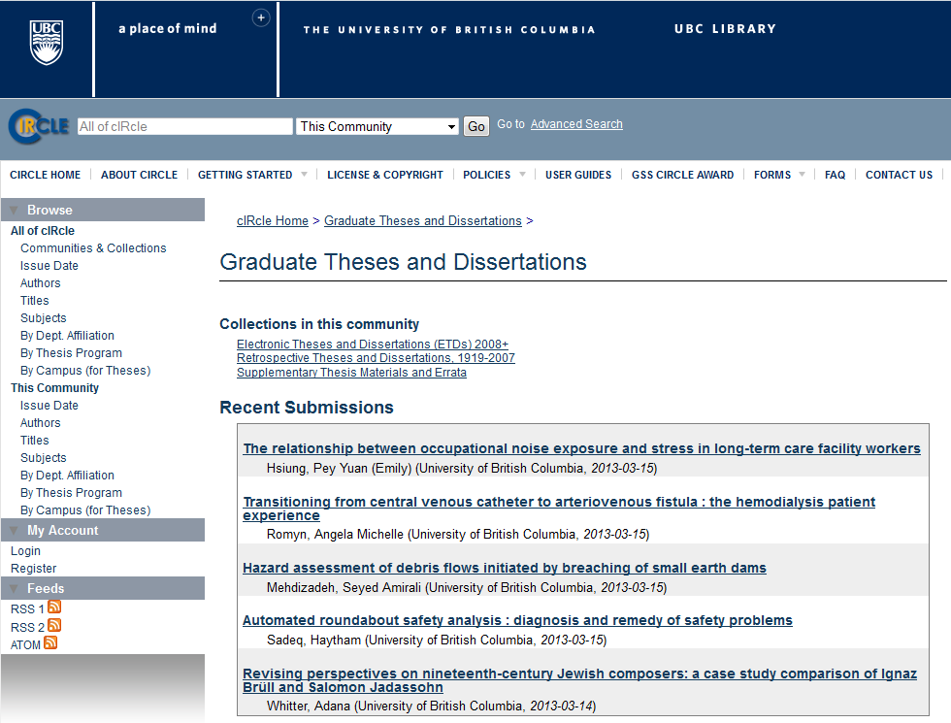

Slide 10
Who answers questions about ETDs?
Faculty of Graduate Studies (FOGS)
Research Commons
cIRcle

Slide 12
What do they do with ETDs?
Faculty of Graduate Studies (FOGS)
Approval to submit to cIRcle thesis collection
Copyright questions
Example queries
I have a cIRcle login but I can’t upload to the collection.
Can I use this image in my thesis?

Slide 13
What do they do with ETDs?
Research Commons
Thesis formatting
Uploading a submission
Example queries:
What citation style do I use for my thesis?
I’m ready to upload my thesis but I could use some help.

Slide 14
What do they do with ETDs?
cIRcle (and CTS)
Account registration
Metadata quality review
Example queries:
I tried to register for an account but keep getting an “Invalid token” message.
I uploaded my thesis to cIRcle but I haven’t heard anything back. Is my thesis available yet?

Slide 15
Basic Referral for ETDs
Contact Us
http://circle.sites.olt.ubc.ca/contact-us/ OR
ubc-circle@interchange.ubc.ca (yes, interchange)
FAQs
http://circle.sites.olt.ubc.ca/faq
Upload Guide
http://circle.sites.olt.ubc.ca/user-guides/

Slide 16
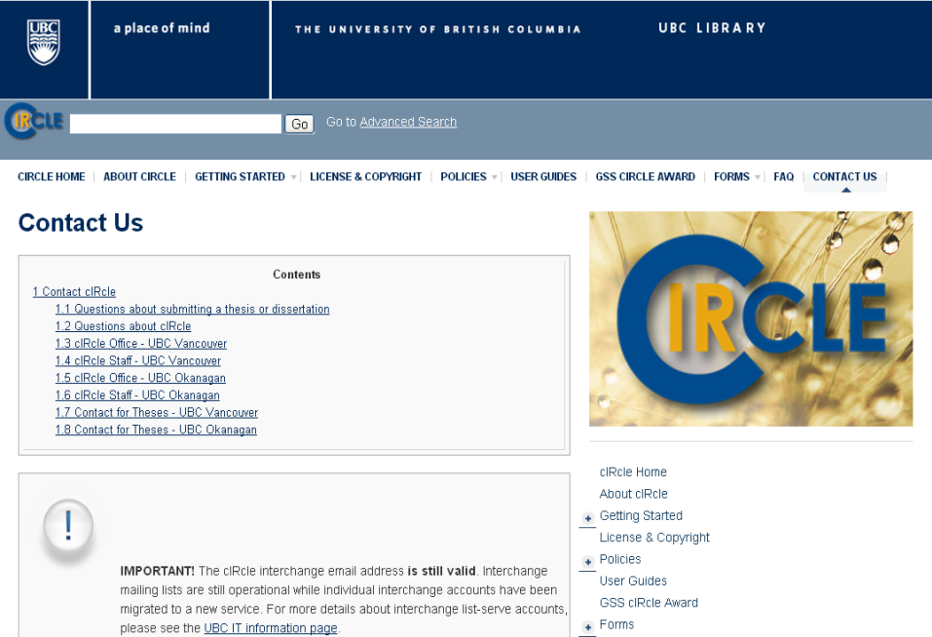

Slide 17
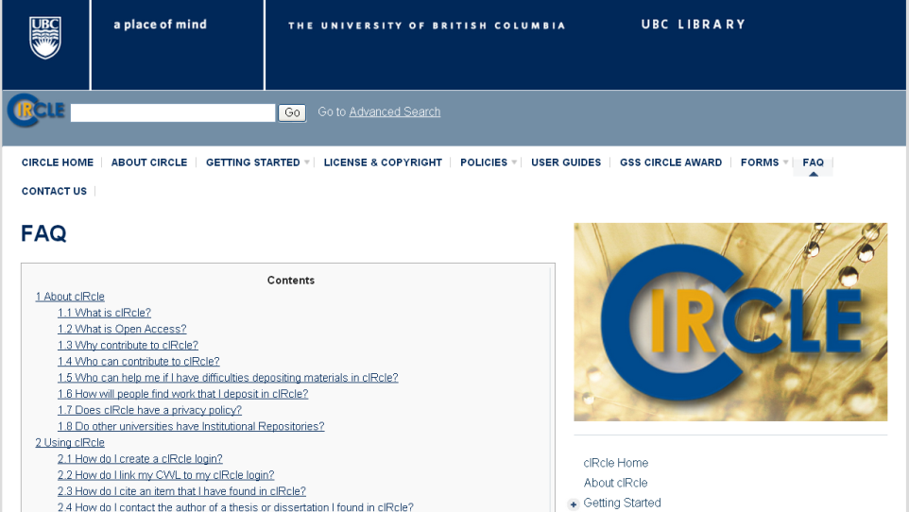

Slide 18
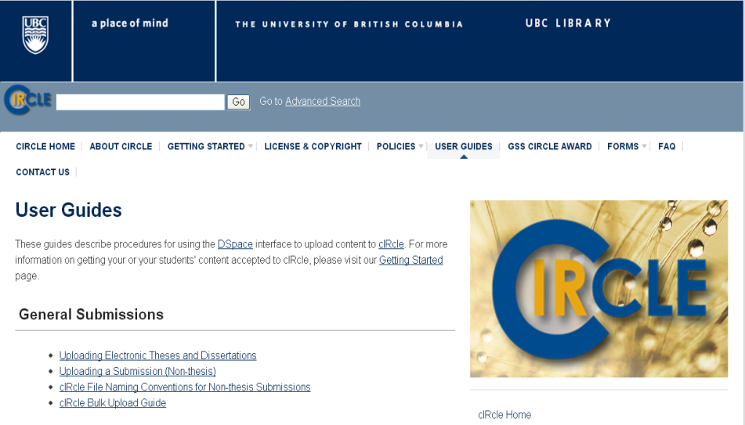

Slide 19
Accessing cIRcle content
Example queries
I can’t find my thesis in cIRcle.
I want my thesis removed from cIRcle.
How do I contact an author of a thesis I found in cIRcle?
I’m trying to download this paper I found in cIRcle but it’s not working.

Slide 20
When in doubt…
ubc-circle@interchange.ubc.ca
Hilde Colenbrander,
cIRcle Coordinator
Tara Stephens,
cIRcle Librarian
Julia Thompson,
cIRcle Digital Repository Specialist
https://circle.ubc.ca
This work is licensed under a Creative Commons Attribution-NonCommercial-ShareAlike 2.5 Canada License

