Slide 1
Introduction to the Library:
a day in the city

Slide 2
Today is a busy day in the city. Here’s your “To Do” list:
Go to the bank and get your finances in order.
Help your uncle Roger plan his mayoral campaign.
Pay that stupid parking ticket.
Meet a friend at the café down the street.
Visit the Museum of Interesting Things.
Take a tour of that new mega-skyscraper.

Slide 3
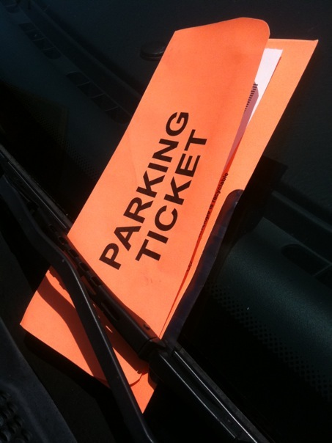
Authority
Influence recognized within a community.
Not universal, but exists in context.
Biases may privilege one form over another.
Next Task
Done!
Source: alicegop on Flickr.com

Slide 4
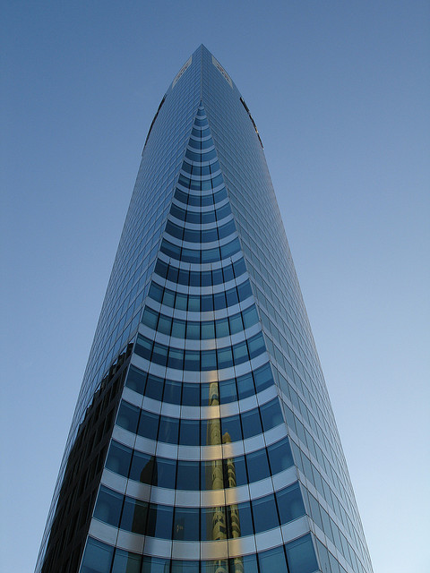
Process
Research is iterative.
No two projects are exactly alike.
Different for each new context.
Requires self-reflection and flexibility.
Next Task
Done!
Source: borkurdotnet on Flickr.com

Slide 5
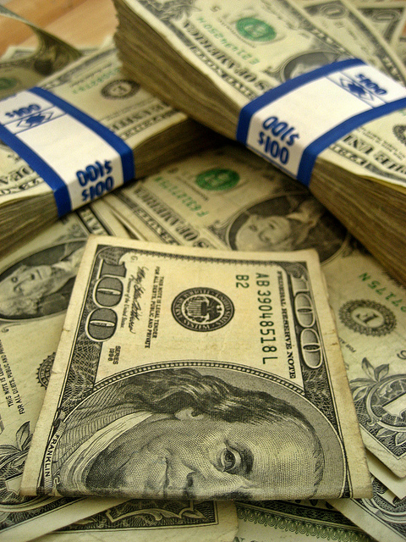
Value
Information has different types of value.
Access is empowering, denying access is marginalizing.
Next Task
Done!
Source: 68751915@N05 on Flickr.com

Slide 6
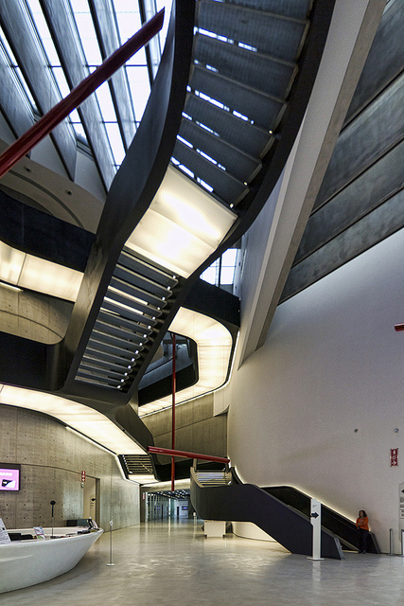
Inquiry
Asking increasingly complex questions.
Looking for open or unresolved issues.
Debate and dialogue work to deepen to conversation.
Next Task
Done!
Source: wojtekgurak on Flickr.com

Slide 7
Conversation
There may be several competing perspectives.
Developing familiarity with the topic lets you enter the conversation.
Providing attribution to other’s ideas.
Next Task
Done!
Source: jeremympiehler on Flickr.com

Slide 8
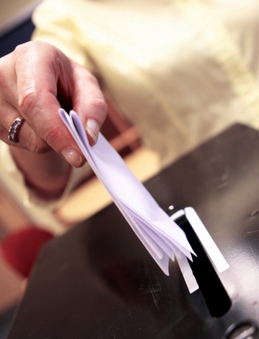
Strategy
Research is nonlinear and iterative.
Requires flexibility to pursue alternatives.
Use multiple methods of searching, instead of only one.
Next Task
Done!
Source: bracknellforest on Flickr.com

Slide 9
Lesson Plan

Slide 10
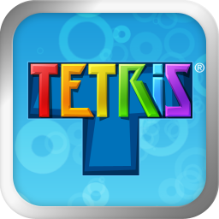

Slide 11
Winnipeg DownTown and the Exchange District. © Wpg Guy. CC BY-SA 3.0

